Slide 1
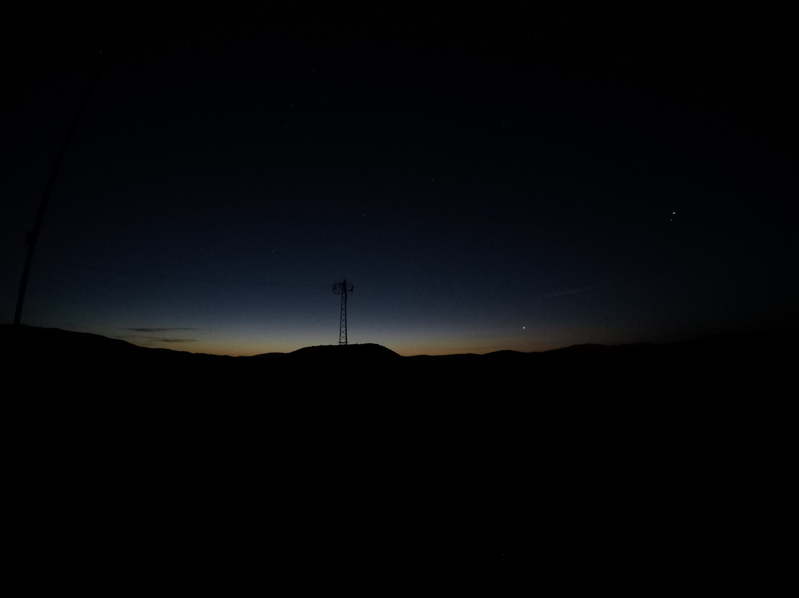
Imsak Time Observation-2022
Erzurum-Horasan Zivin Martyrdom
2 sec exposure difference
Obser.: Rufai ÇINAR Geophysical engineer
Fecr-i Kazib

Slide 2
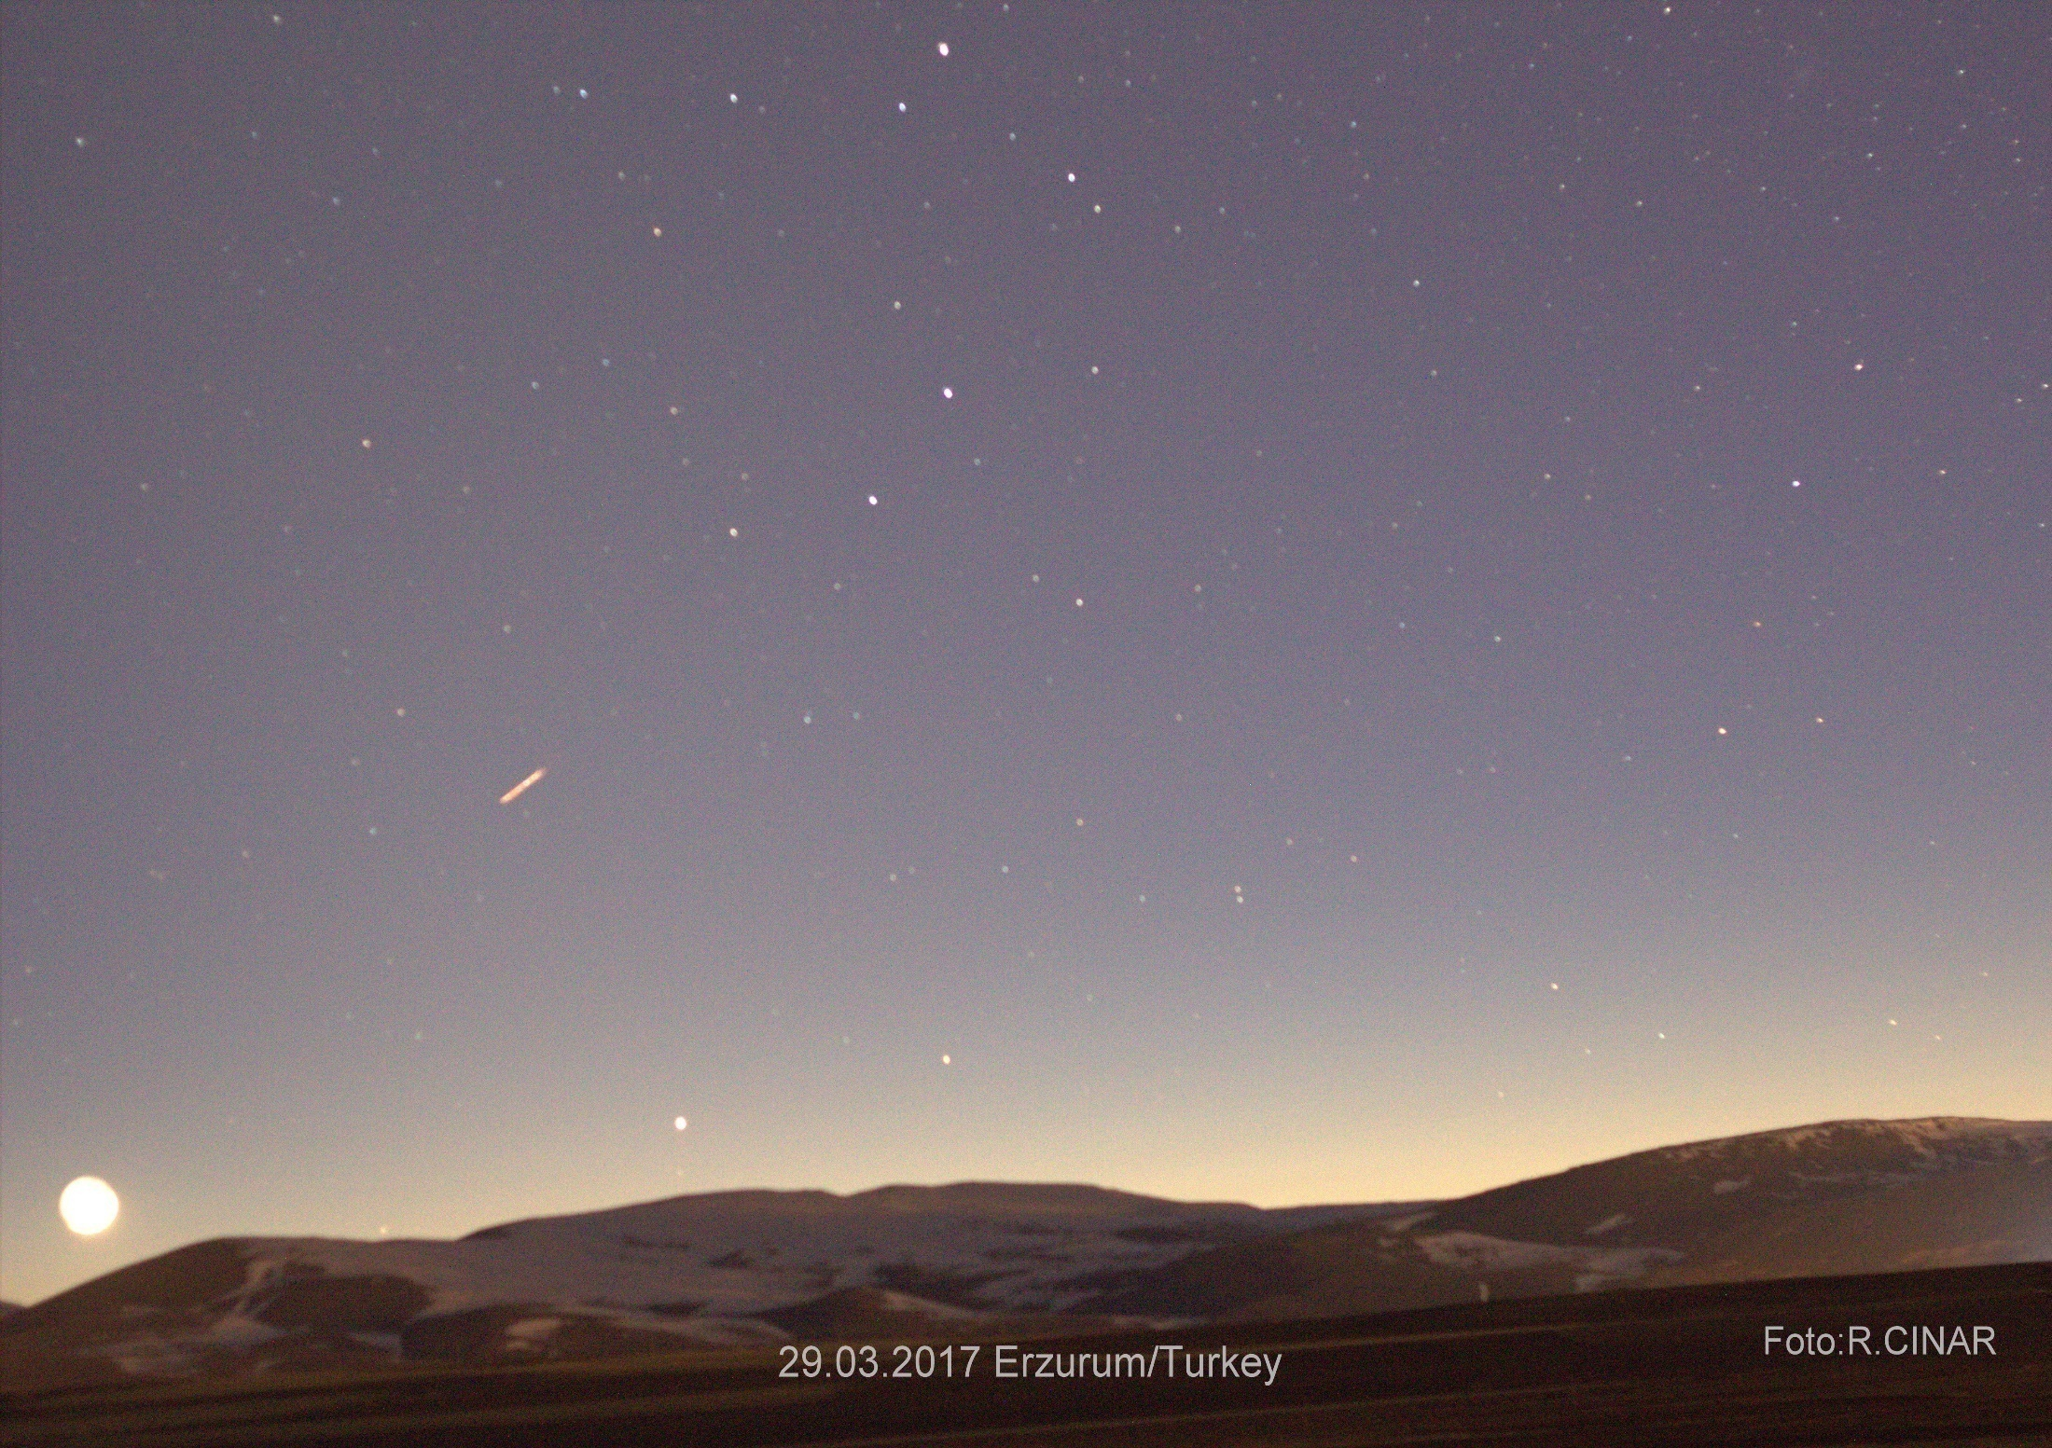
Exposure makes a thin crescent look like a full moon
March 29, 2017 three months start (Sunset first crescent)

Slide 3
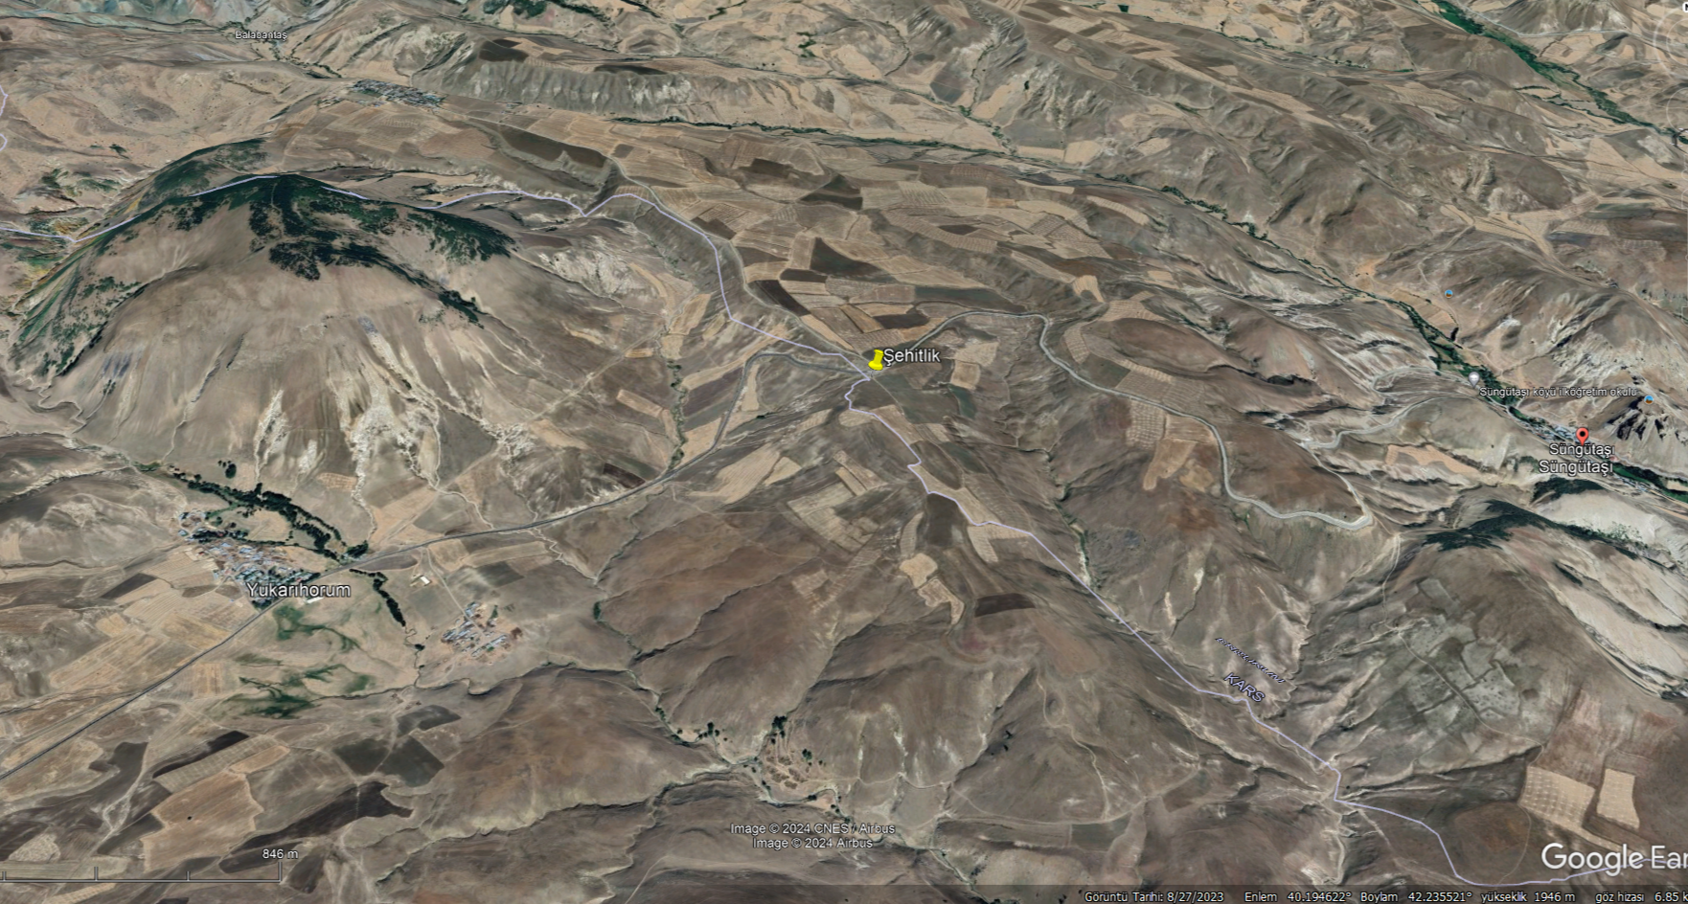
Erzurum Imsak Time Observation 2022
Horasan Yk Horum Martyrdom Monument
Date: May 31, 2022

Slide 4

Erzurum Yk Horum martyrdom İmsak
May 31, 2022 Diyanet Imsak 02:45 18º
After 25 minutes the environment is pitch dark
Time: 03:10 Sun: -15.0°

Slide 5
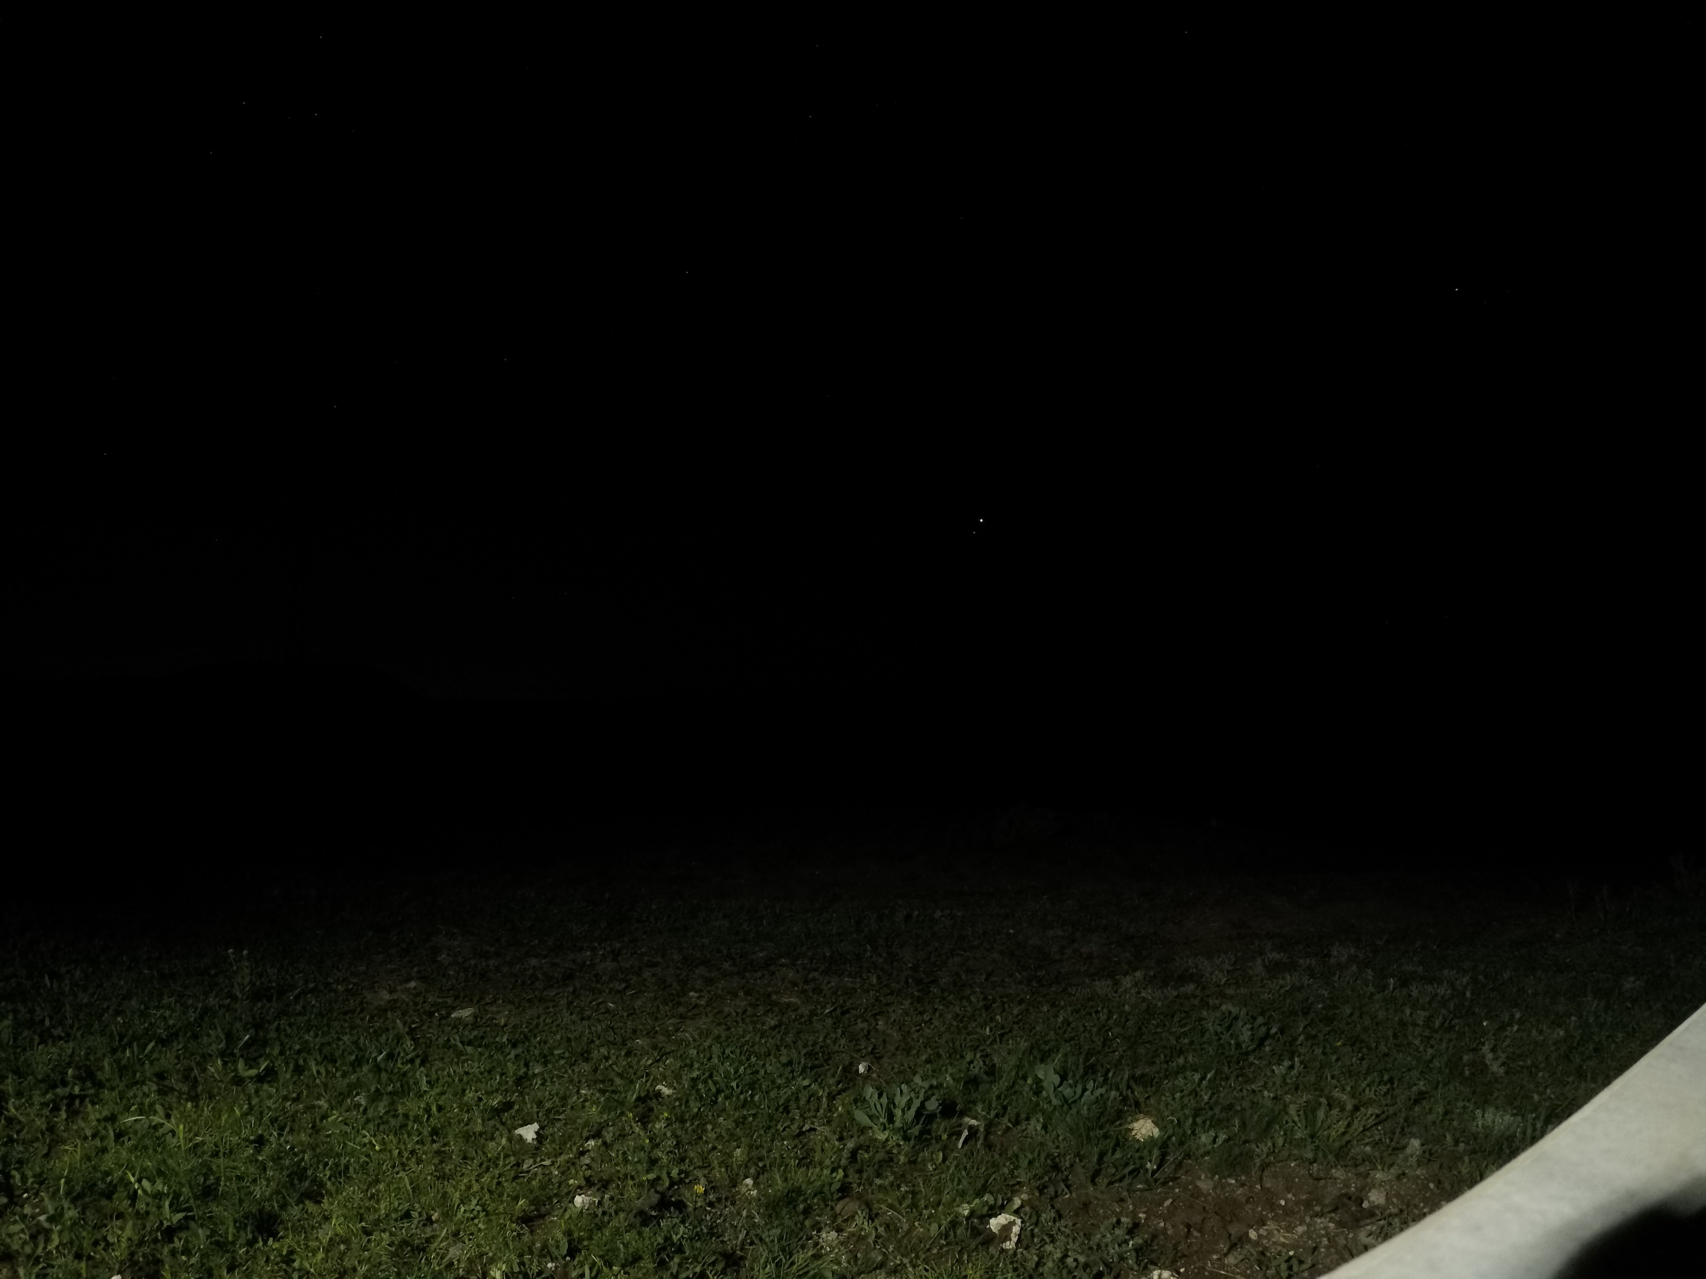
Altitude: 2080
Time: 03:11 Sun: -14.9º

Slide 6

Time: 03:12 Sun: -14.7º

Slide 7
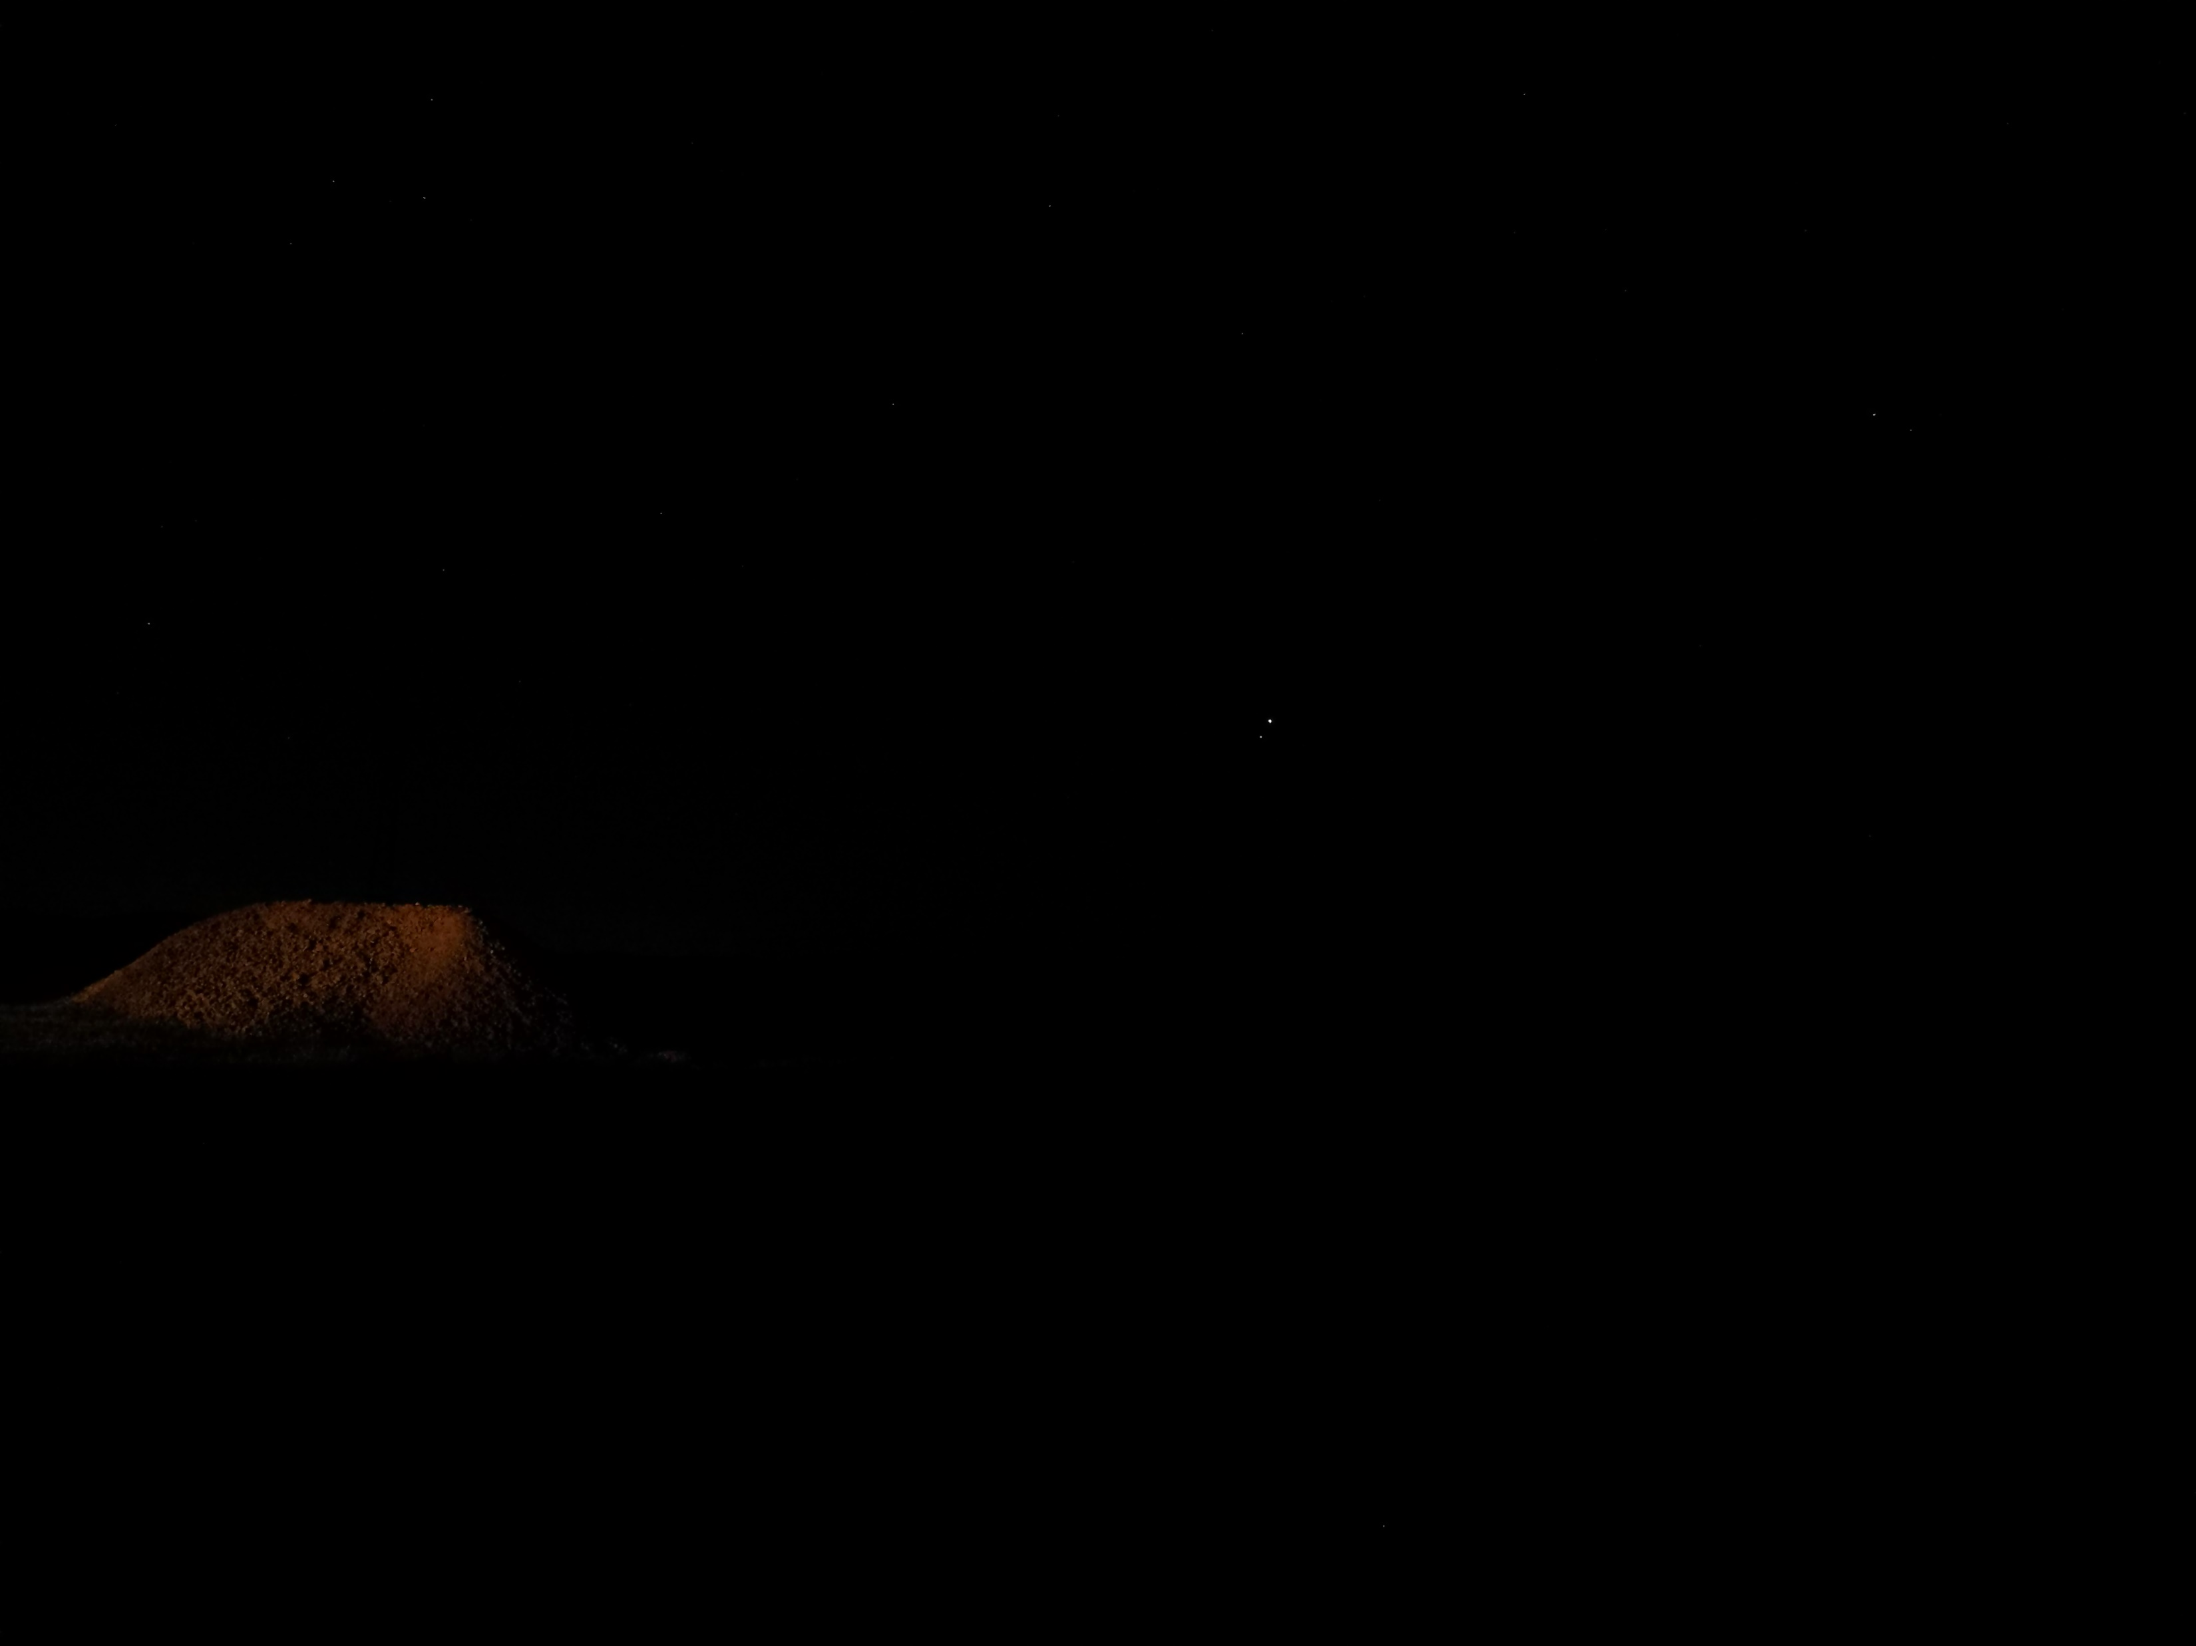
Time: 03:13 Sun: -14,6º

Slide 8
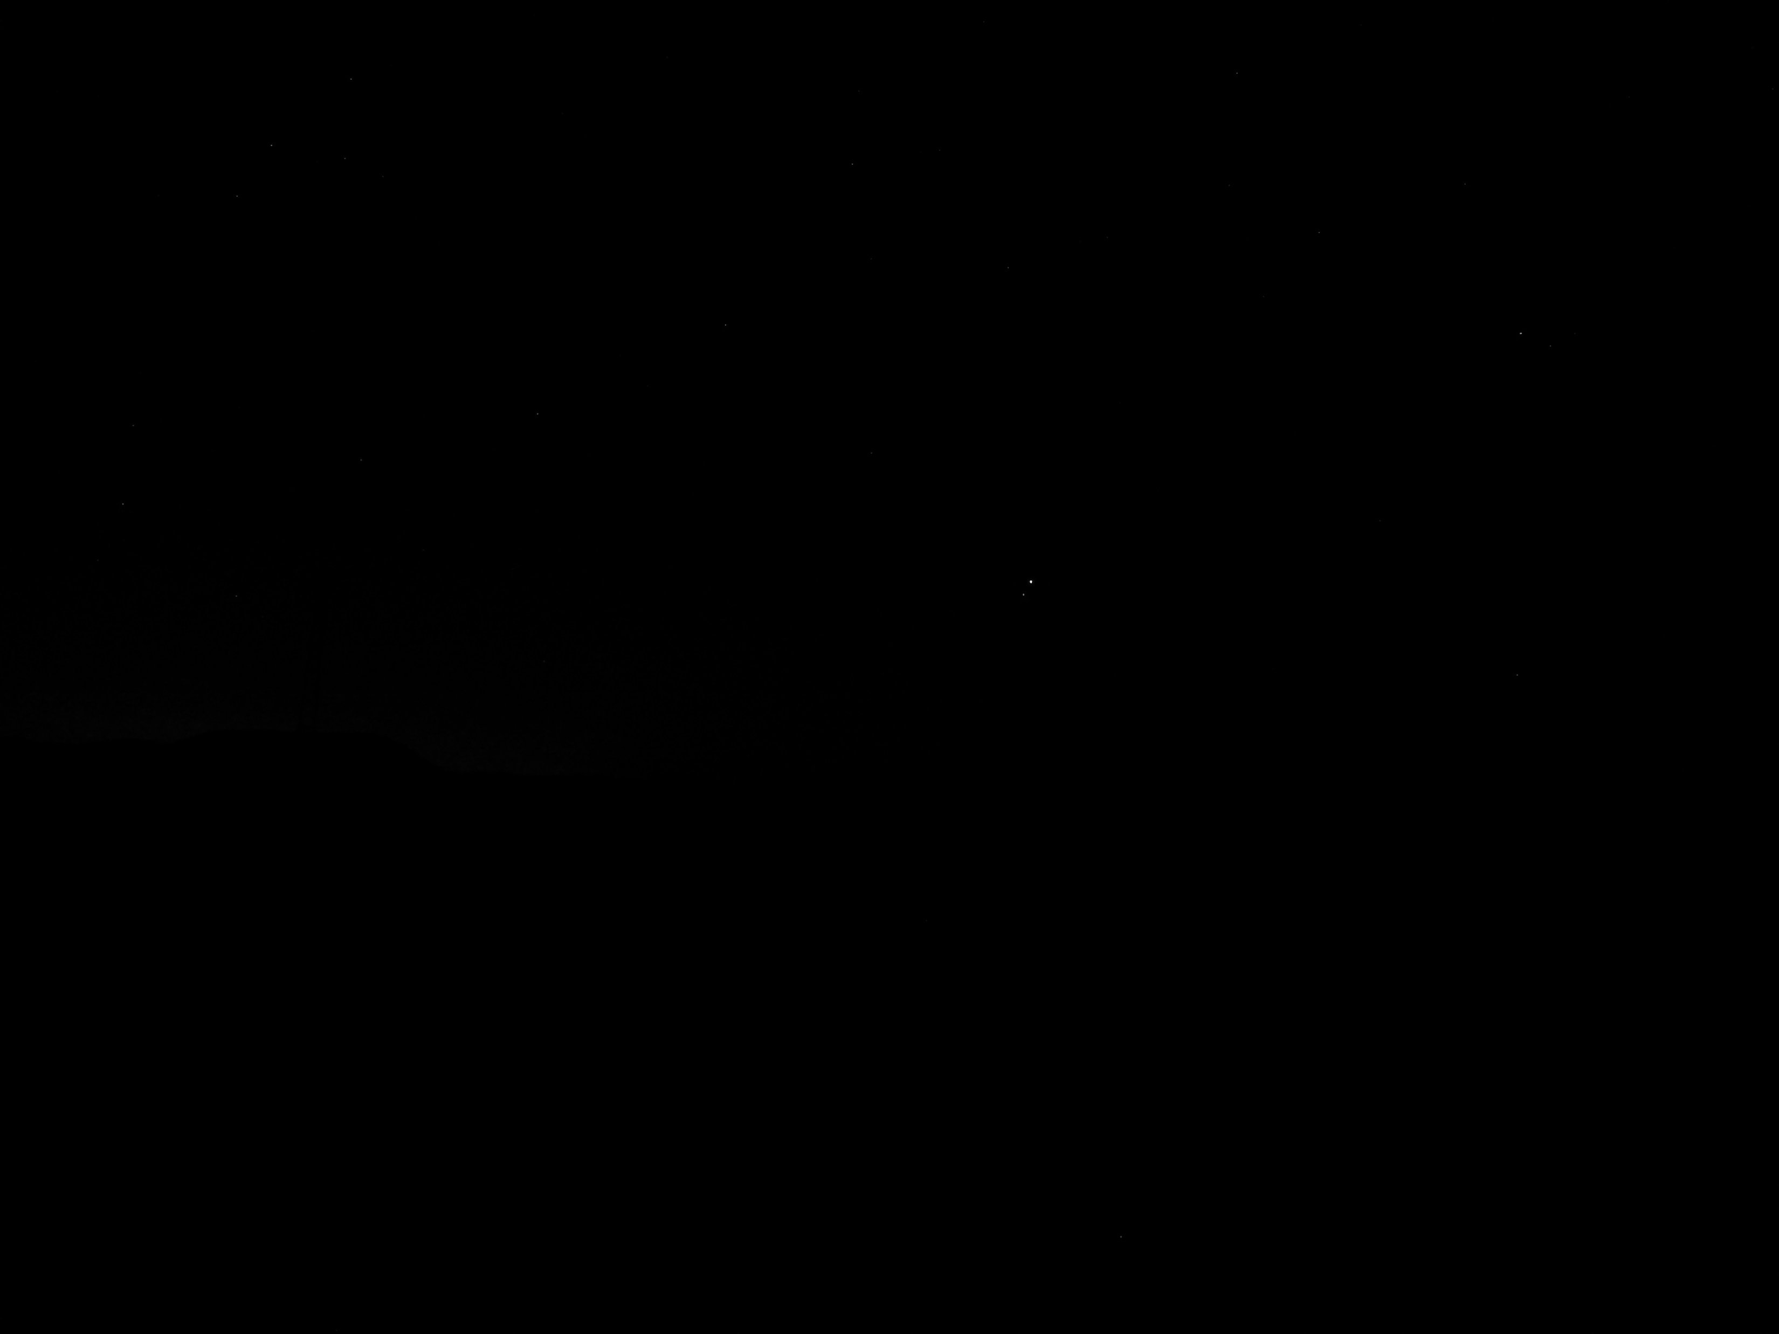
Time: 03:14 Sun: -14,5º

Slide 9
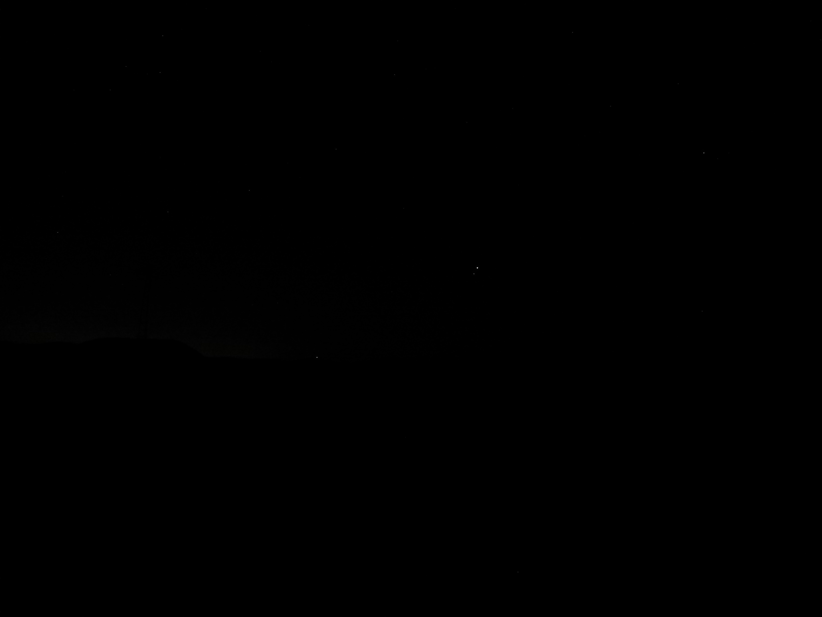
Time : 03:15 Sun: -14,3º

Slide 10
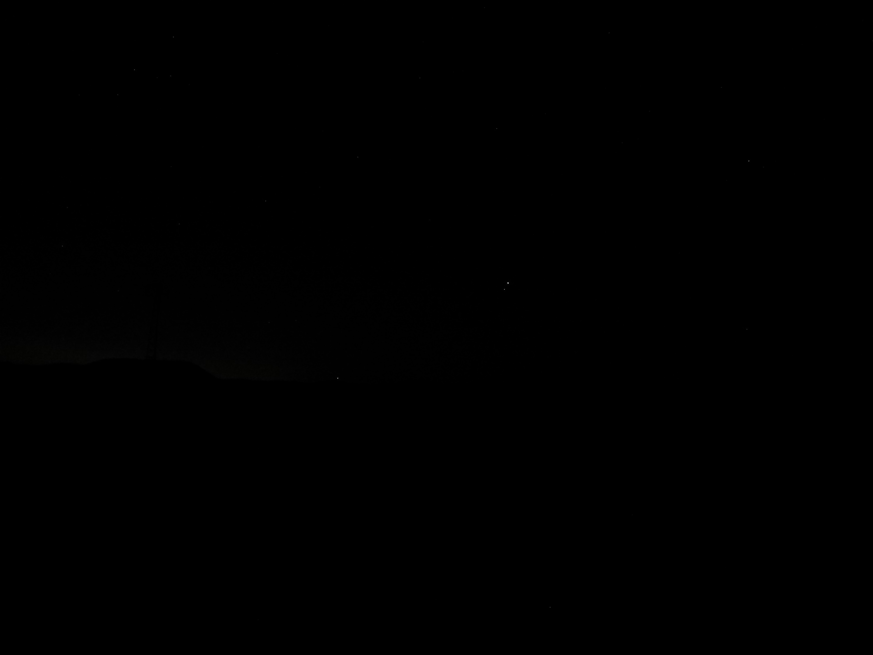
Time : 03:16 Sun: -14,2º

Slide 11

Time : 03:17 Sun: -14,1º

Slide 12
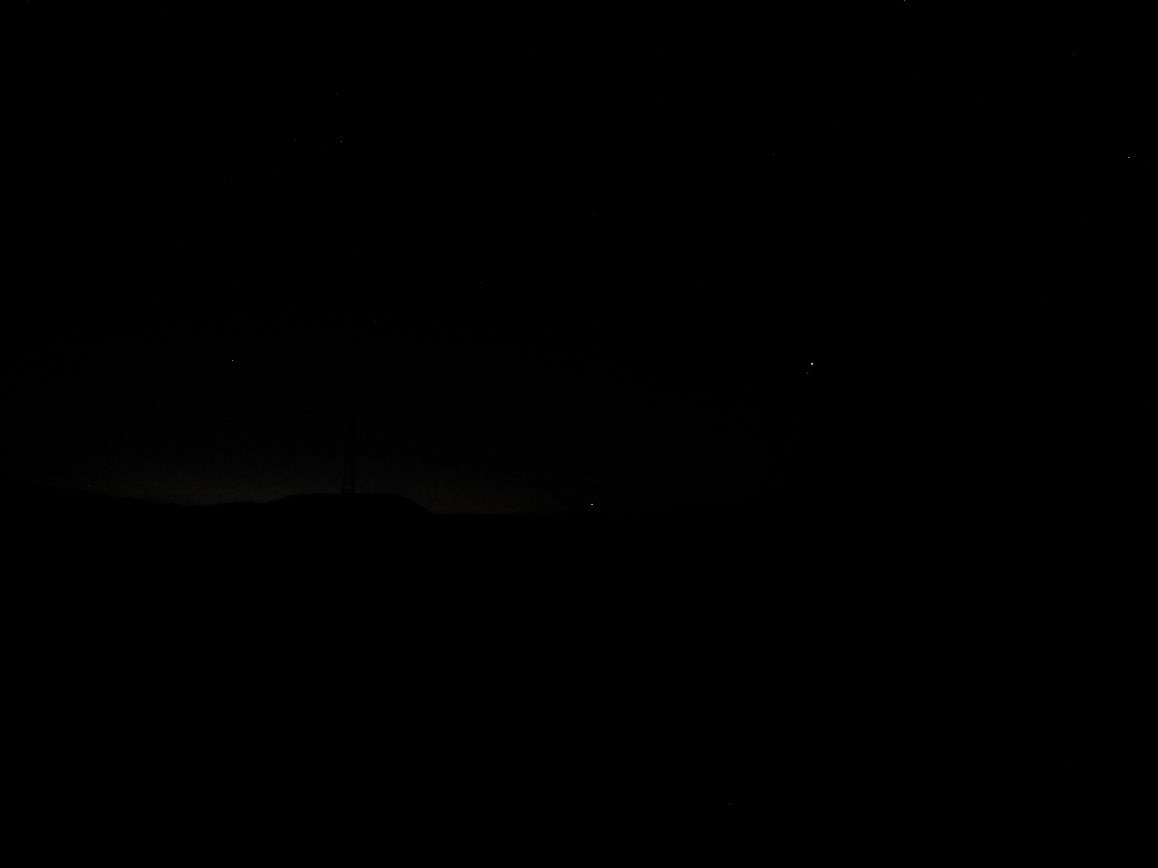
Time : 03:18 Sun: -13,9º

Slide 13
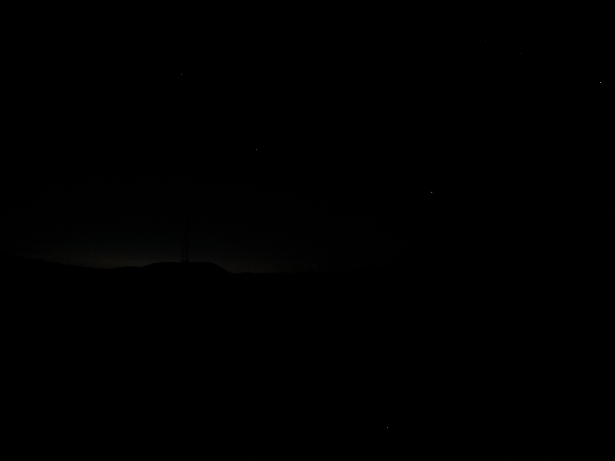
Time : 03:19 Sun: -13,8º

Slide 14
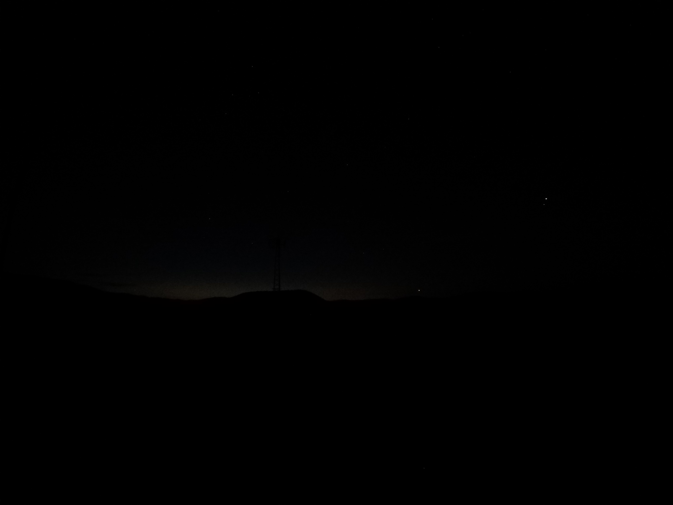
2 sec exposure has brought the imsak forward 1° 8 min.
Because our eyes do not perceive this light yet!
Time: 03:20 Sun : -13,7º

Slide 15
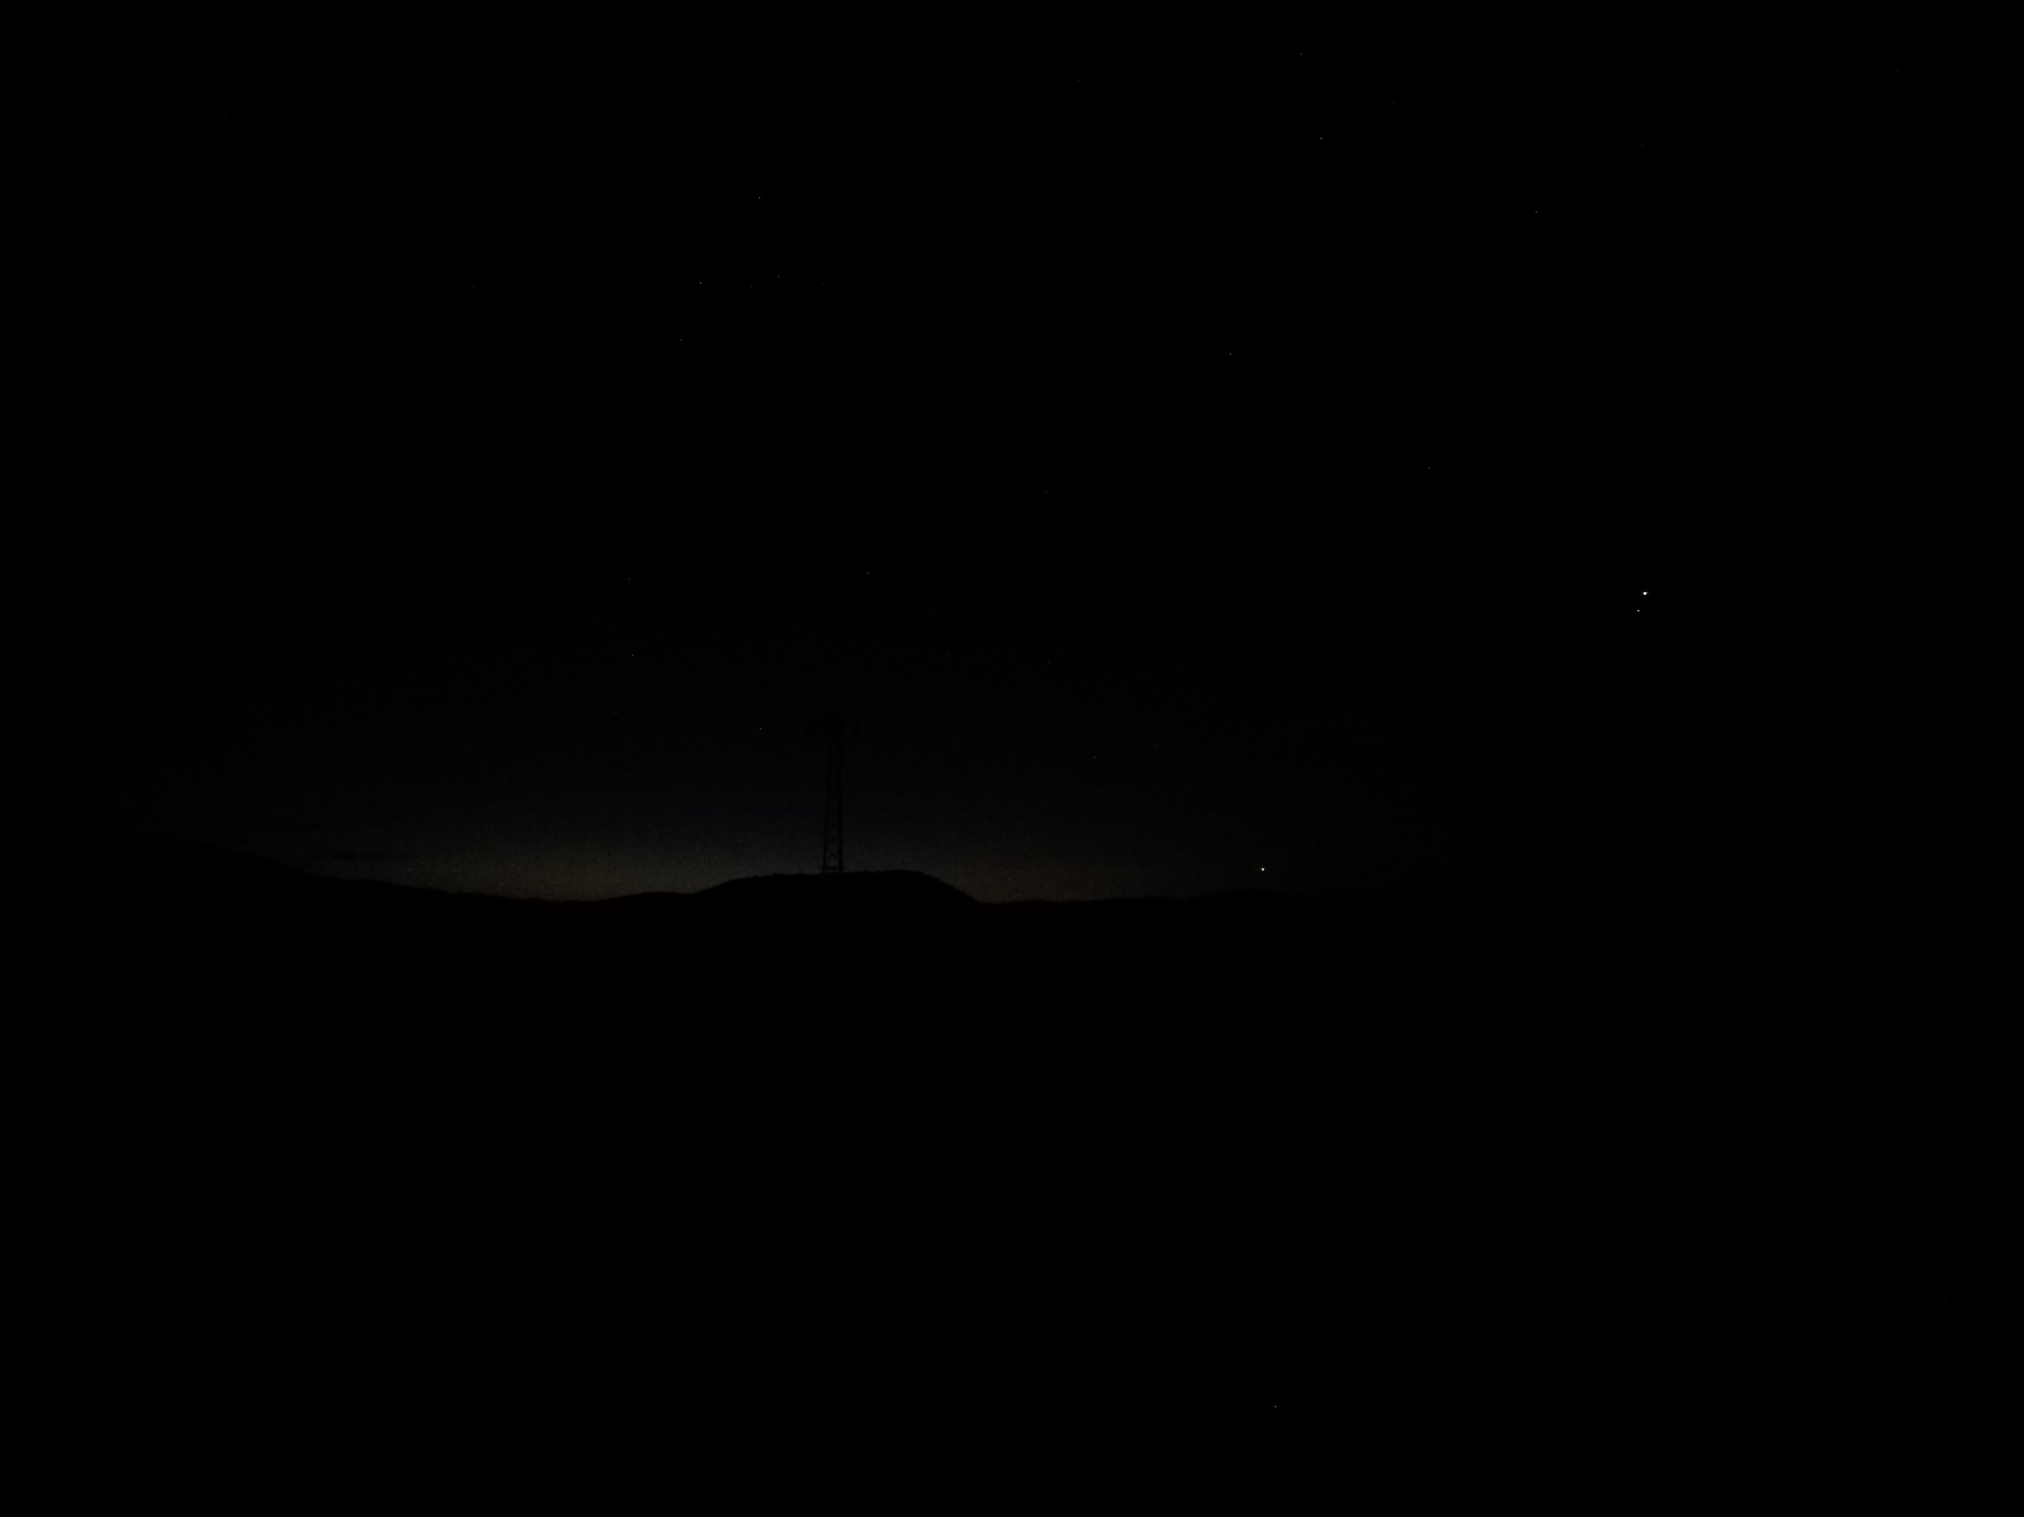
Time: 03:21 Sun: -13,5º

Slide 16
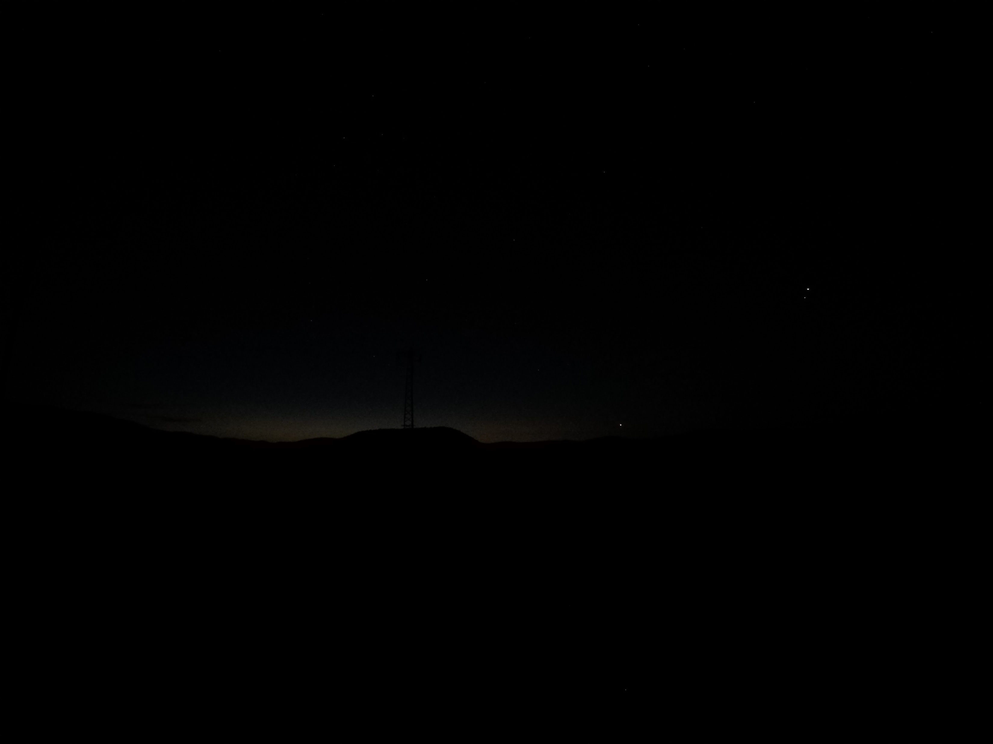
Time: 03:22 Sun: -13,4º

Slide 17
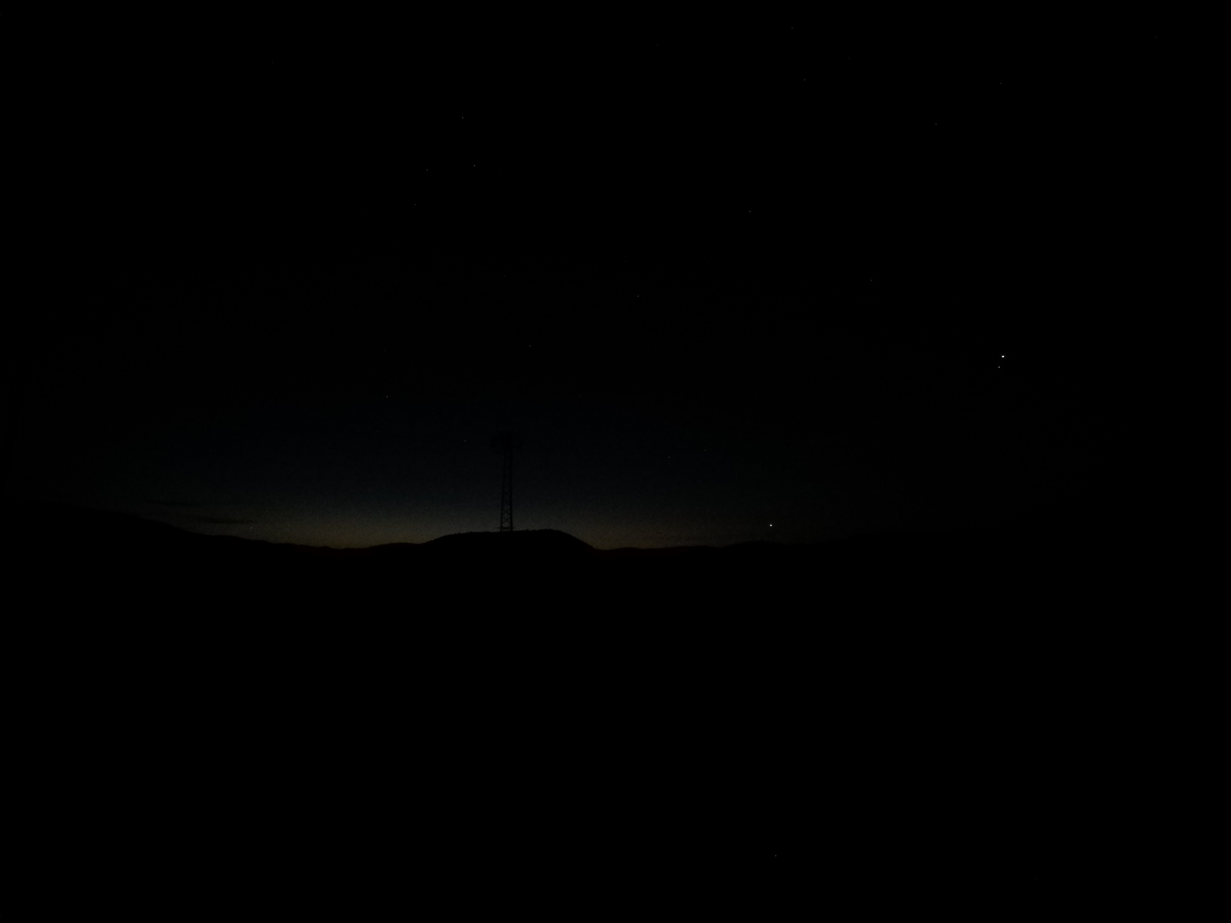
Time: 03:23 Sun: -13,3º

Slide 18
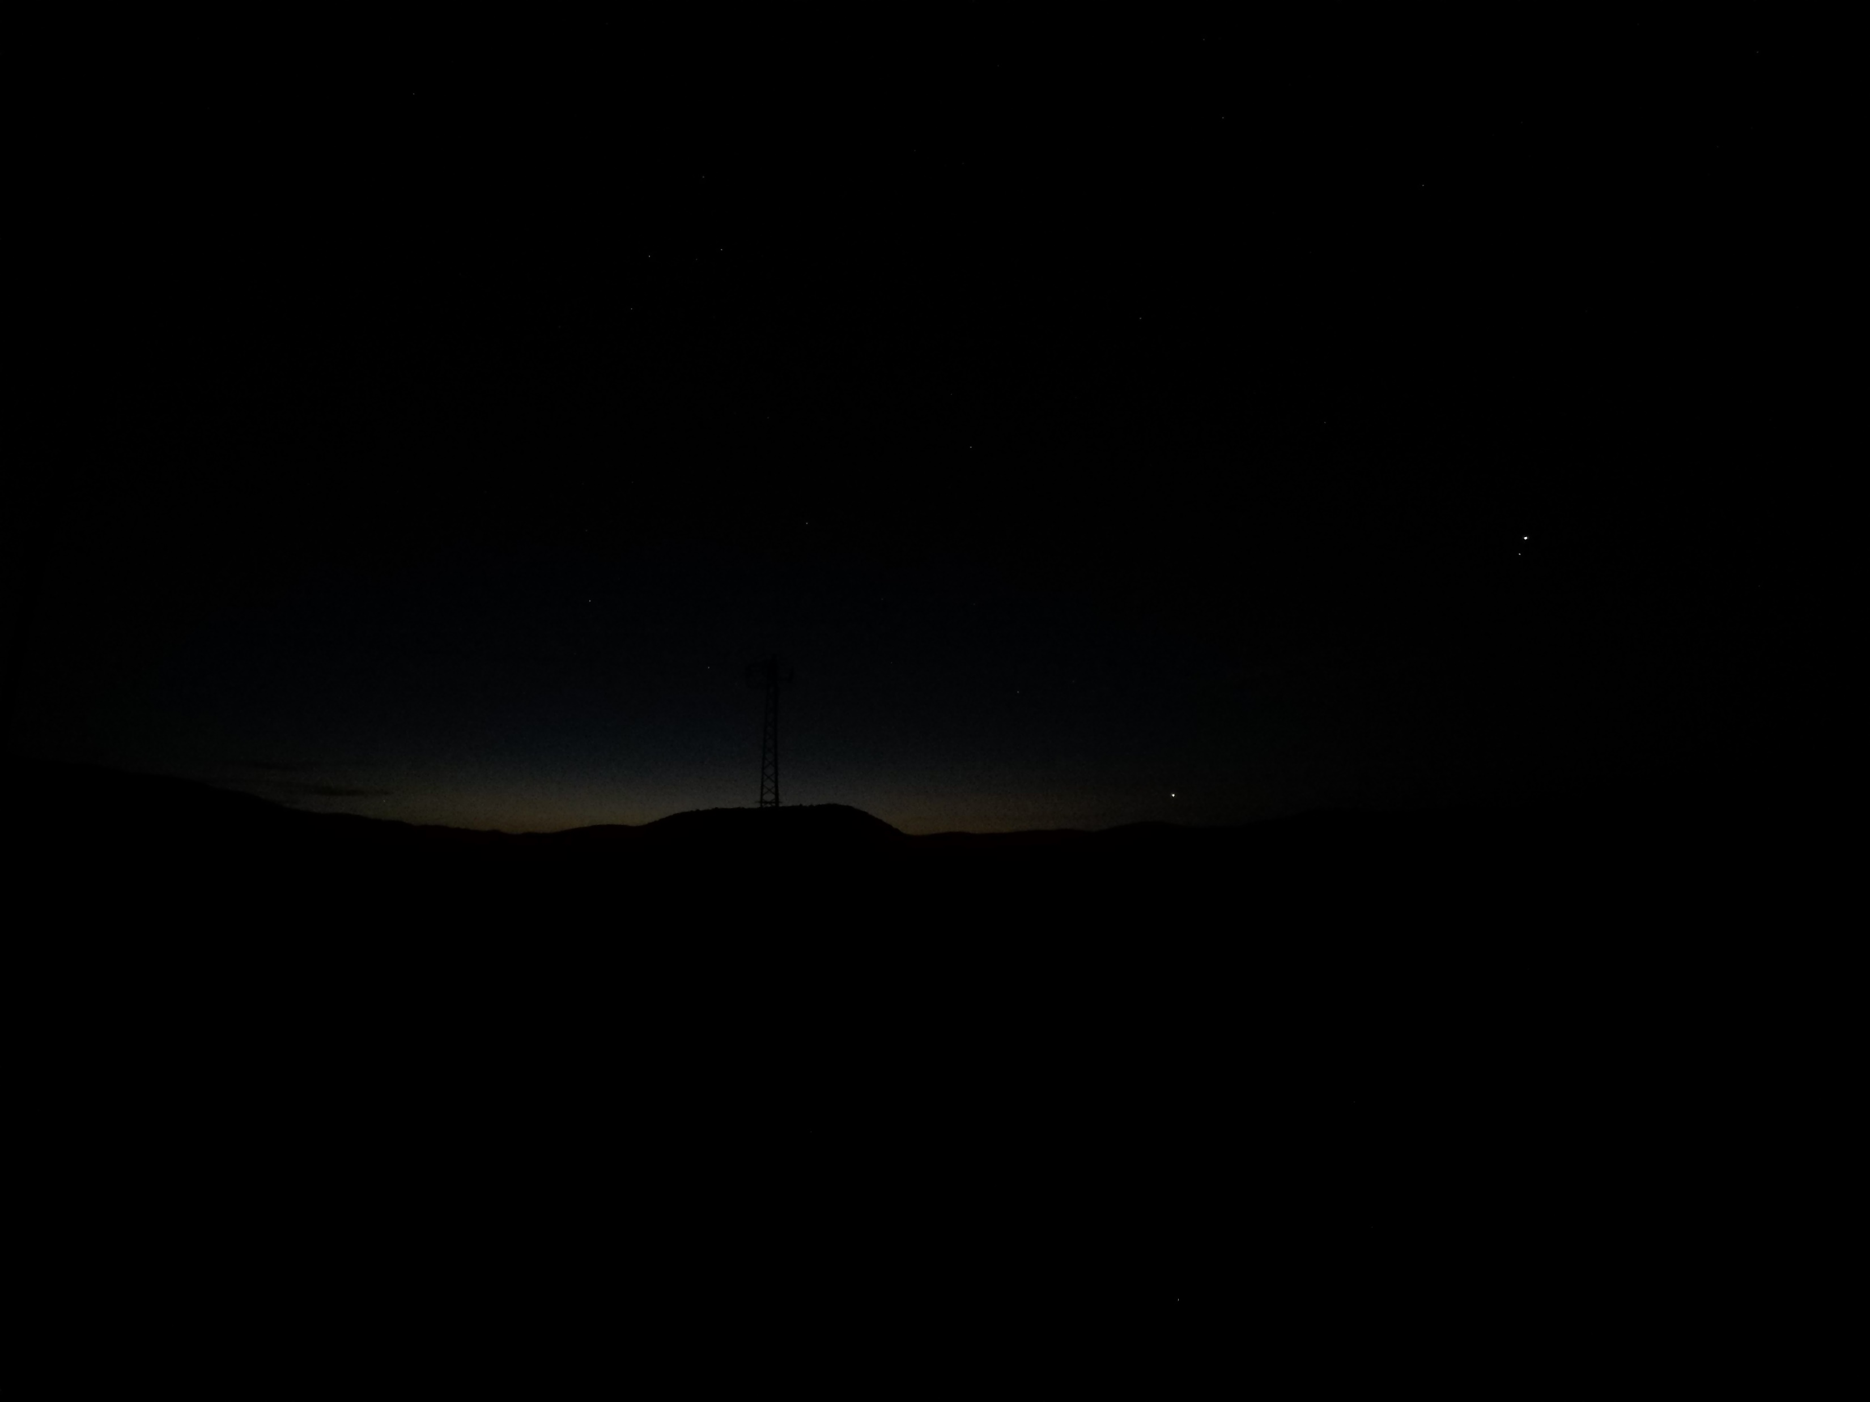
Time: 03:24 Sun: -13,1º

Slide 19
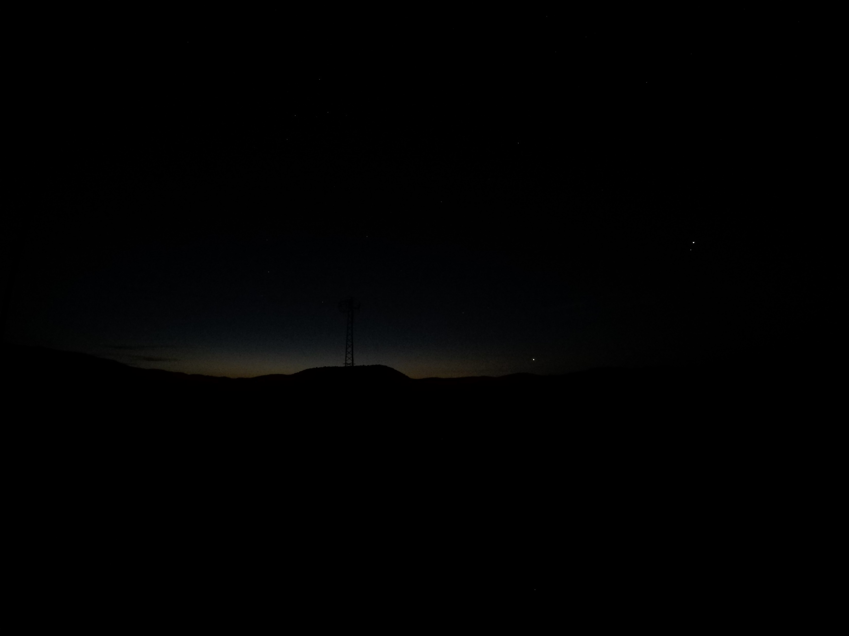
Time: 03:25 Sun:-13,0º

Slide 20
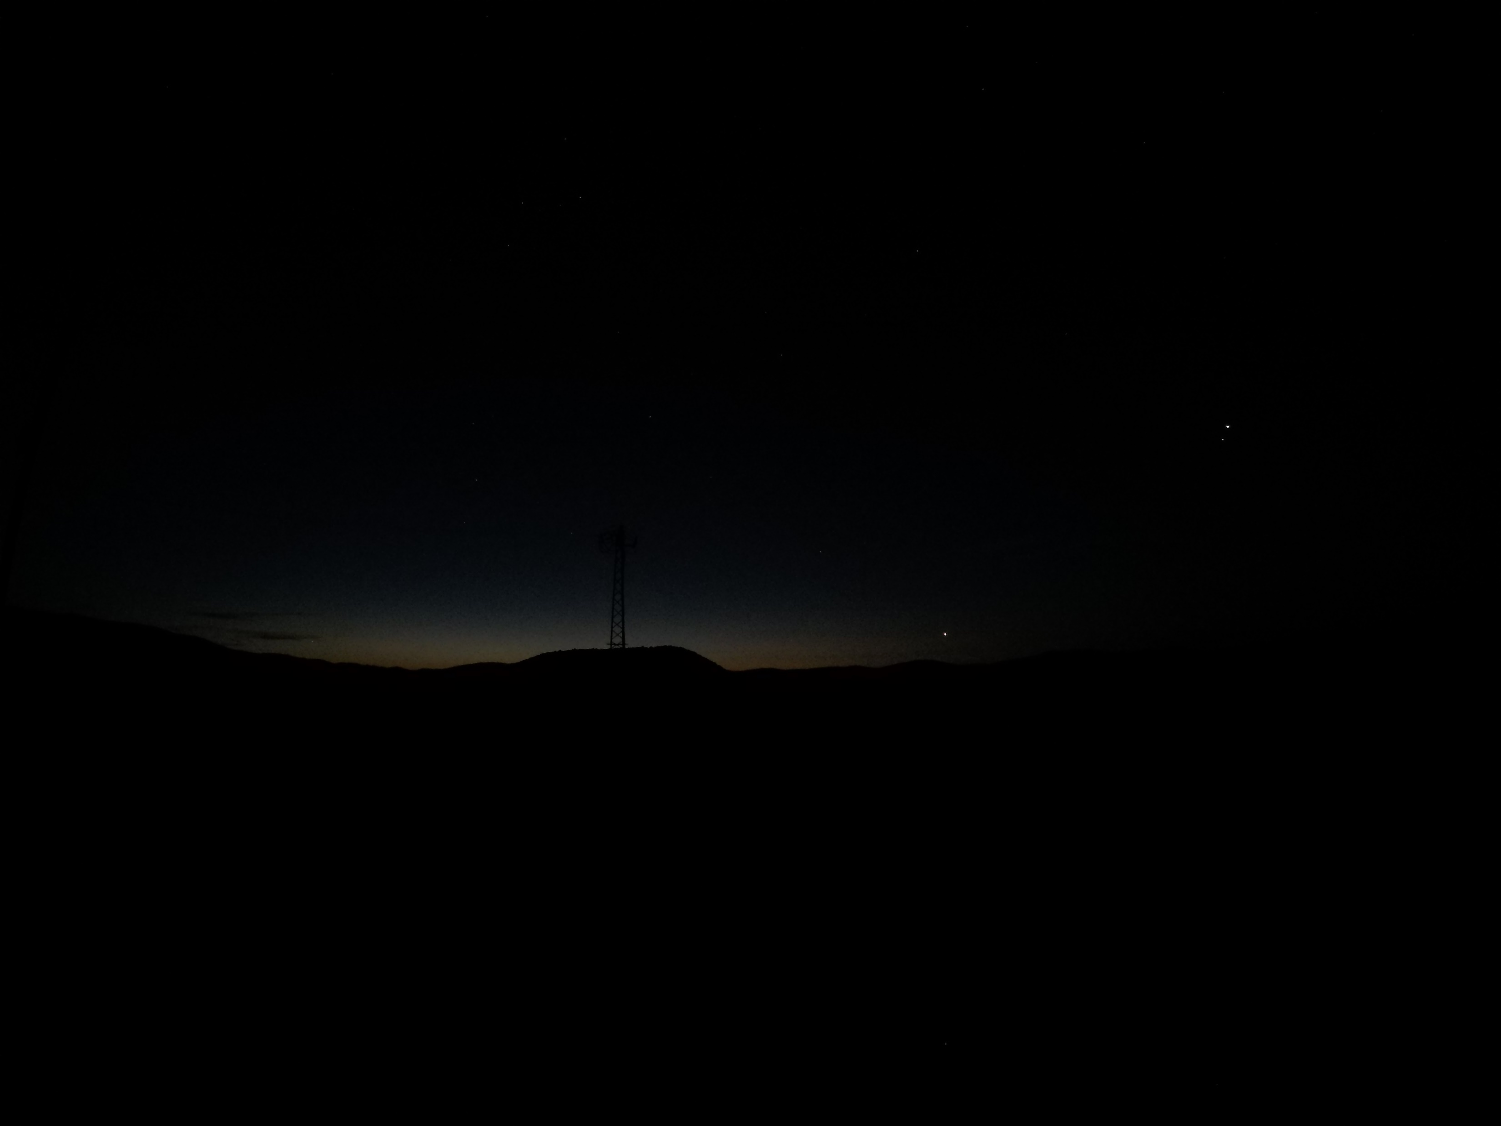
Time: 03:26 Sun: -12,9º

Slide 21
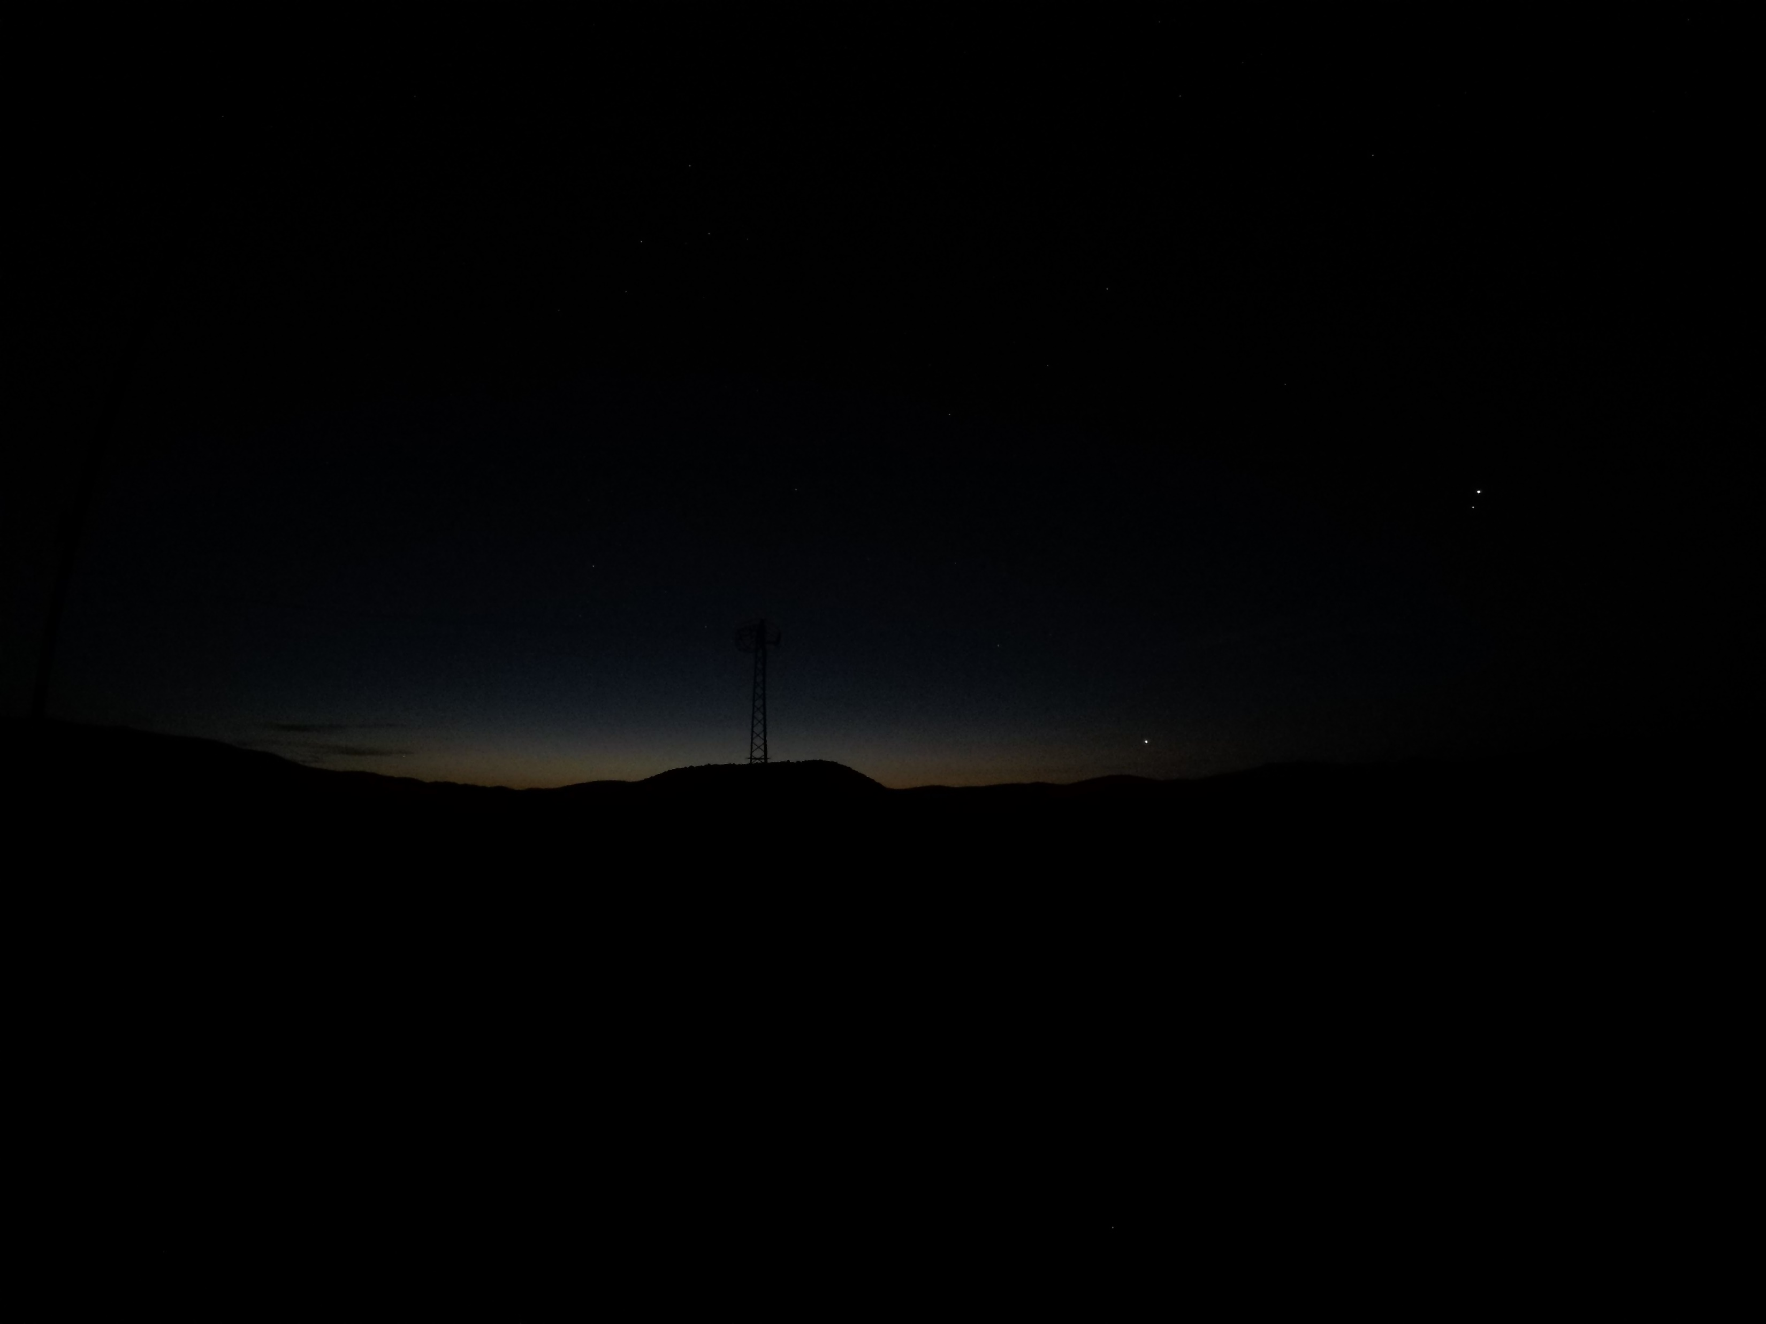
Time: 03:27 Sun: -12,7º

Slide 22

Birds started singing at 03:28 at 12.5°
Time: 03:28 Sun: -12,6º

Slide 23
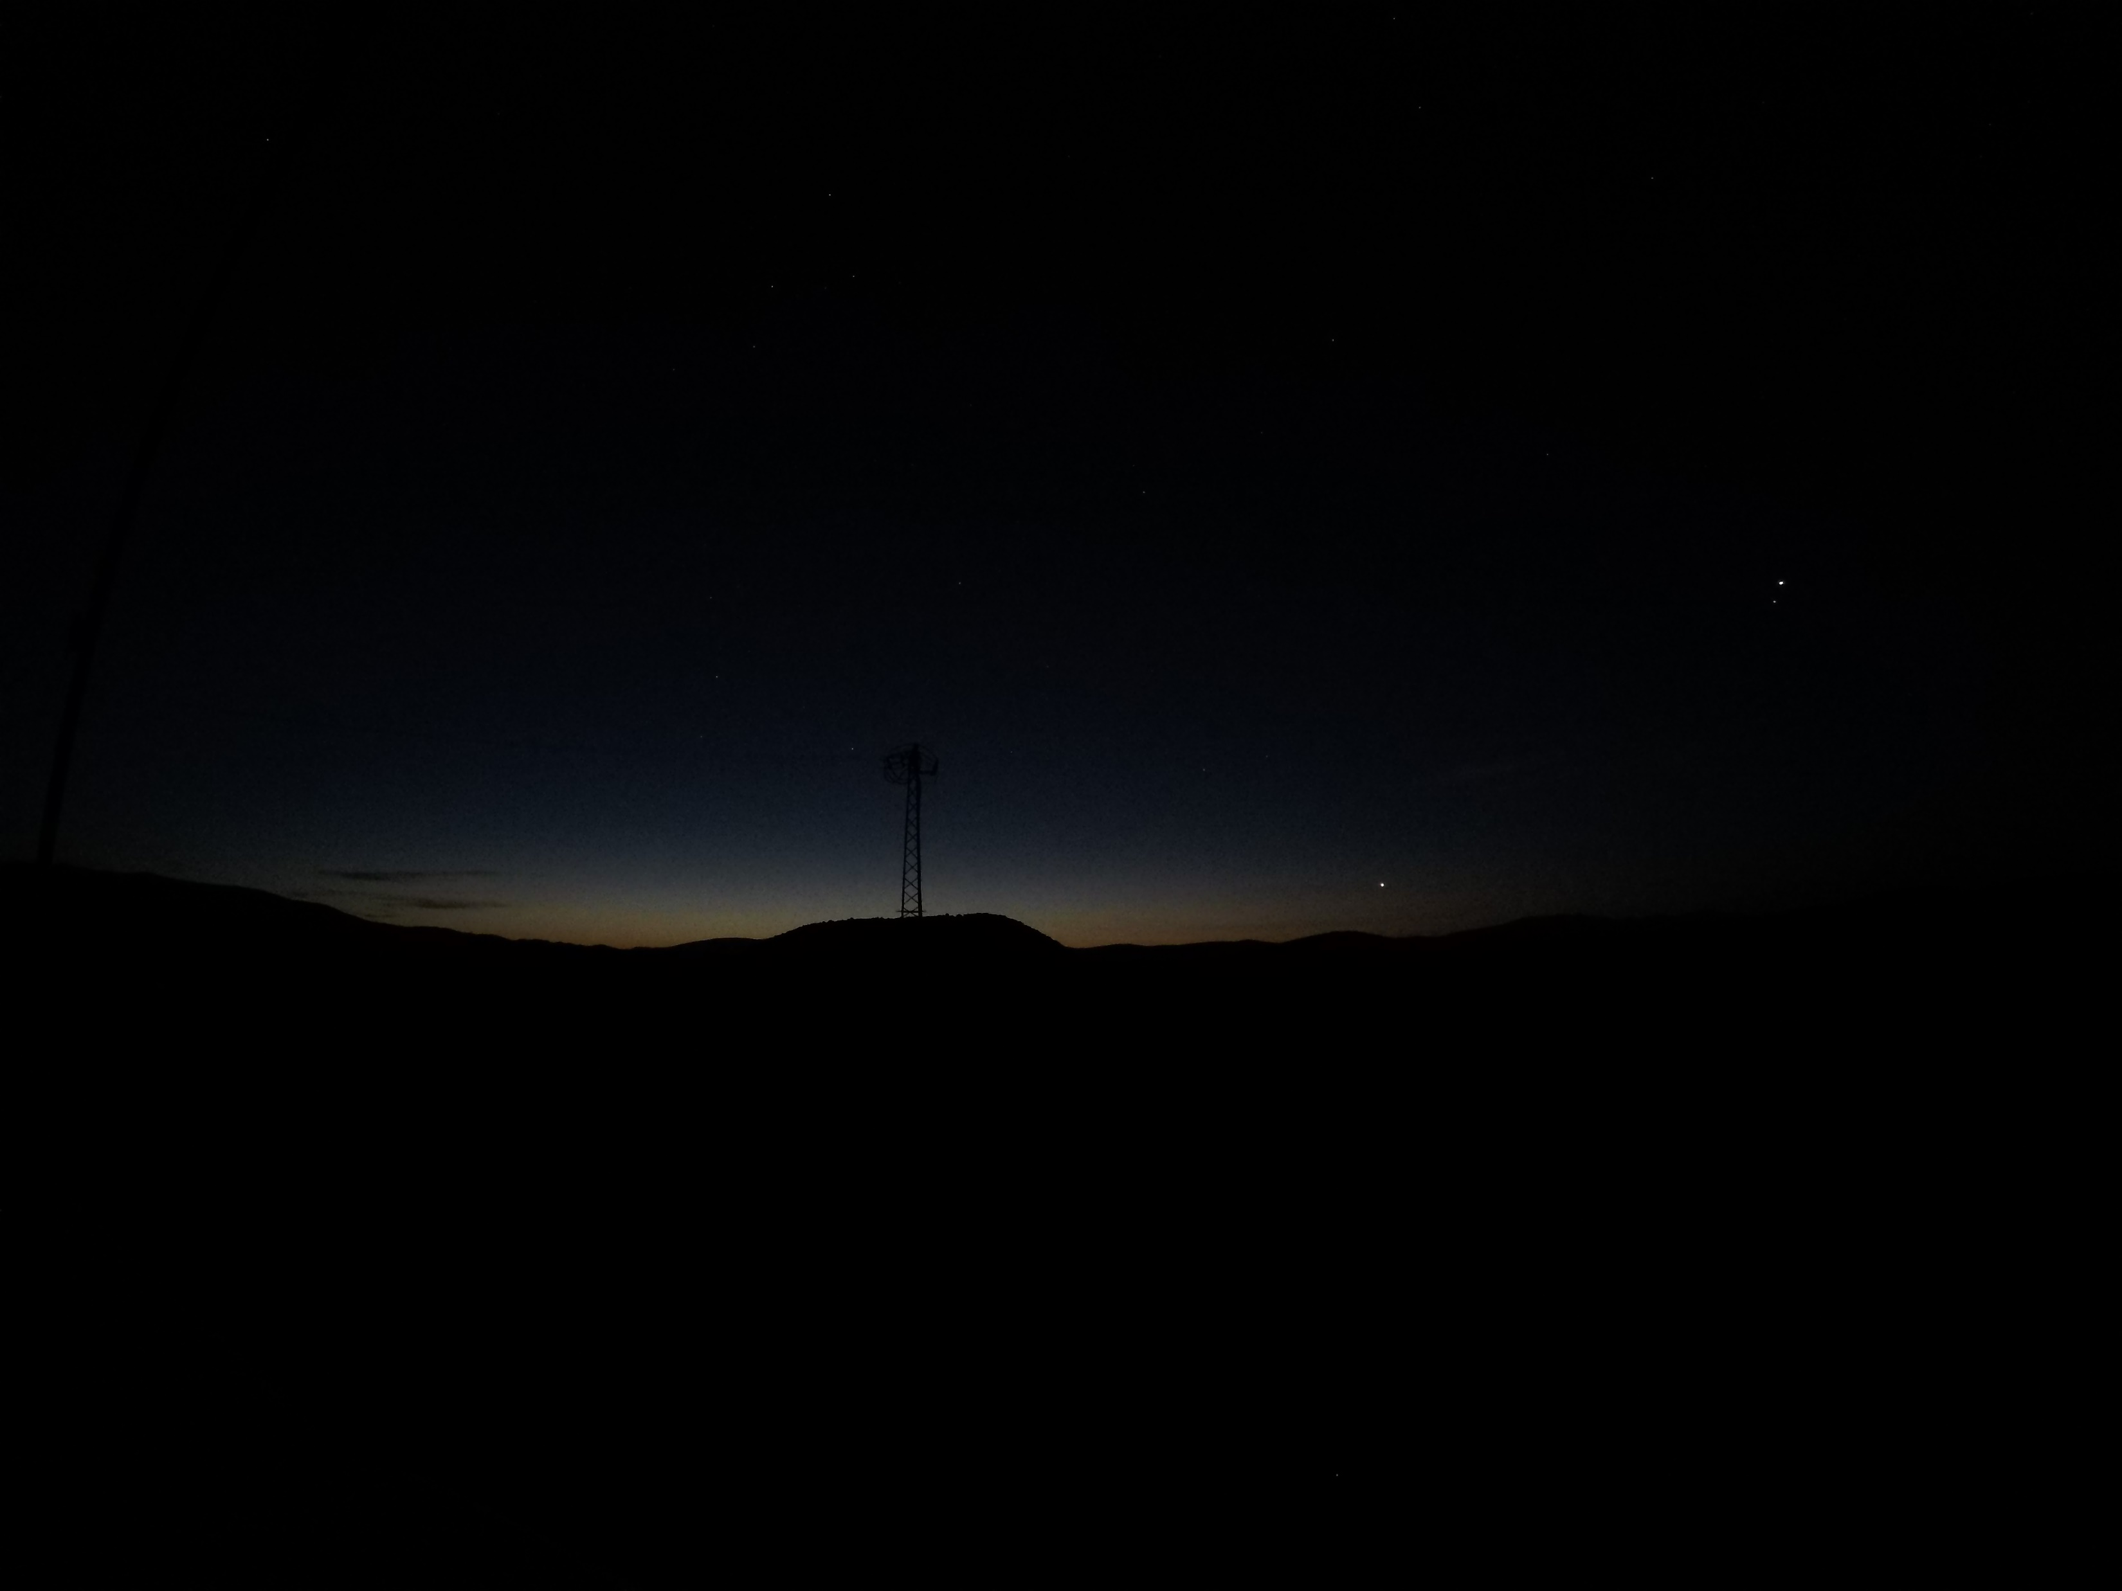
Time: 03:29 Sun: -12,4º

Slide 24

Time: 03:30 Sun: -12,3º

Slide 25
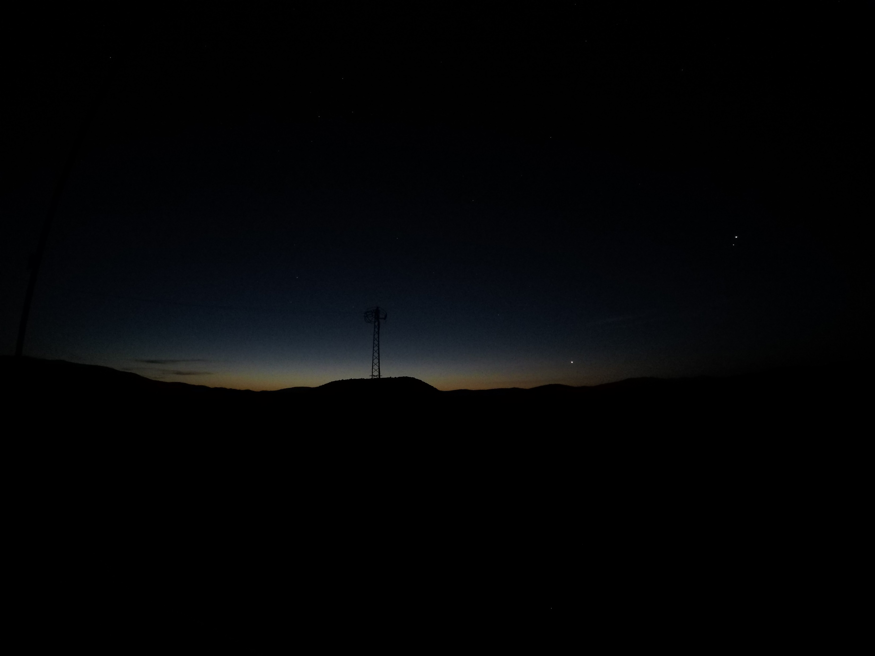
Time: 03:31 Sun: -12,2º

Slide 26

Time: 03:32 Sun: -12,0º

Slide 27
Time: 3:33 Sun: -11,9°

Slide 28
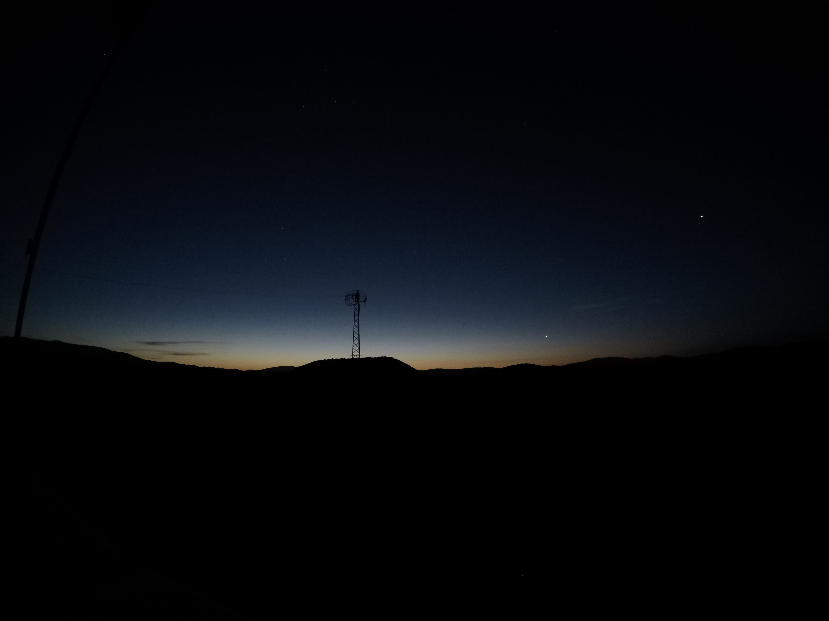
Time: 3:36 Sun: -11,5°
Saat: 3:36 Güneş:11,5°

Slide 29

Time: 3:39 Sun: -11,0°

Slide 30

As a result, in the photos we took with 2 seconds of exposure, the brightness of Imsak is seen as the Sun is -13.7° below the horizon.
That is, 7-8 minutes earlier than normal.
This means that prayers performed immediately after the call to prayer are outside the time
Time (Fajr Sadiq): occurs 35 minutes later in winter and 45 minutes later in summer.
Time: 3:43 Sun: -10,5°

