Slide 1
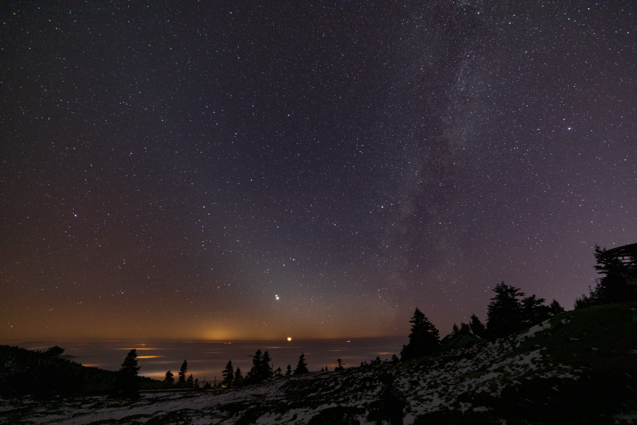
Imsak Time Observation-2023
Erzurum-Horasan Hacıahmet Village
Observ.: Rufai ÇINAR
Geophysical engineer
Fajr-i Kazib-Zodiac light

Slide 2
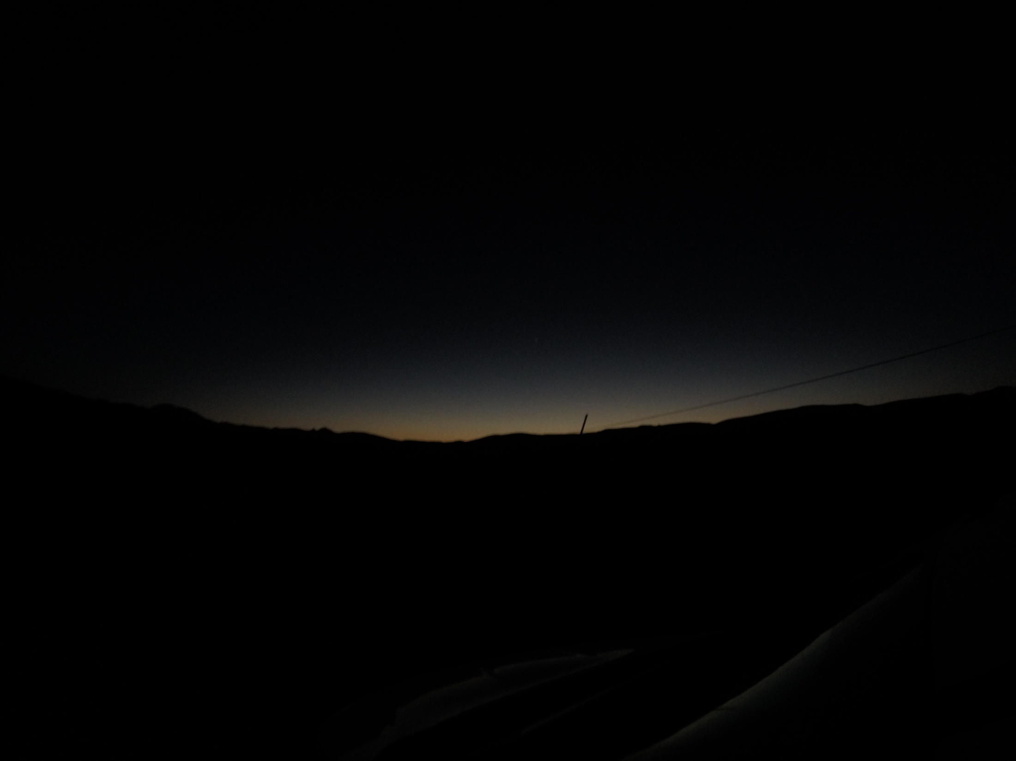
IMSAK TIME WITH VERSES AND HADITHS
It is stated in verse 187 of Surah Al-Baqarah: «… Eat and drink until the white thread of dawn can be distinguished from the black thread, then do not complete the fast until the following night." (Elmalılı Hamdi Yazır) However, our Prophet explained that what was meant by the thread example was night and day. It is narrated from Adiy b. Hatim (d. after 60/680) (r.a.) that he said: "When the verse above was revealed, I took two threads, one black and the other white, and put them under my pillow. I would look at them during sahur and when the dawn was bright enough to distinguish one from the other, I would stop eating and drinking. In the morning,
I went to the Messenger of Allah (pbuh) and informed him of what I had done. He said: "How big your pillow is! What is meant in the verse is the whiteness of the day and the blackness of the night. How can you fit them under one pillow?" (Bukhari, Sawm, 16).
Hadith: Our Prophet said, “Eat and drink, do not let the (false) dawn that shines upwards deceive you (do not prevent you from eating and drinking) Eat and drink until the REDNESS (sadık fajr) rises”1. After Tirmidhi said that the hadith is ‘hasan karib’, he stated that the action among the scholars is according to this and that this opinion is the opinion of all the scholars.

Slide 3
The zodiacal light is vertical from the horizon
The Diyanet organization and MVL take this as the beginning of the fast

Slide 4
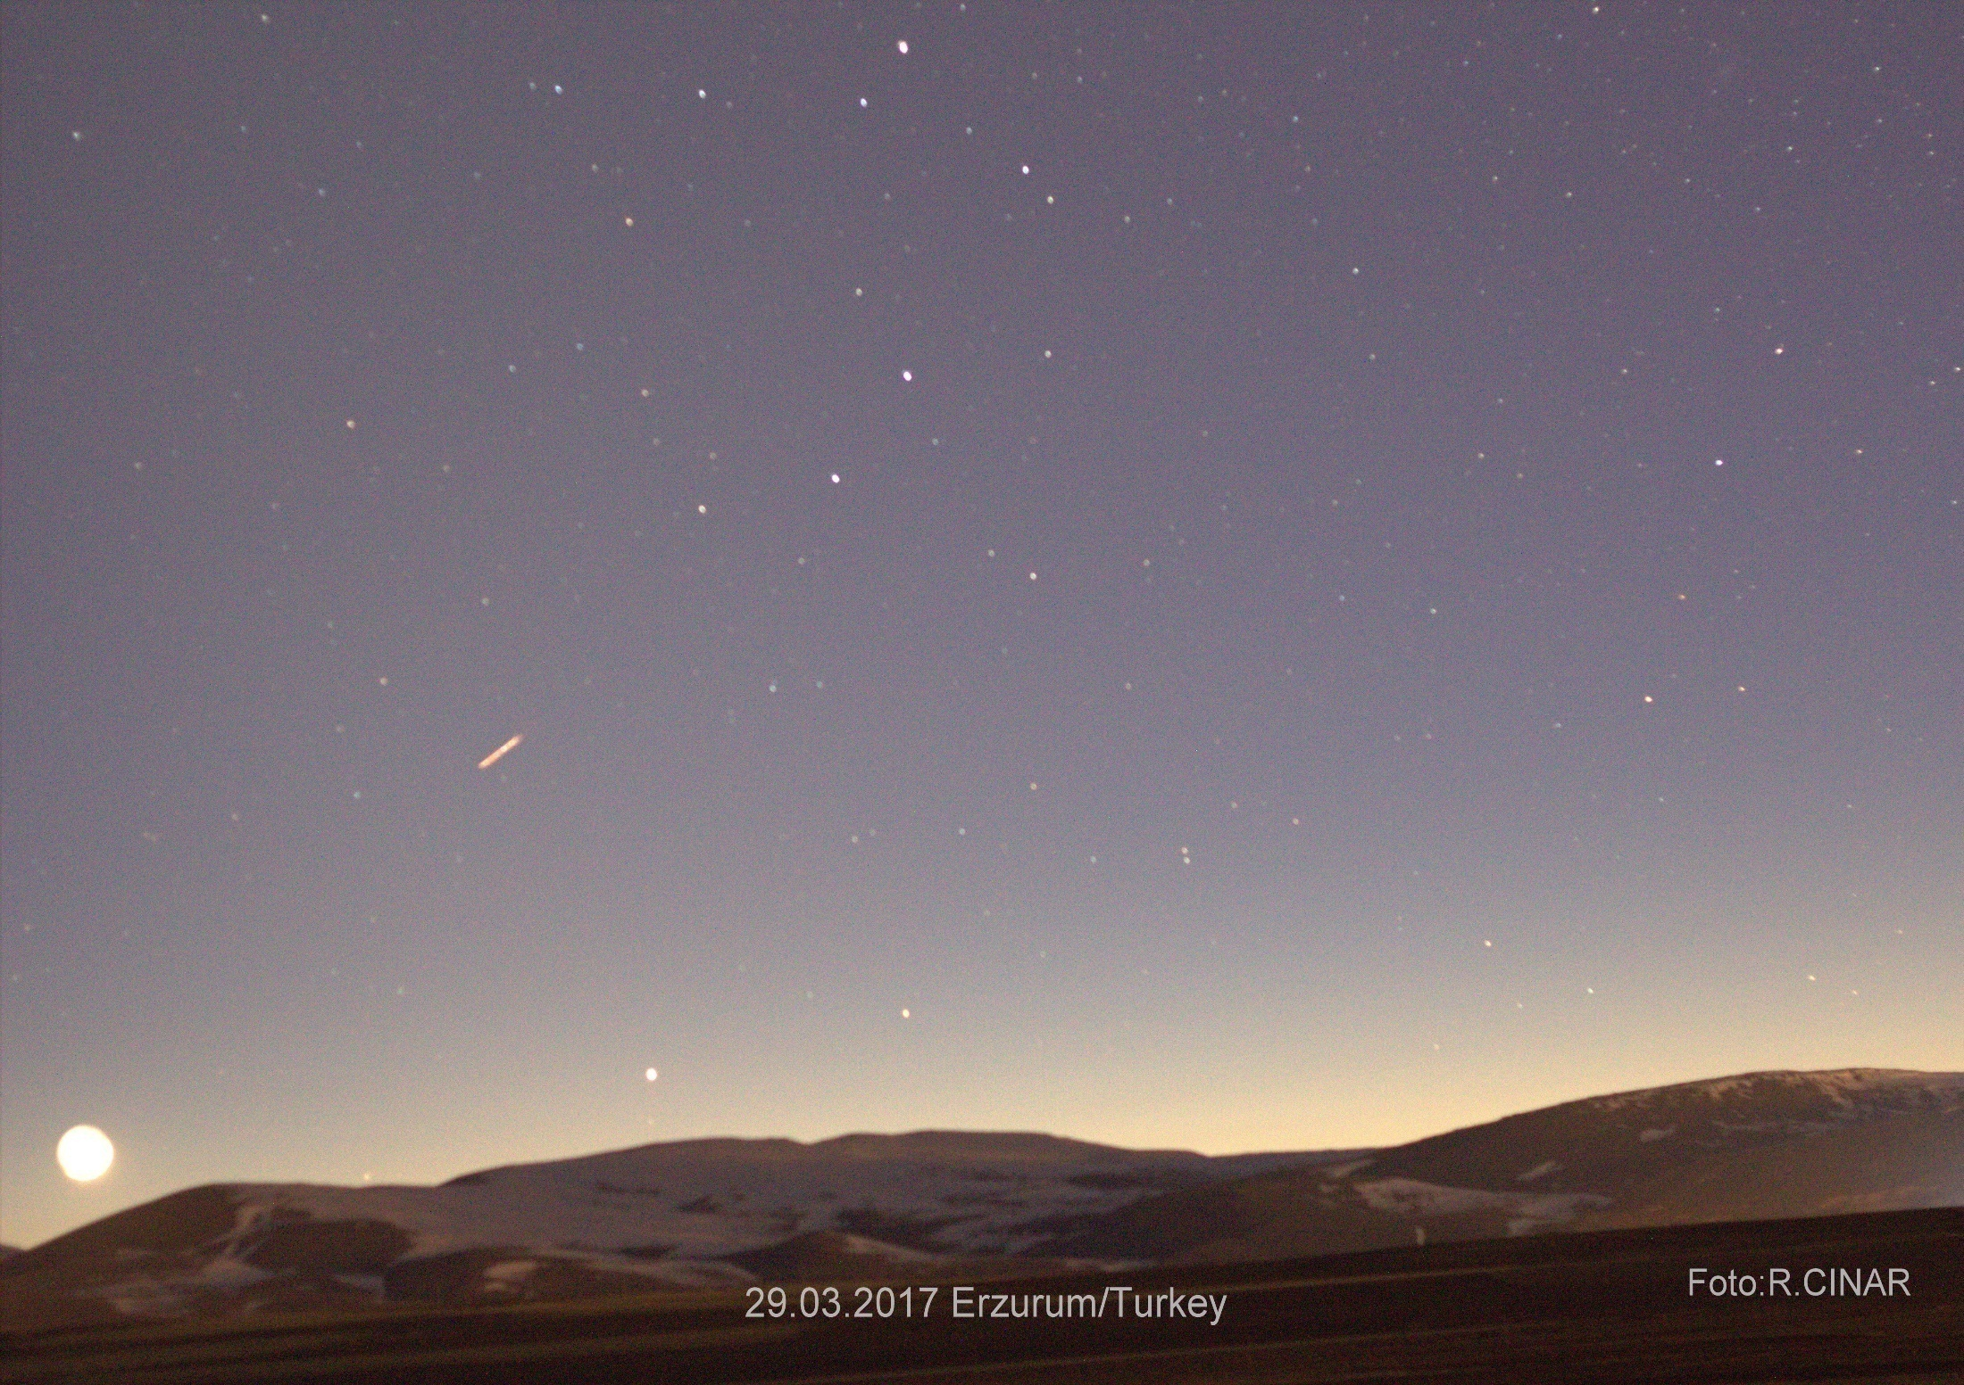
Exposure makes a thin crescent look like a full moon
March 29, 2017 three months start (Sunset first crescent)

Slide 5
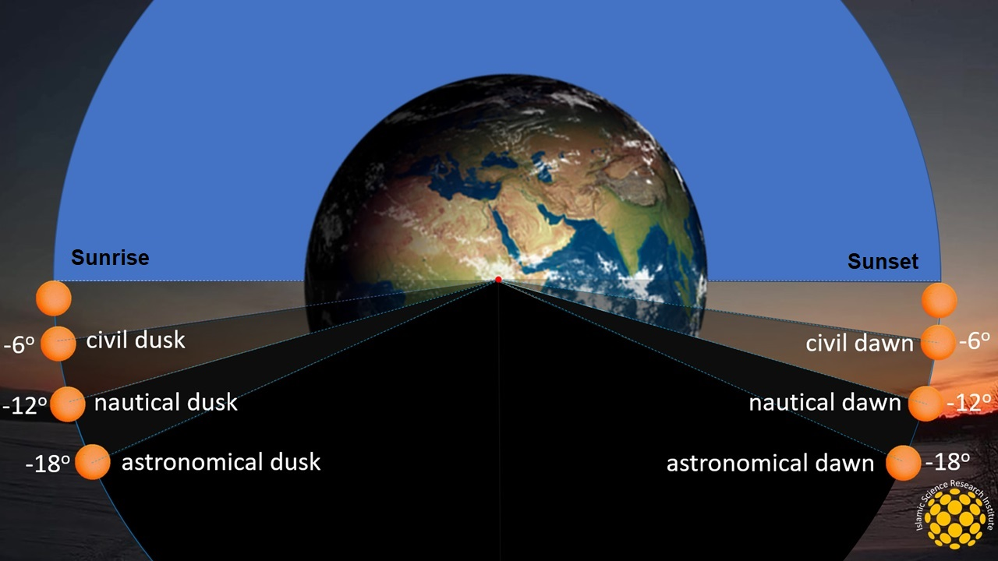

Slide 6
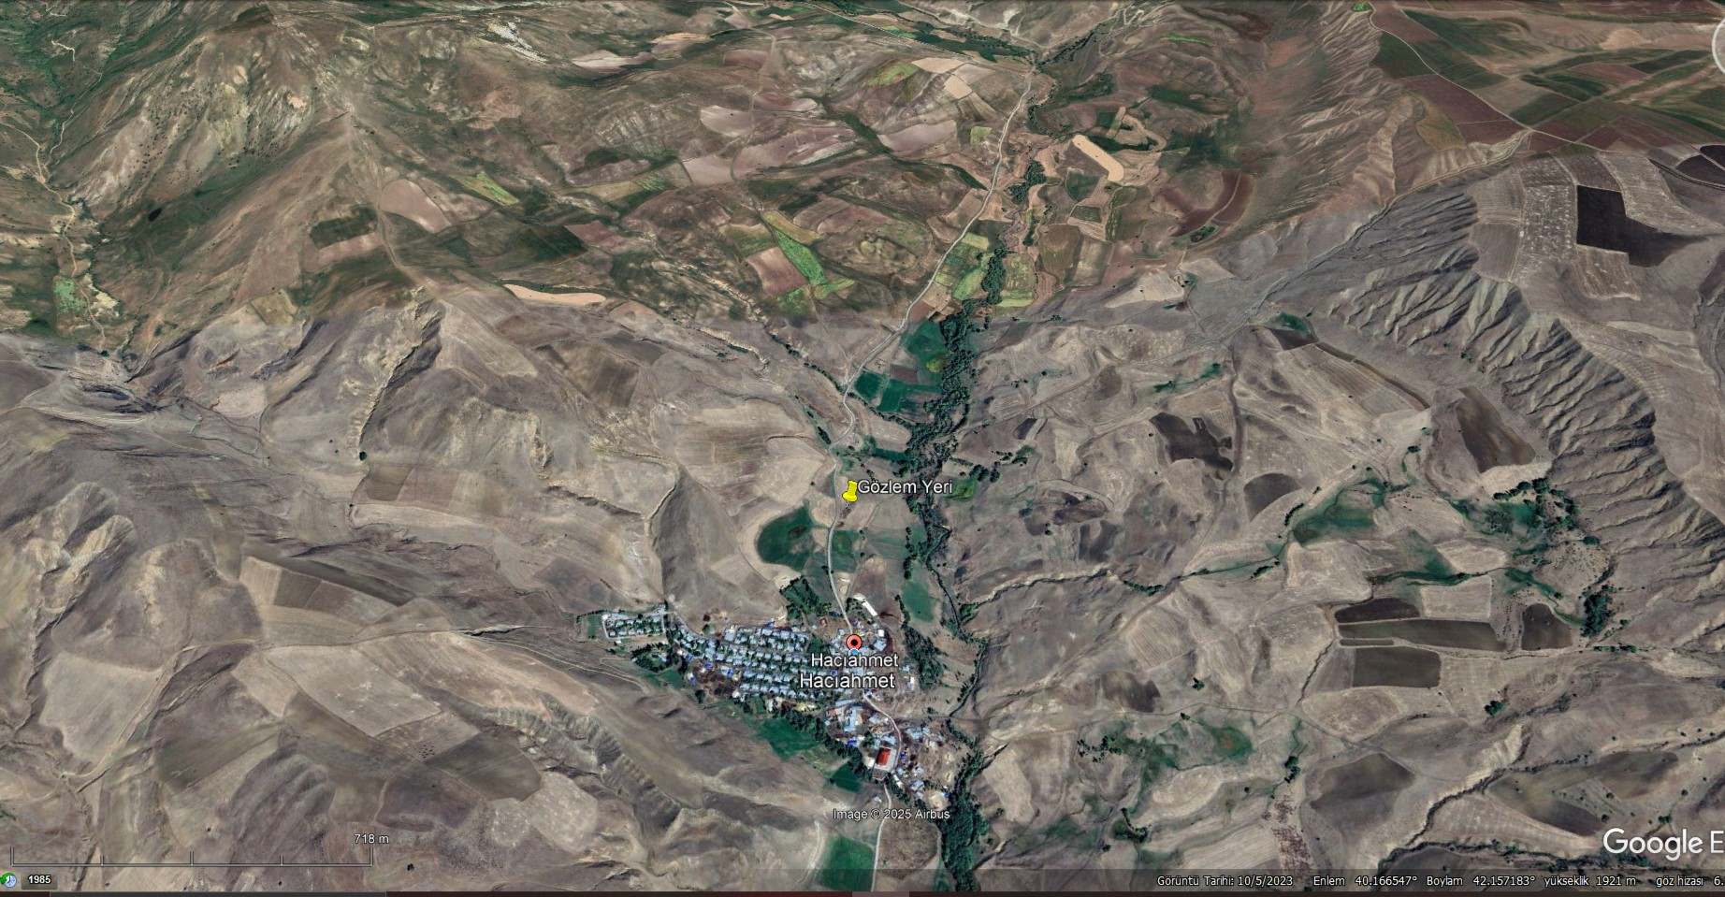
Erzurum-Horasan Hacıahmet Village
Date: July 13, 2023
Altitude 1820 m

Slide 7
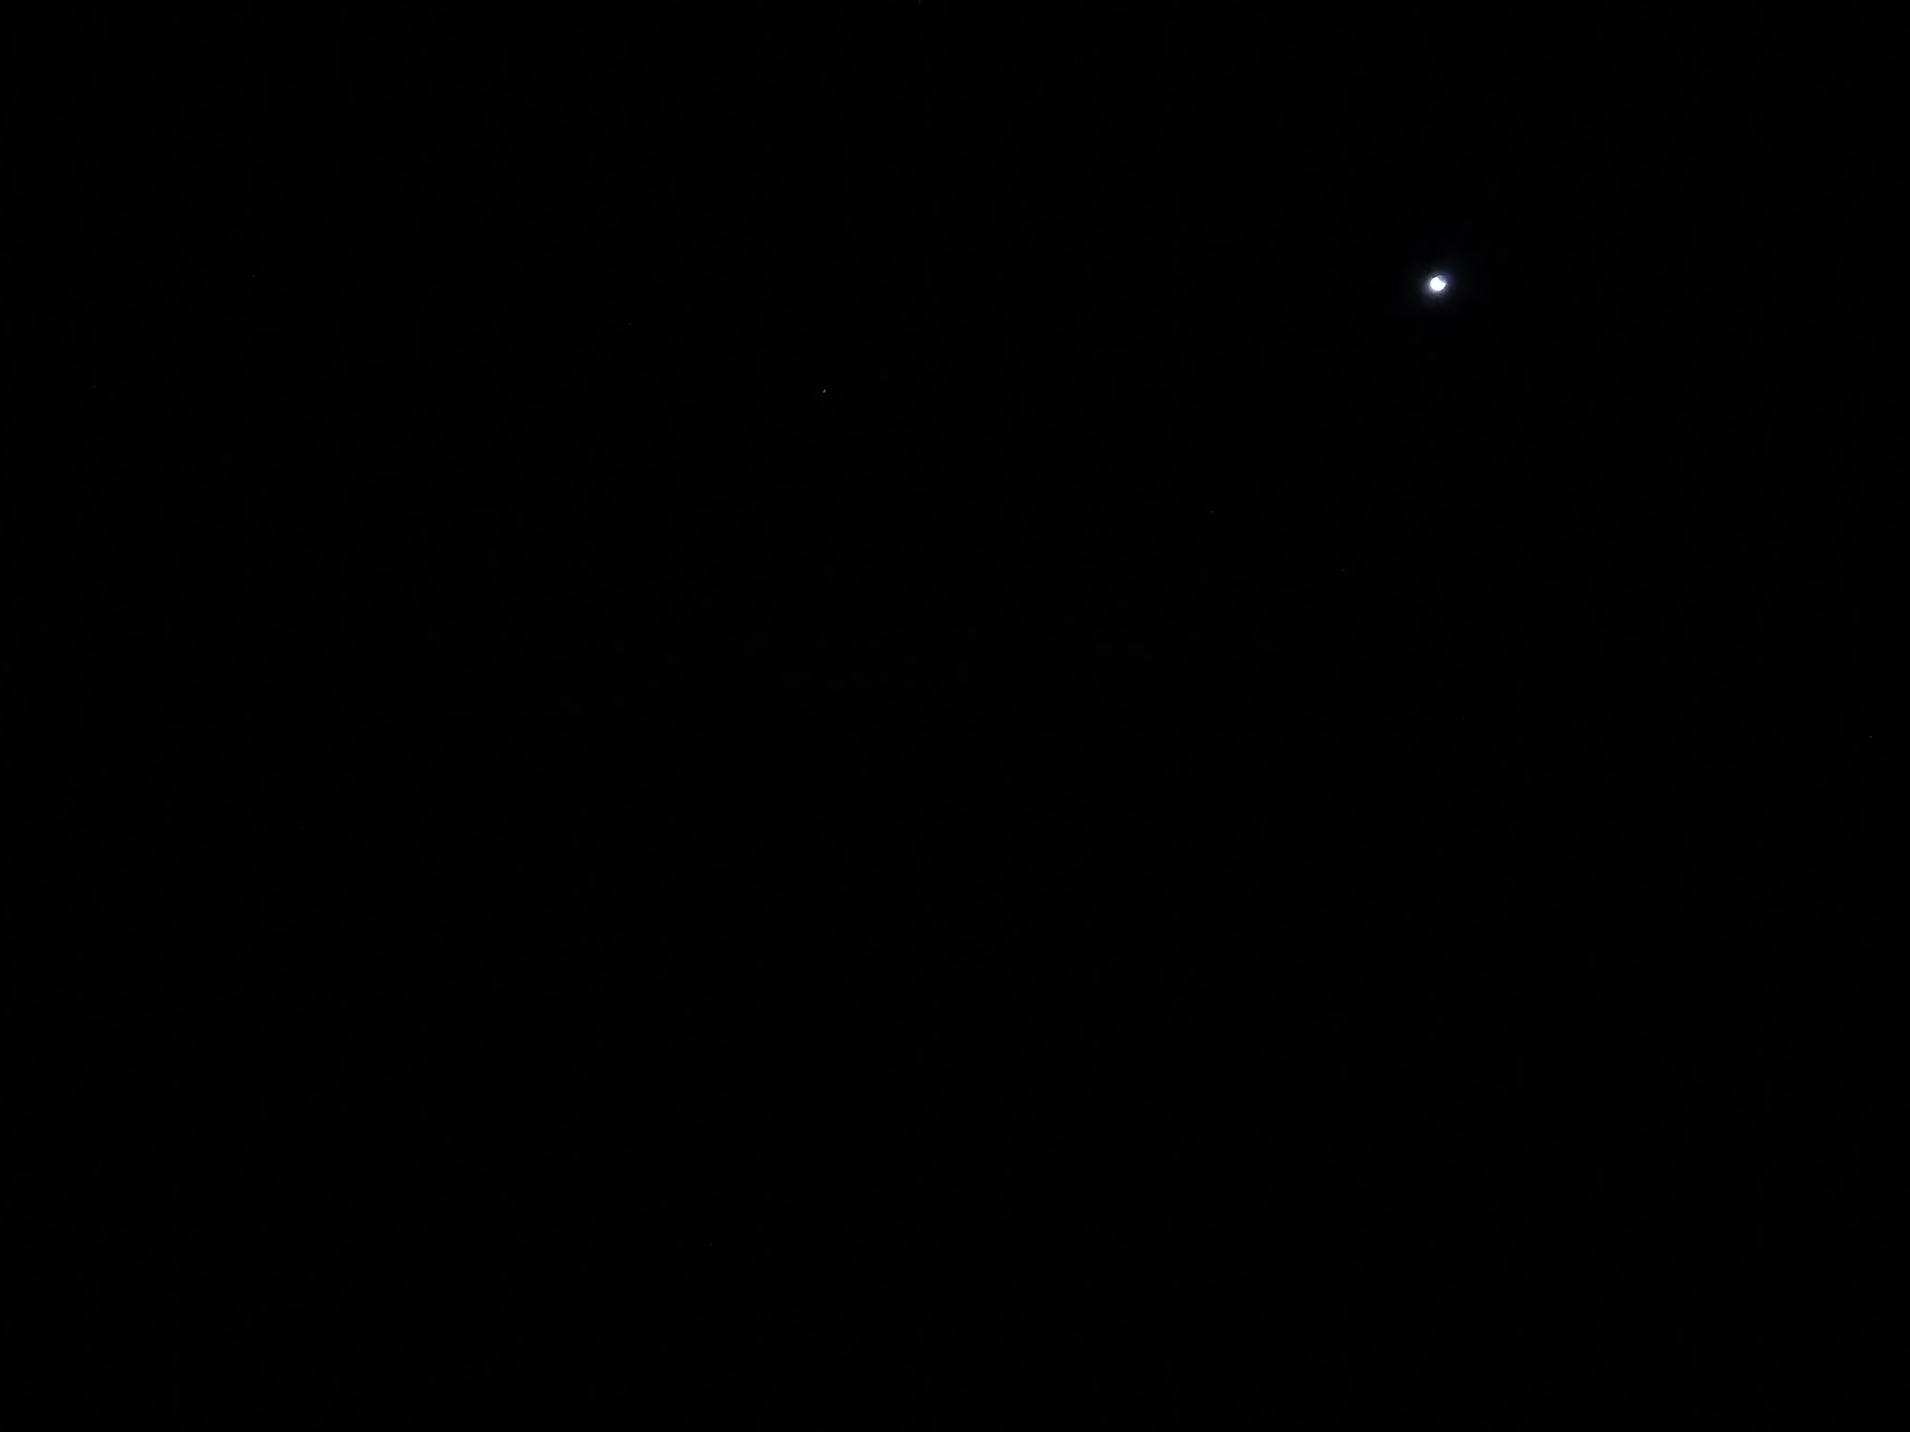
Date: July 13, 2023
Diyanet & Mwl imsak 02:54
North ABD Islamic community Imsak time
25 minutes later the area is pitch dark
Hour : 03:19 Sun: -14,9º

Slide 8
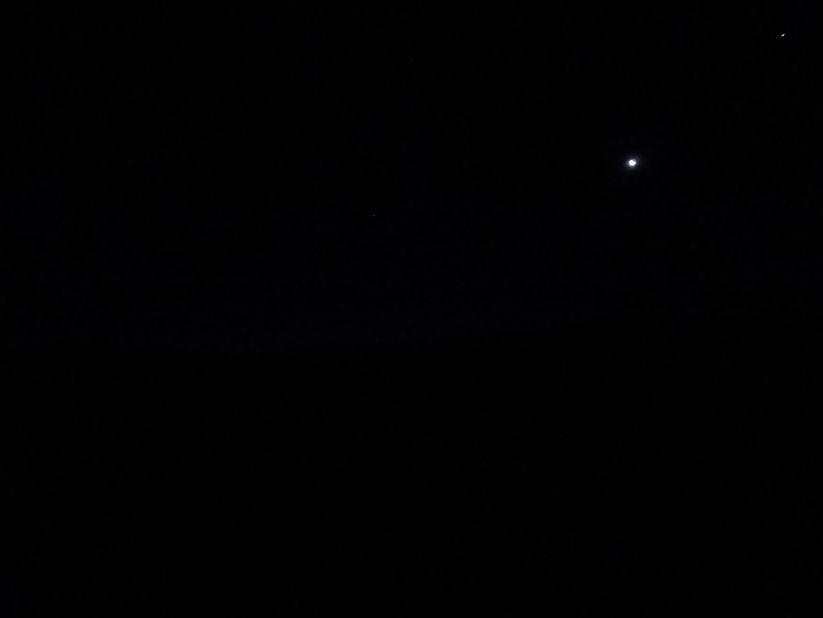
Hour : 03:20 Sun: -14,8º

Slide 9
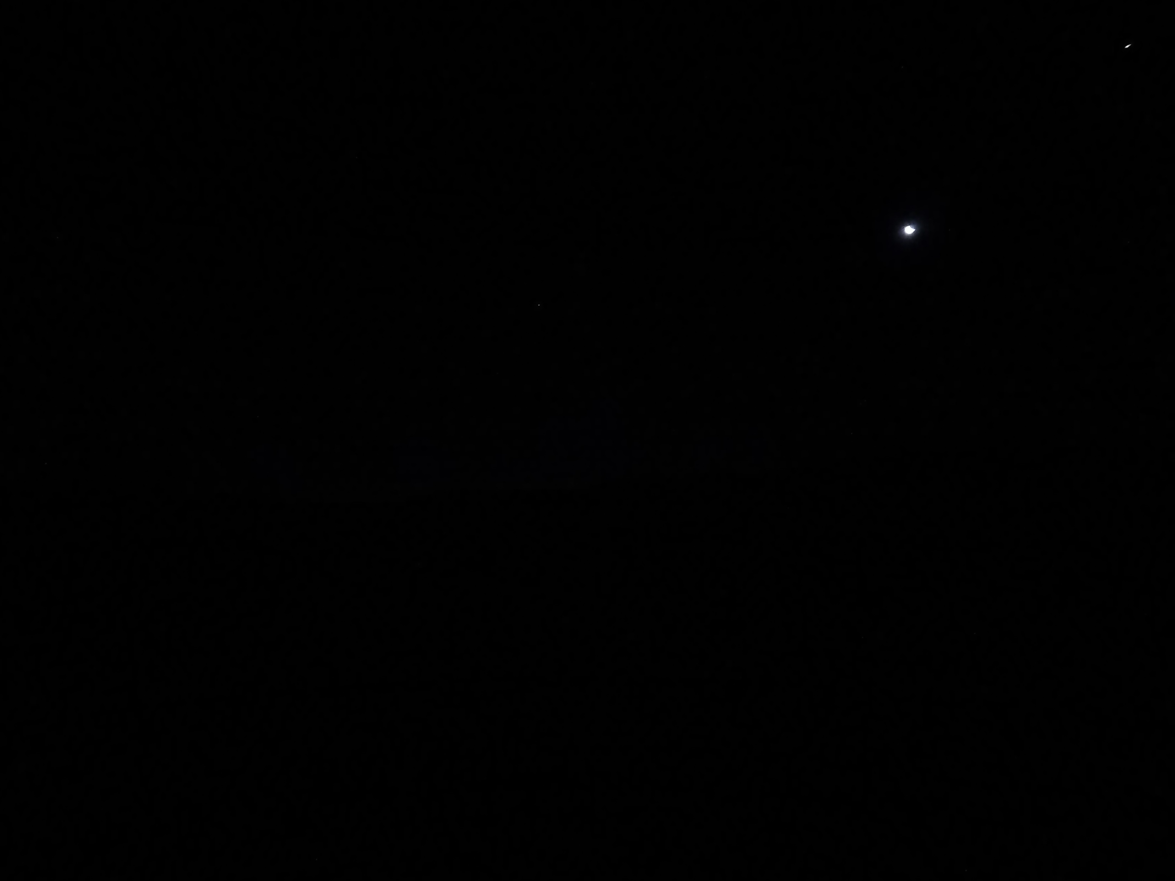
Hour : 03:21 Sun: -14,7º

Slide 10
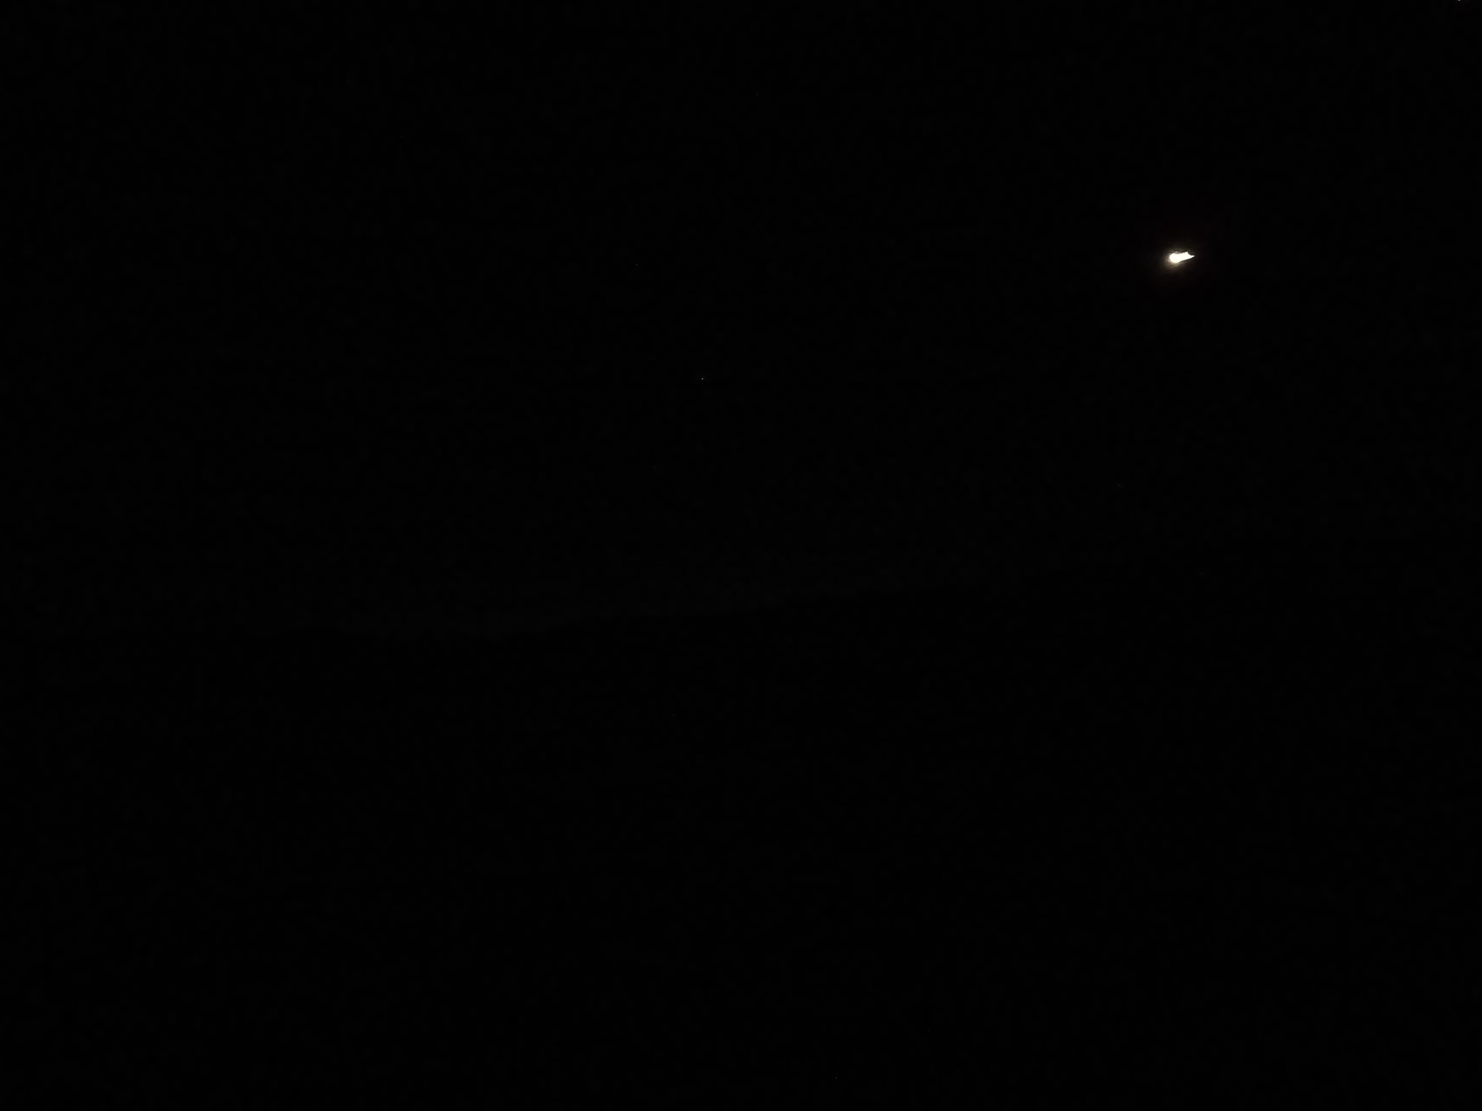
Hour : 03:22 Sun: -14,5º

Slide 11
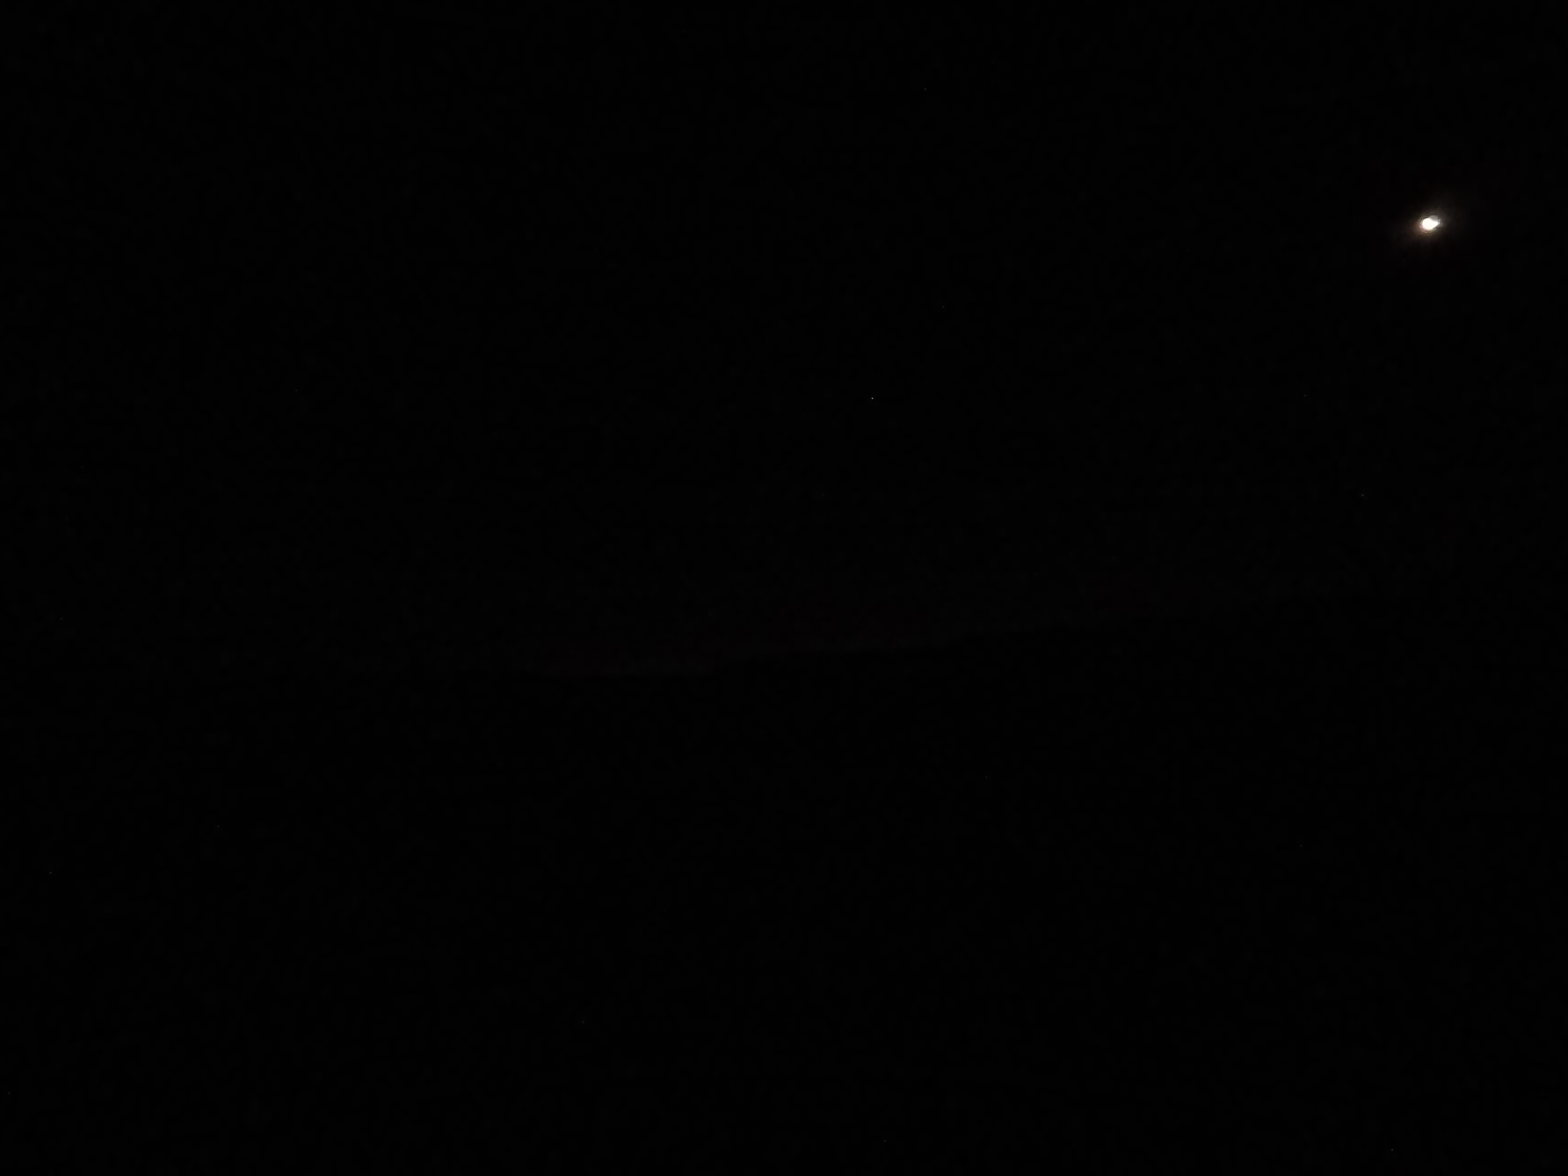
Hour : 03:23 Sun: -14,4º

Slide 12
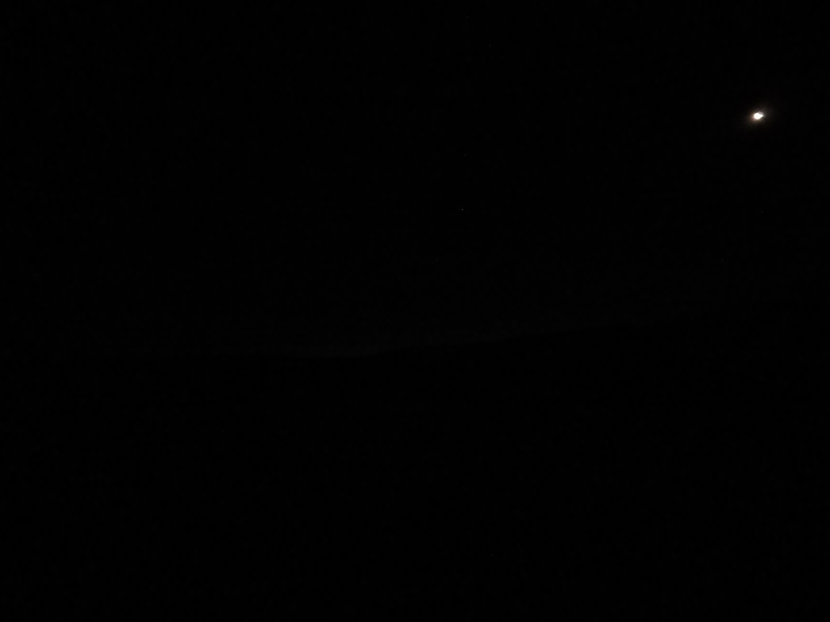
Hour : 03:24 Sun: -14,3º

Slide 13
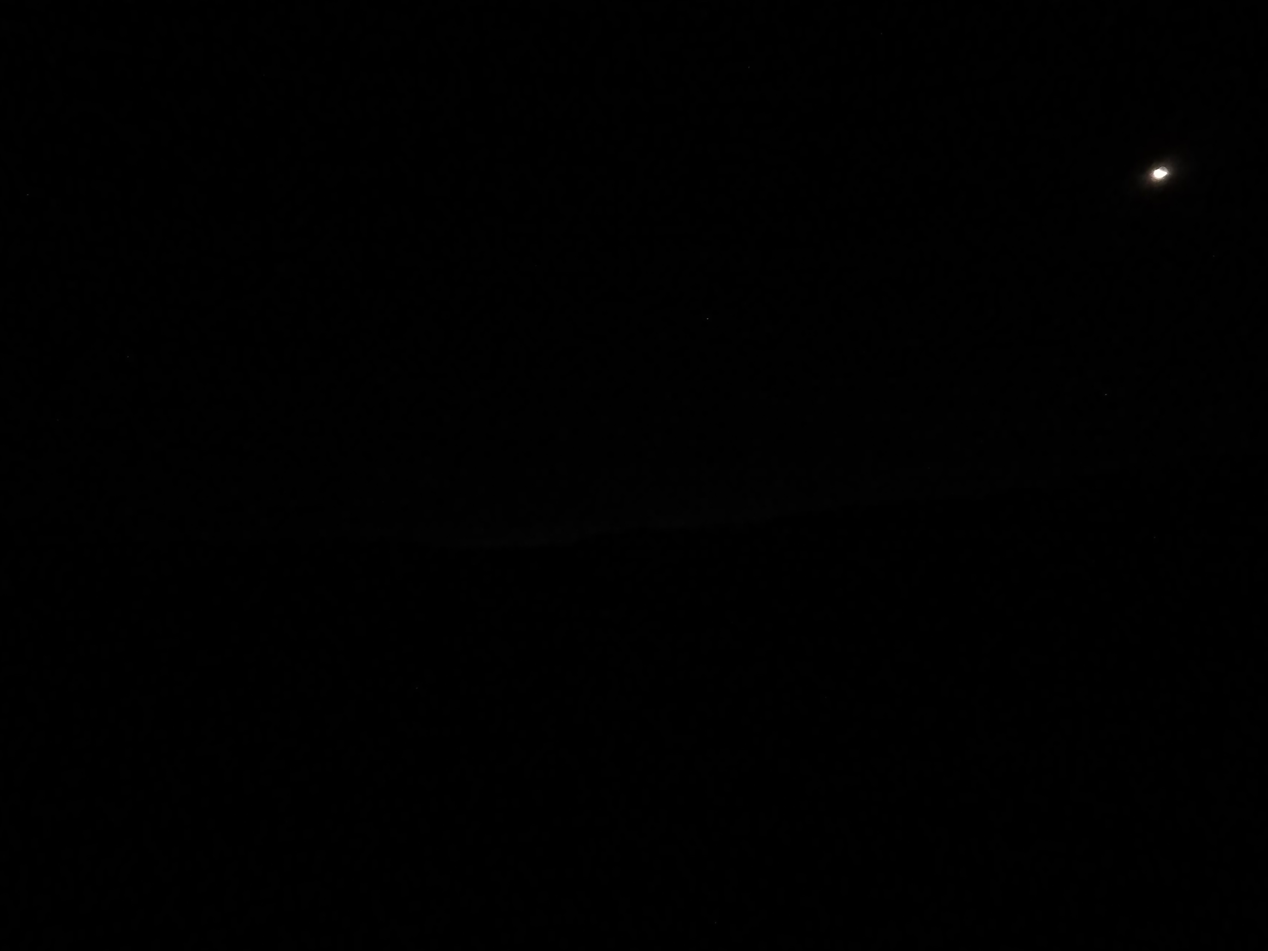
Hour : 03:25 Sun: 14,1º

Slide 14
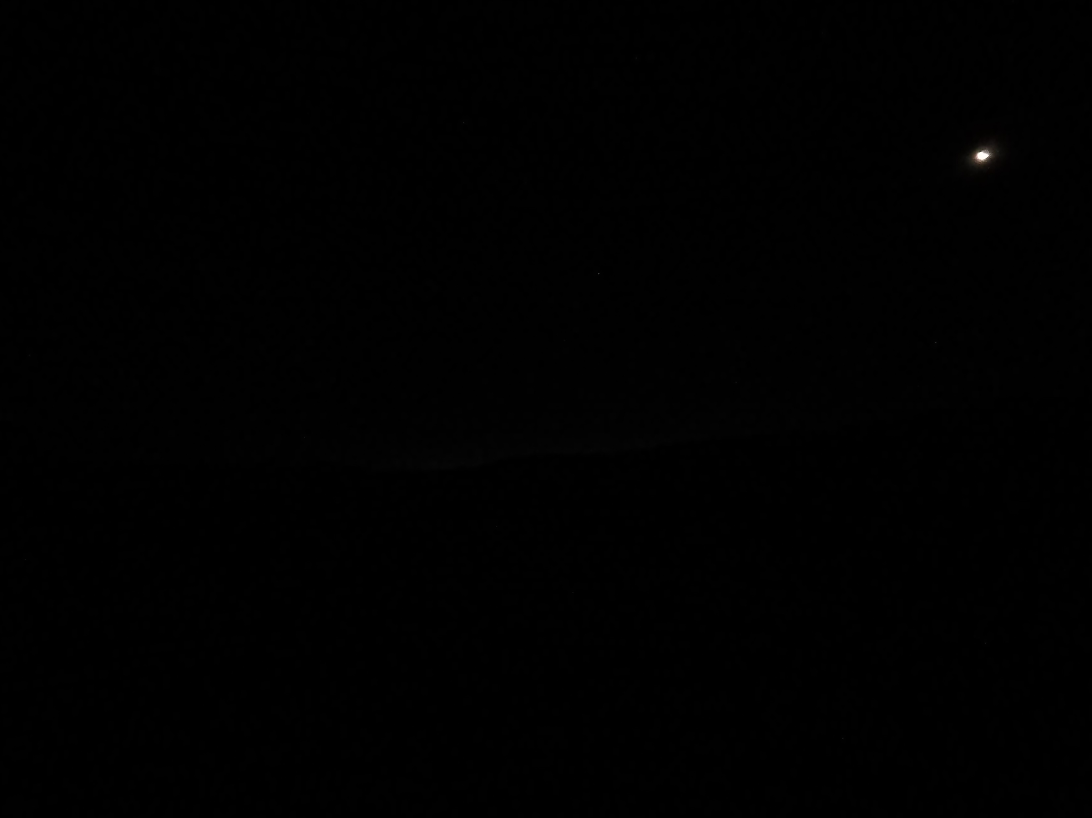
Hour : 03:26 Sun: -14,0º

Slide 15
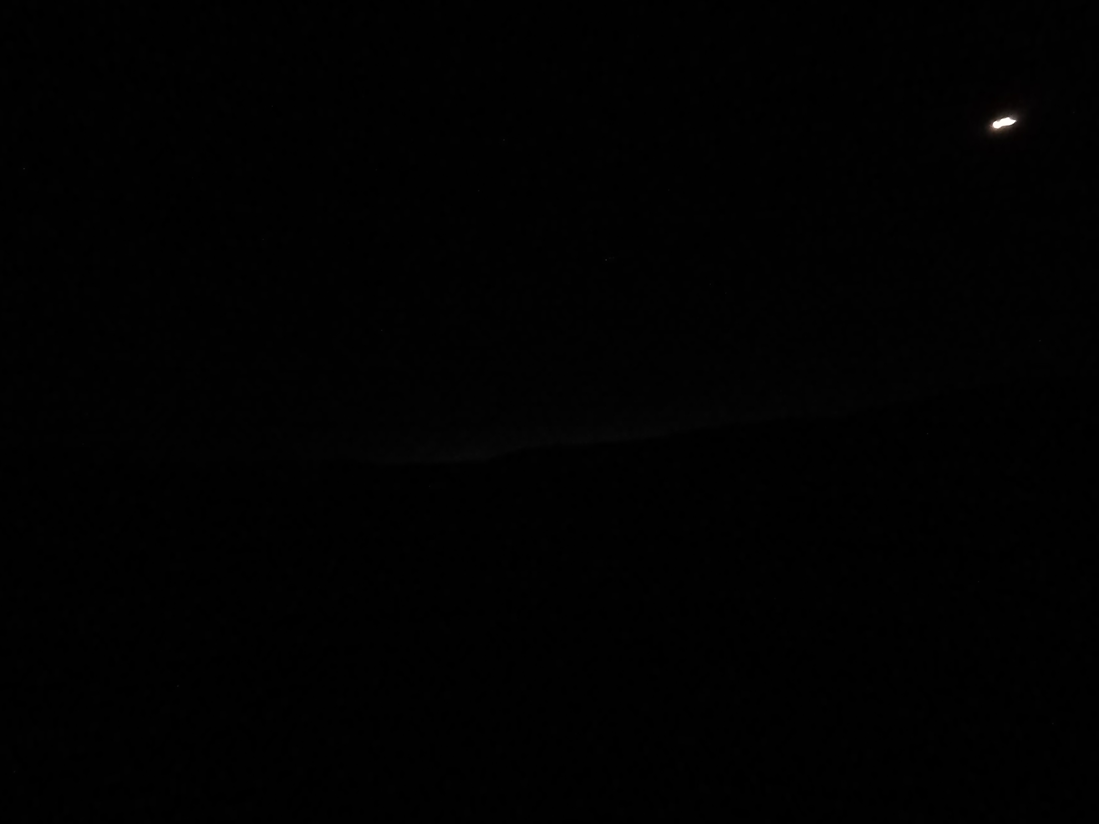
Hour : 03:27 Sun: -13,9º

Slide 16
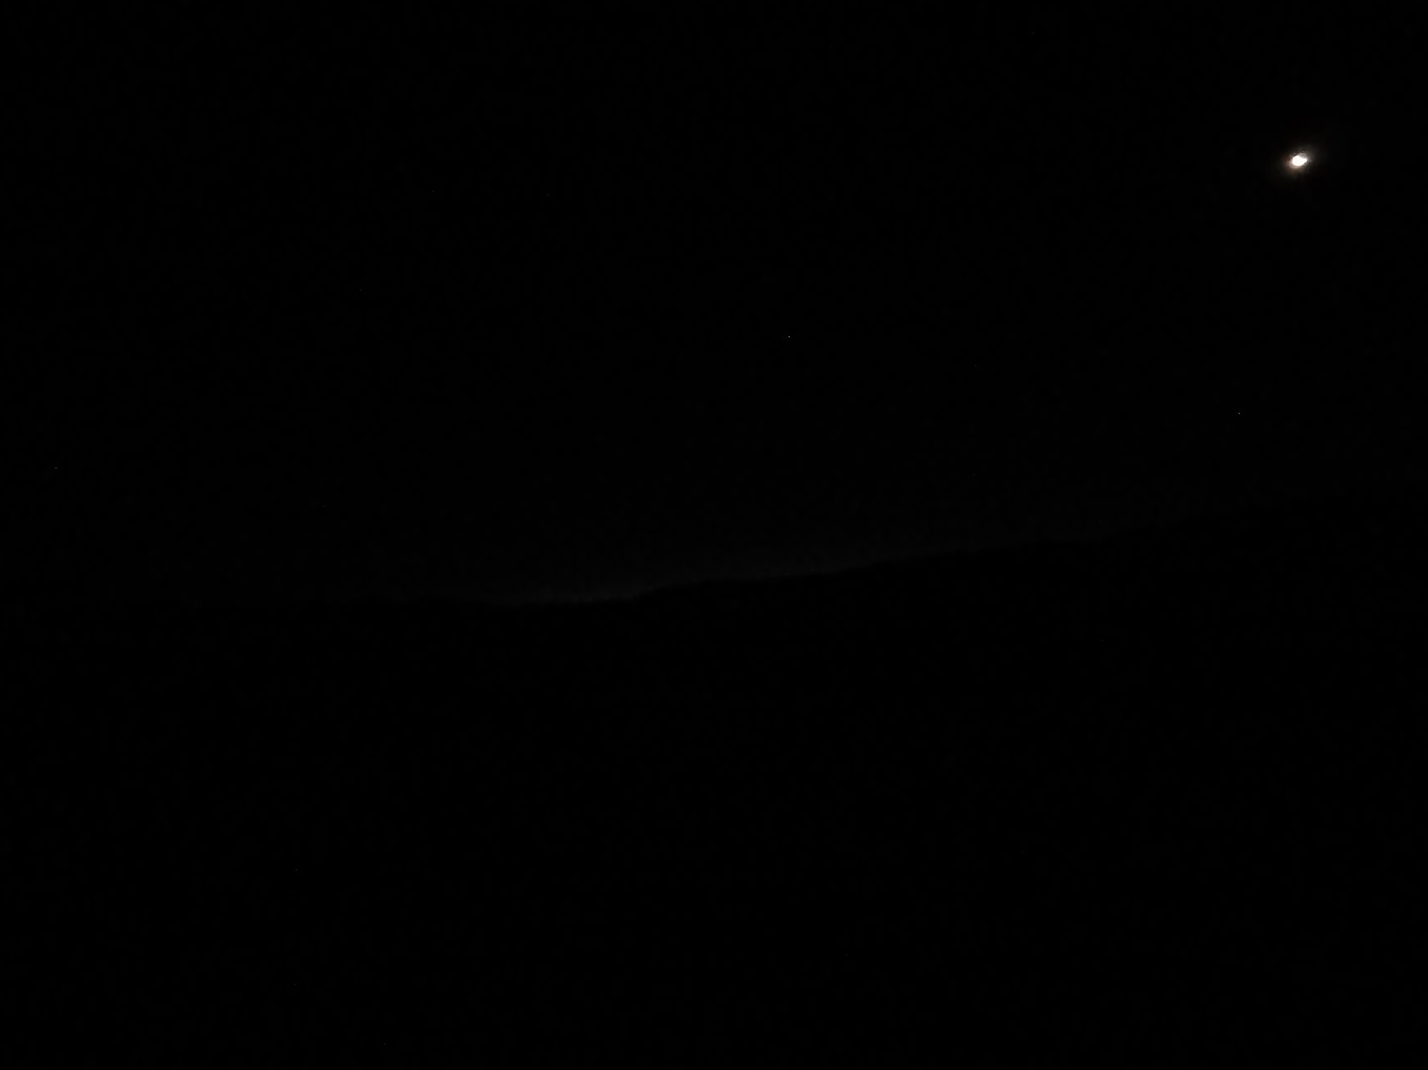
Hour : 03:28 Sun: -13,7º

Slide 17
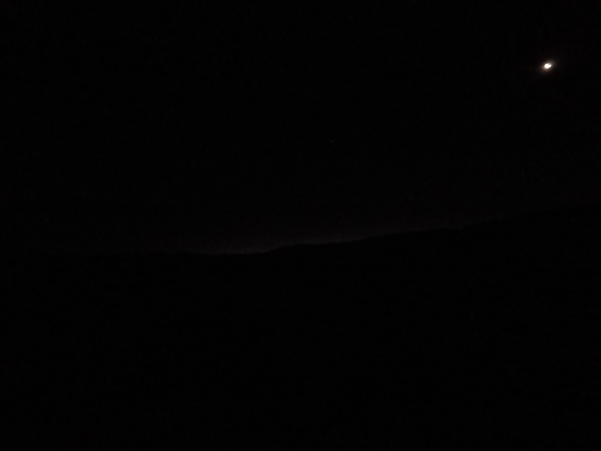
Hour : 03:29 Sun: -13,6º

Slide 18
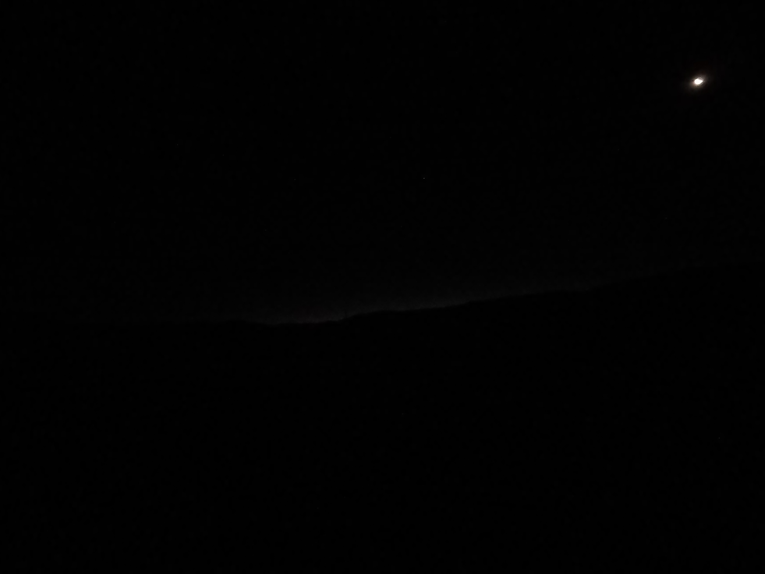
Hour : 03:30 Sun: -13,5º

Slide 19
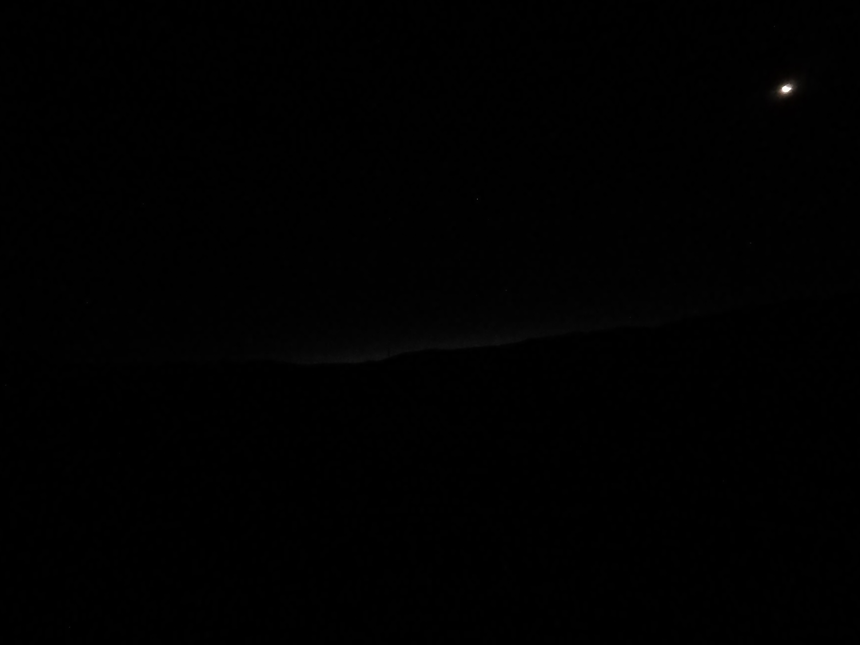
Hour : 03:31 Sun: -13,3º

Slide 20
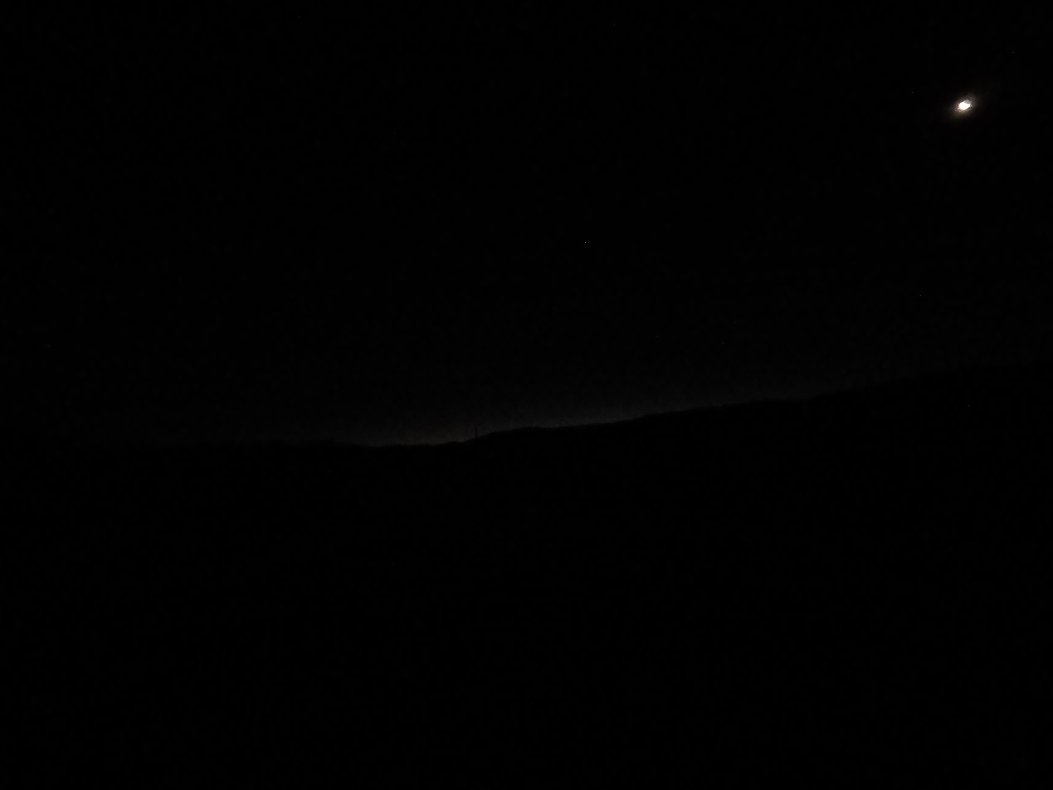
Hour : 03:32 Sun: -13,2º

Slide 21
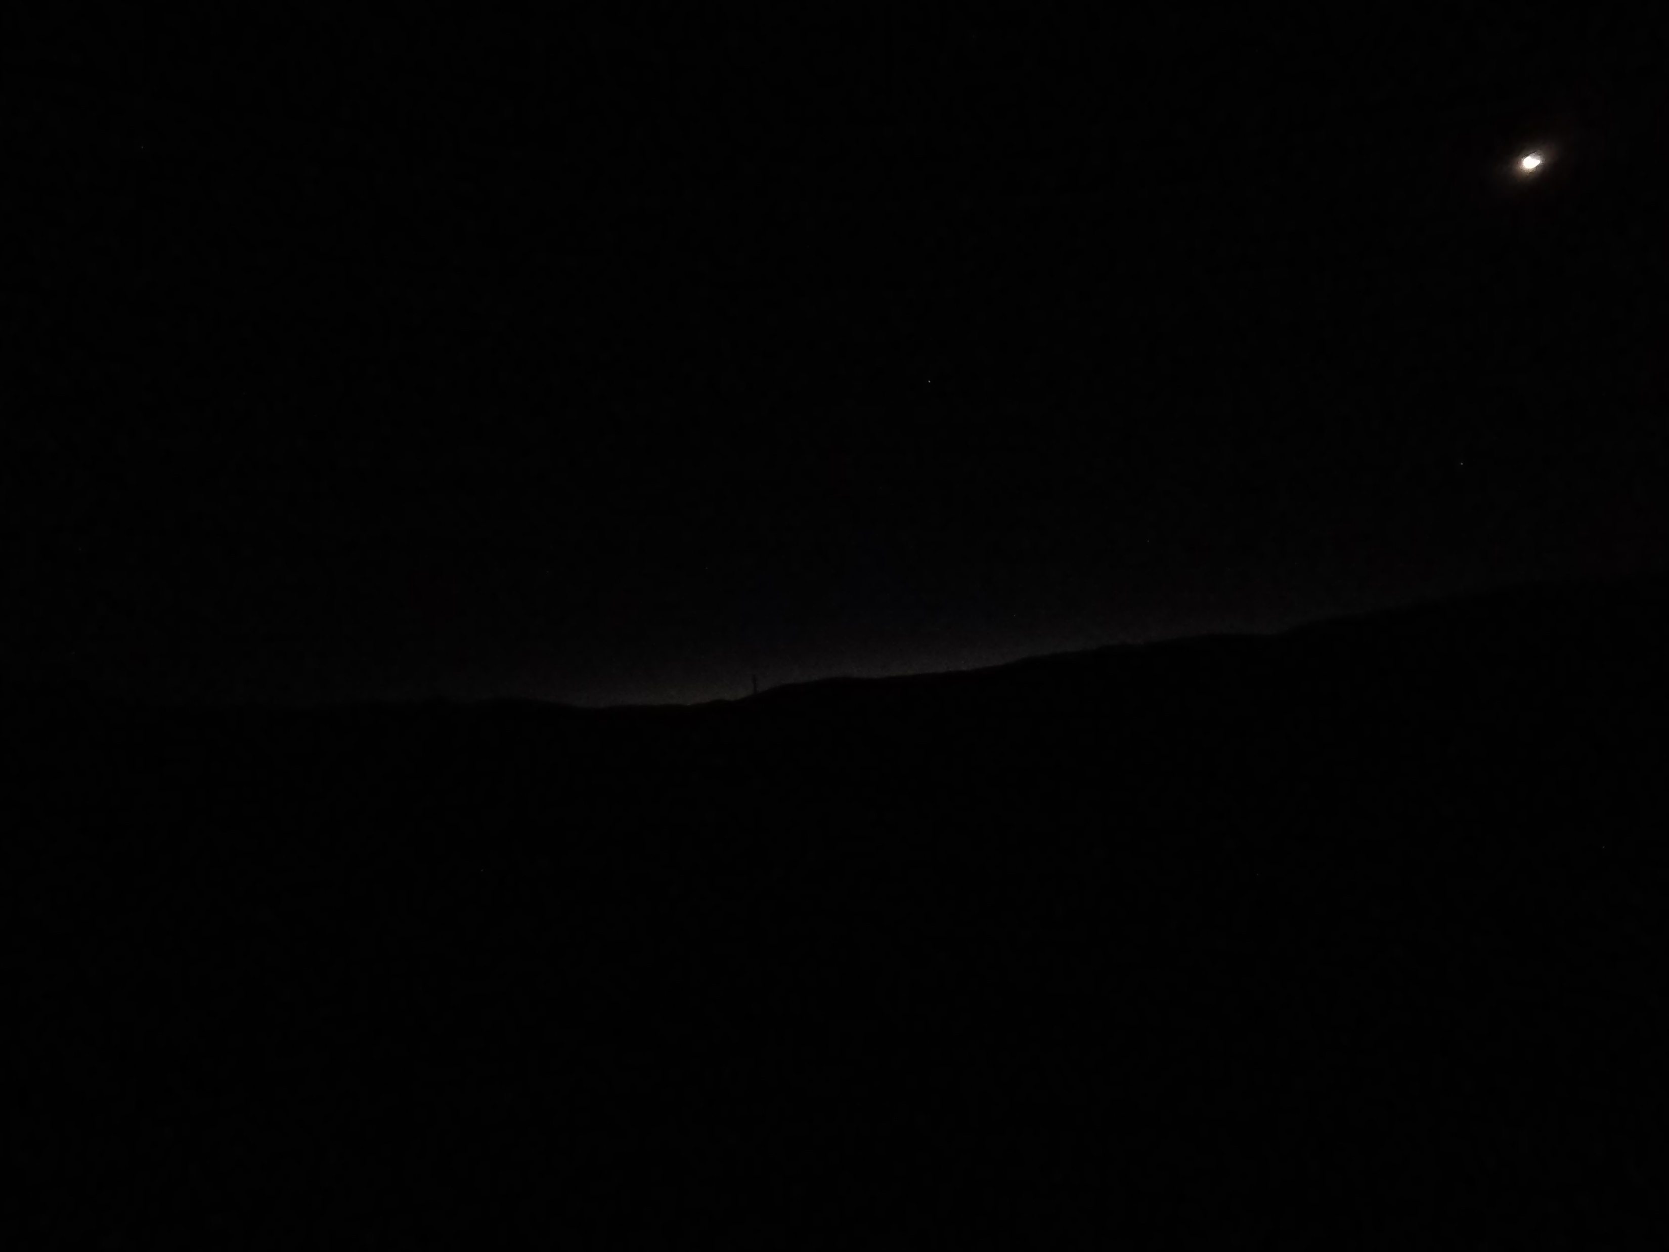
Hour : 03:33 Sun: -13,1º

Slide 22
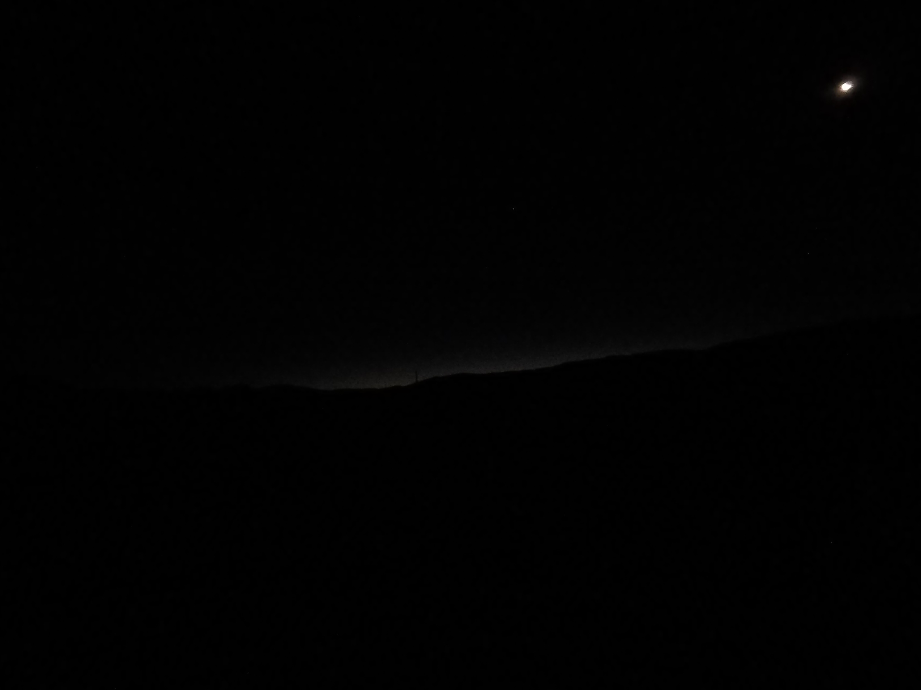
Hour : 03:34 Sun: -12,9º

Slide 23
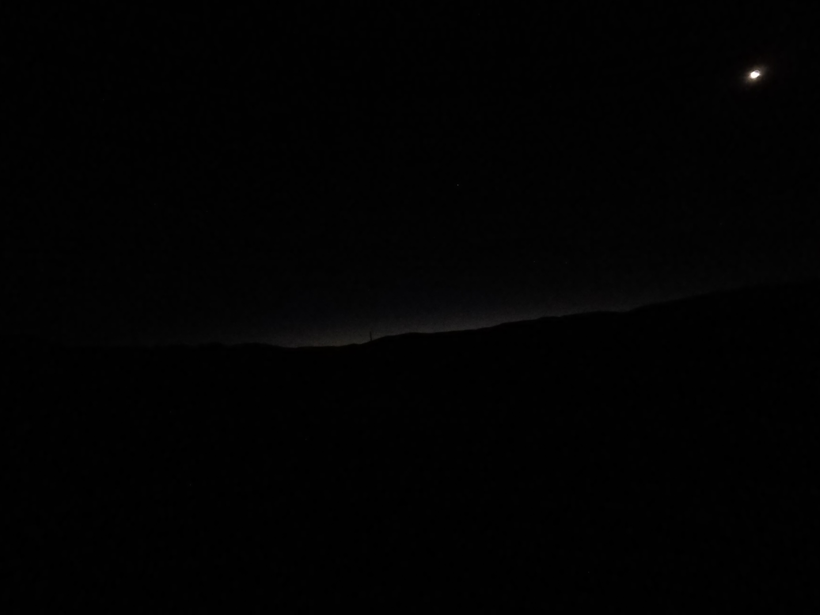
Imsak time
41 minutes after Diyanet and Mwl
Hour : 03:35 Sun: -12,8º

Slide 24
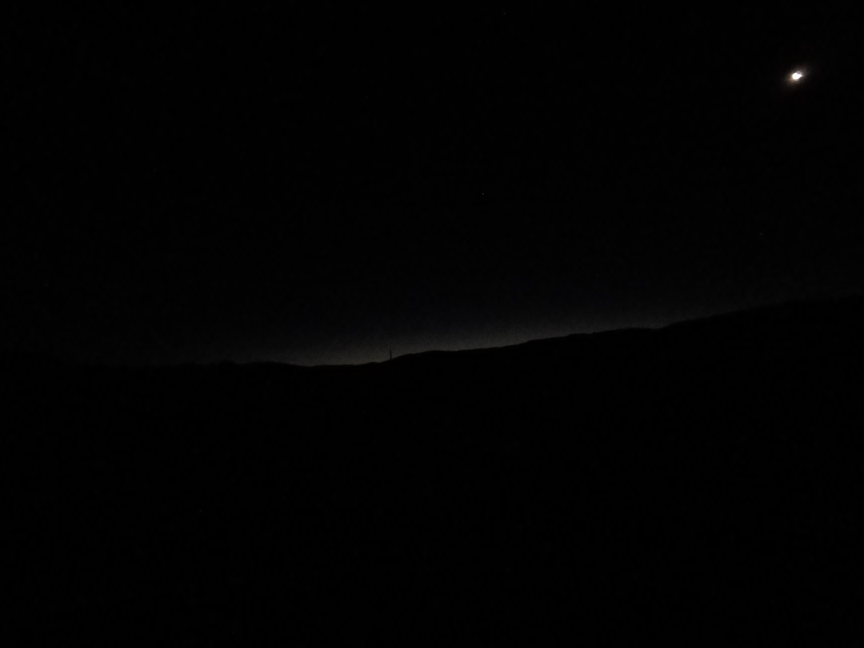
Hour : 03:36 Sun: -12,7º

Slide 25
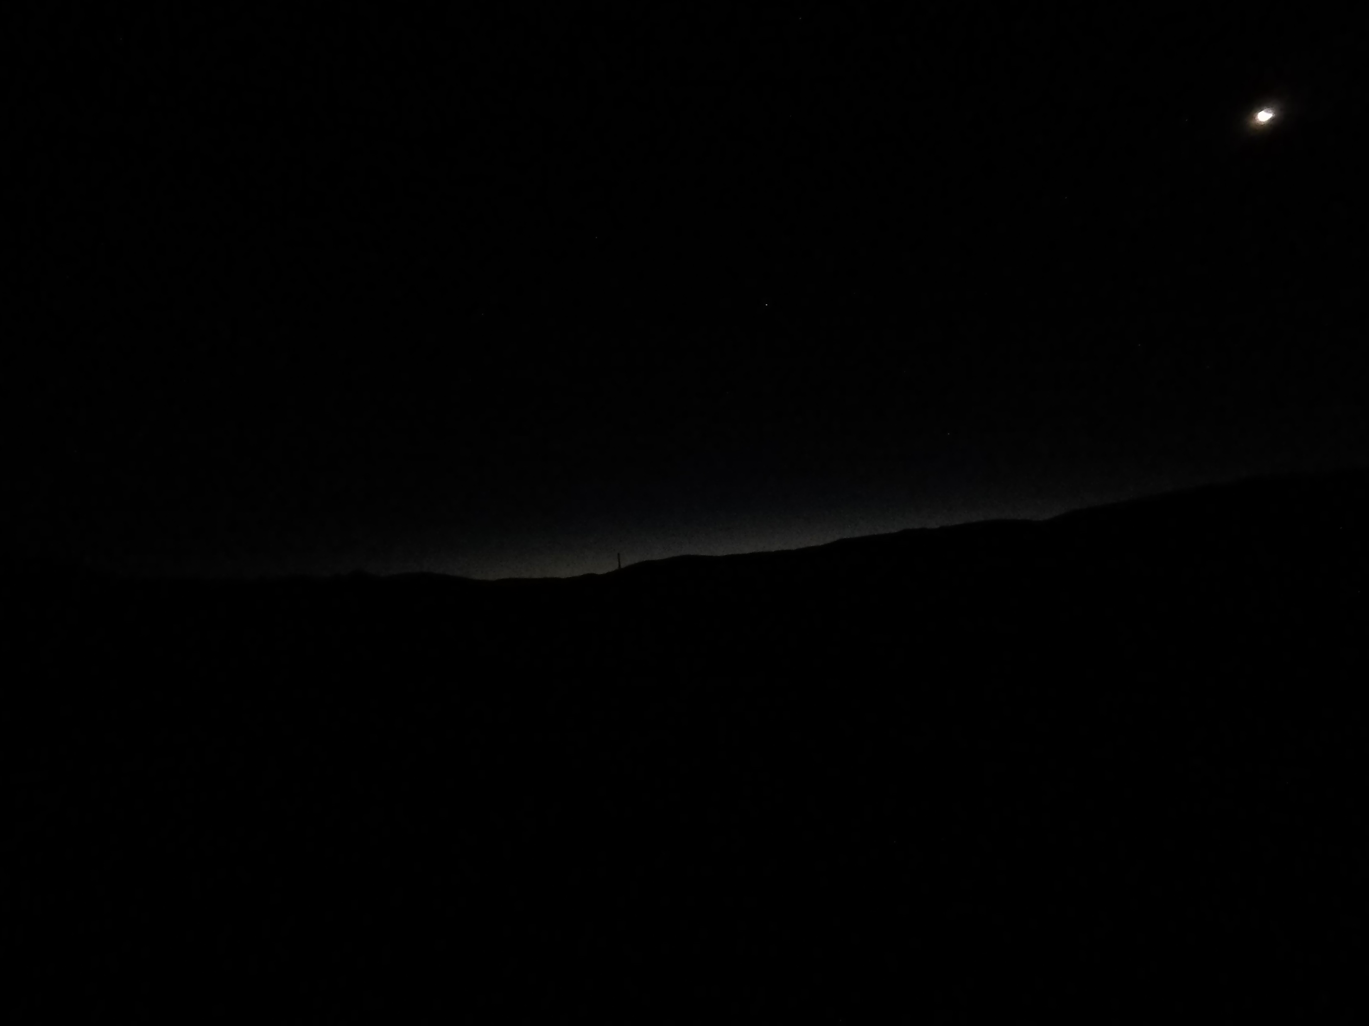
Hour : 03:37 Sun: -12,5º

Slide 26
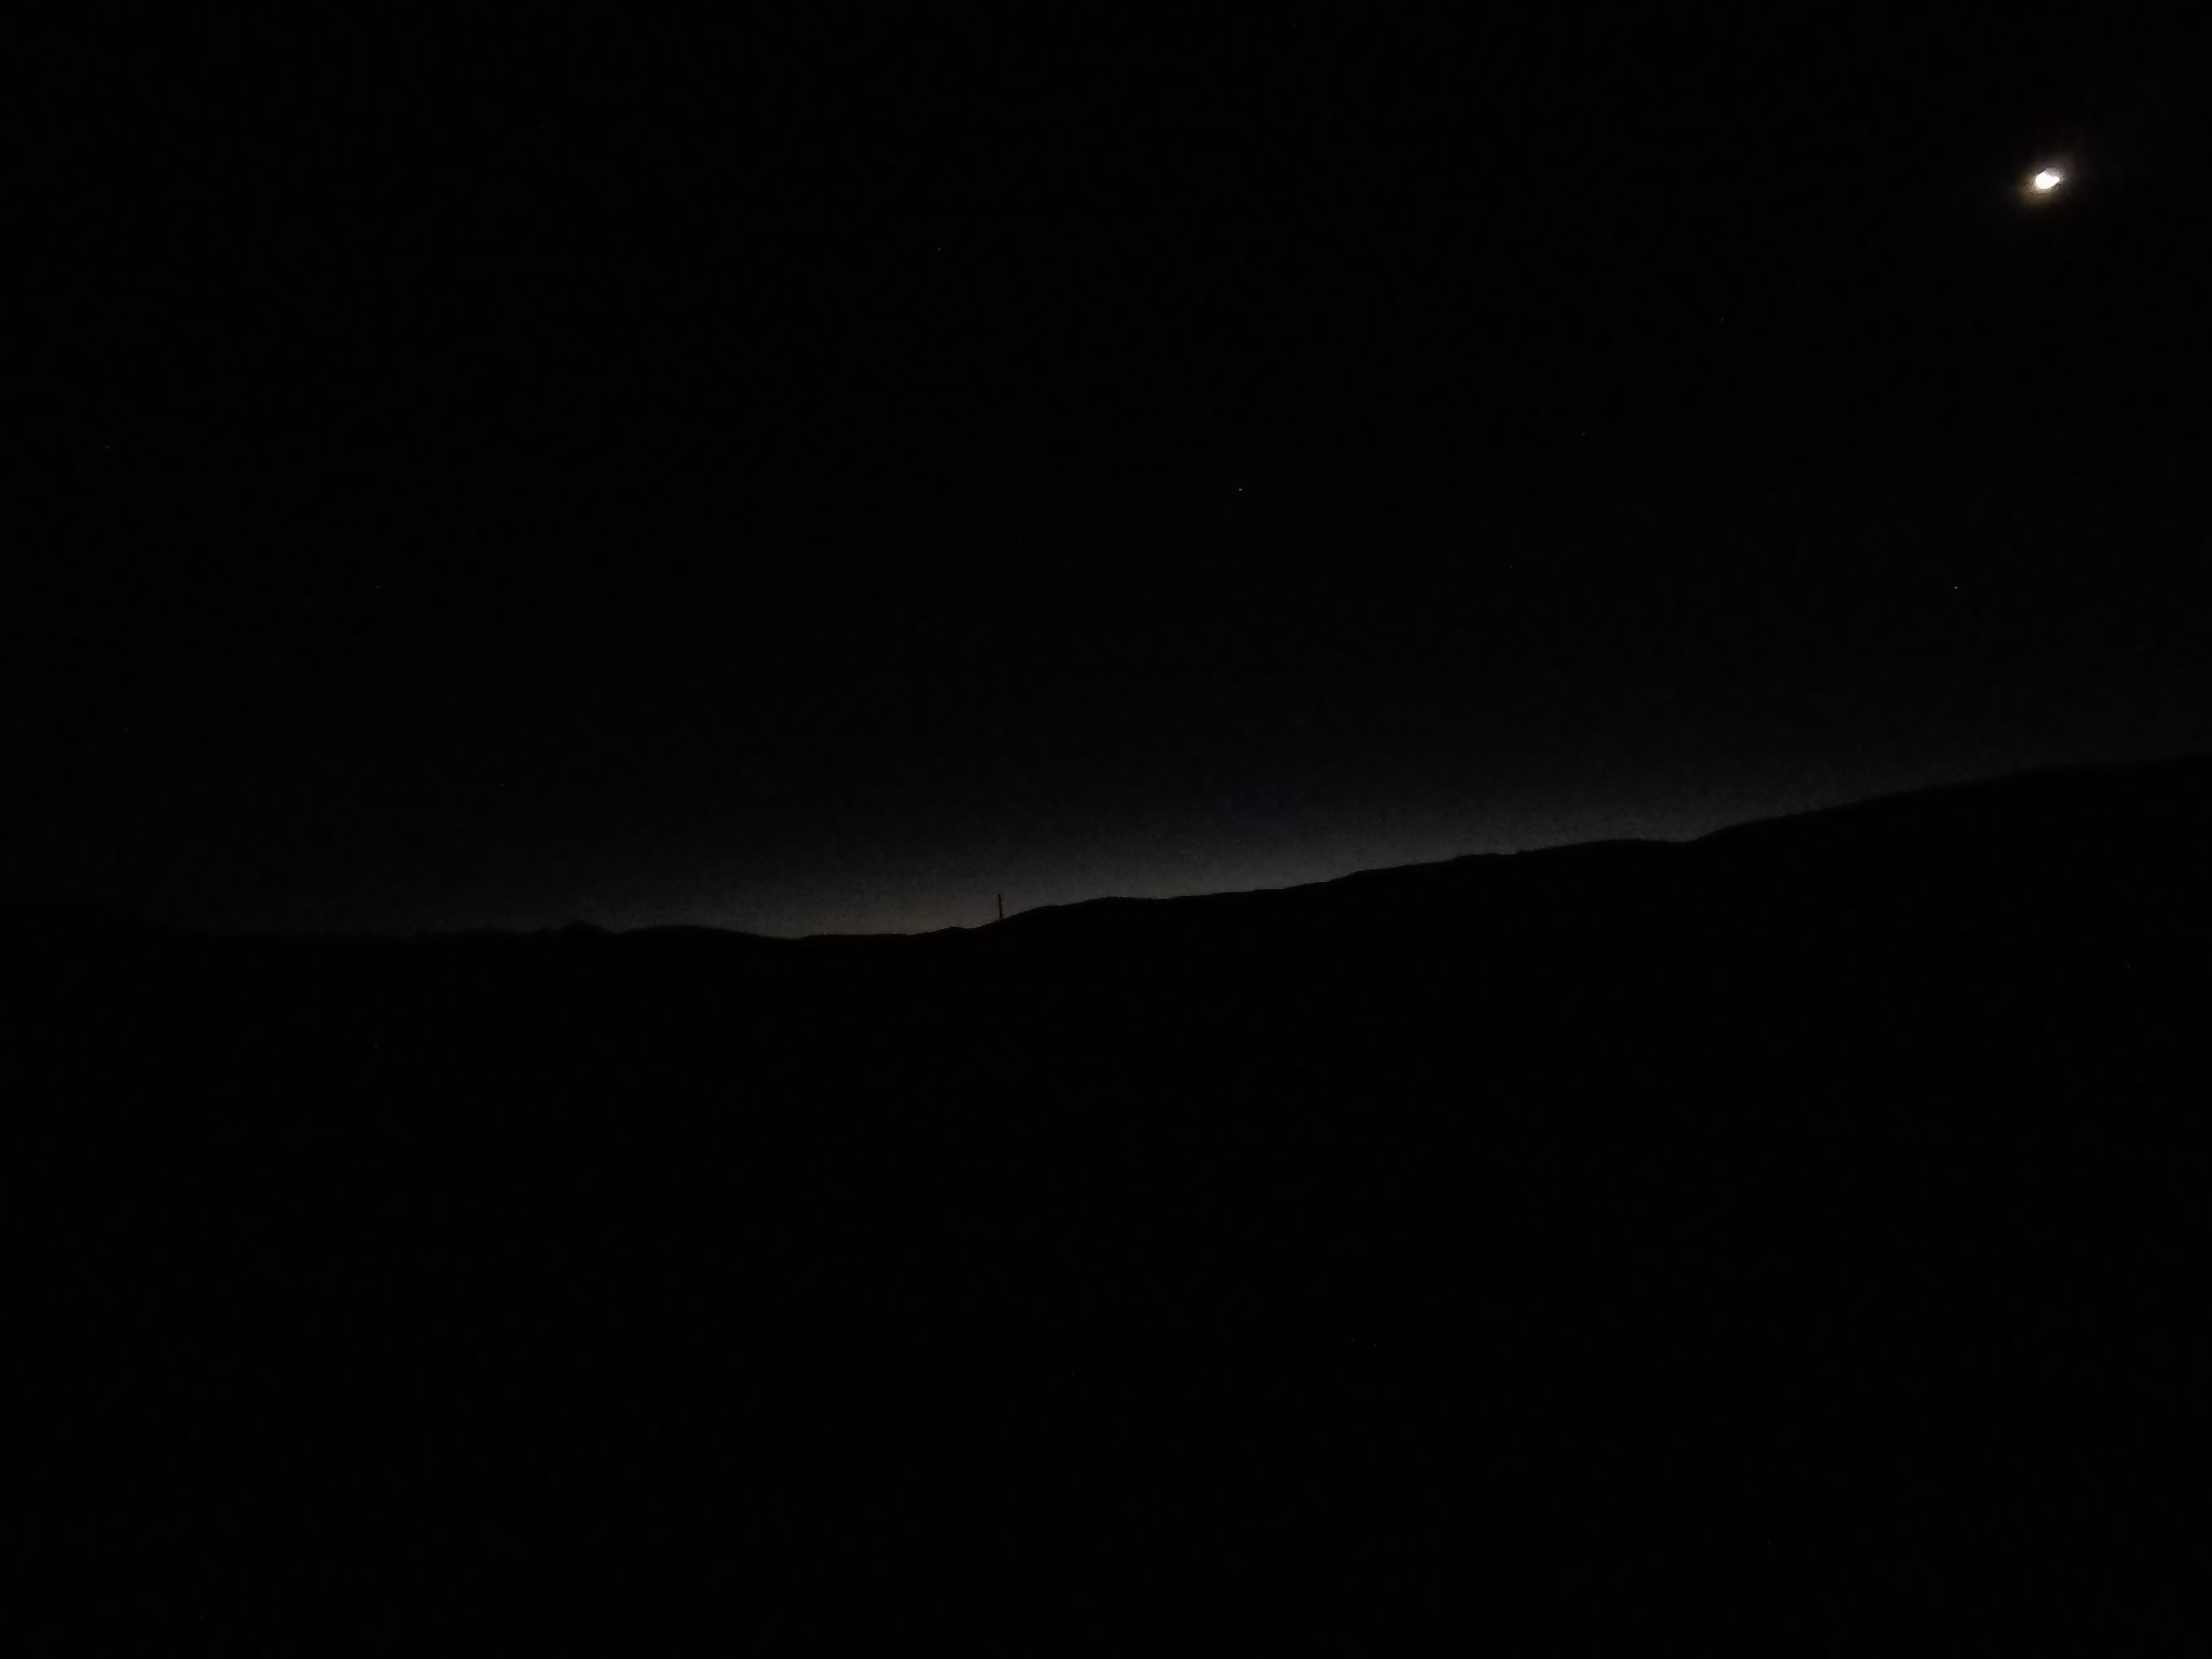
Hour : 03:38 Sun: -12,4º

Slide 27
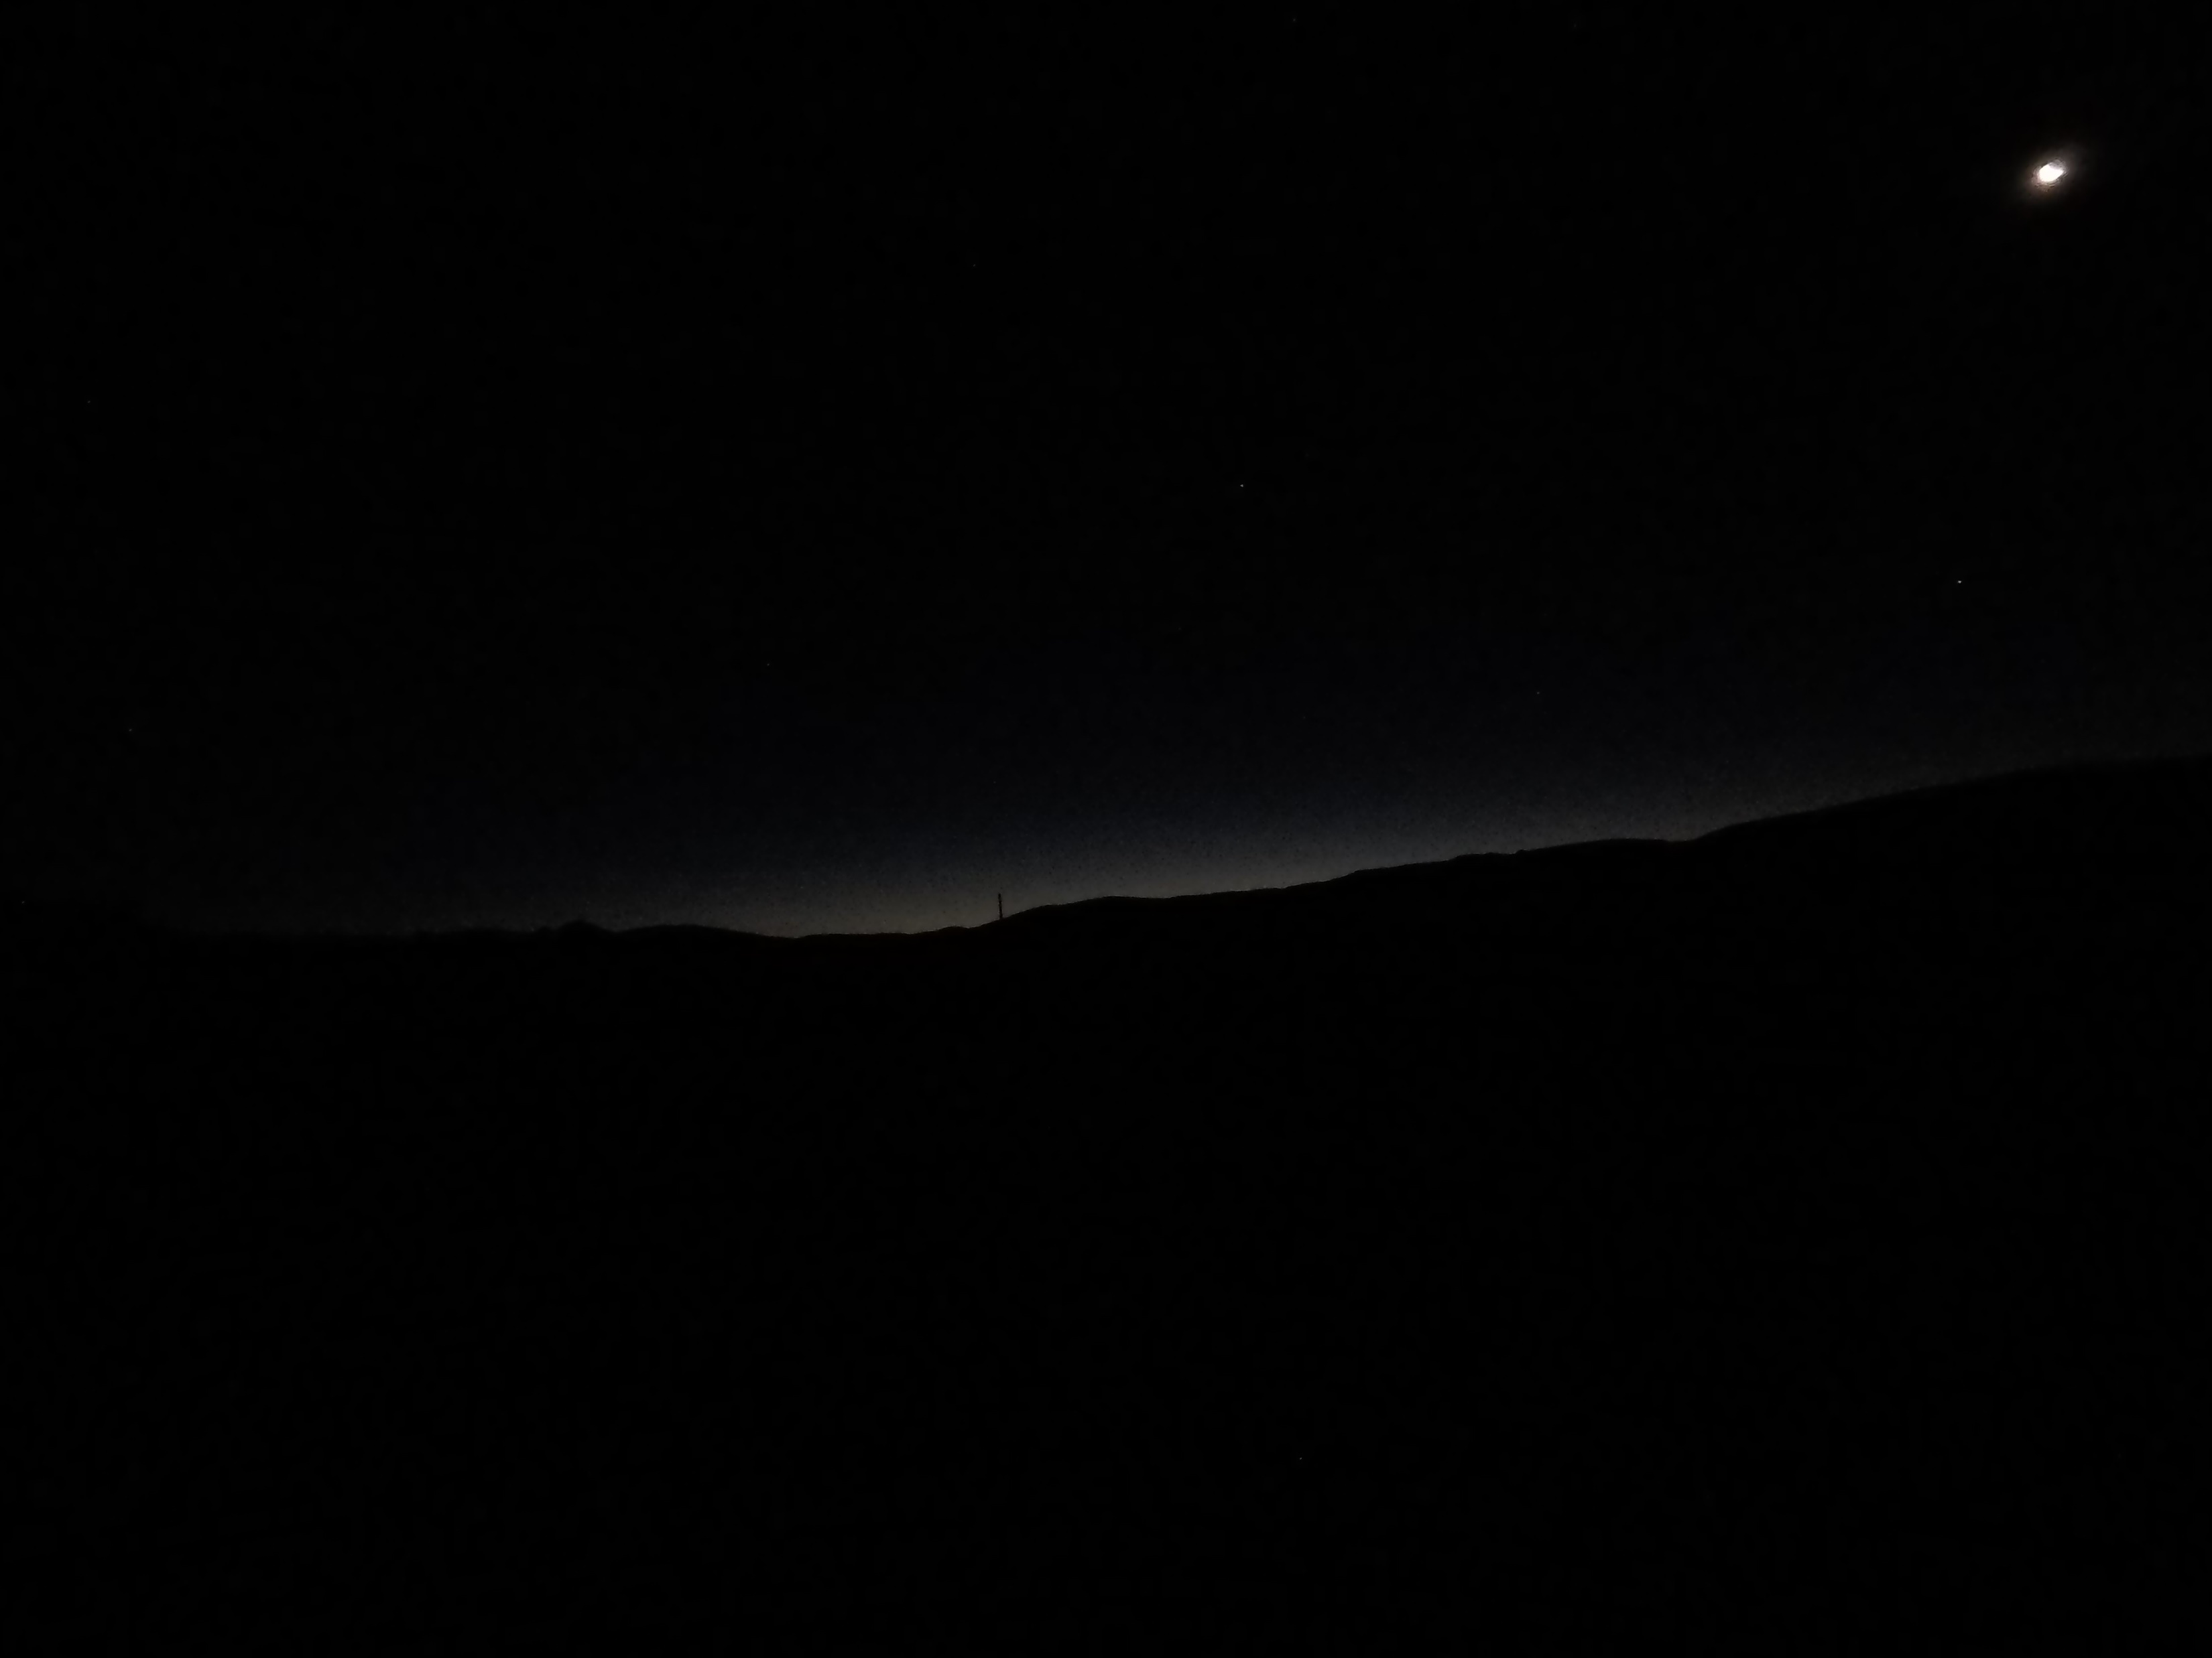
Hour : 03:39 Sun: -12,2º

Slide 28
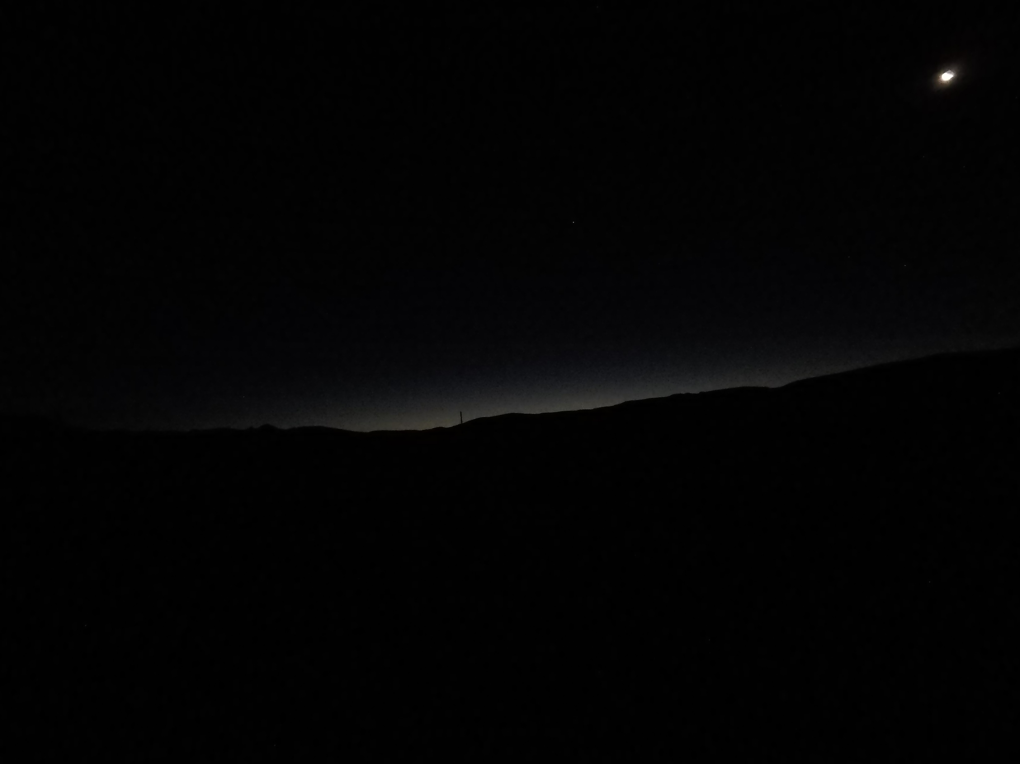
Hour : 03:40 Sun: -12,1º

Slide 29
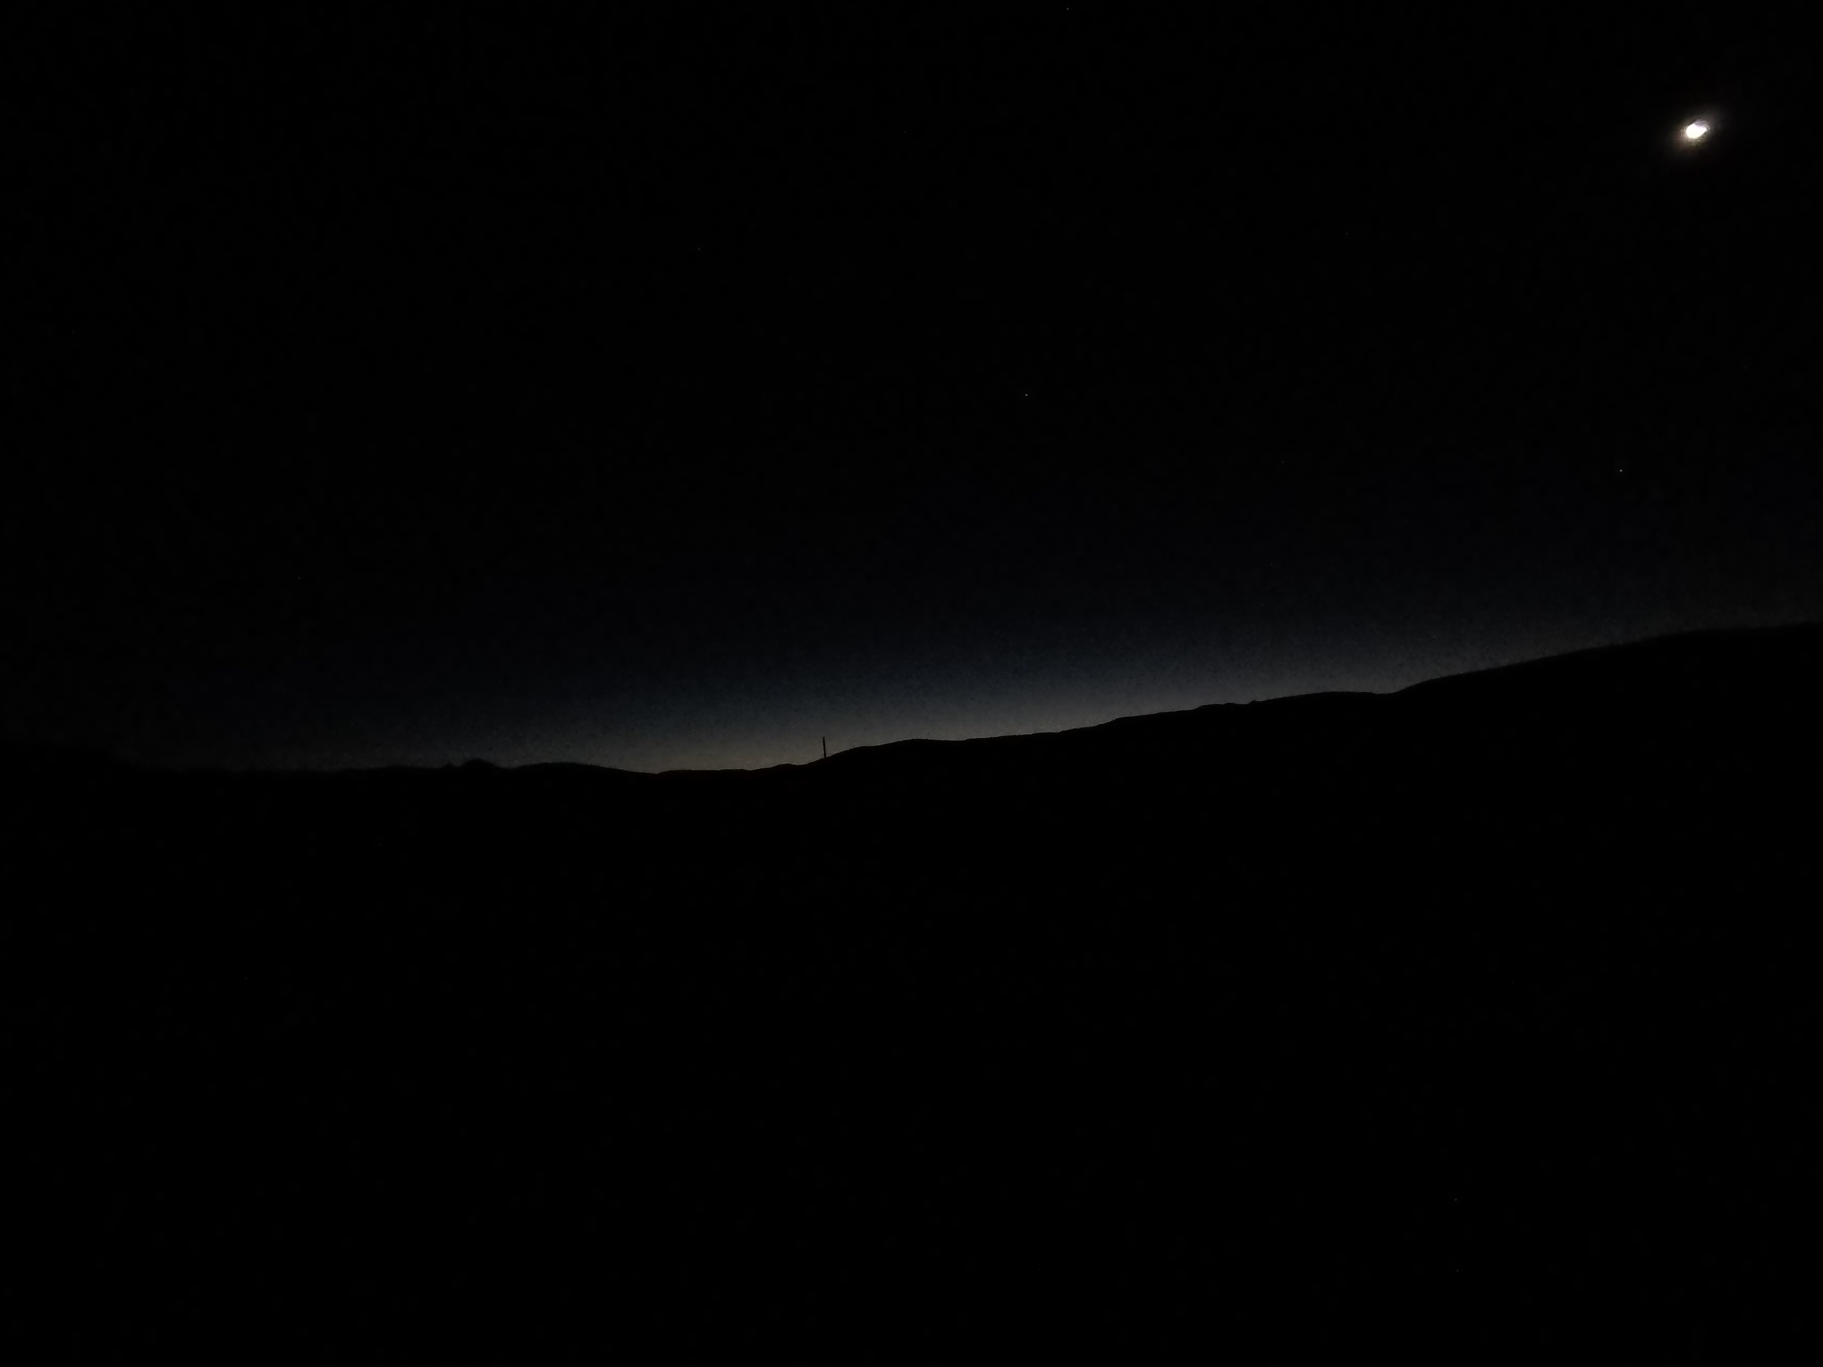
Nautical Twilight
Hour : 03:41 Sun: 12,0º

Slide 30
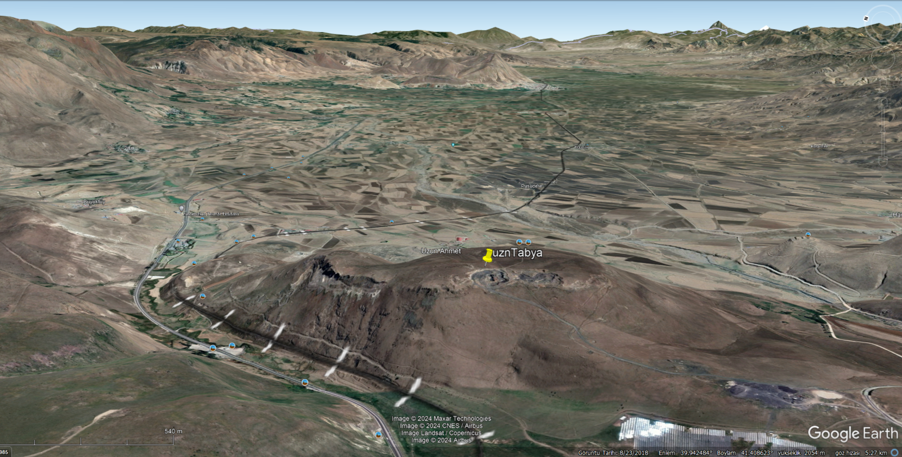
Erzurum Uzunahmet Fort Imsak Observation-2022
Altitude:2080 Plain altitude 1700-1800
Date: June 7, 2022

Slide 31

Diyanet & Mwl imsak 02:44
12 minutes later the area is pitch dark
Hour: 2:56 Sun: -16,8°

Slide 32
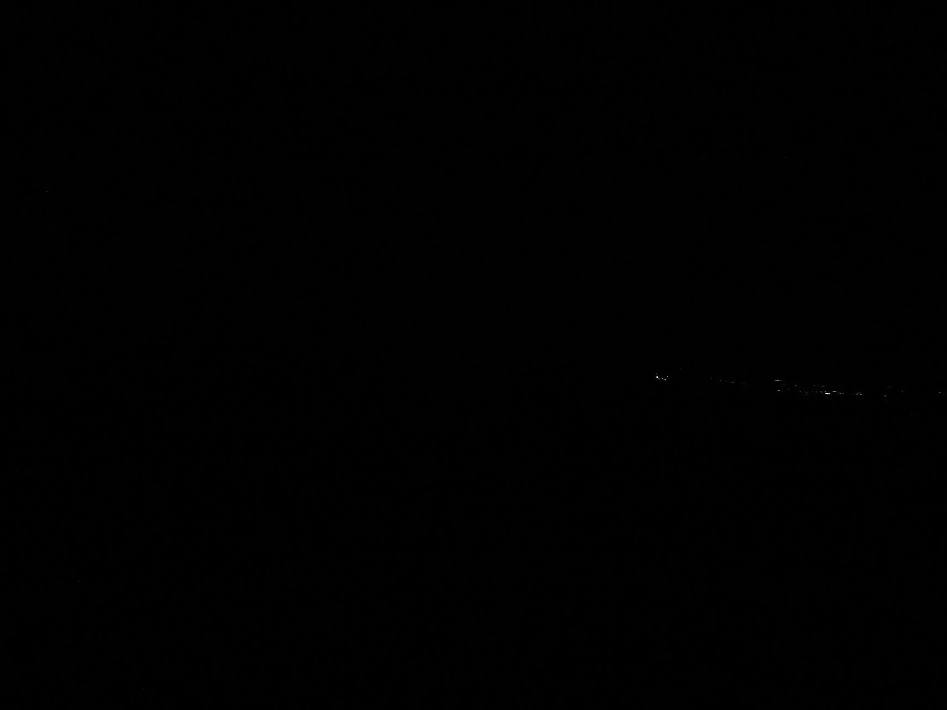
Hour: 2:57 Sun: -16,7°

Slide 33
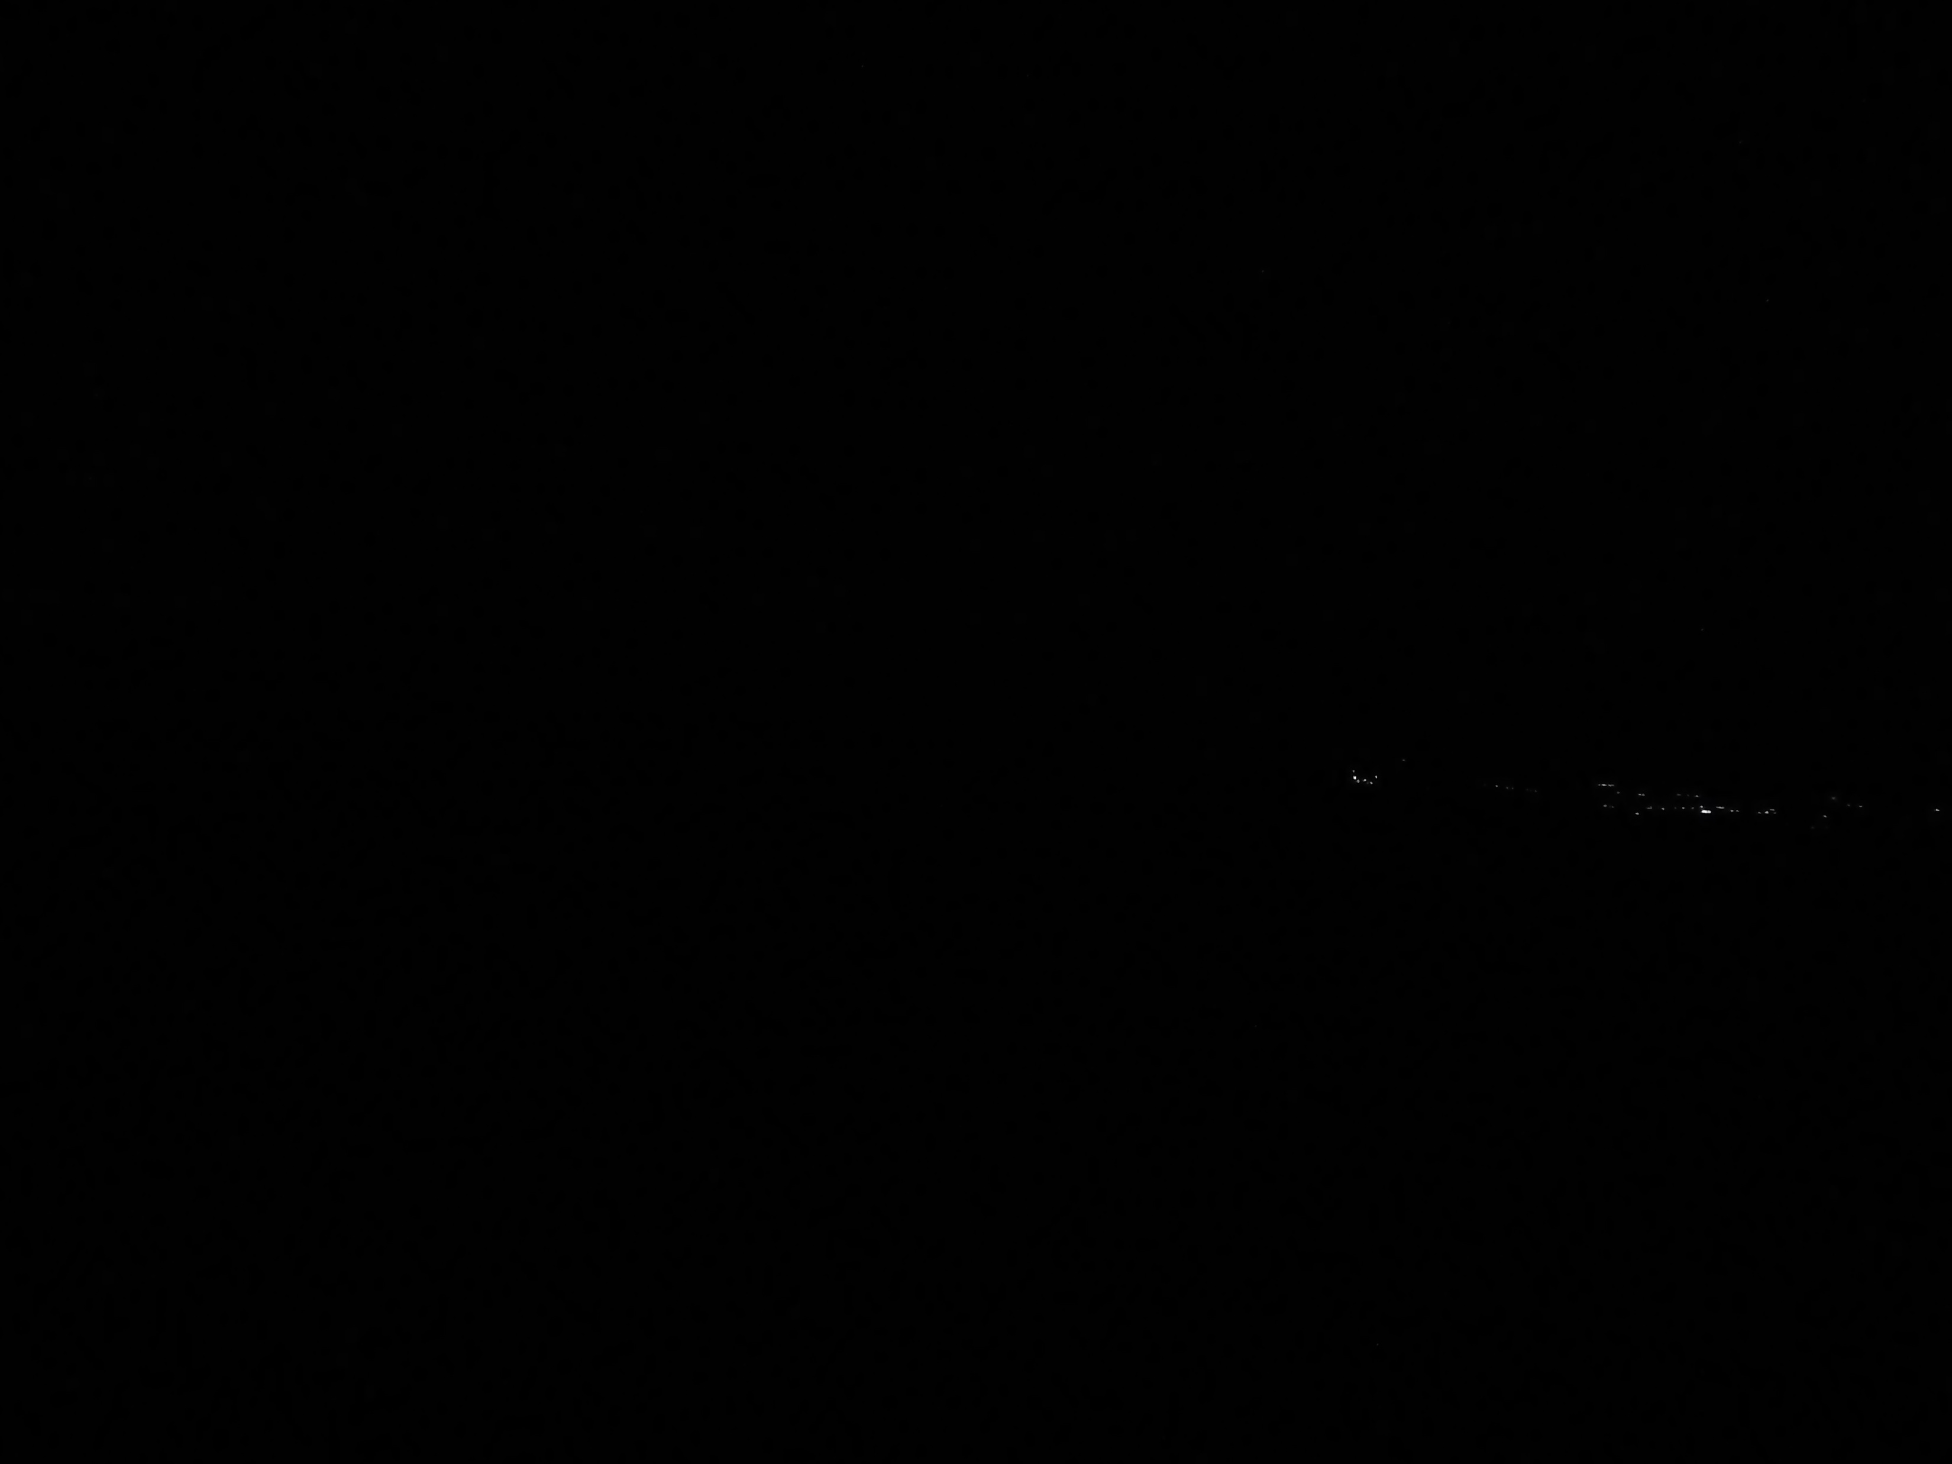
Hour: 2:57 Sun: -16,6°

Slide 34
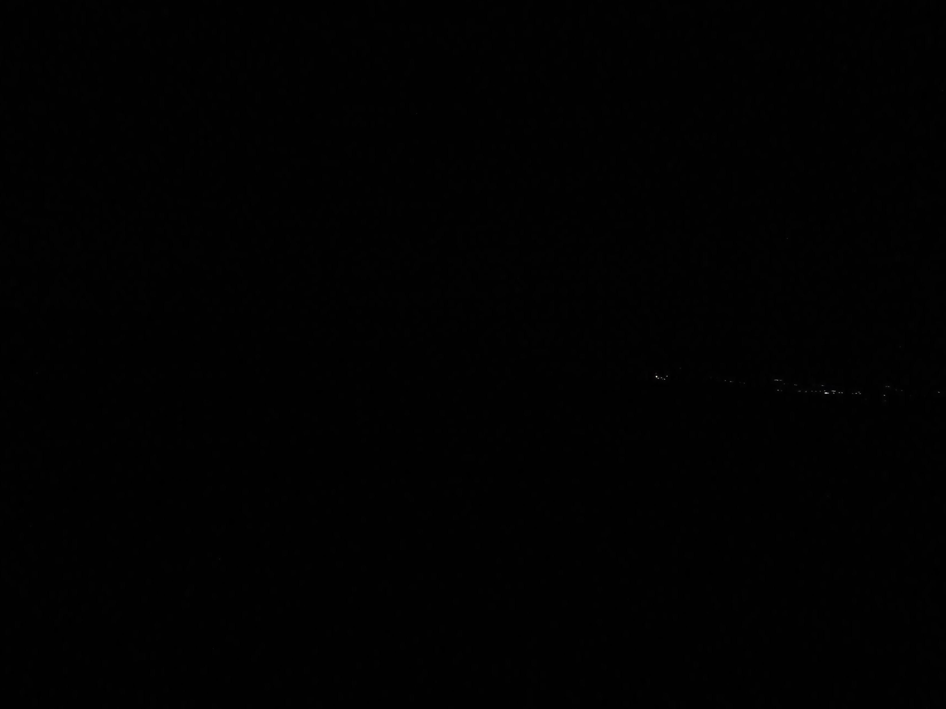
Hour: 2:58 Sun: -16,5°

Slide 35
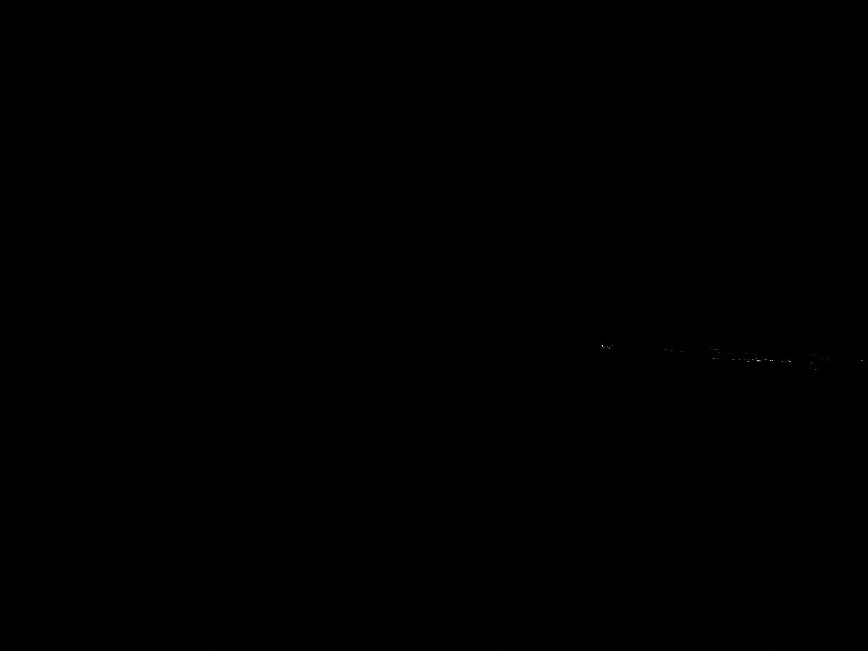
Hour: 2:59 Sun: -16,4°

Slide 36
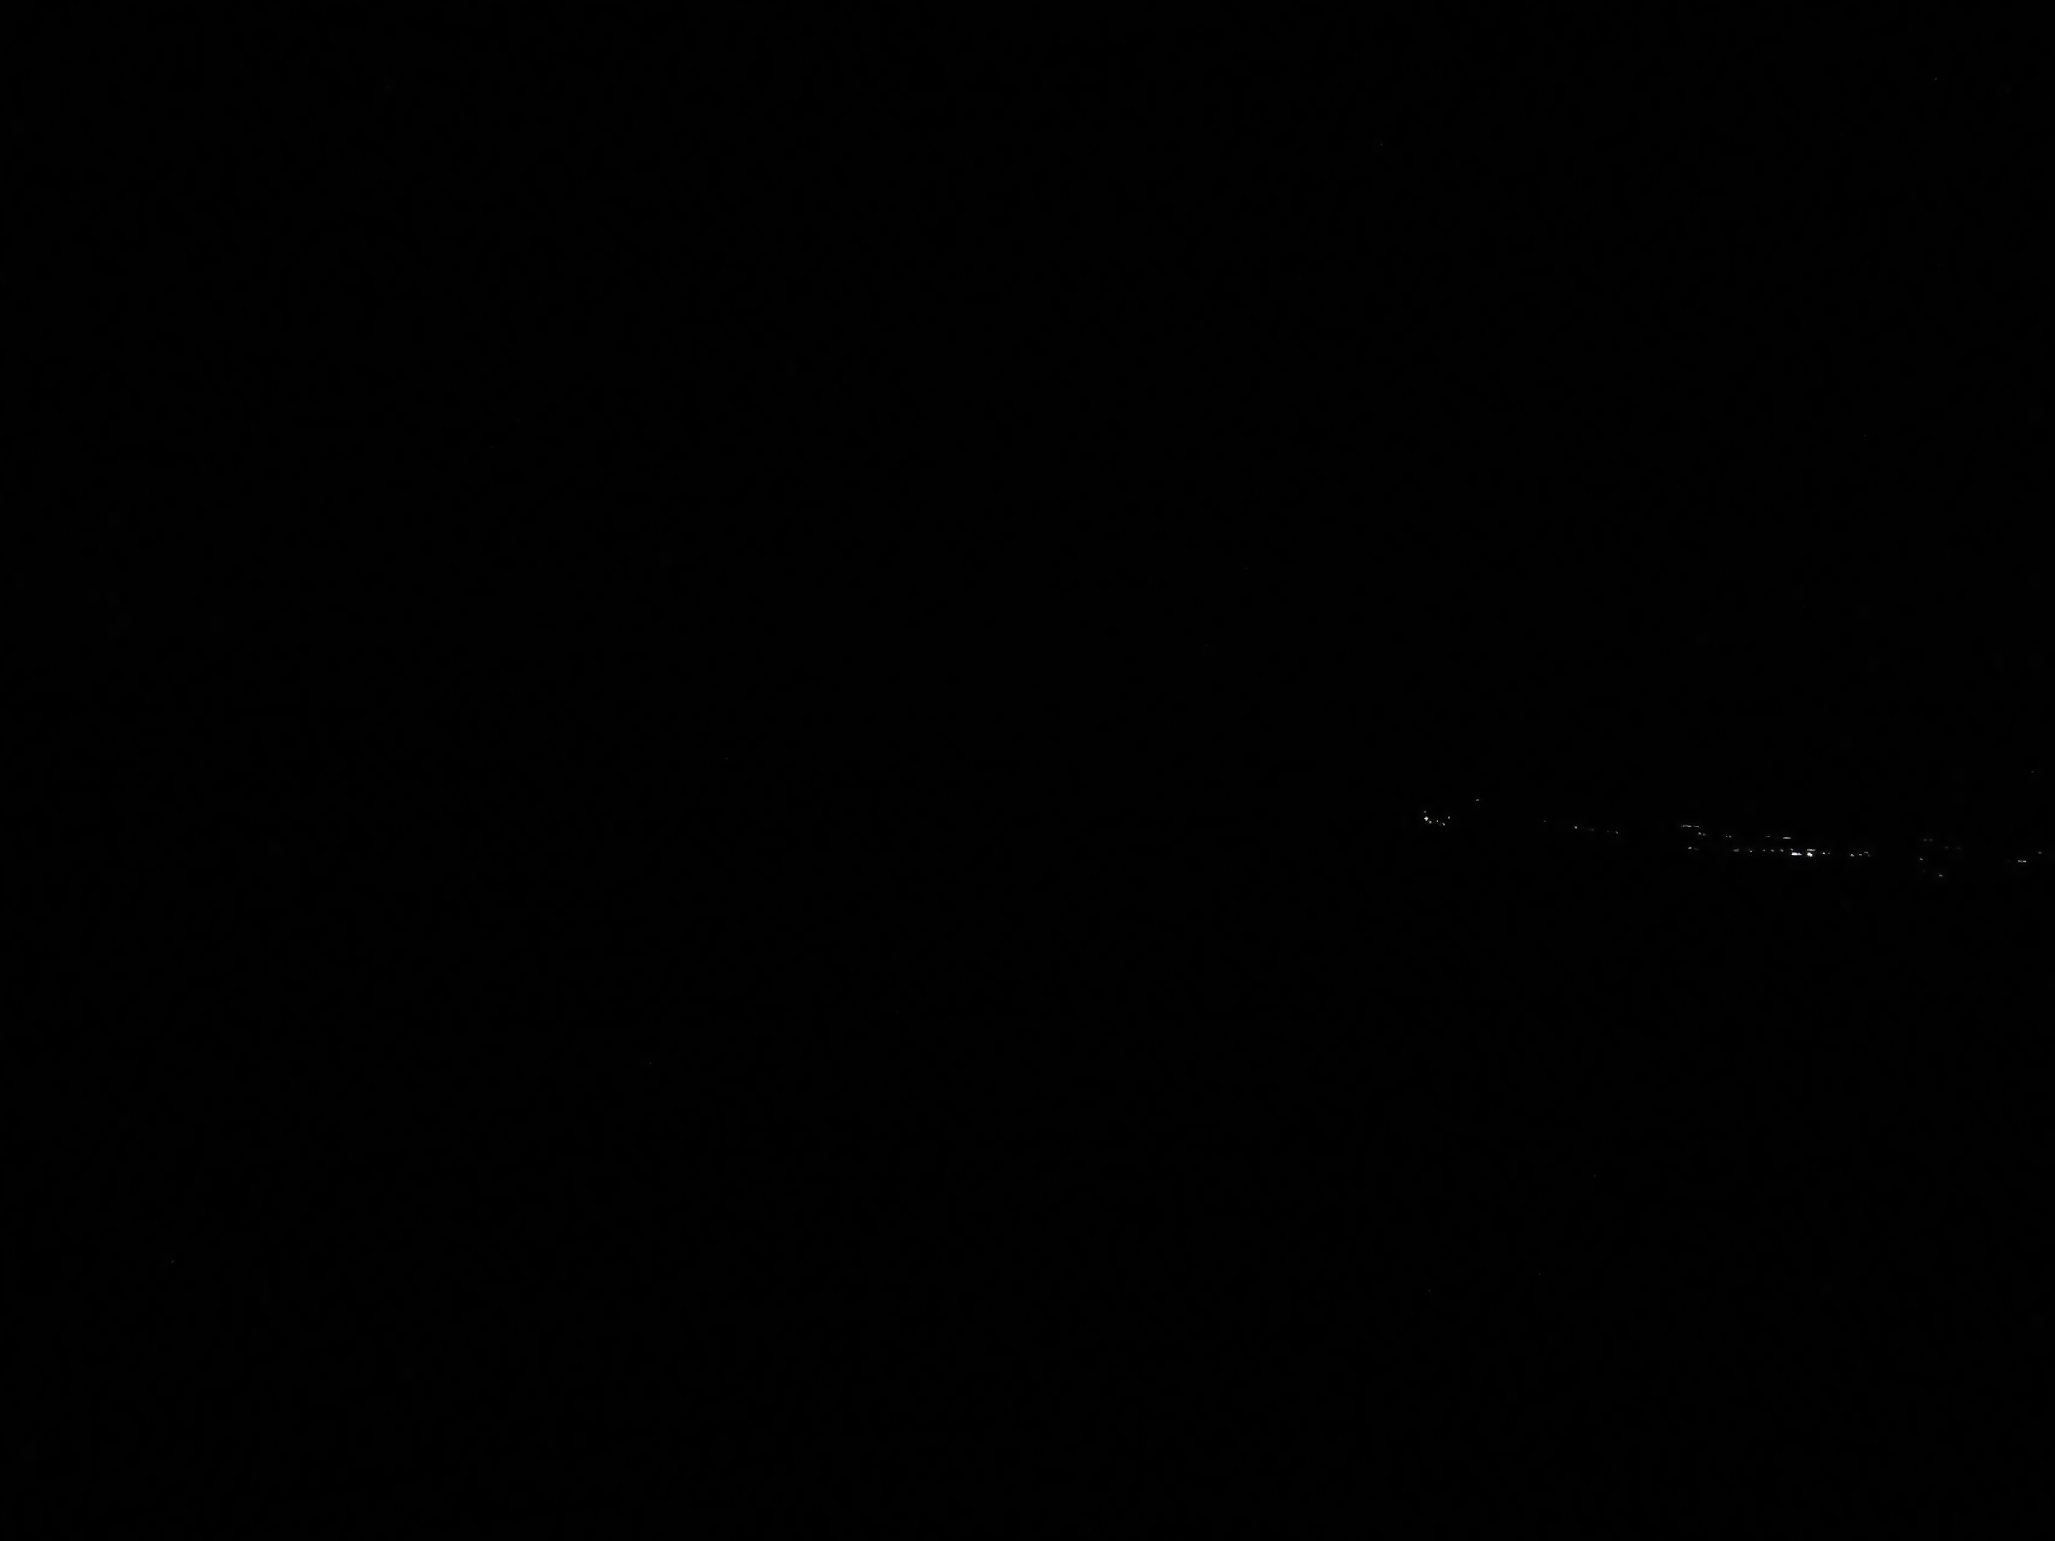
Hour: 3:00 Sun: -16,3°

Slide 37

Hour: 3:01 Sun: -16,2°

Slide 38
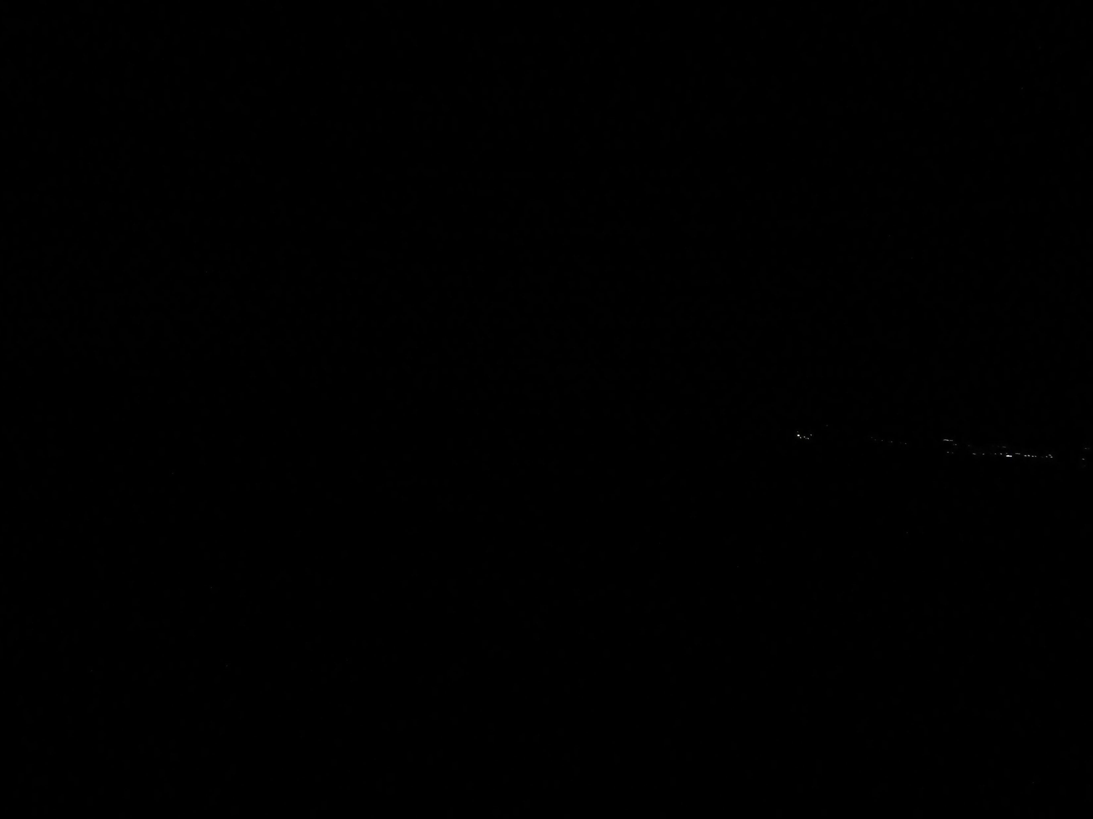
Hour: 3:02 Sun:-16,1°

Slide 39
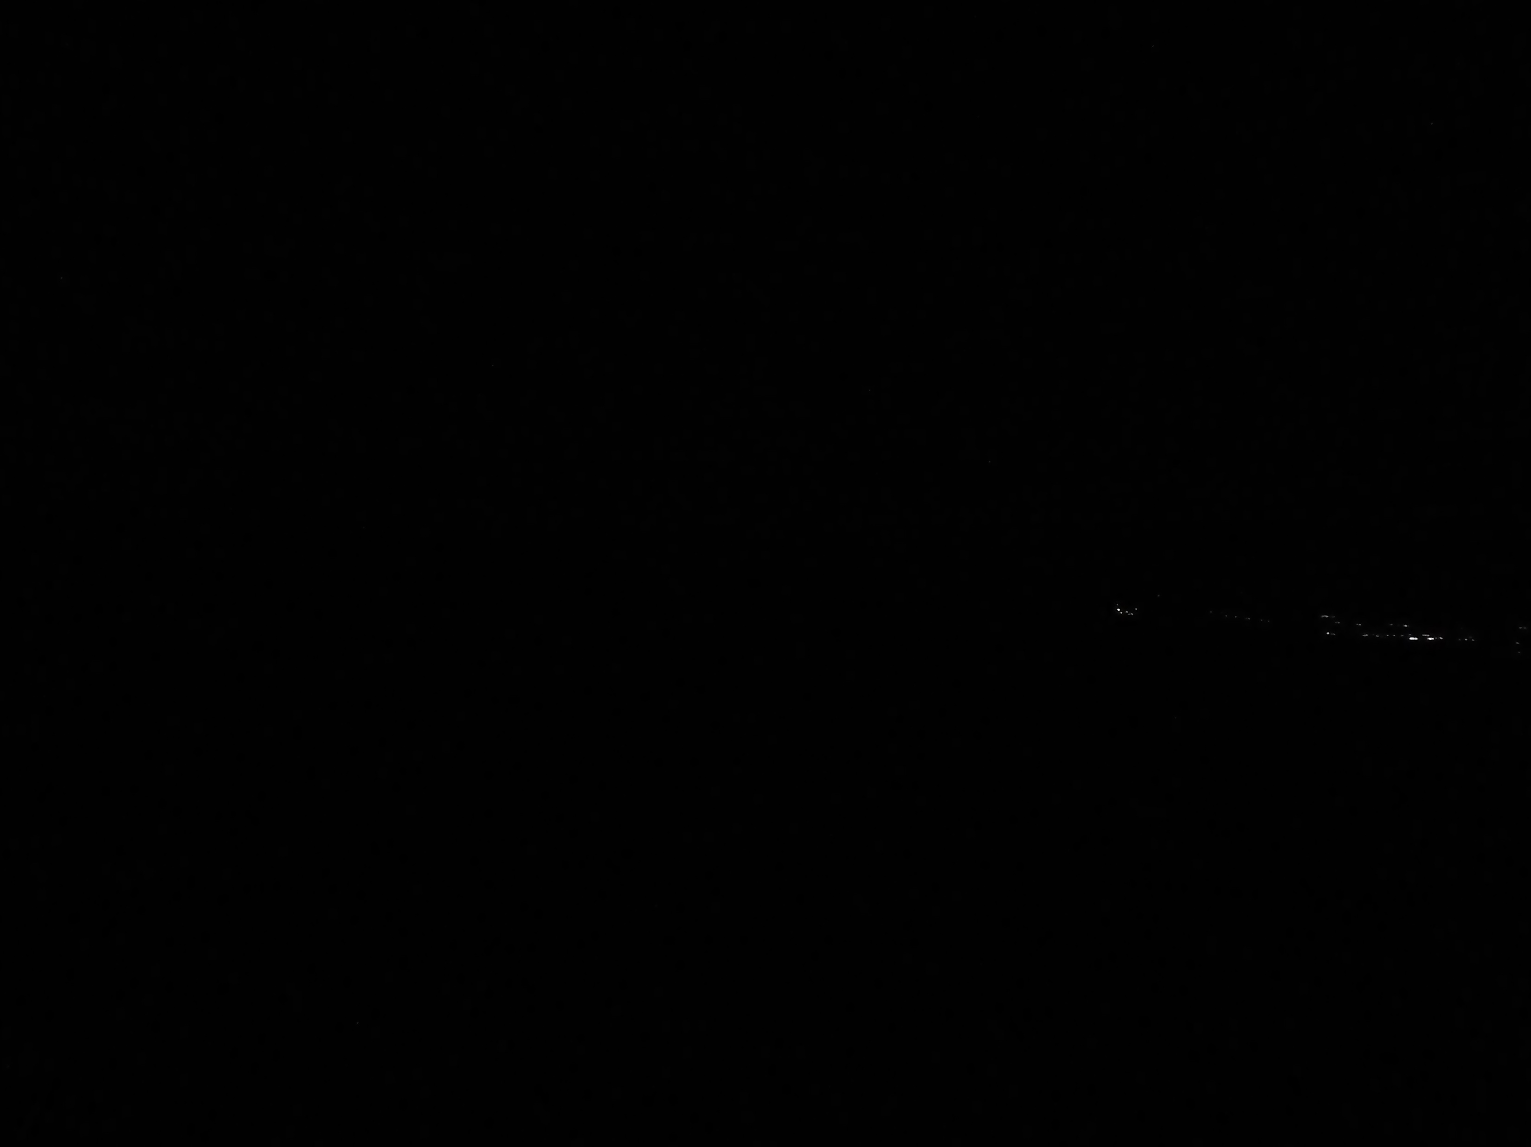
Hour: 3:02:30 Sun:-16,0°

Slide 40
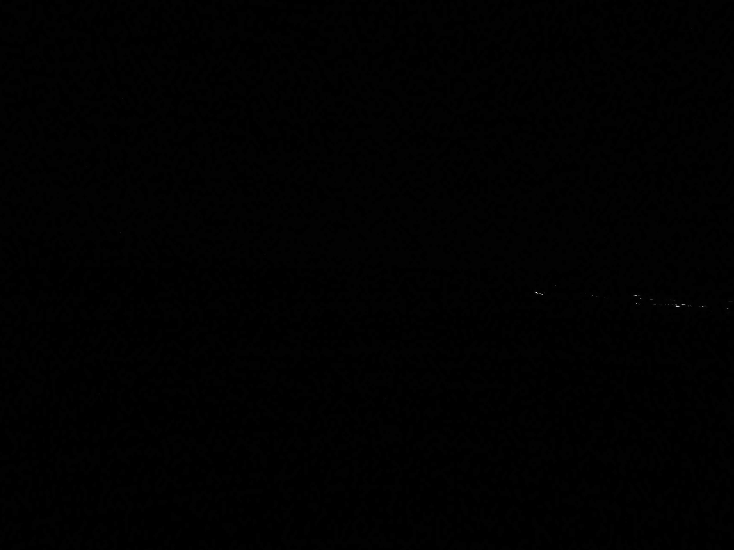
Hour: 3:03 Sun:-15,9°

Slide 41
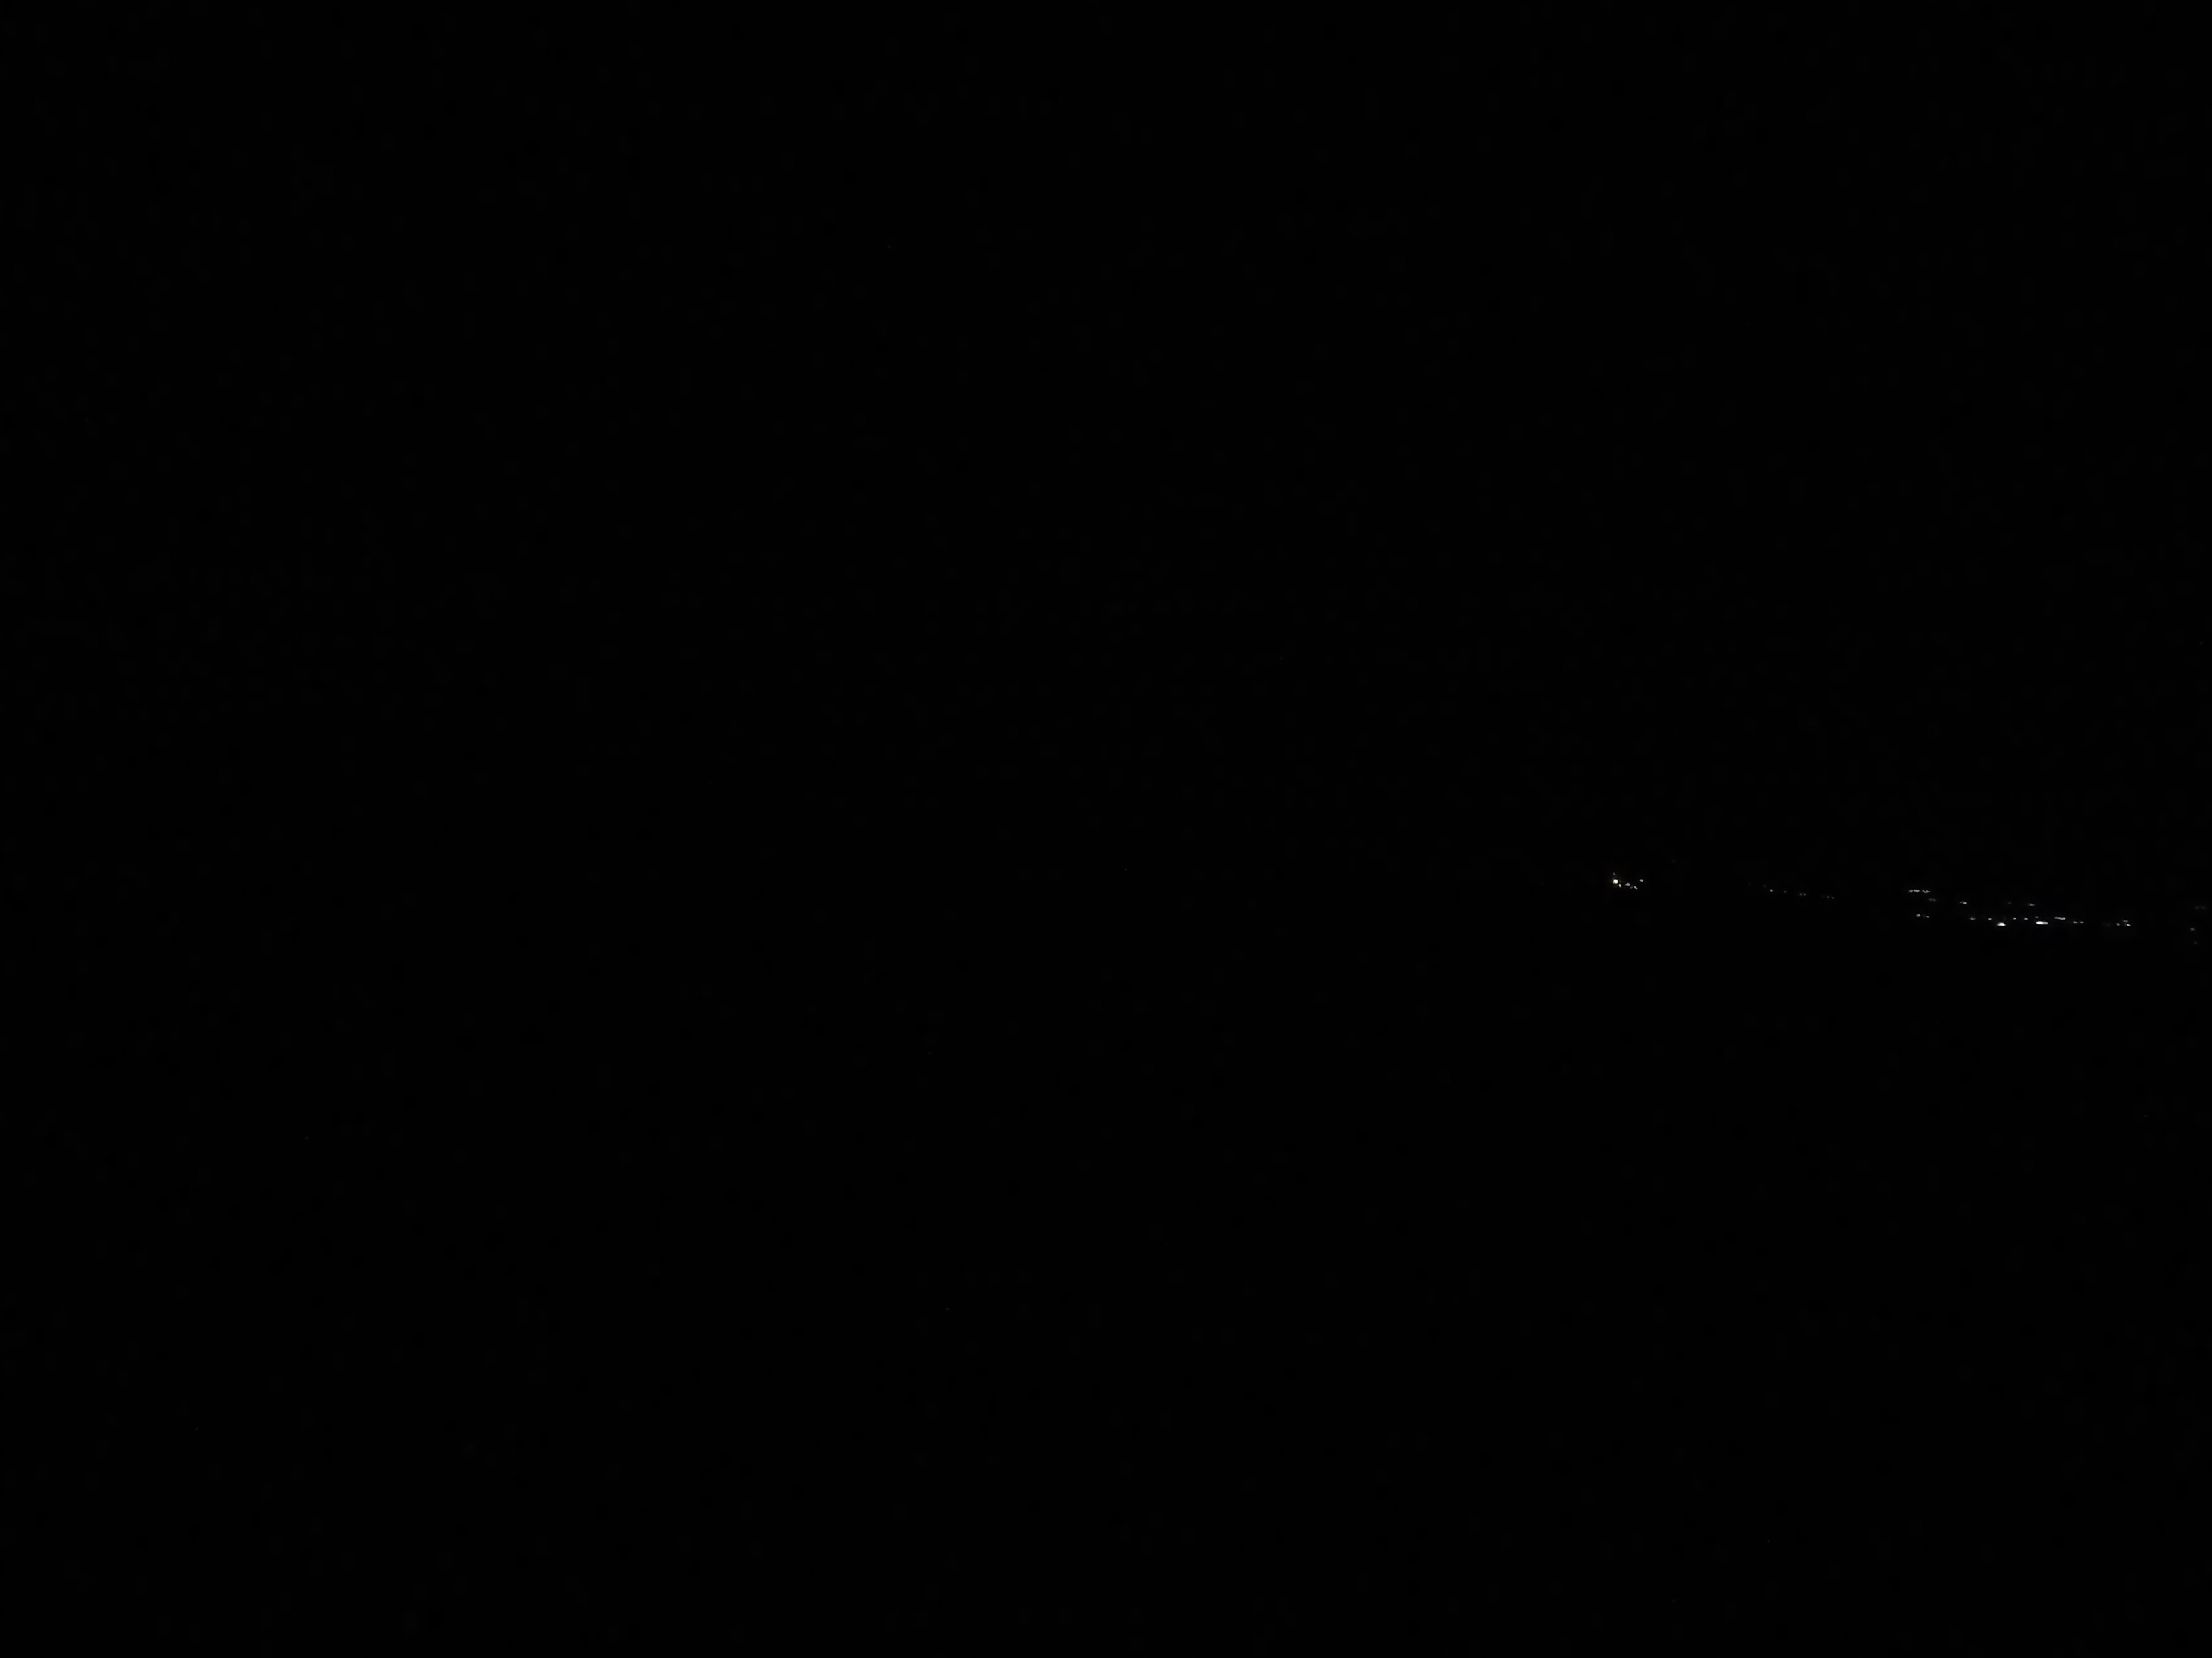
Hour: 3:04 Sun:-15,8°

Slide 42
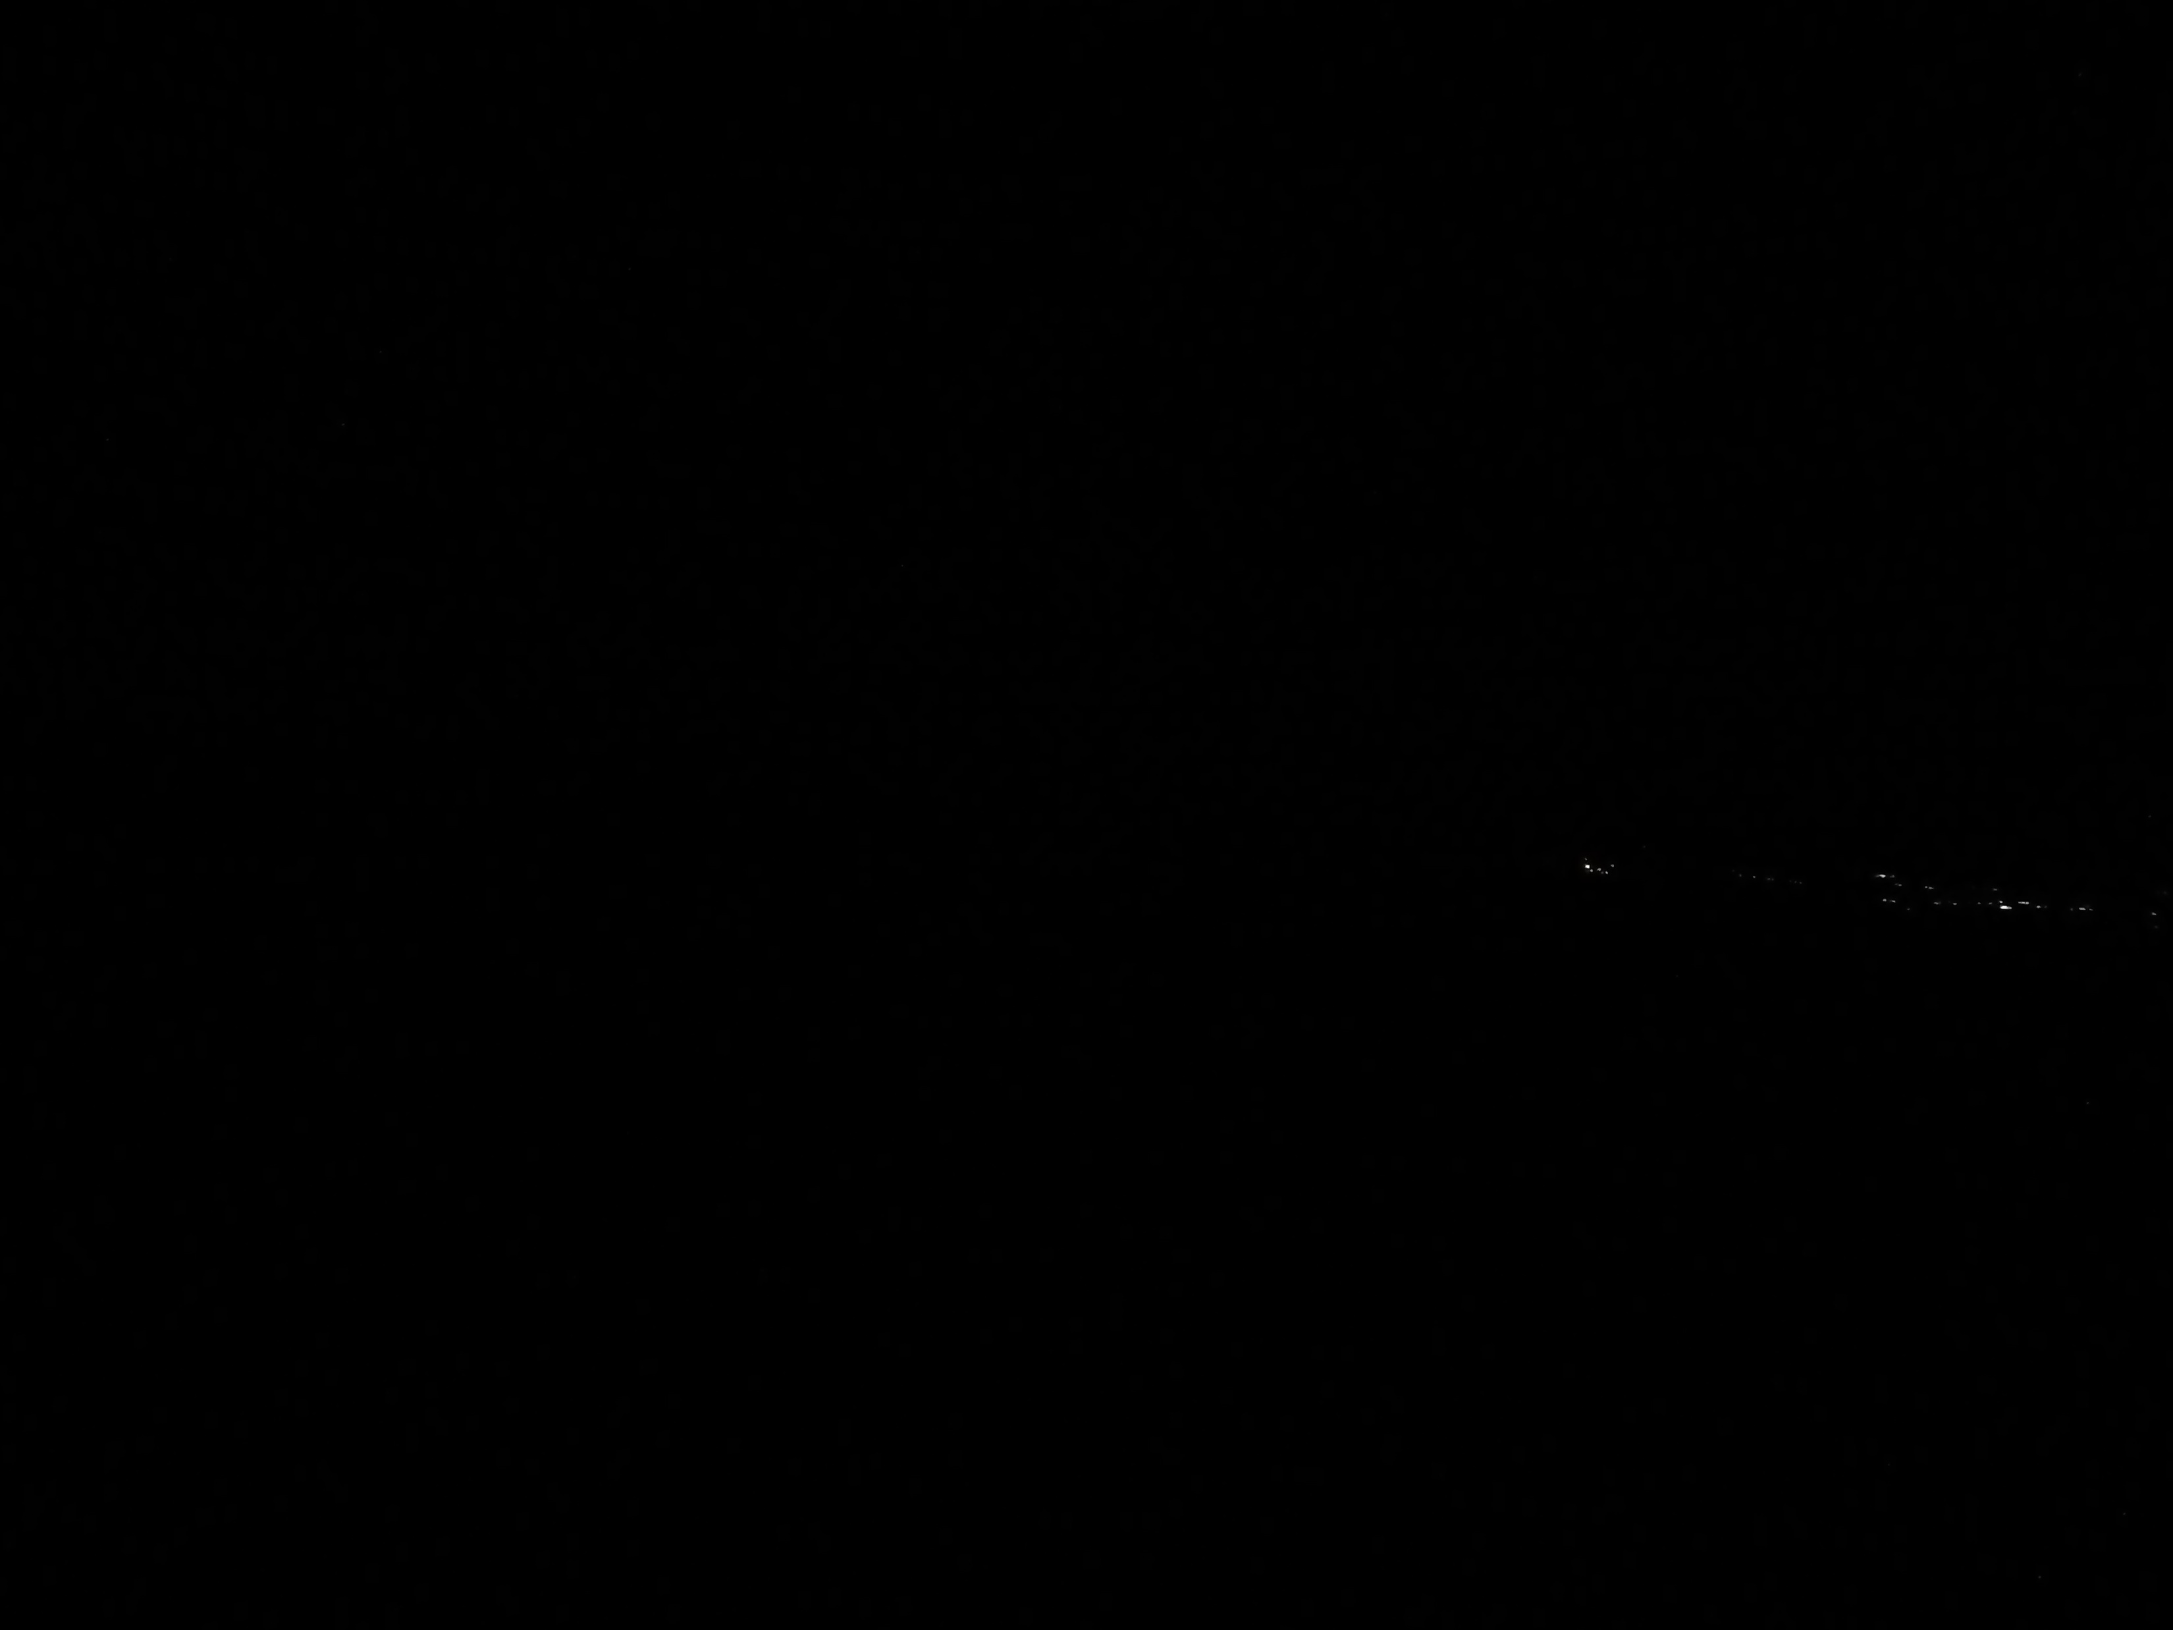
Hour: 3:05 Sun: -15,7°

Slide 43
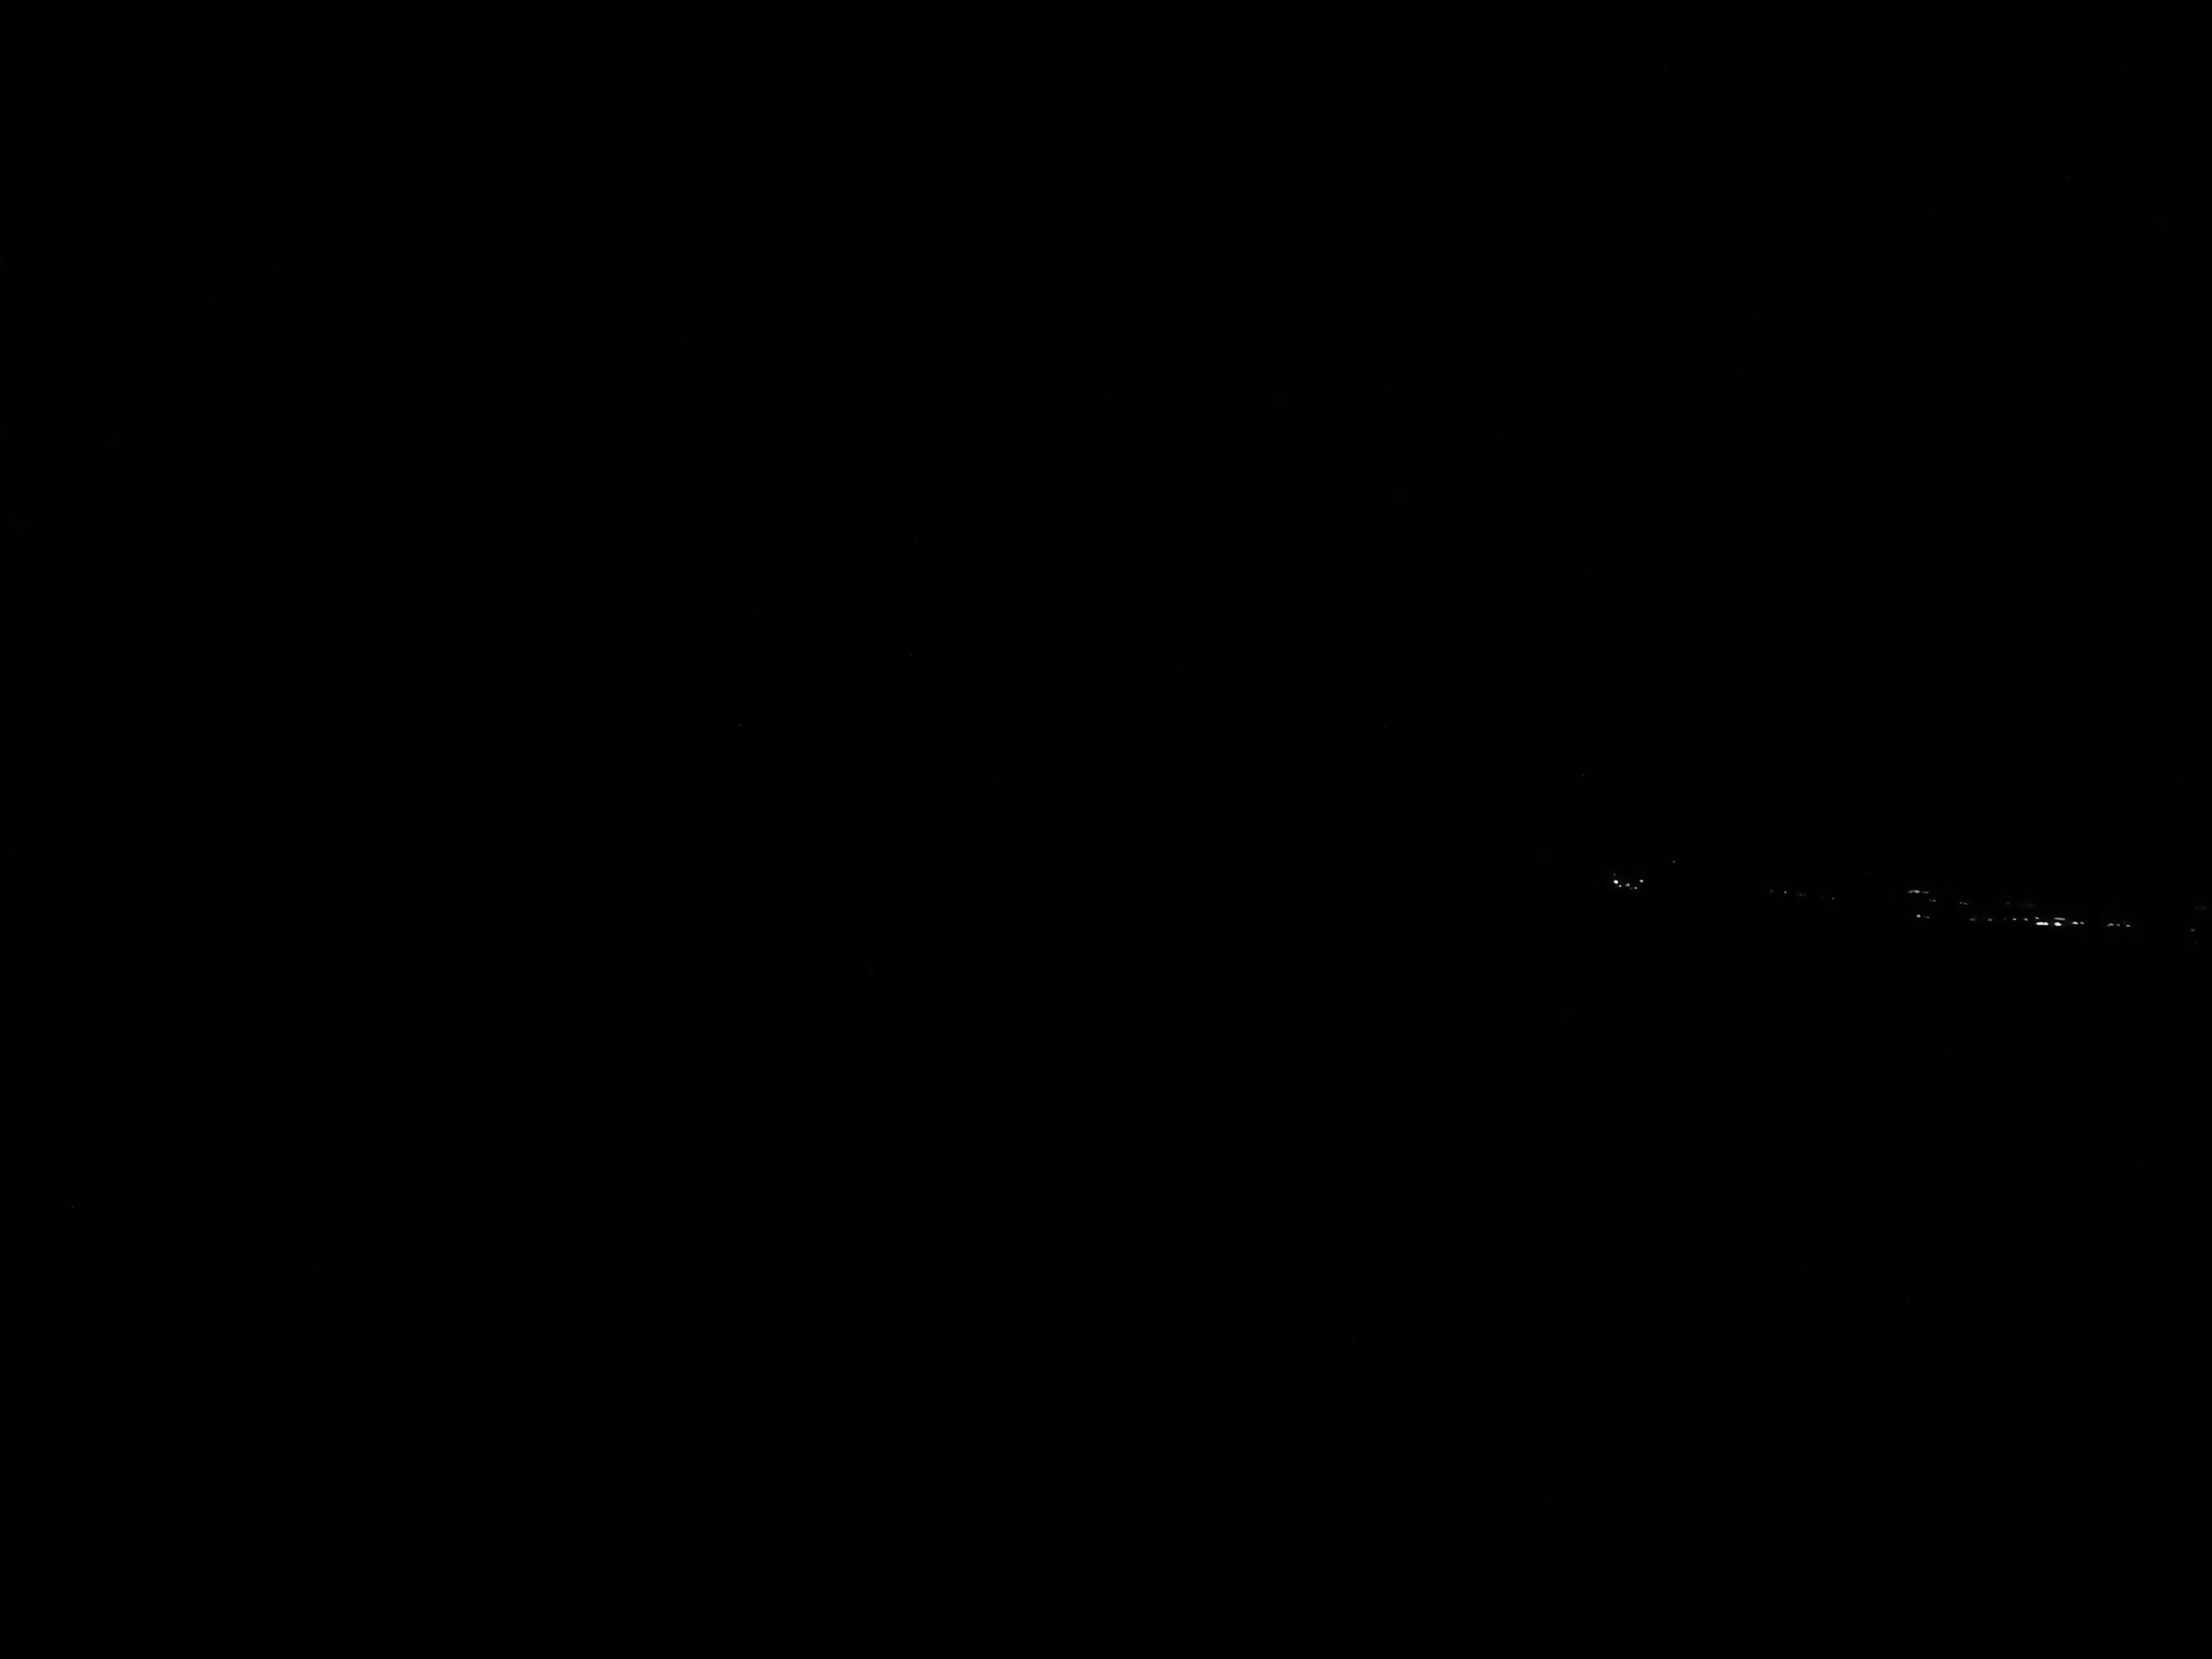
Hour: 3:06 Sun: -15,6°

Slide 44
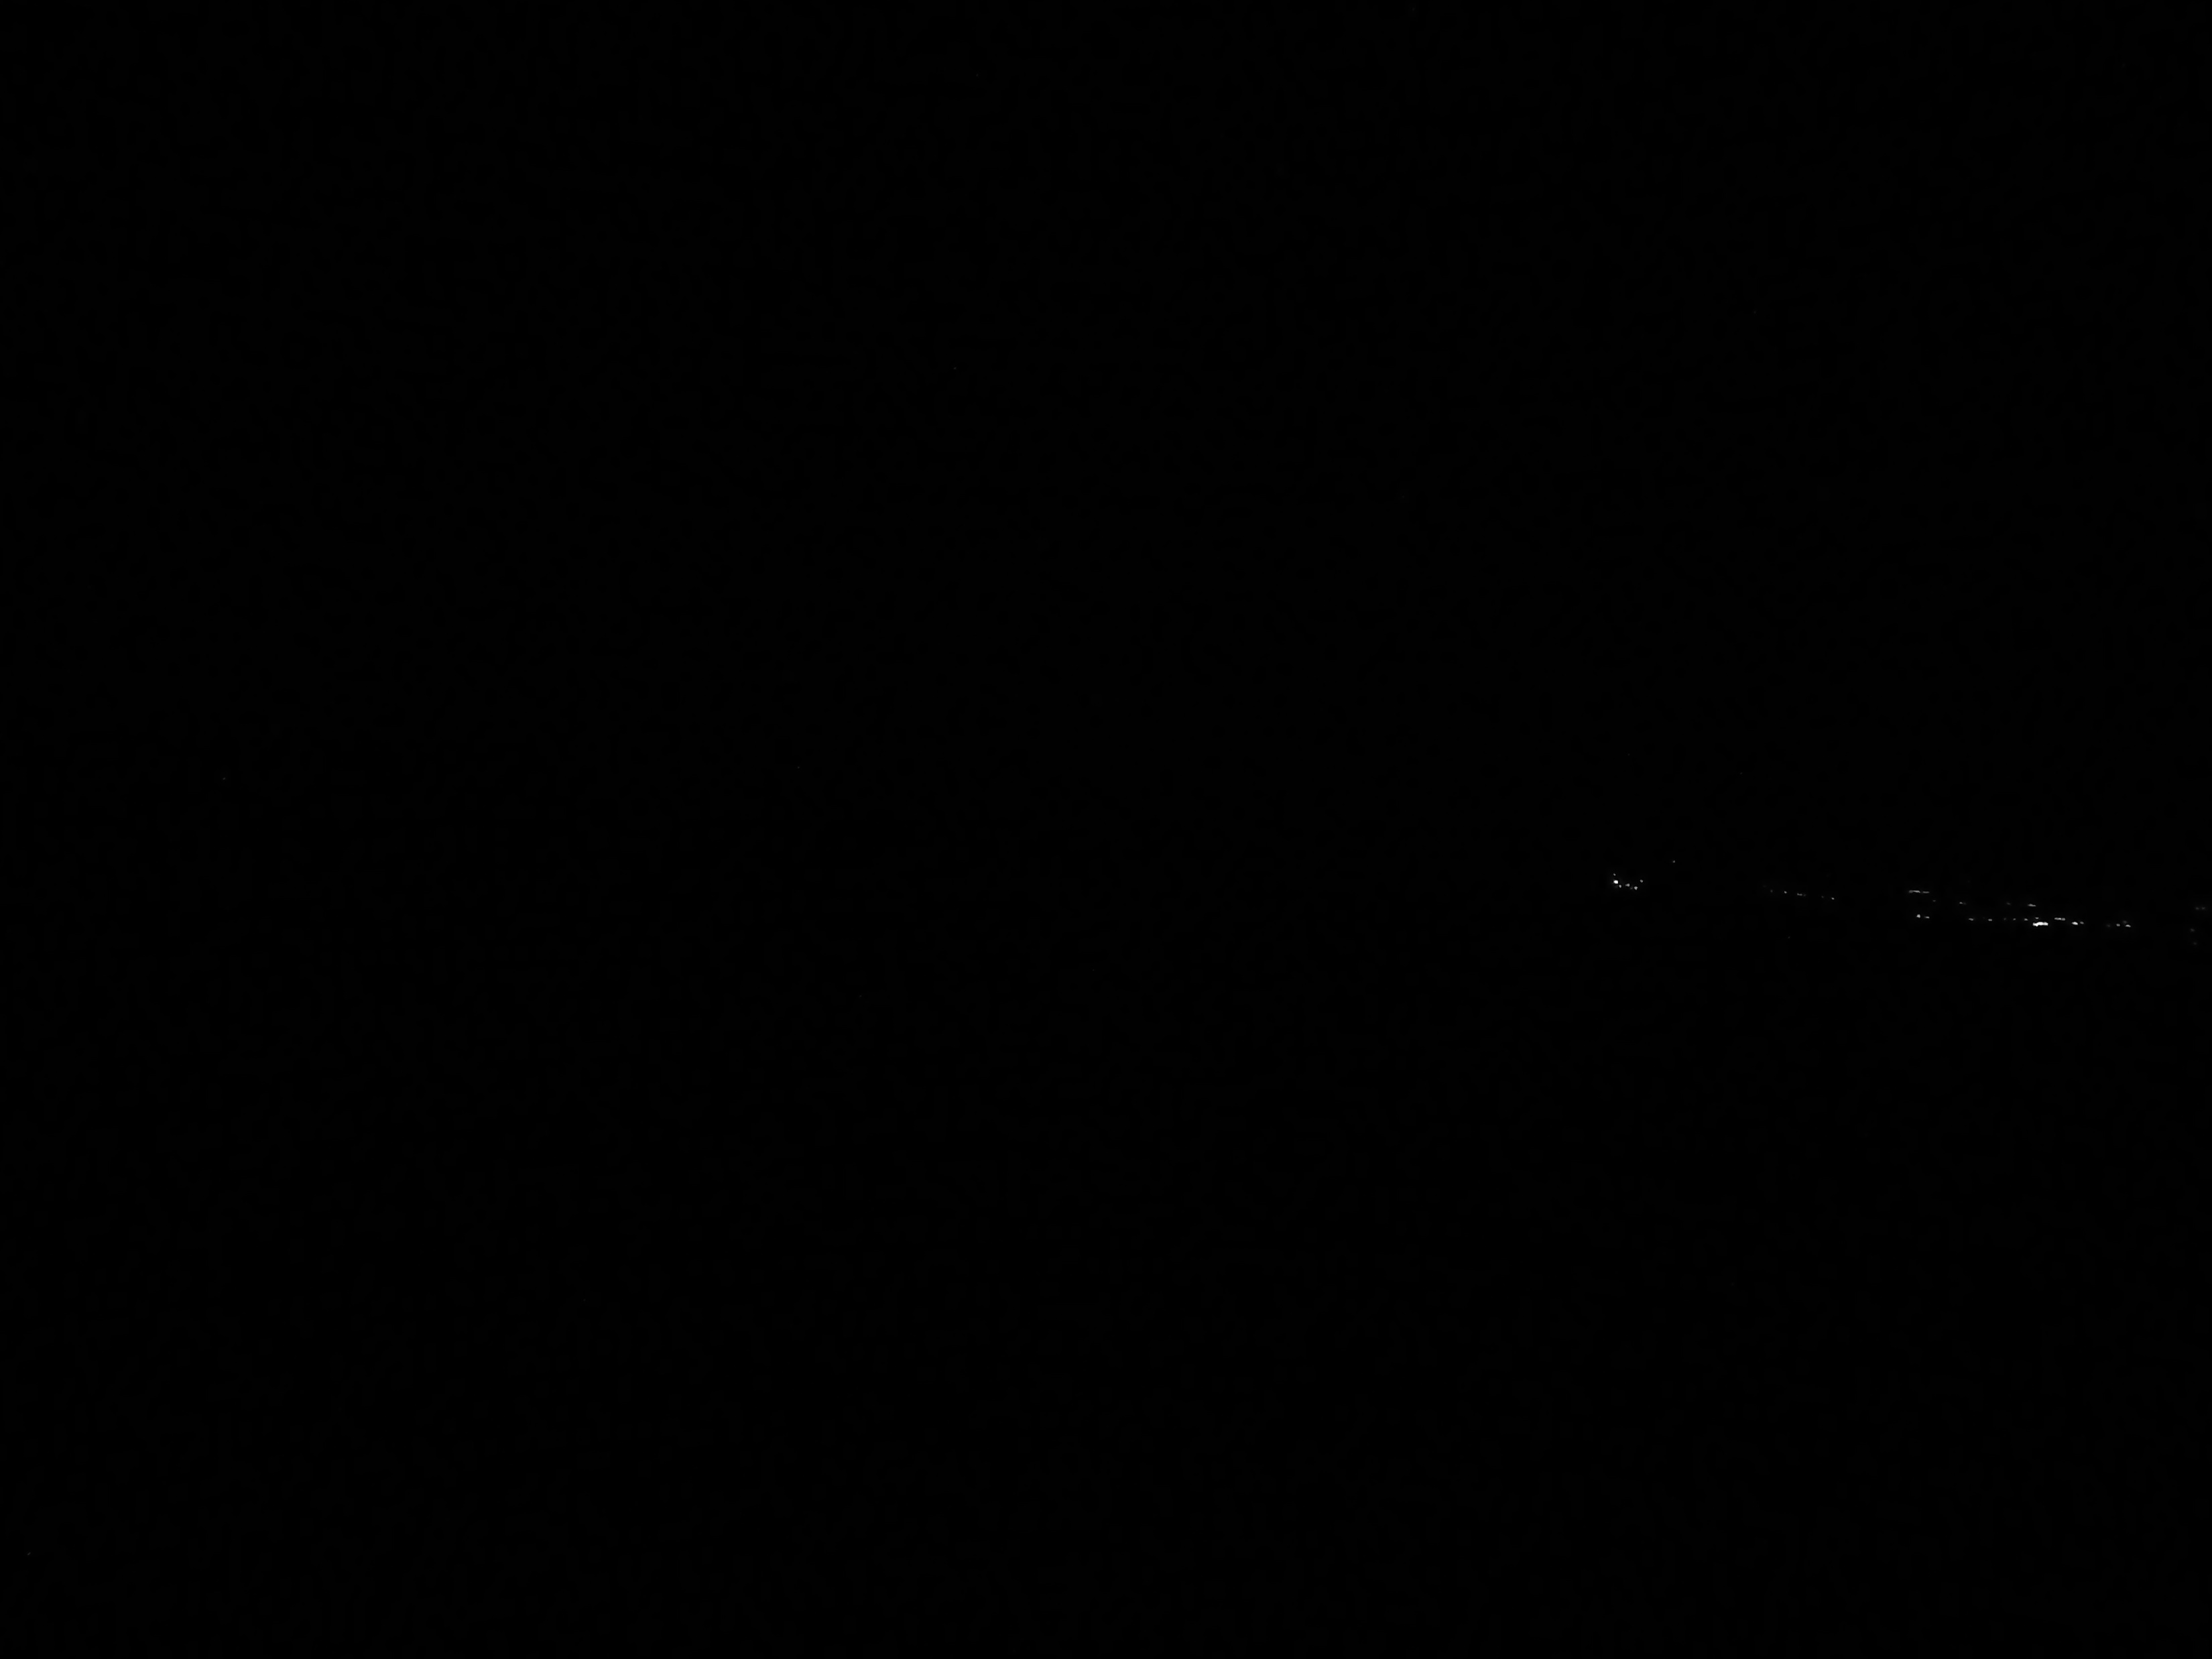
Hour: 3:06:30 Sun: -15,5°

Slide 45
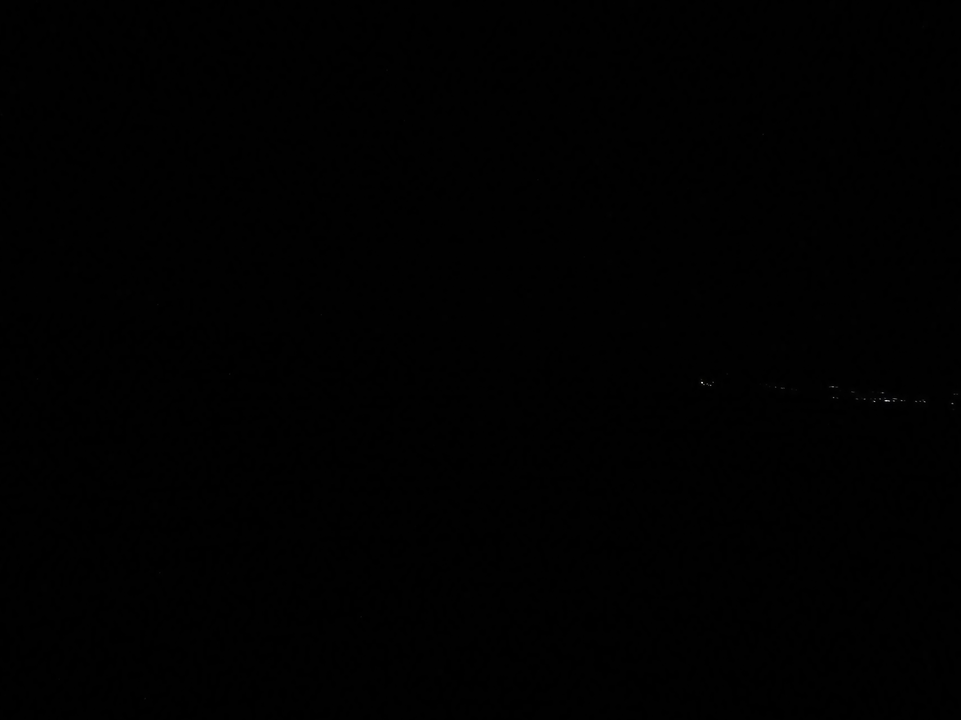
Hour: 3:07 Sun: -15,4°

Slide 46
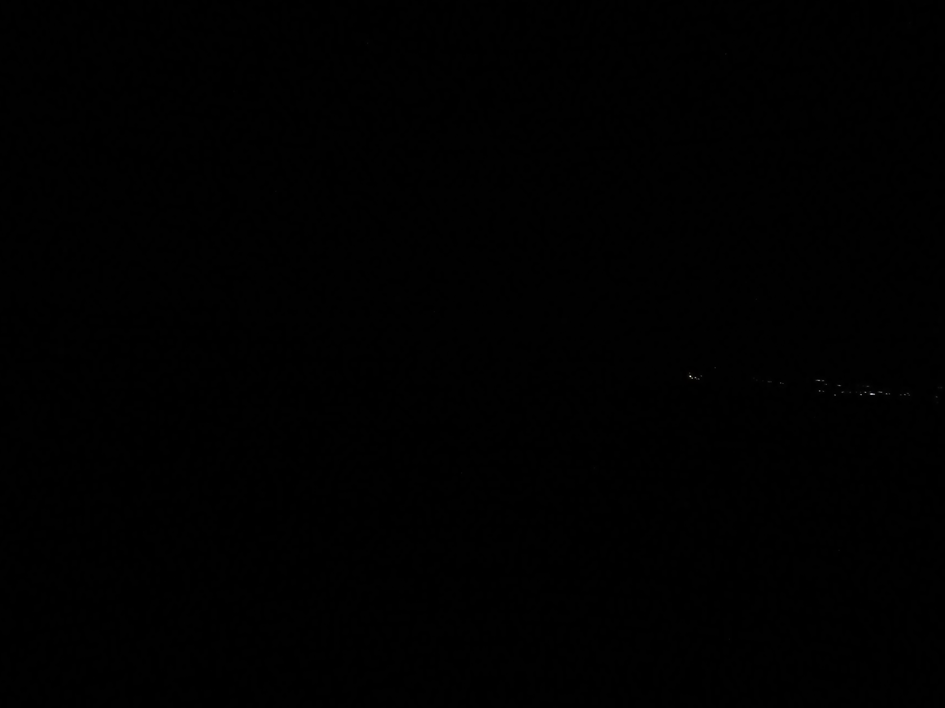
Hour: 3:08 Sun: -15,3°

Slide 47
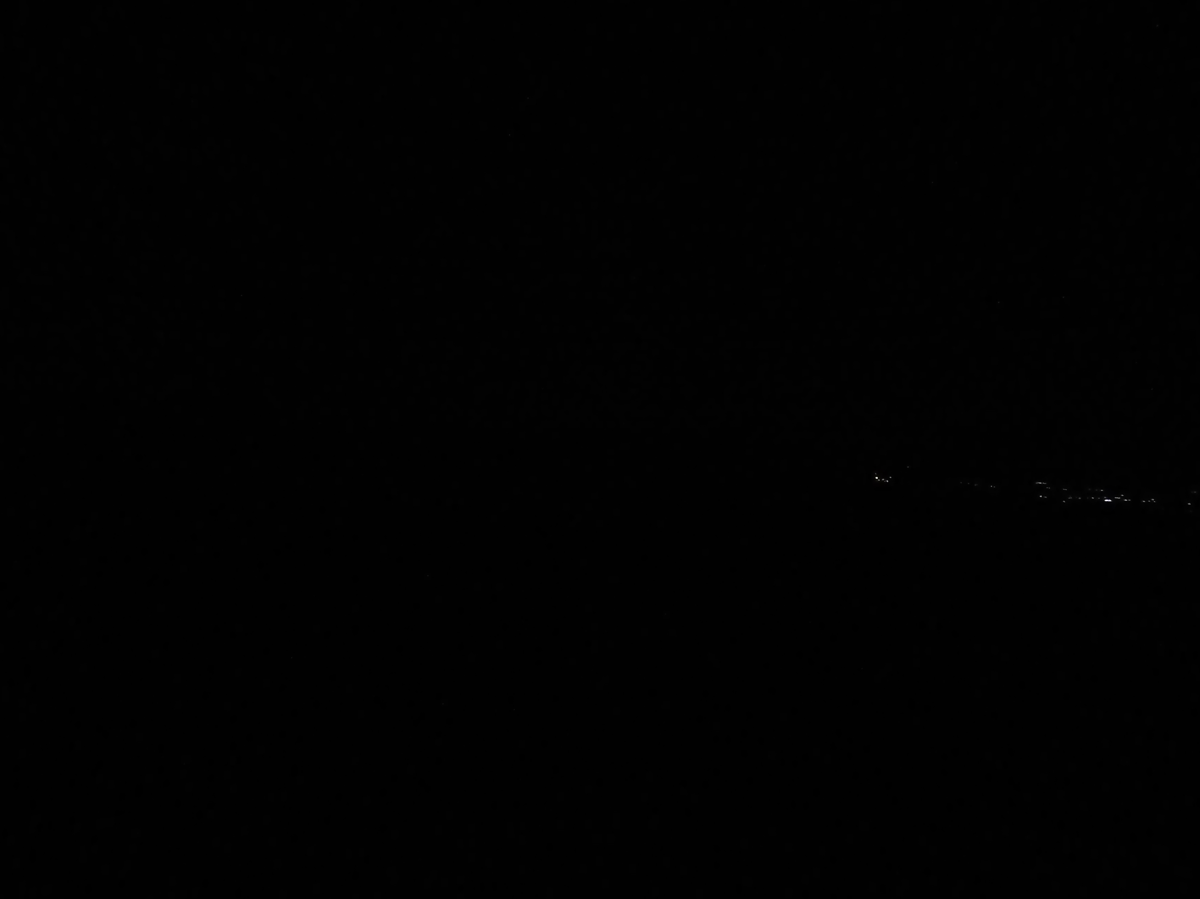
Hour: 3:09 Sun: -15,2°

Slide 48
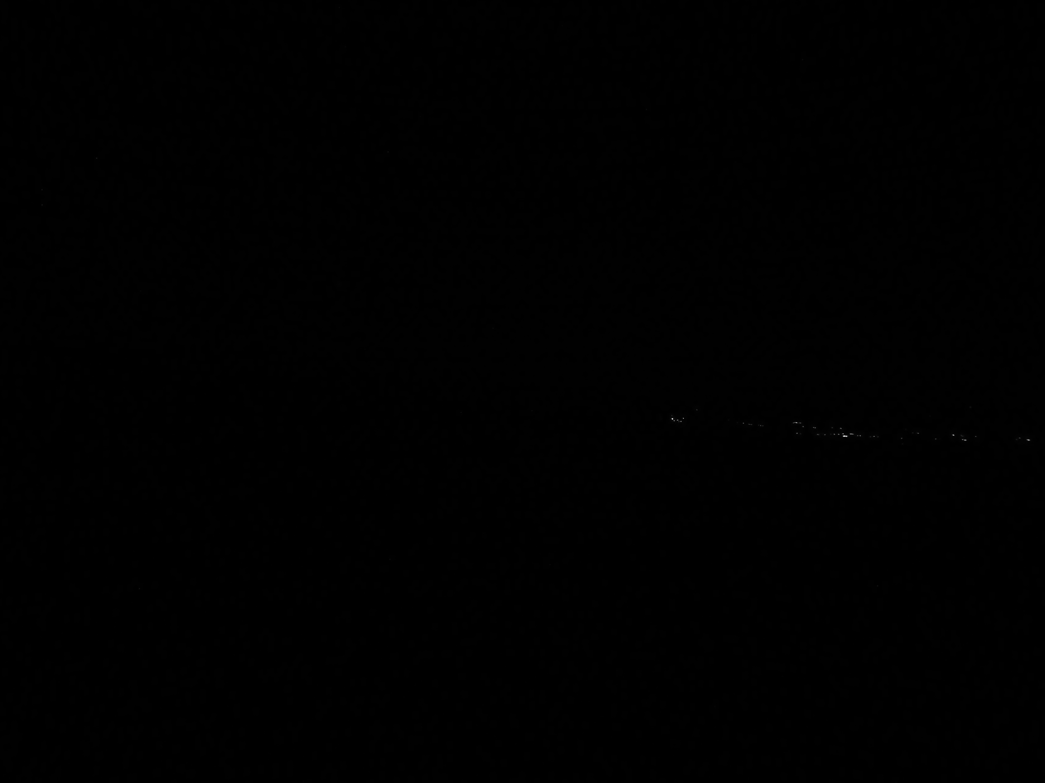
Hour: 3:10 Sun: -15,1°

Slide 49
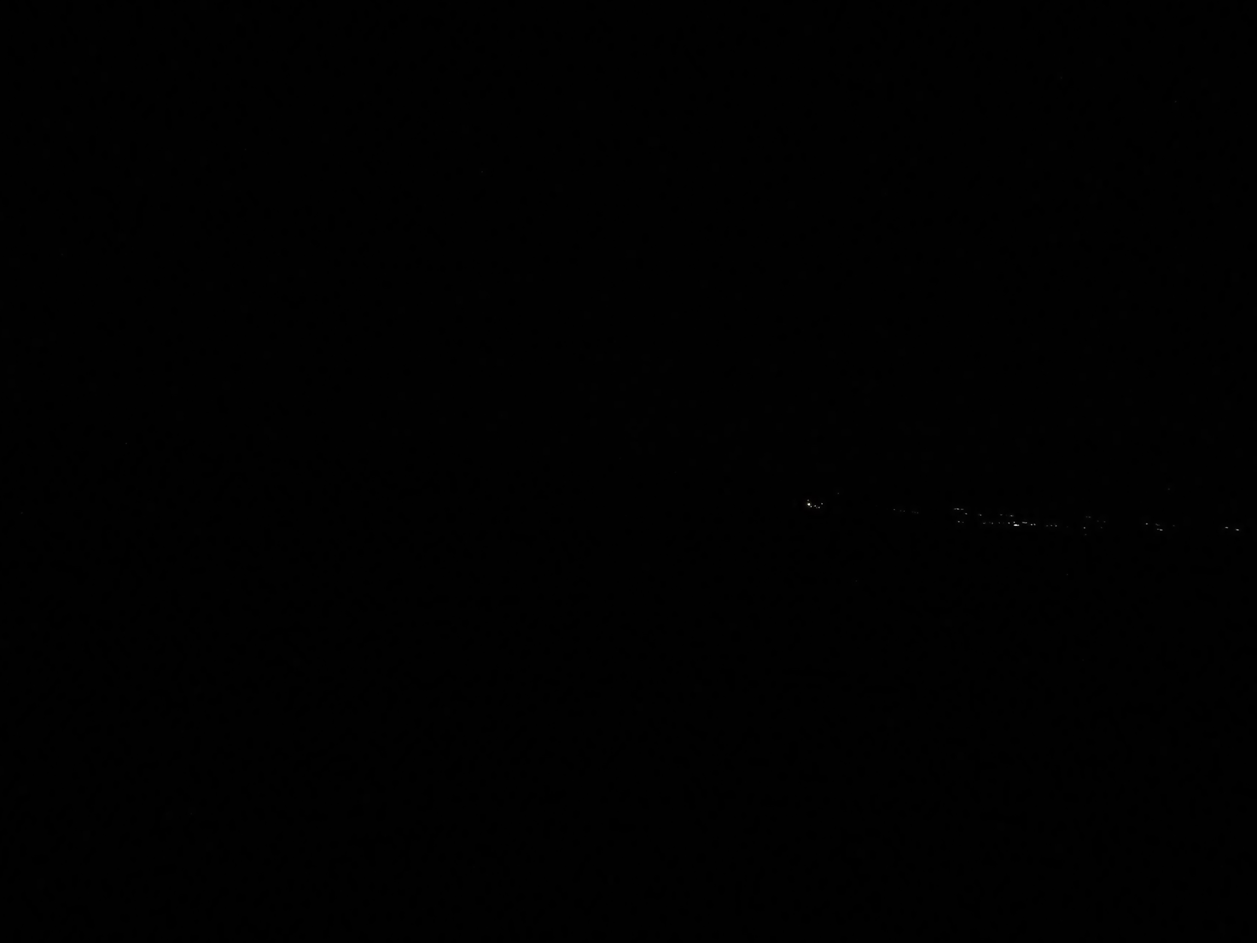
North American Islamic Community Imsak Time
Hour: 3:10:30 Sun: -15,0°

Slide 50
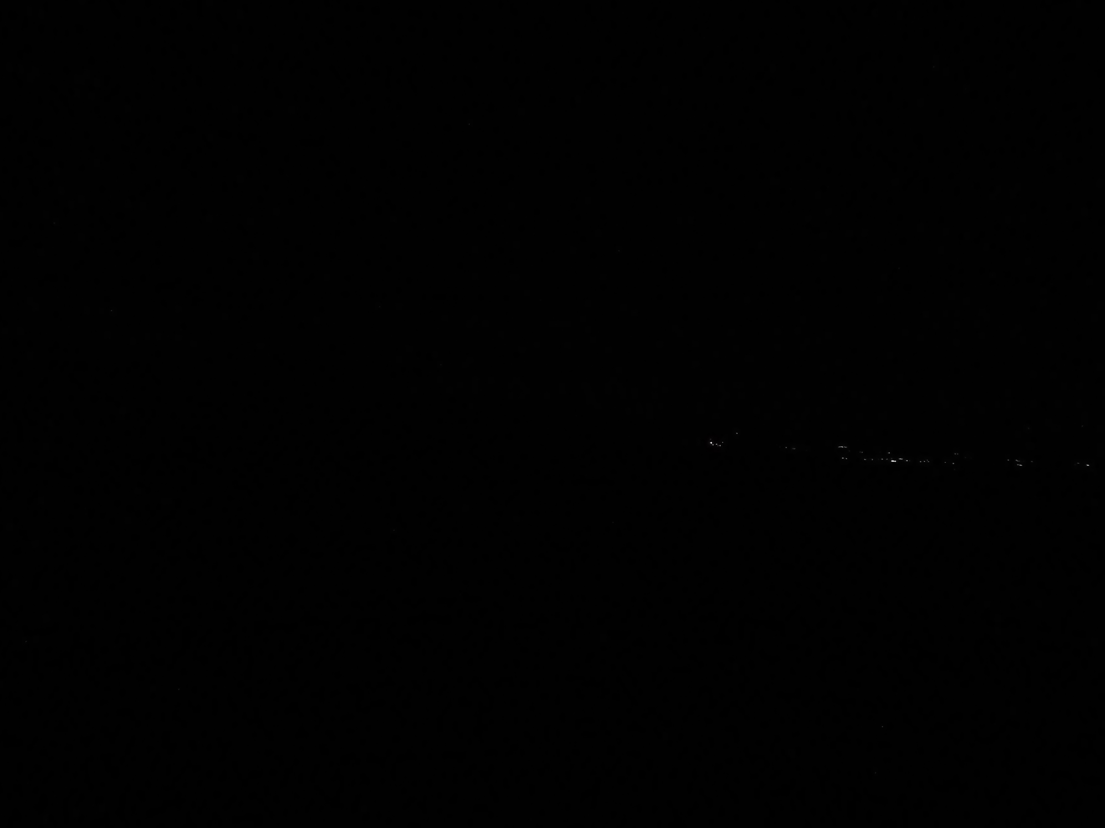
Hour: 3:11 Sun: -14,9°

Slide 51
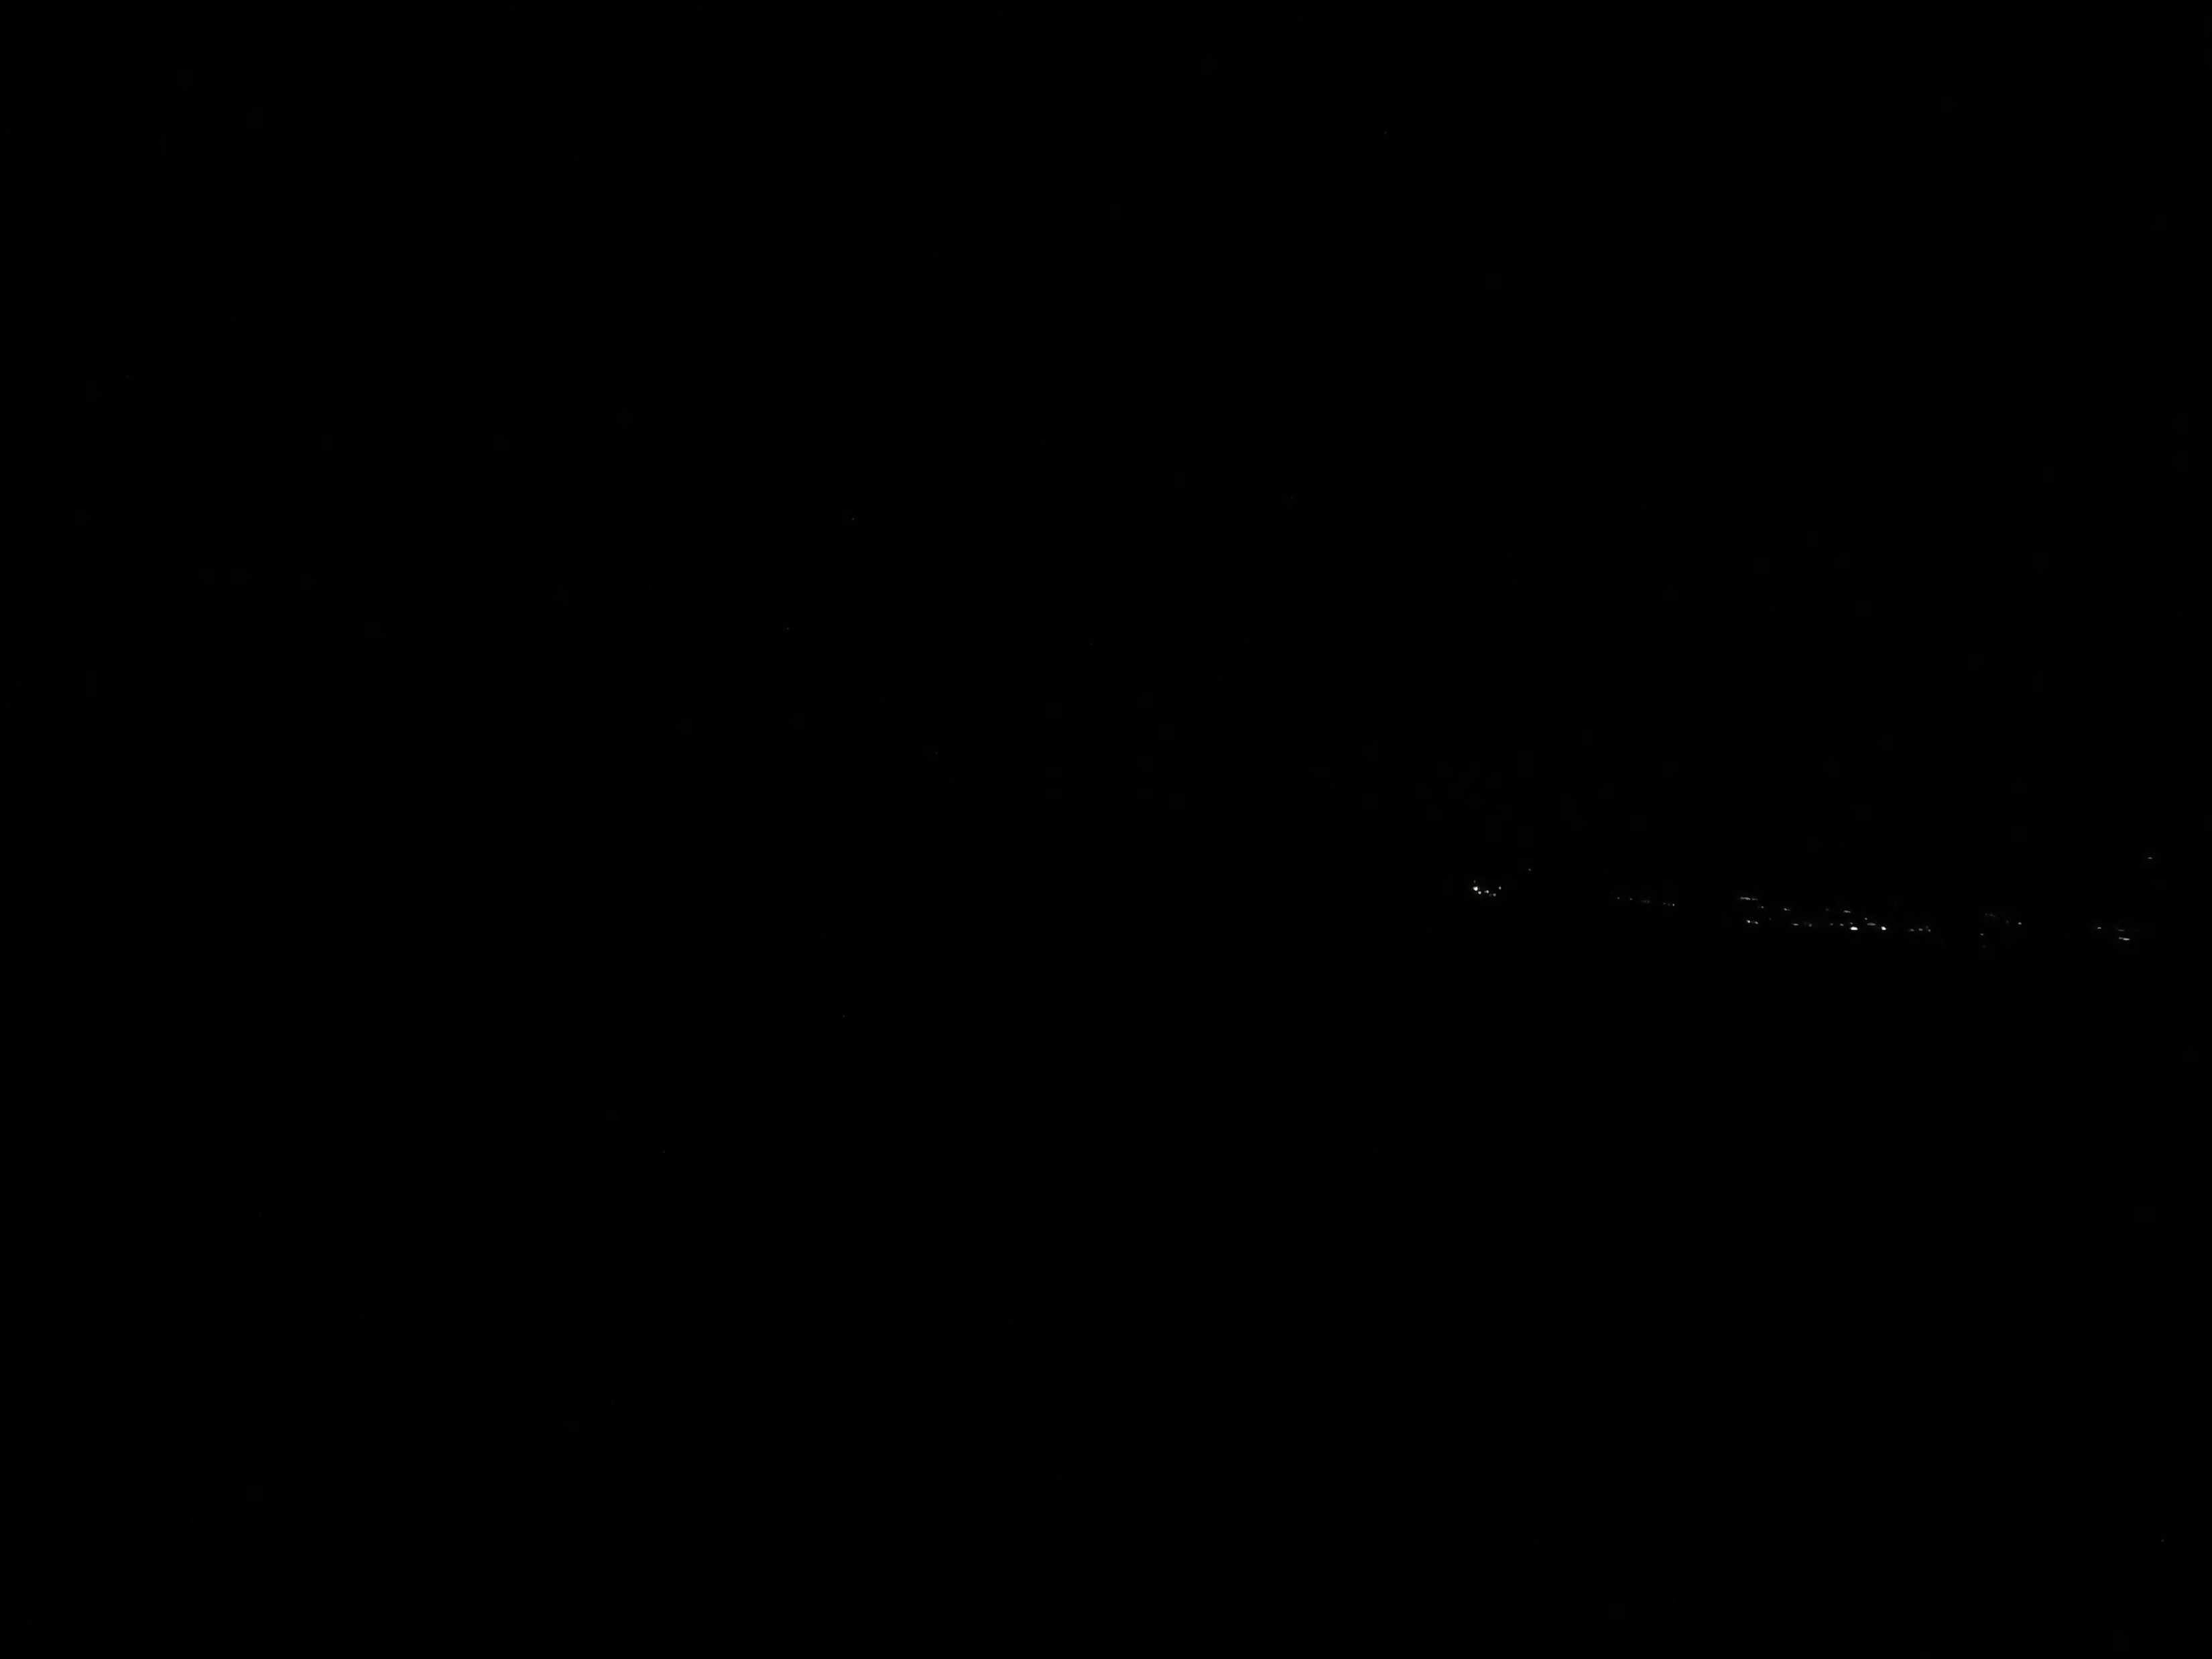
Hour: 3:12 Sun: -14,8°

Slide 52
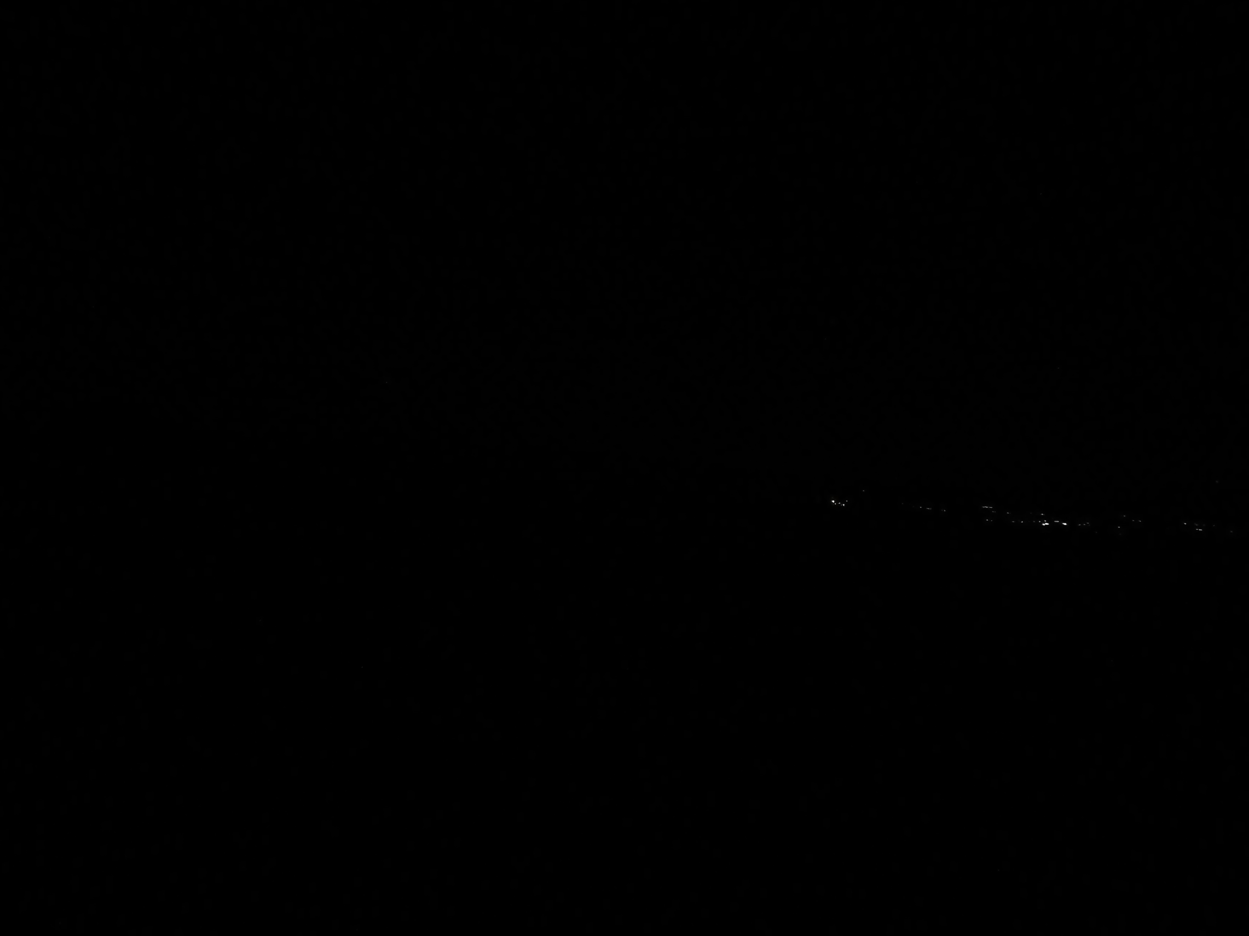
Hour: 3:13 Sun: -14,7°

Slide 53
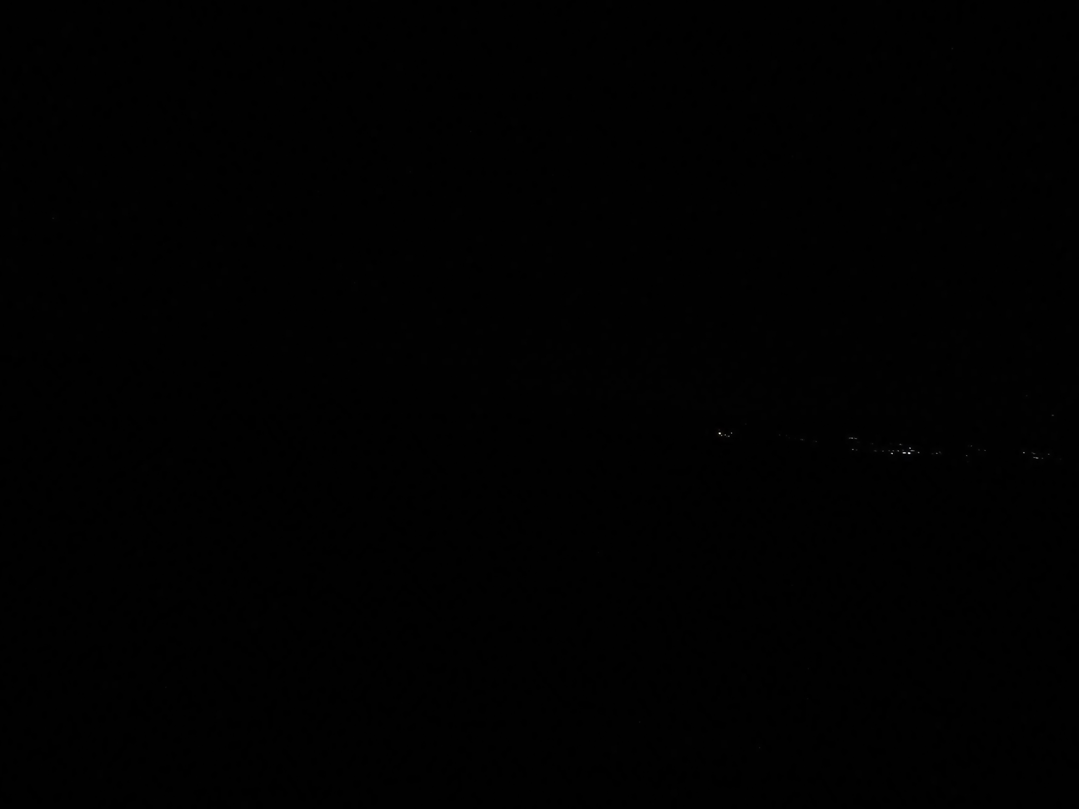
Hour: 3:13:30 Sun: -14,6°

Slide 54

Hour: 3:14 Sun: -14,5°

Slide 55

Hour: 3:15 Sun: -14,4°

Slide 56

Hour: 3:16 Sun: -14,3°

Slide 57

Hour: 3:16:30 Sun: -14,2°

Slide 58

Hour: 3:17 Sun: -14,1°

Slide 59

Hour: 3:18 Sun: -14,0°

Slide 60

Hour: 3:19 Sun: -13,9°

Slide 61

Hour: 3:20 Sun: -13,8°

Slide 62

Hour: 3:20:30 Sun: -13,7°

Slide 63

Hour: 3:21 Sun: -13,6°

Slide 64

Hour: 3:22 Sun: -13,5°

Slide 65

Hour: 3:23 Sun: -13,4°

Slide 66

Hour: 3:23:30 Sun: -13,3°

Slide 67

Hour: 3:24 Sun: -13,2°

Slide 68

Hour: 3:25 Sun: -13,1°

Slide 69

Hour: 3:26 Sun: -13,0°

Slide 70

Hour: 3:26:30 Sun: -12,9°

Slide 71

Hour: 3:27 Sun: -12,8°

Slide 72

Hour: 3:28 Sun: -12,7°

Slide 73

Imsak time
44 minutes after Diyanet and Mwl
Hour: 3:28:30 Sun: -12,6°

Slide 74

Hour: 3:29 Sun: -12,5°

Slide 75

Hour: 3:30 Sun: -12,4°

Slide 76

Hour: 3:31 Sun: -12,3°

Slide 77

Hour: 3:31:30 Sun: -12,2°

Slide 78

Hour: 3:32 Sun: -12,1°

Slide 79

Nautical Twilight
Hour: 3:33 Sun: -12,0°

Slide 80

Hour: 3:36 Sun: -11,5°

Slide 81

Hour: 3:40 Sun: -11,0°

Slide 82

Result: The time of Imsak is between -12.5° -13°
below the horizon, depending on your altitude.
This means: Prayers performed immediately after the call to prayer are outside the time
Imsak Time (Fecri Sadık): occurs 35 minutes later in winter and 45 minutes later in summer.
Hour: 3:44 Sun: -10,5°

