Slide 1
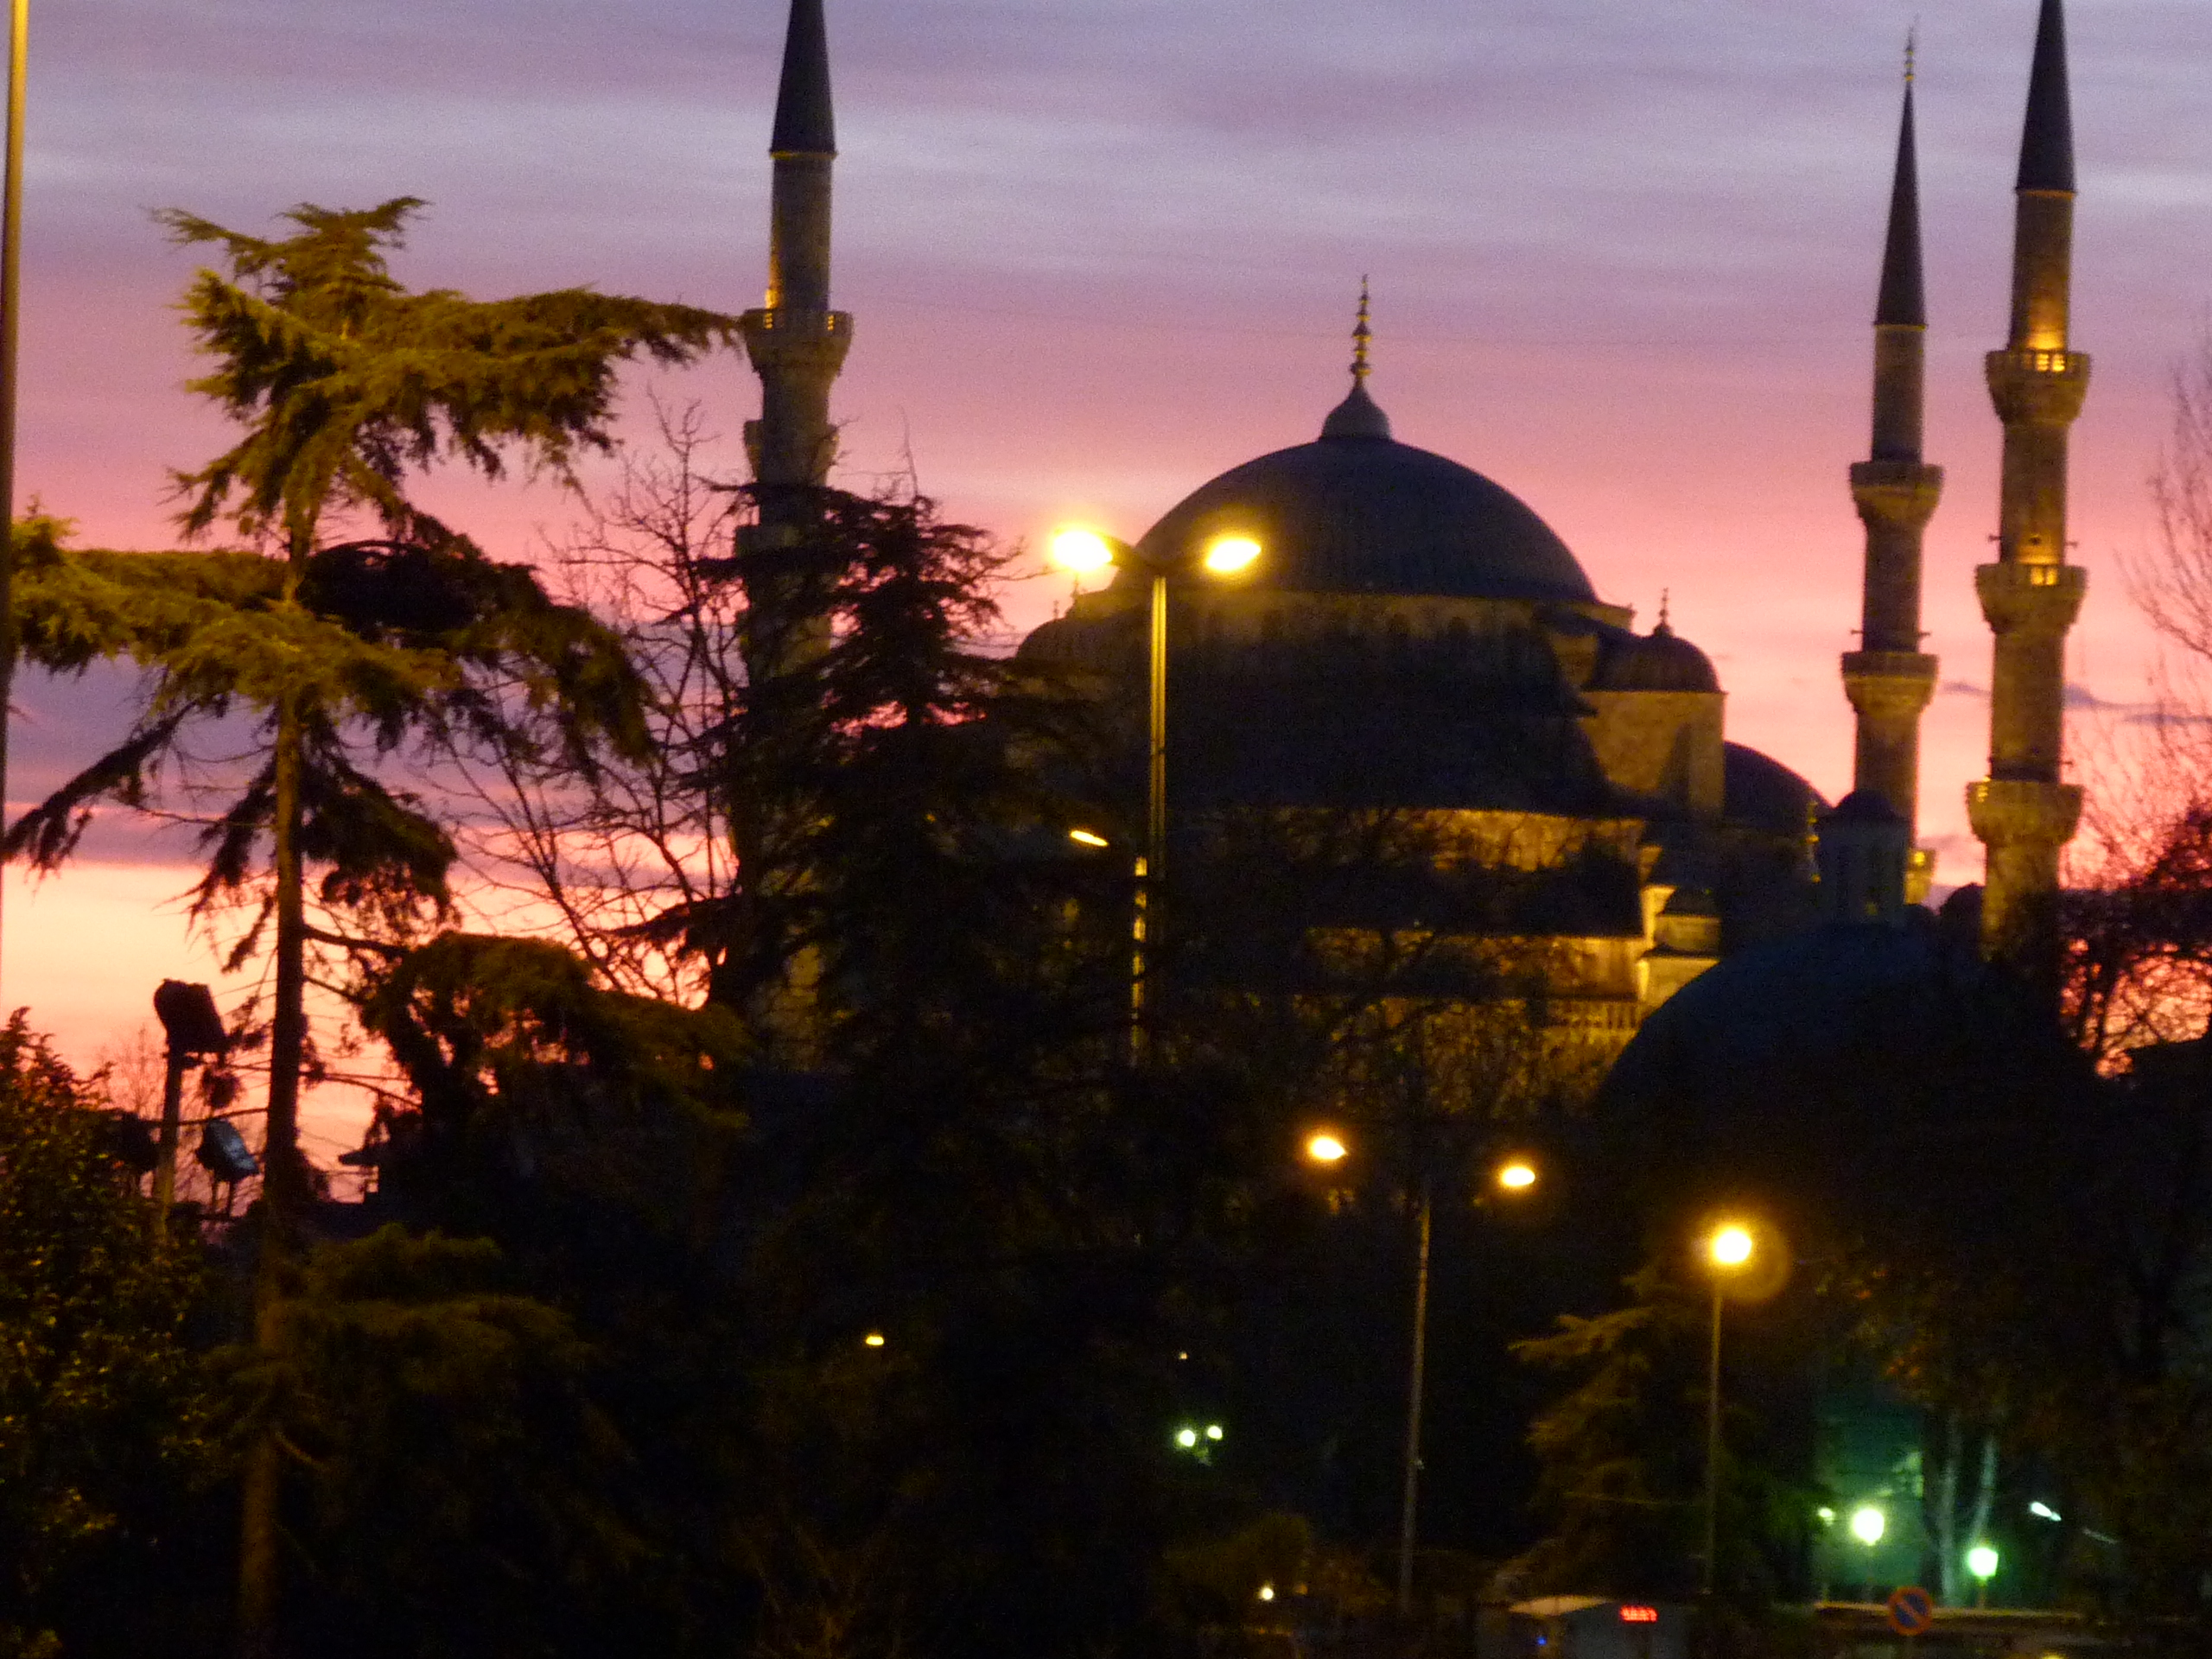

Observ: Rufai ÇINAR
Geophysical Eng. Erzurum Regional Directorate
Observation Location: Erzurum Börekli Village
Observation Date: October 18, 2020

Slide 2
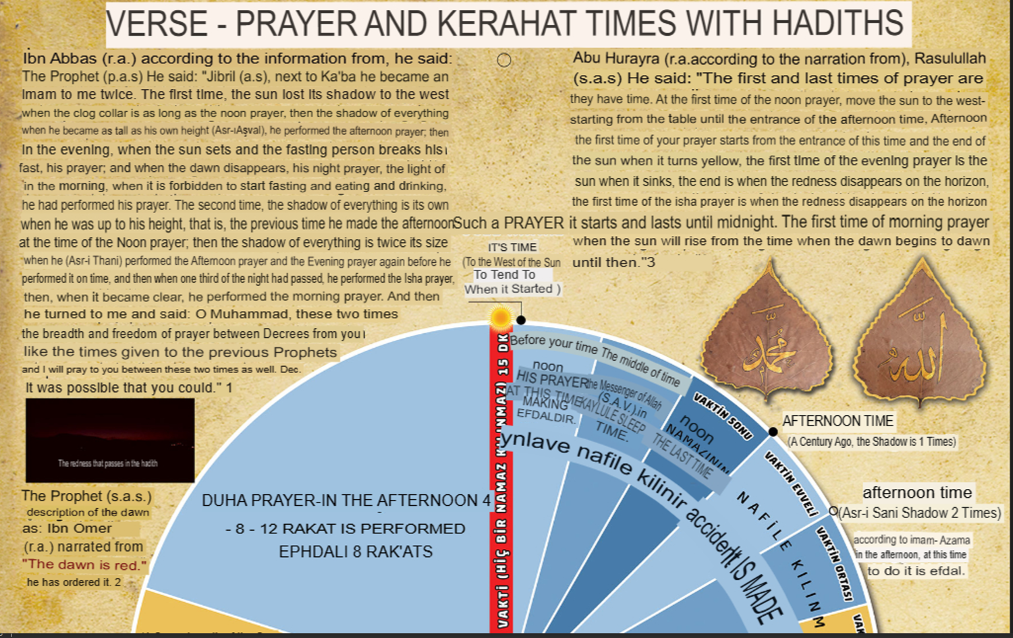

Slide 3
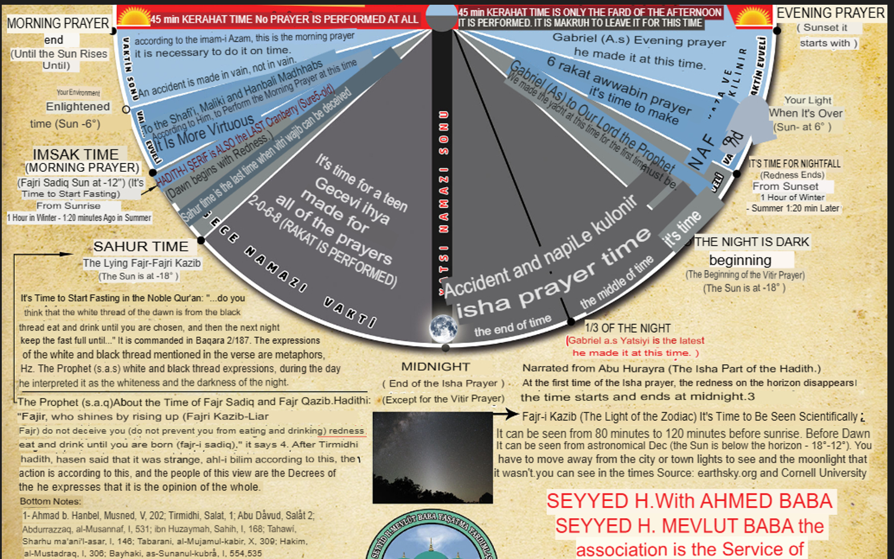

Slide 4
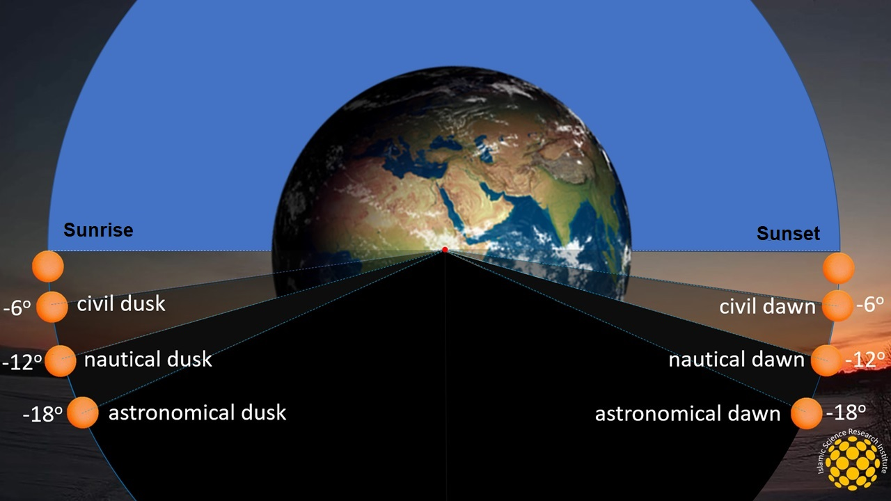

Slide 5
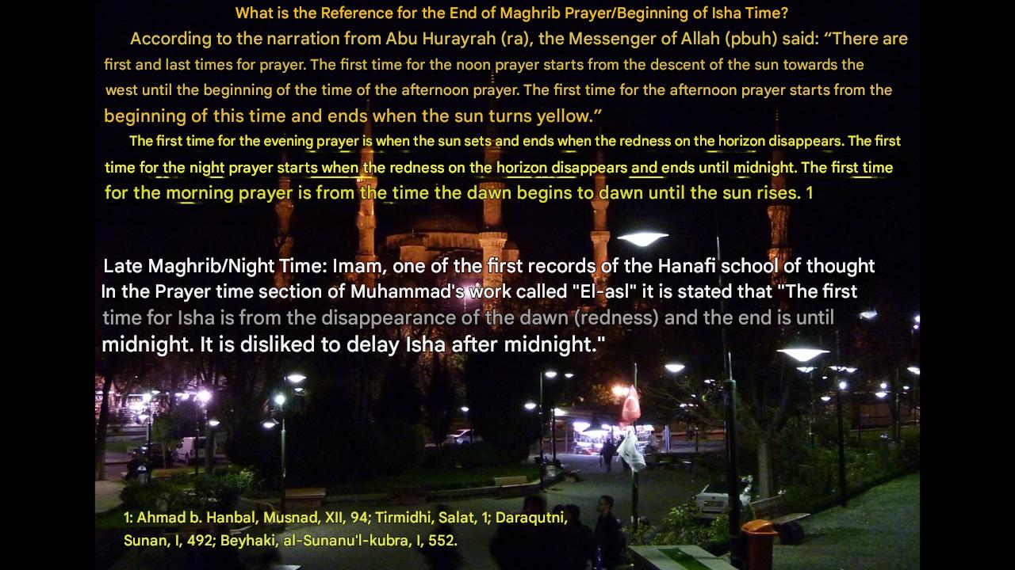
When Gabriel as the imam of the Kaaba became the imam and led the prayer,
the expression "When the dawn disappears" was used for the time of Isha and
according to Ibn Omar, the Prophet said "The dawn is redness".

Slide 6
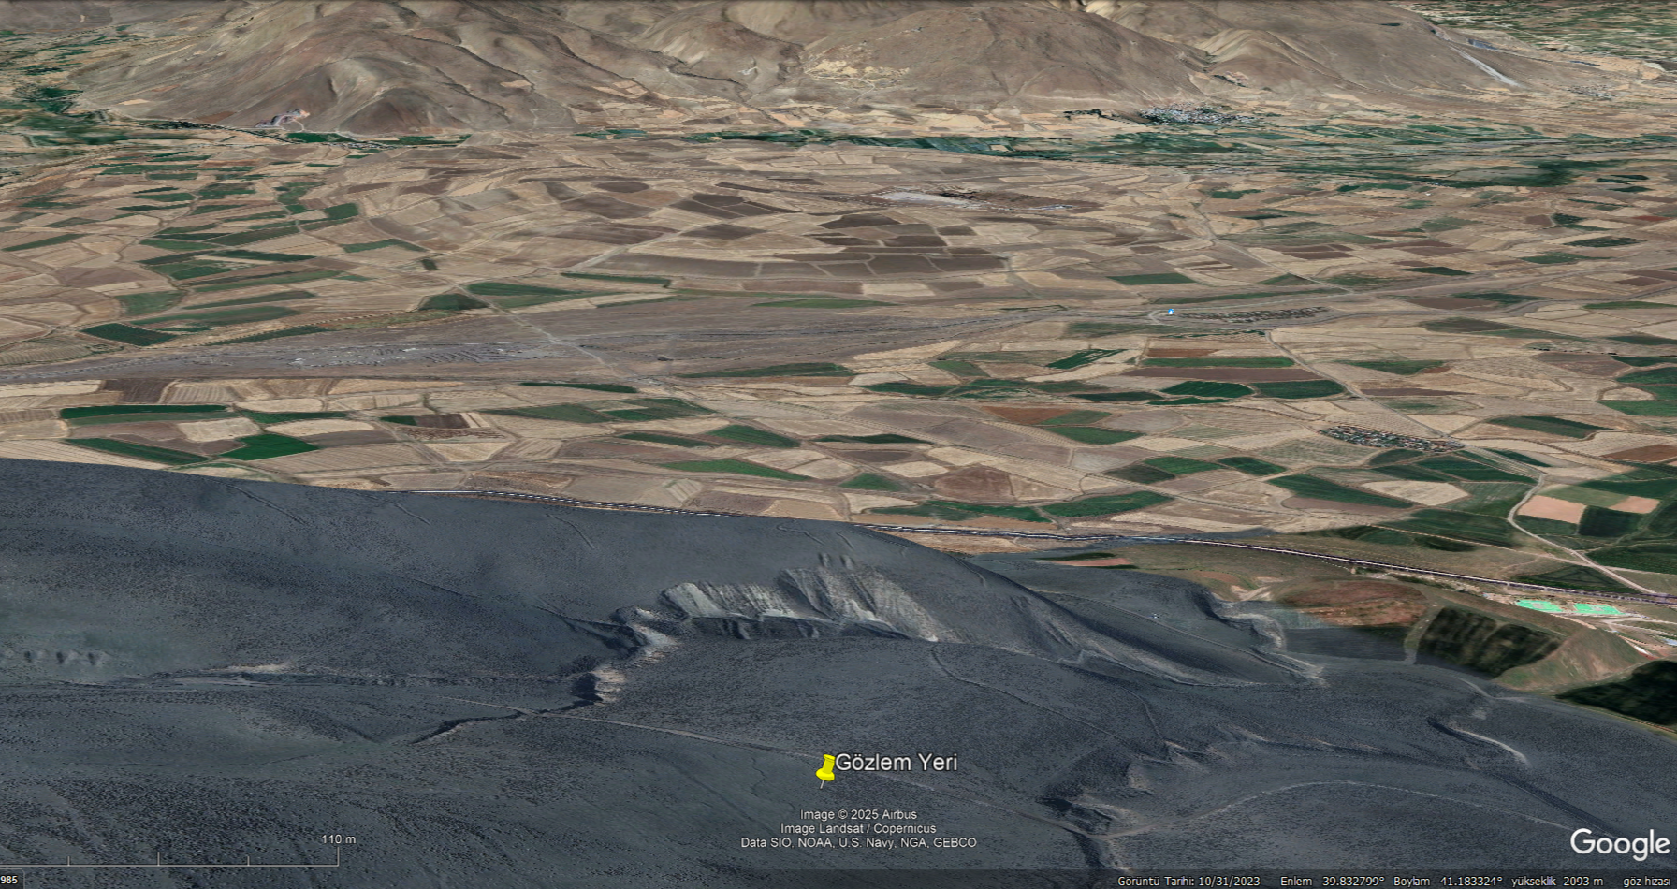
Erzurum West Börekli village ridge Night
Observation-2020 Altitude: 2110 Plain altitude 1950
Date: October 18, 2020

Slide 7
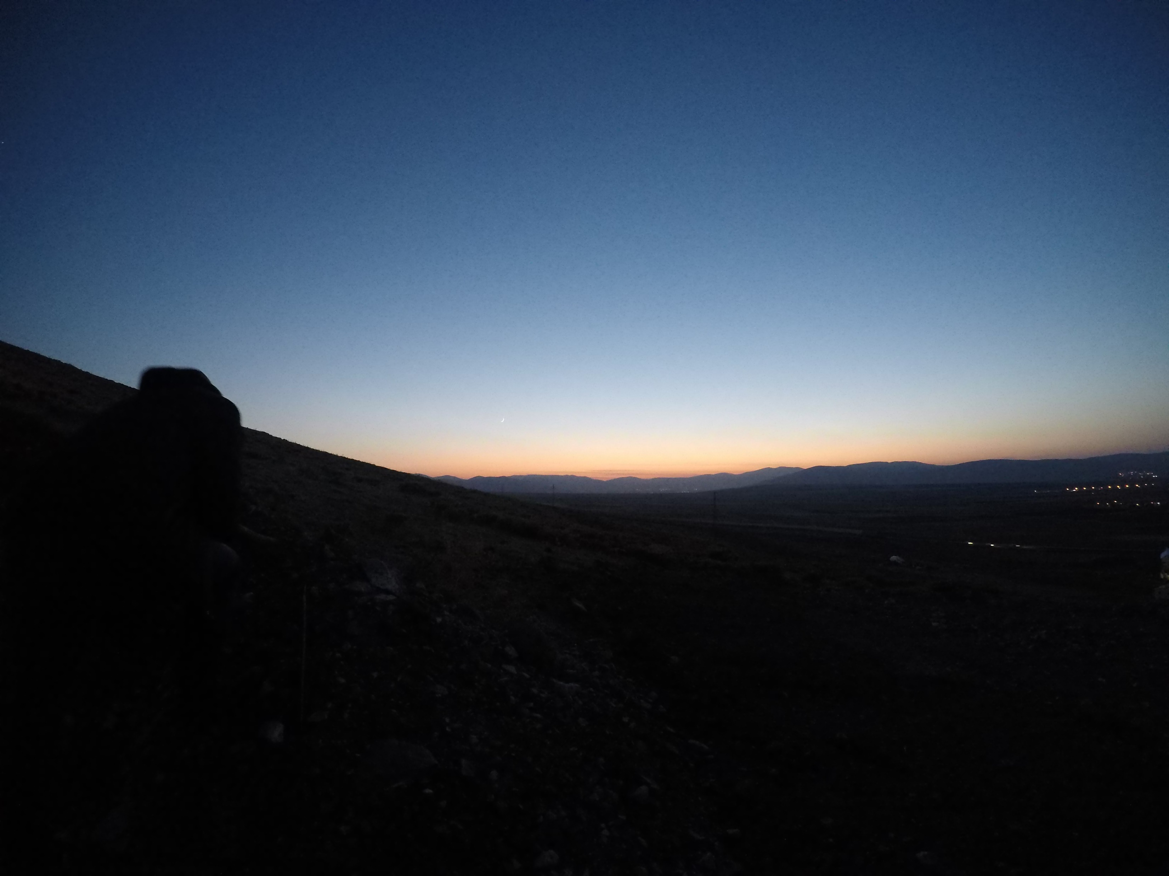
Sunset: 17:31
27 minutes later
Hour: 17:58 Sun: -6,0°

Slide 8
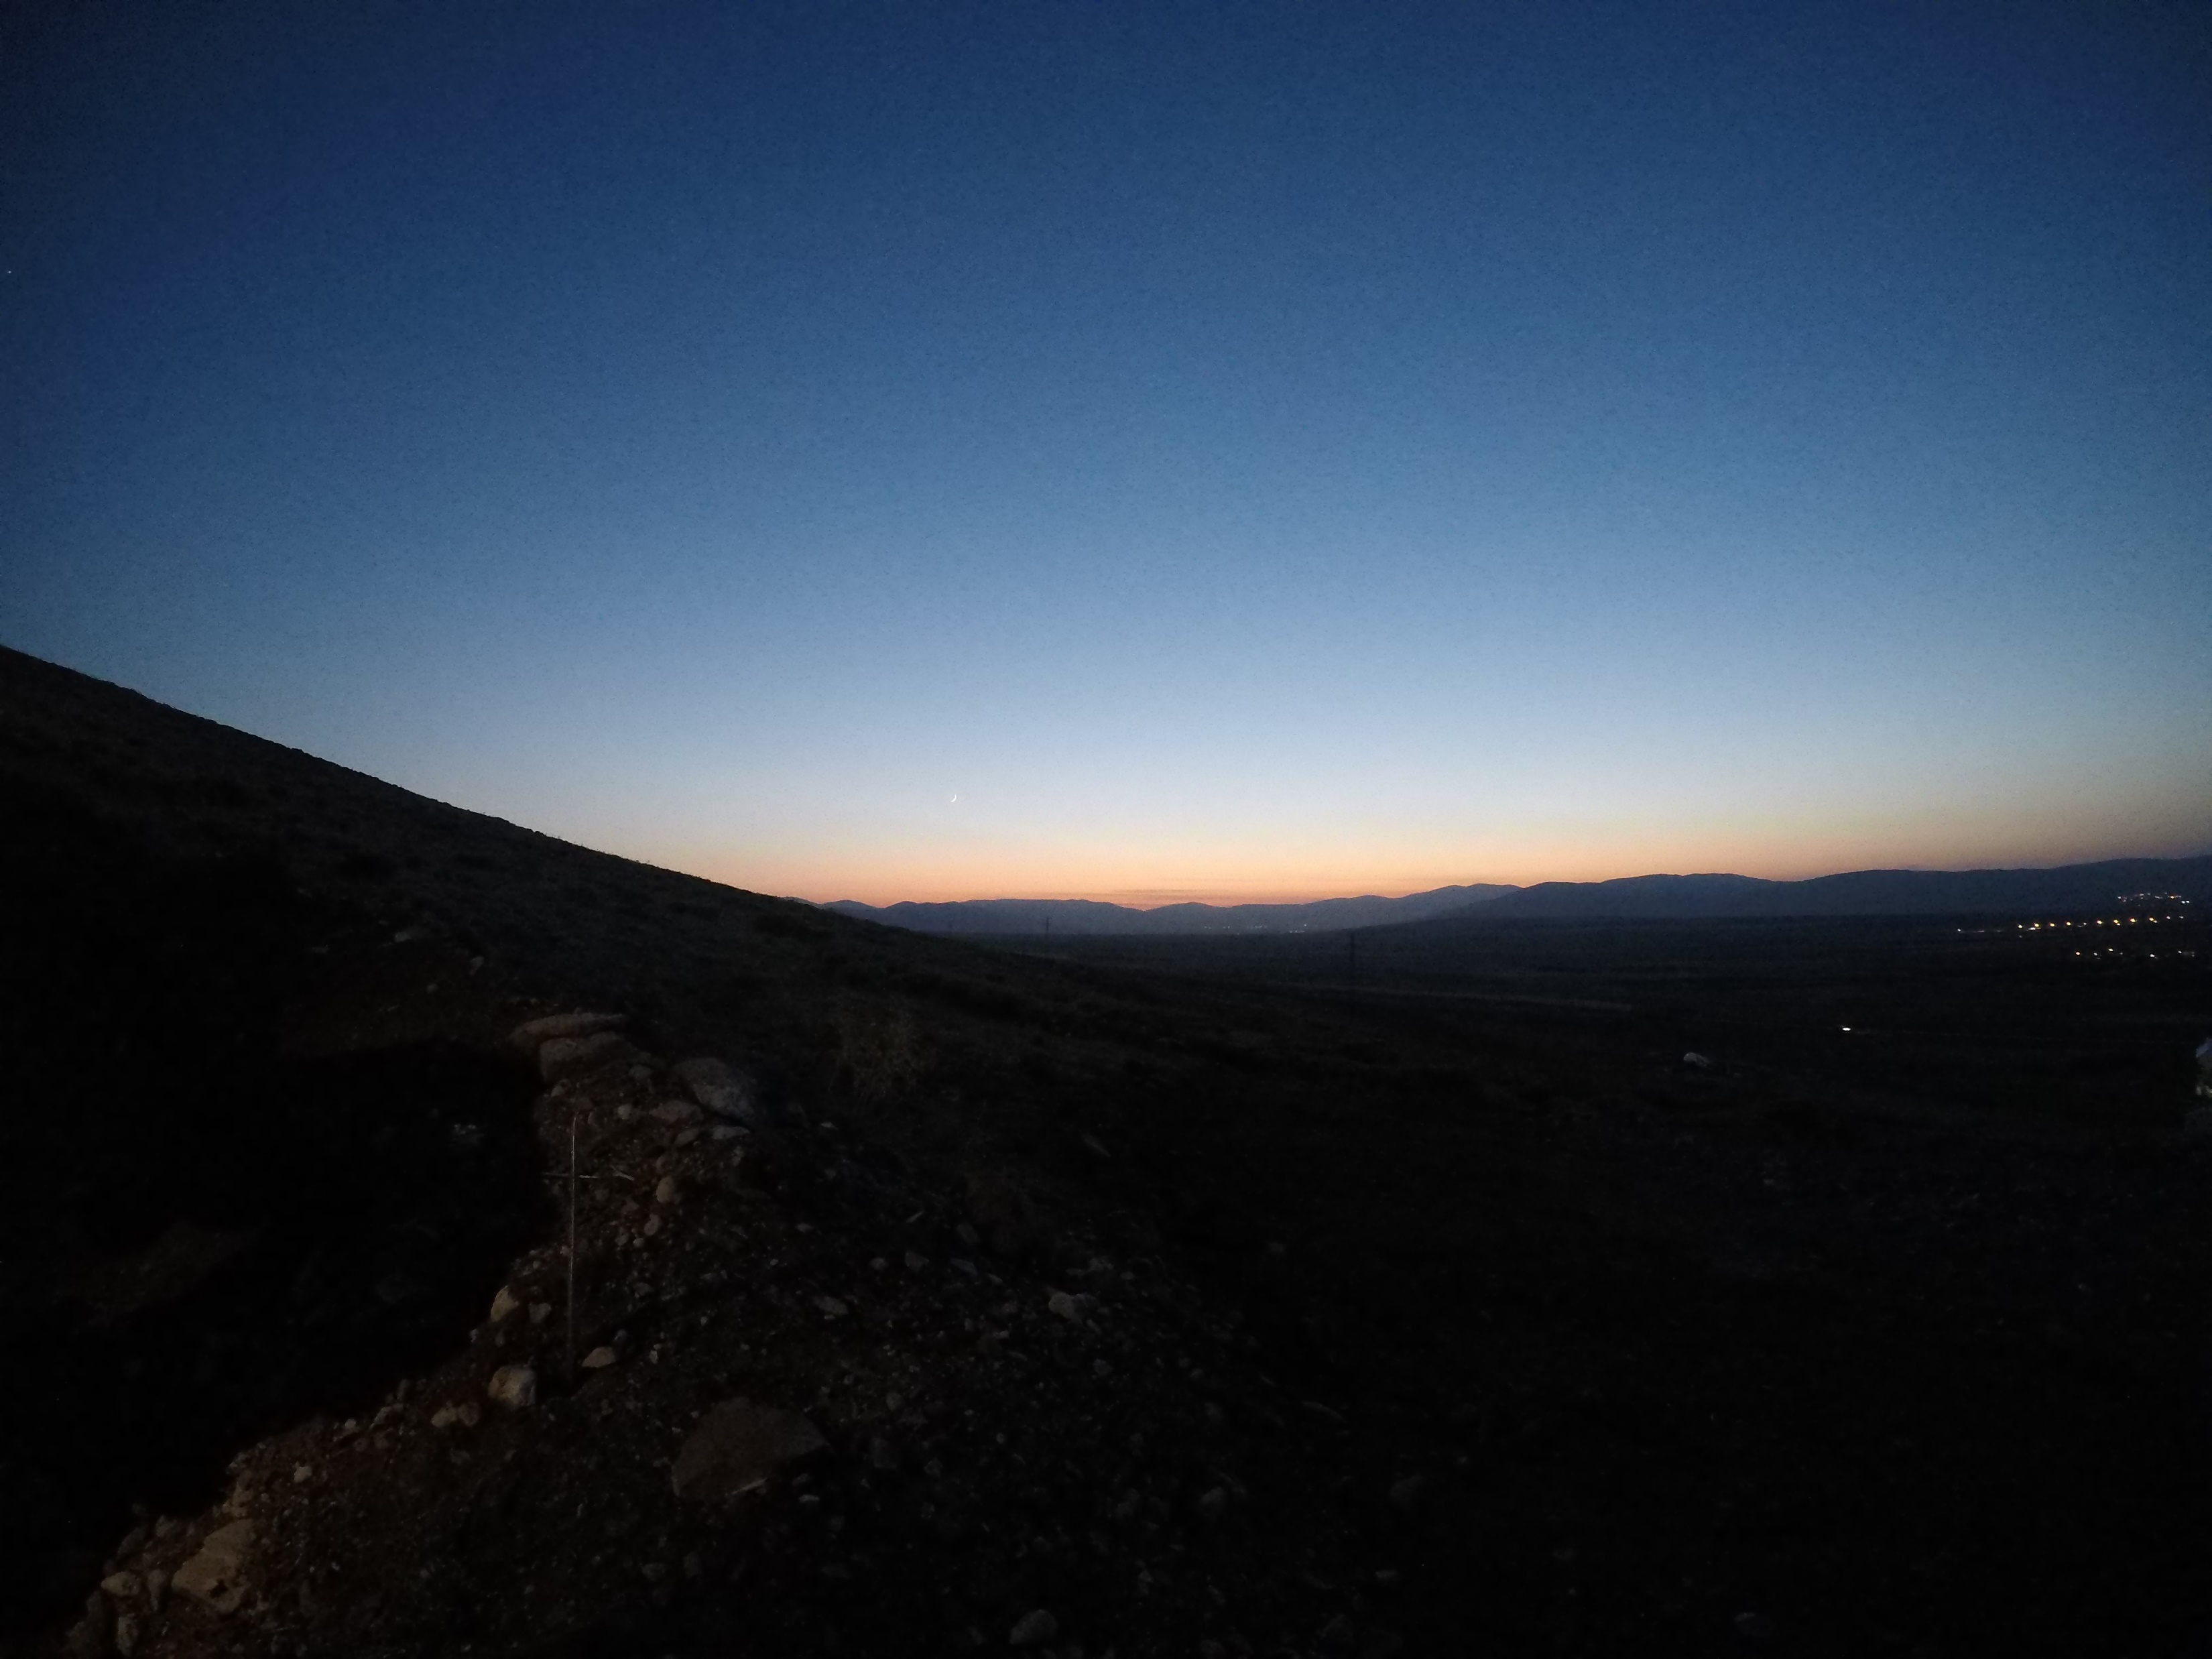
Hour: 17:59 Sun: -6,2°

Slide 9
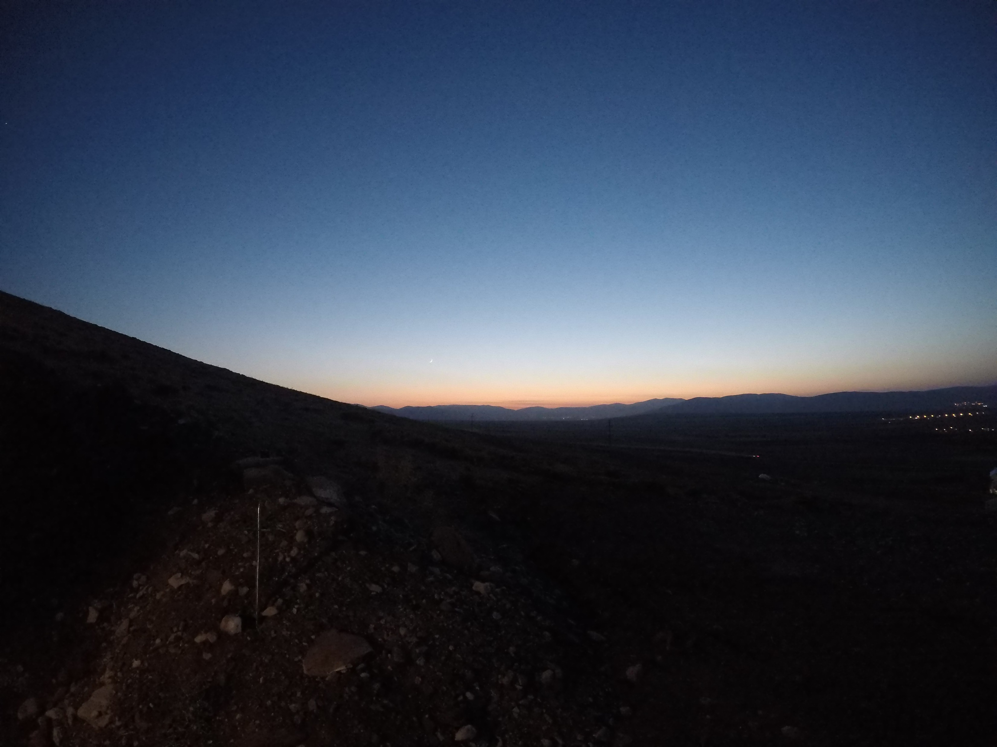
Hour: 18:00 Sun: -6,4°

Slide 10
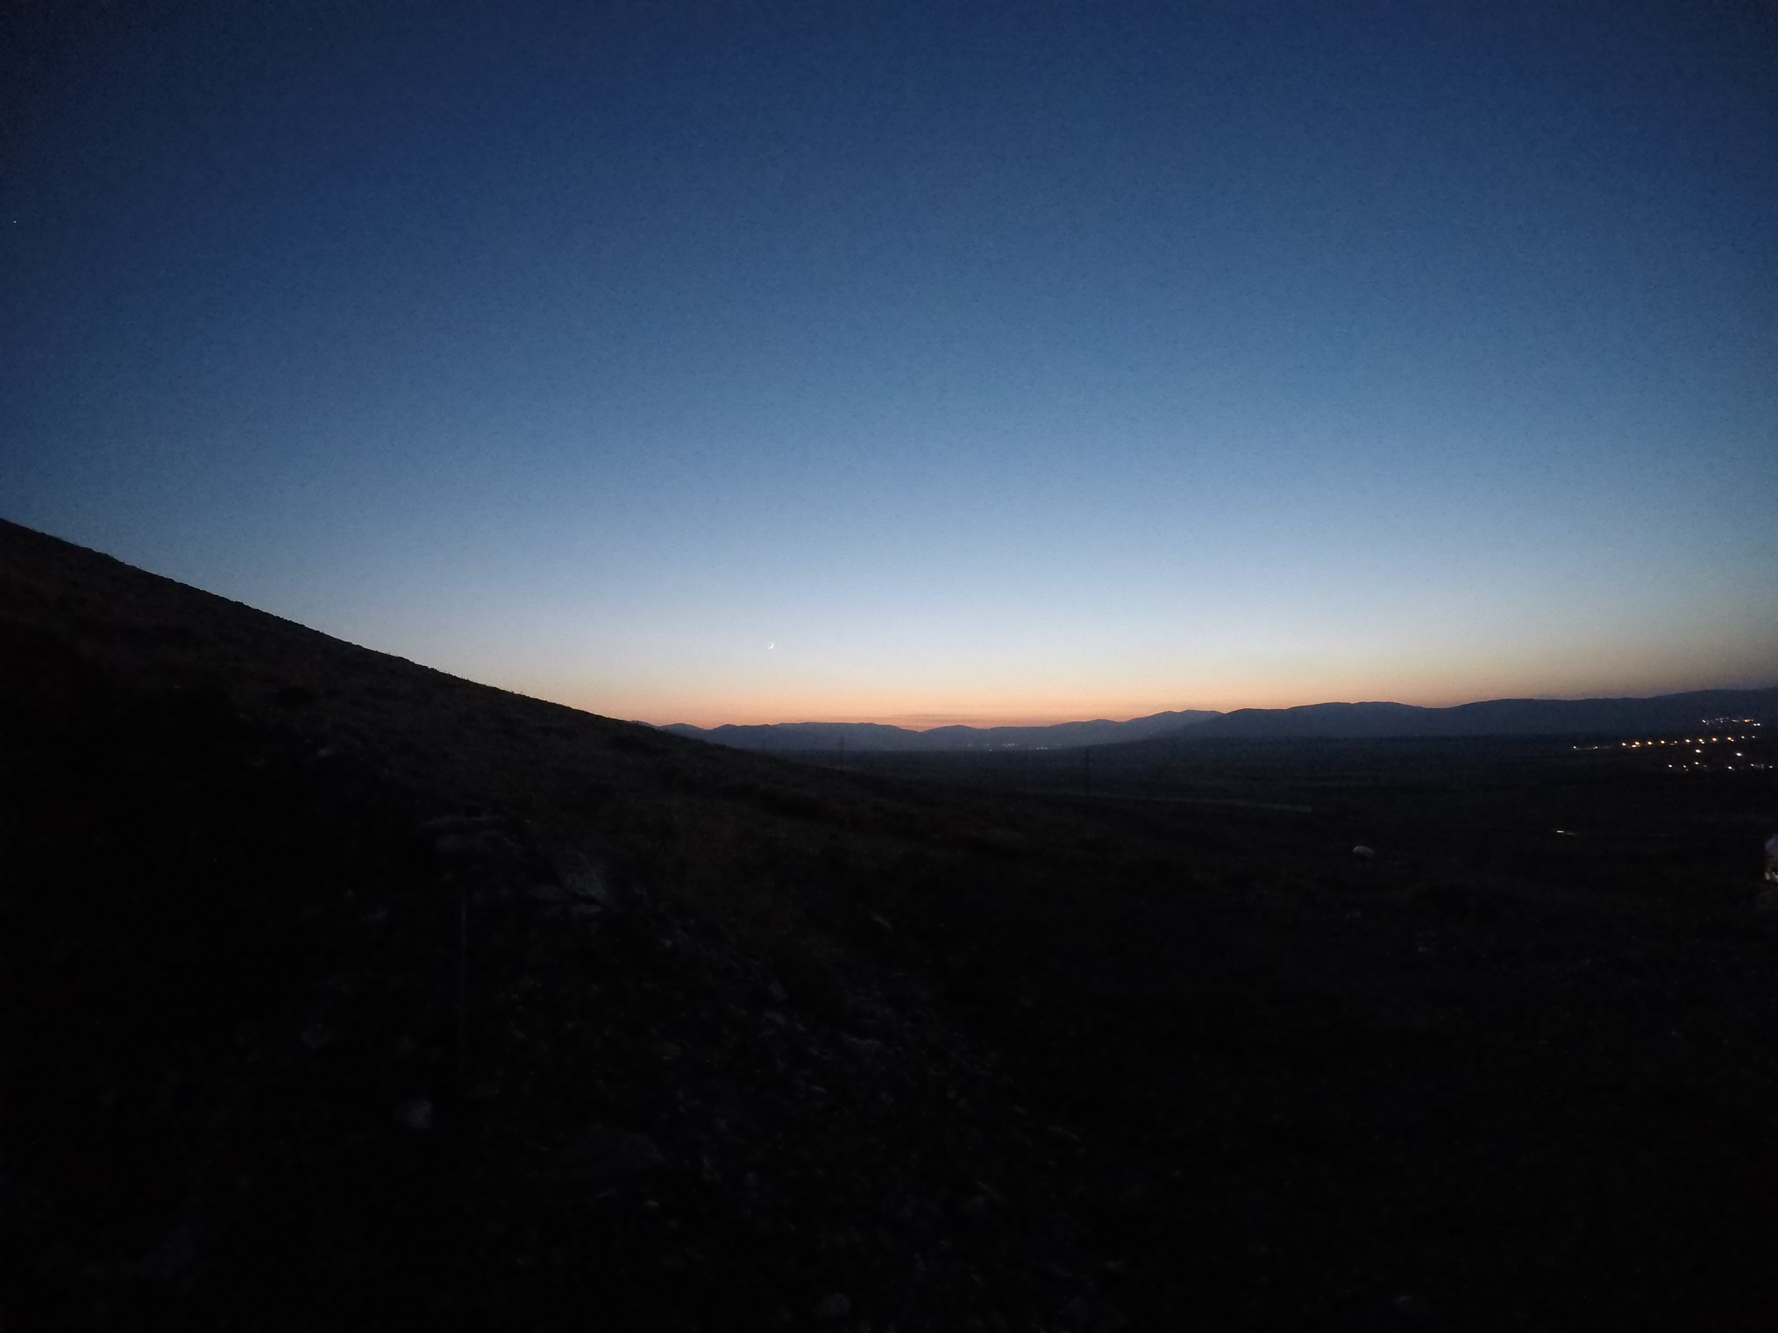
Hour: 18:01 Sun: -6,5°

Slide 11
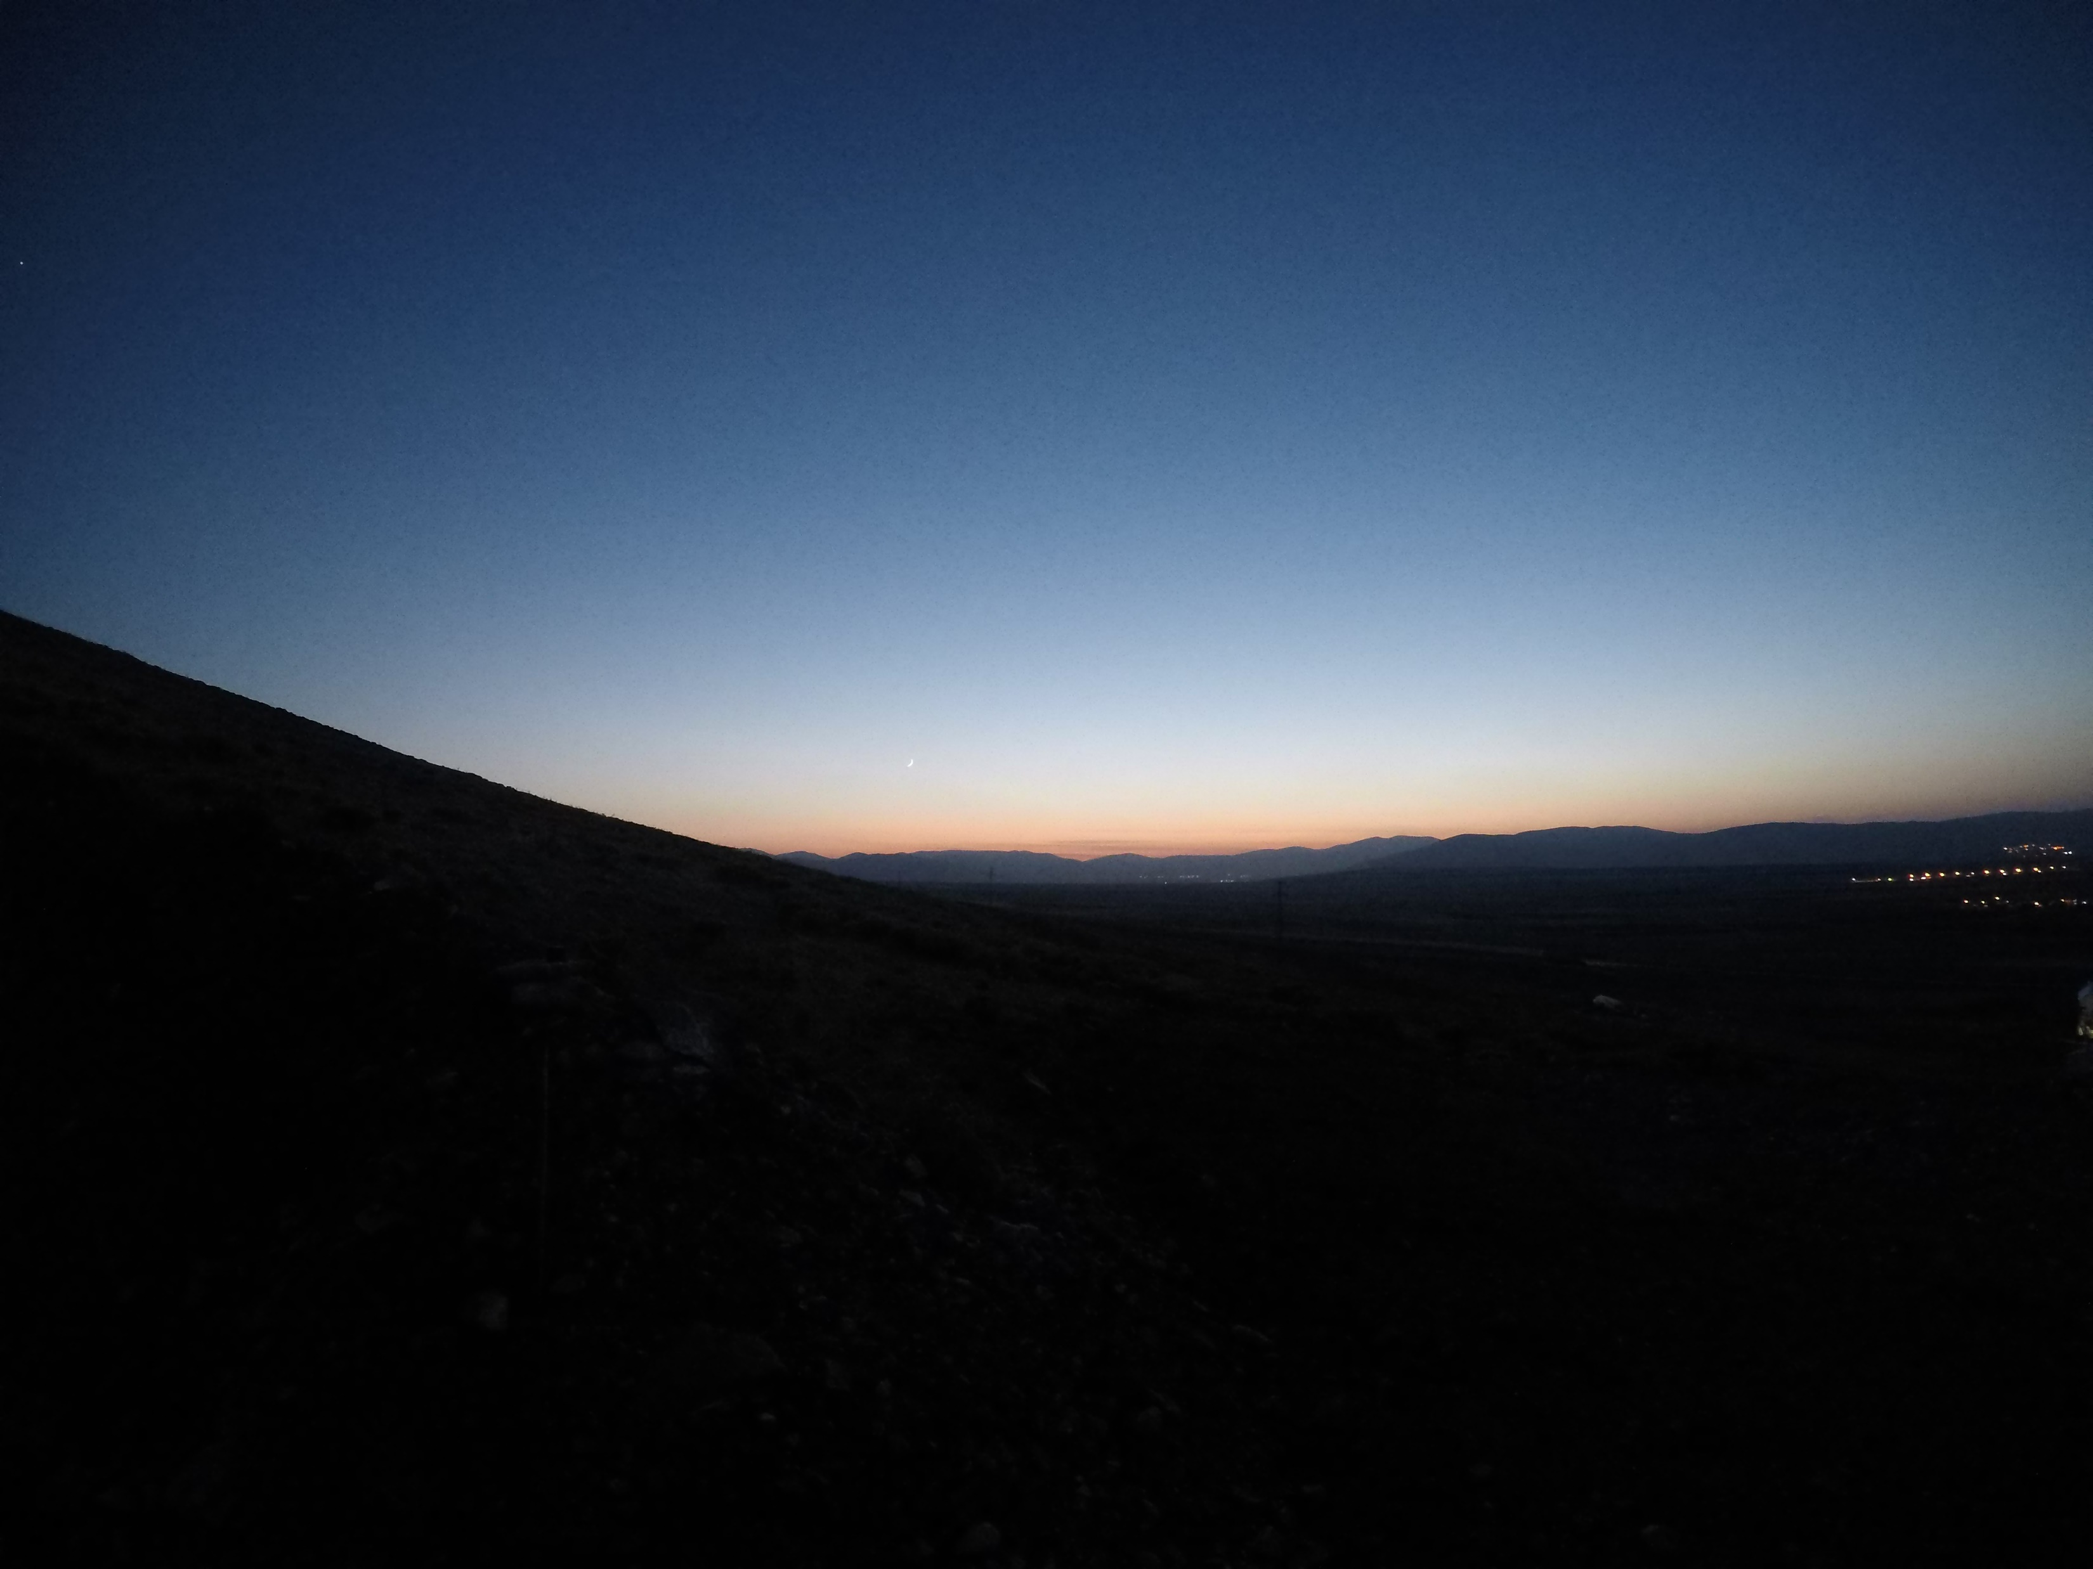
Hour: 18:02 Sun: -6,7°

Slide 12

Hour: 18:03 Sun: -6,9°

Slide 13

Hour: 18:04 Sun: -7,1°

Slide 14
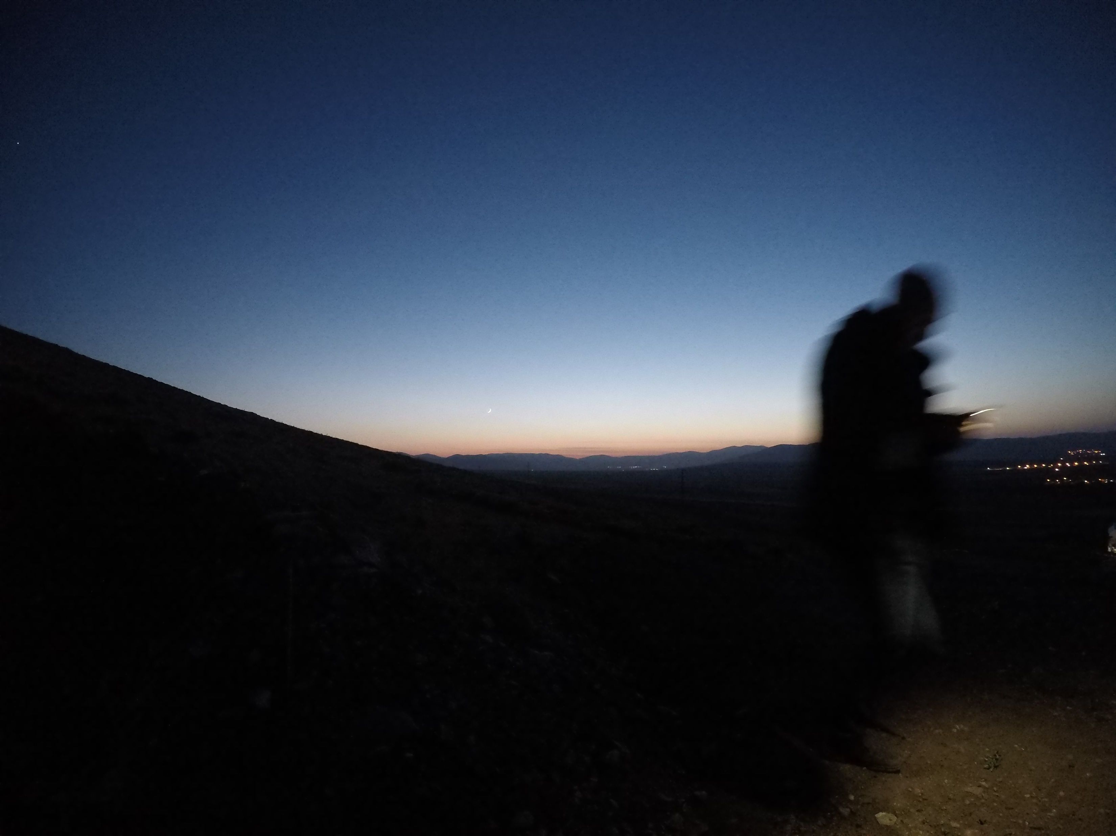
Hour: 18:05 Sun: -7,3°

Slide 15
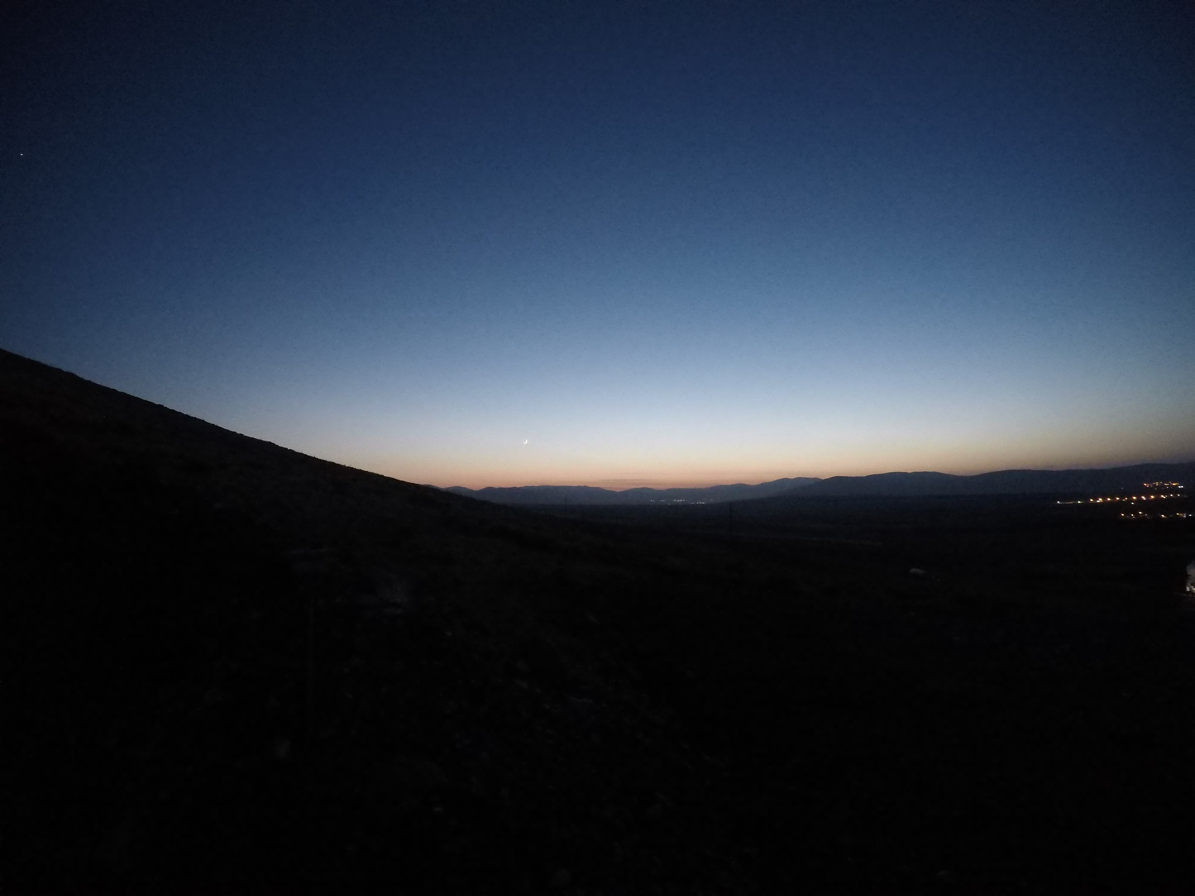
Hour: 18:06 Sun: -7,5°

Slide 16
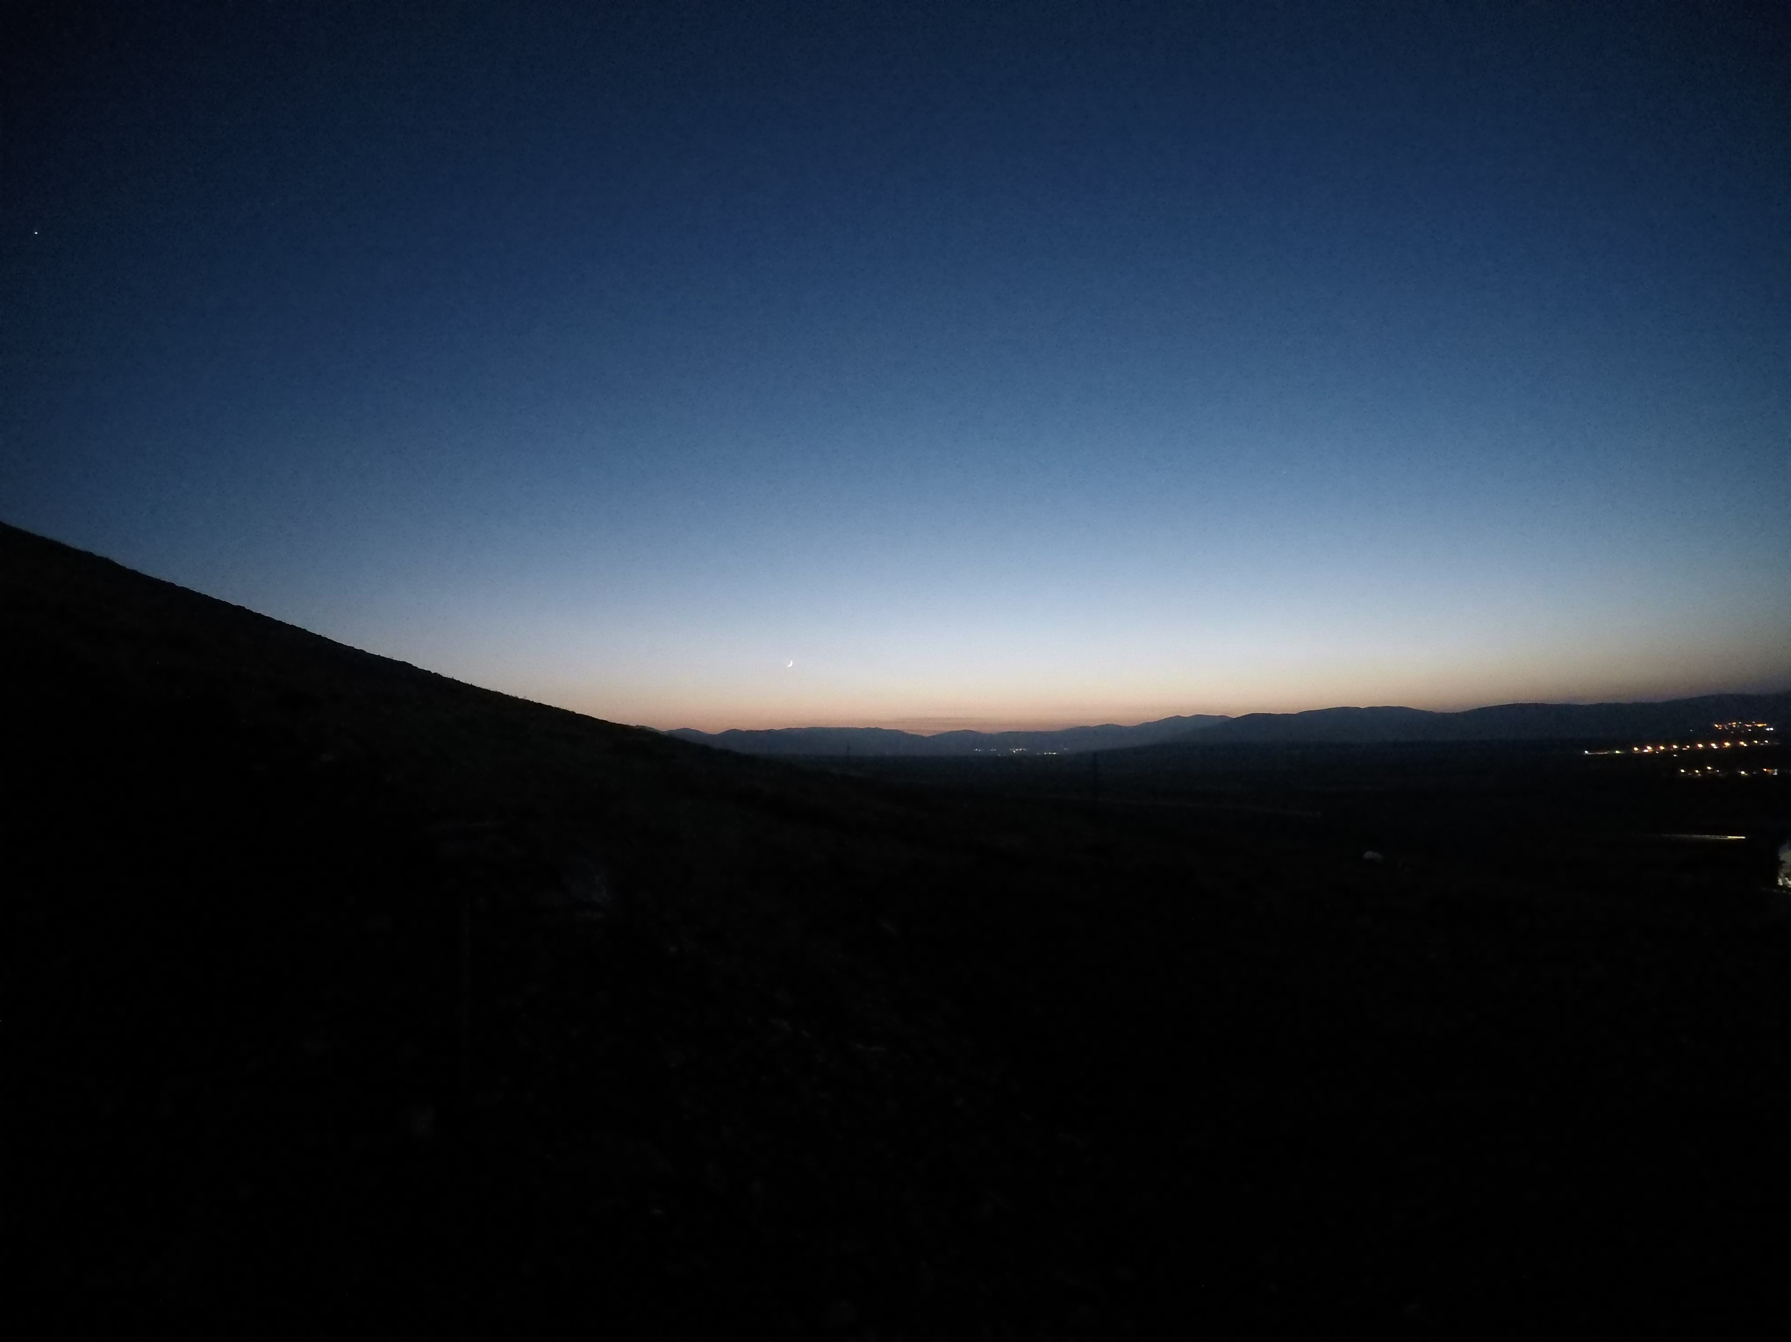
Hour: 18:07 Sun: -7,7°

Slide 17
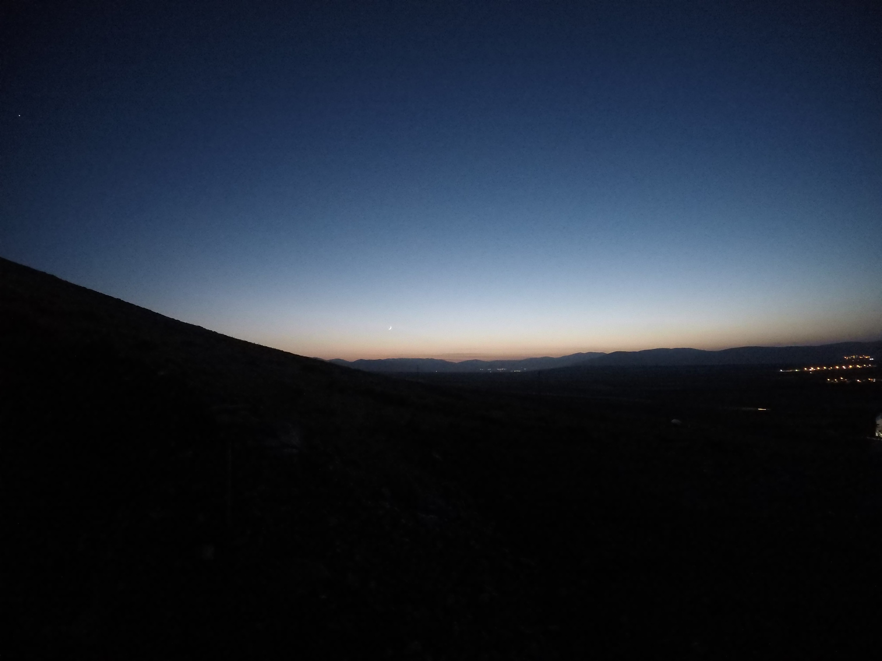
Hour: 18:08 Sun: -7,9°

Slide 18
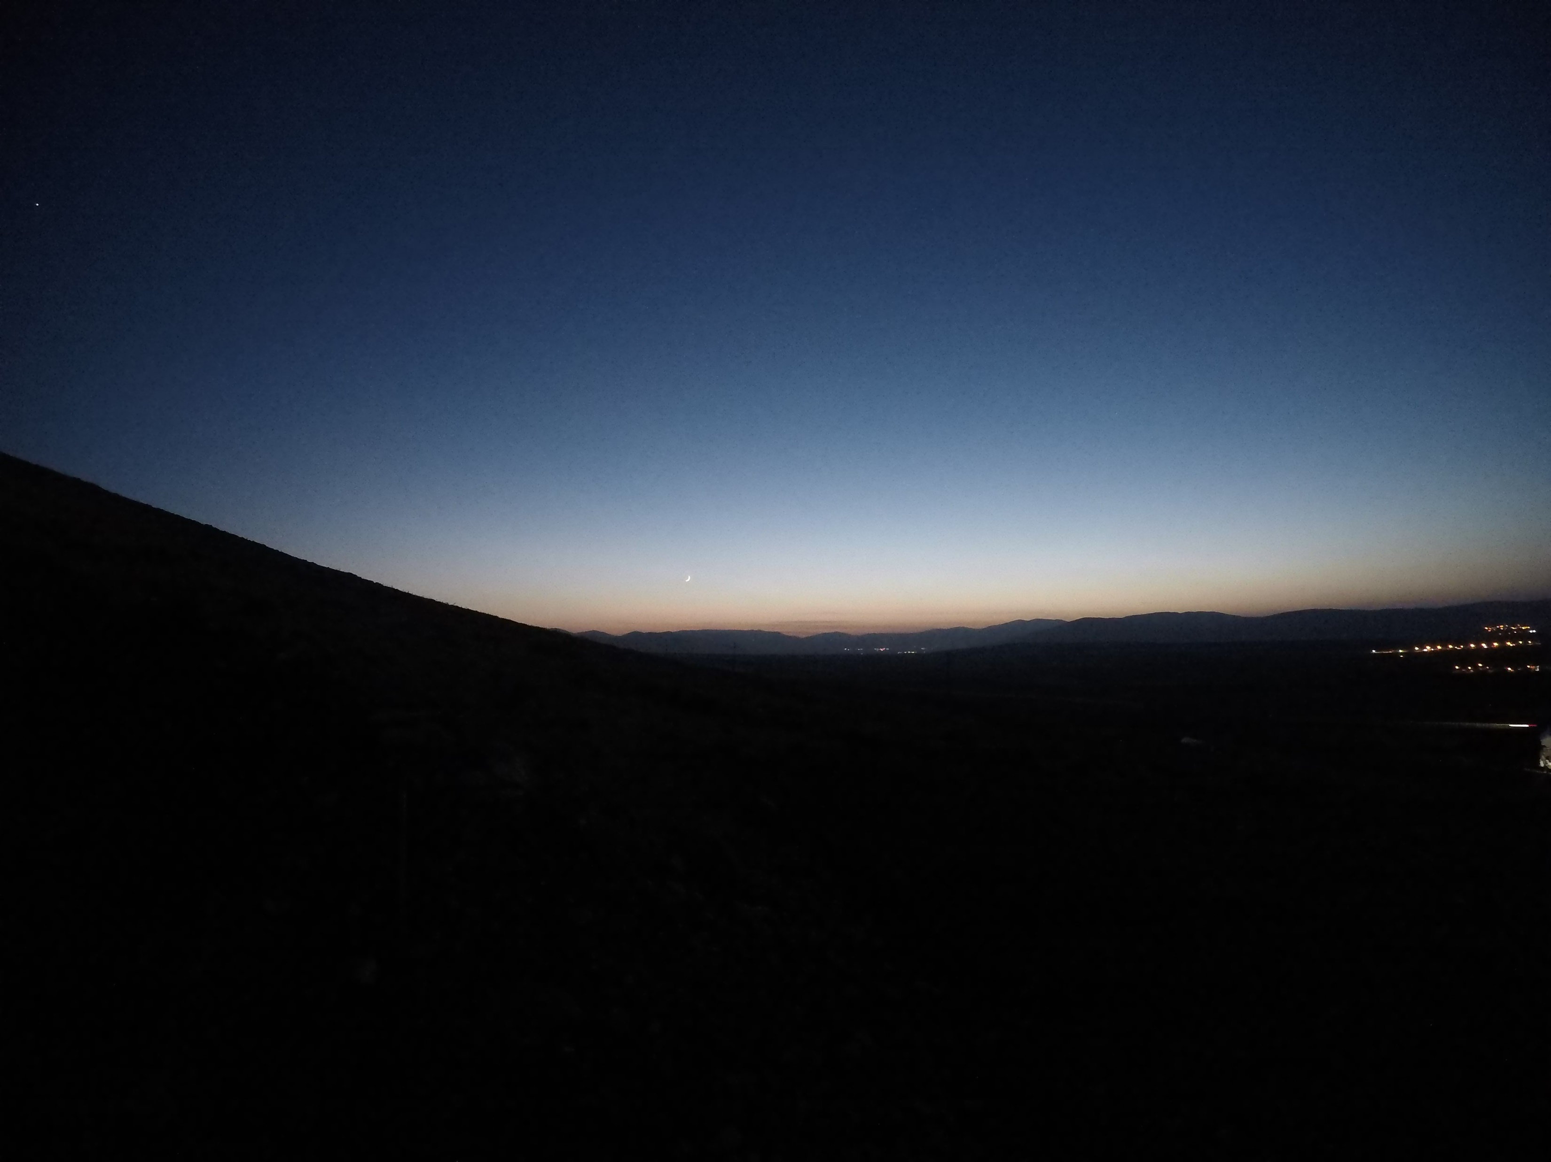
Hour: 18:09 Sun: -8,1°

Slide 19
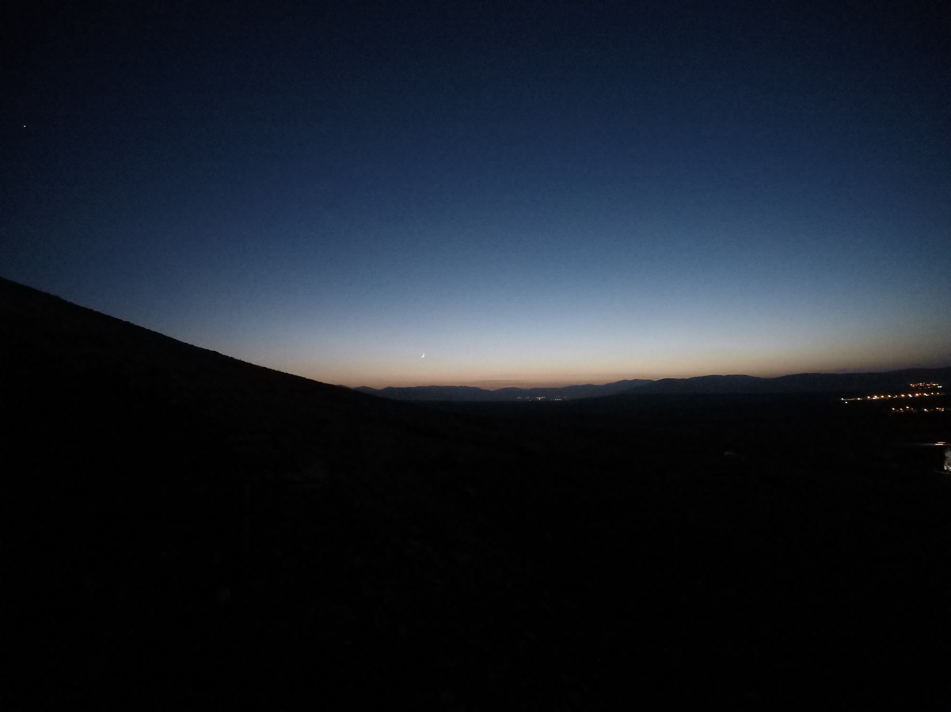
Hour: 18:10 Sun: -8,3°

Slide 20
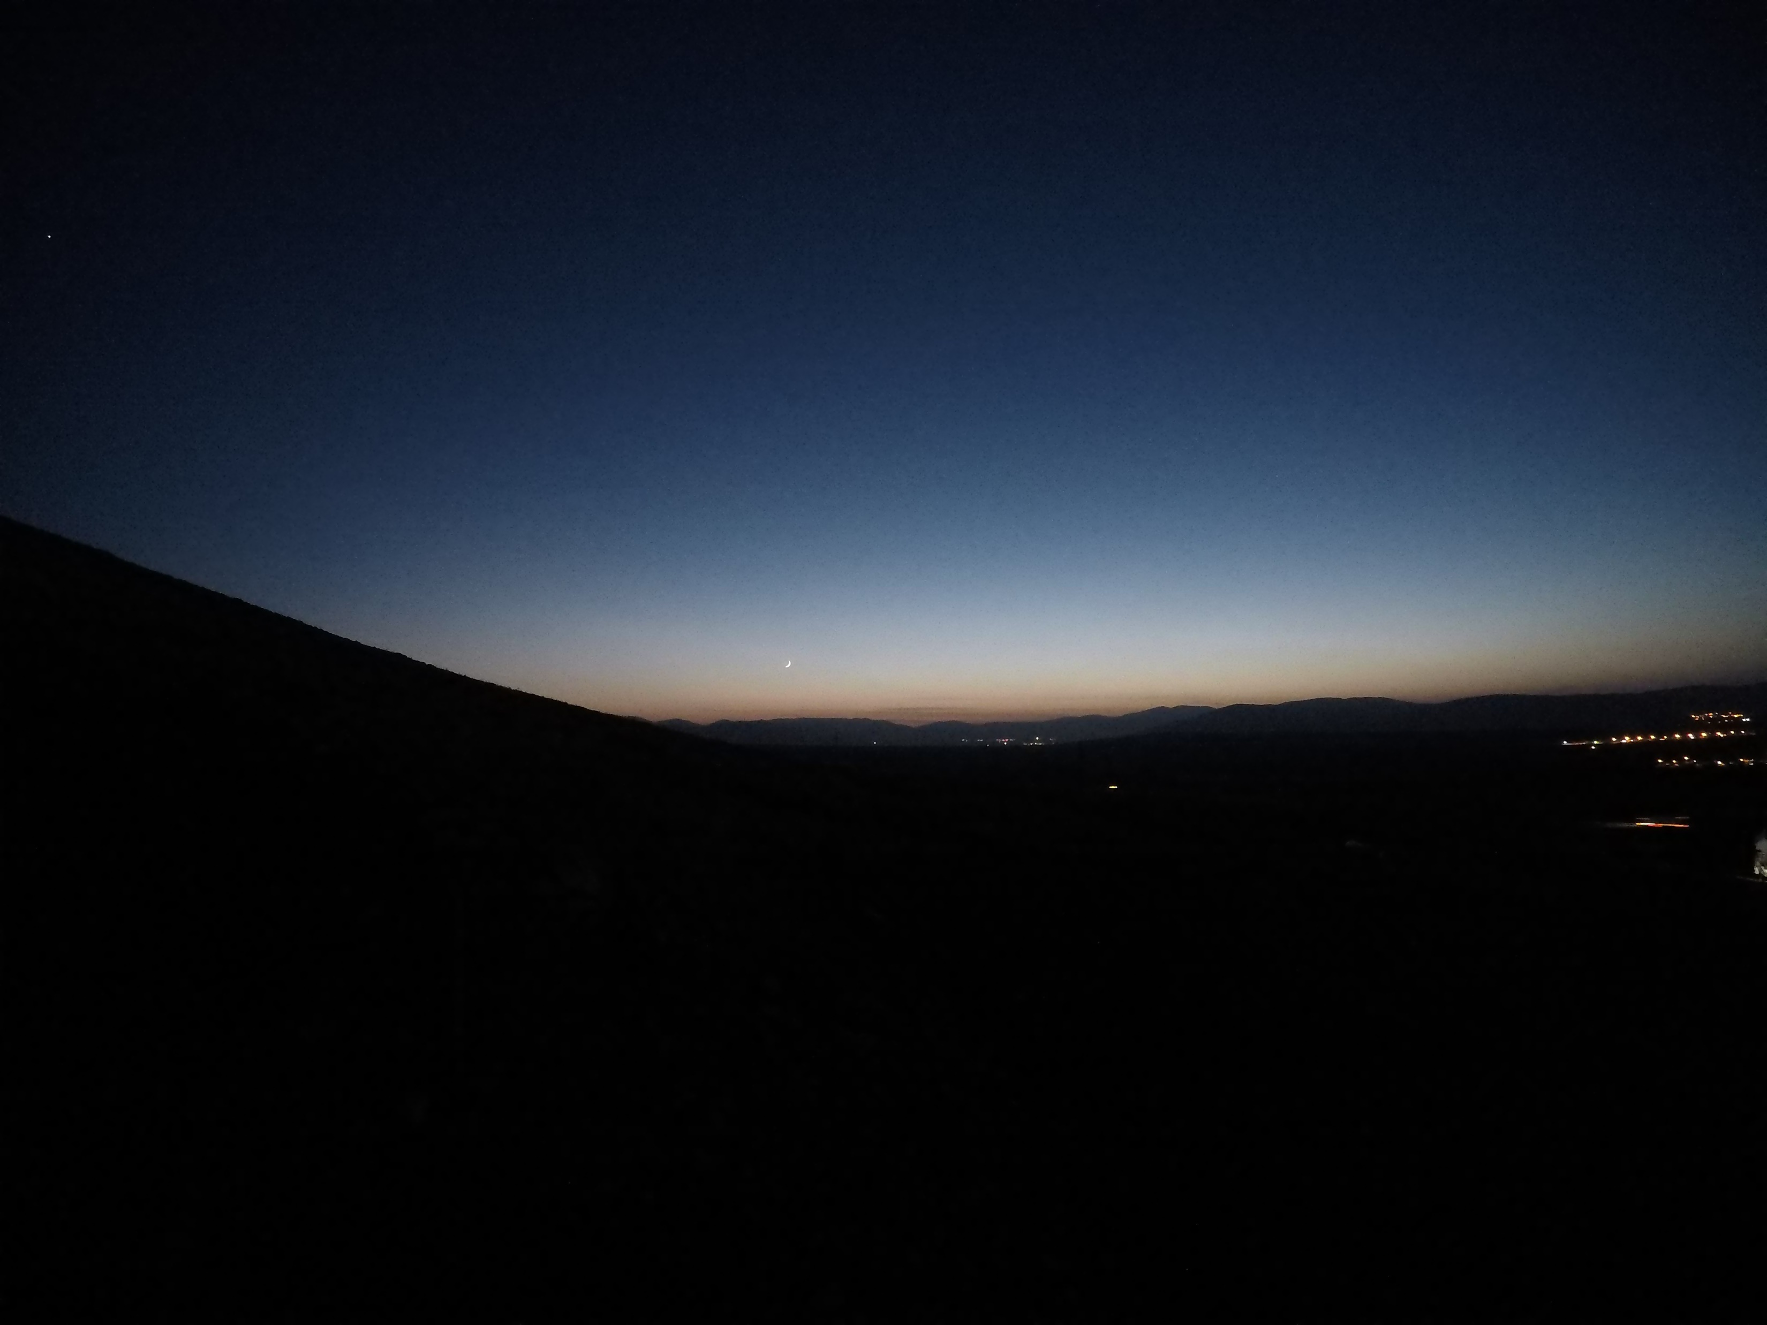
Hour: 18:11 Sun: -8,5°

Slide 21
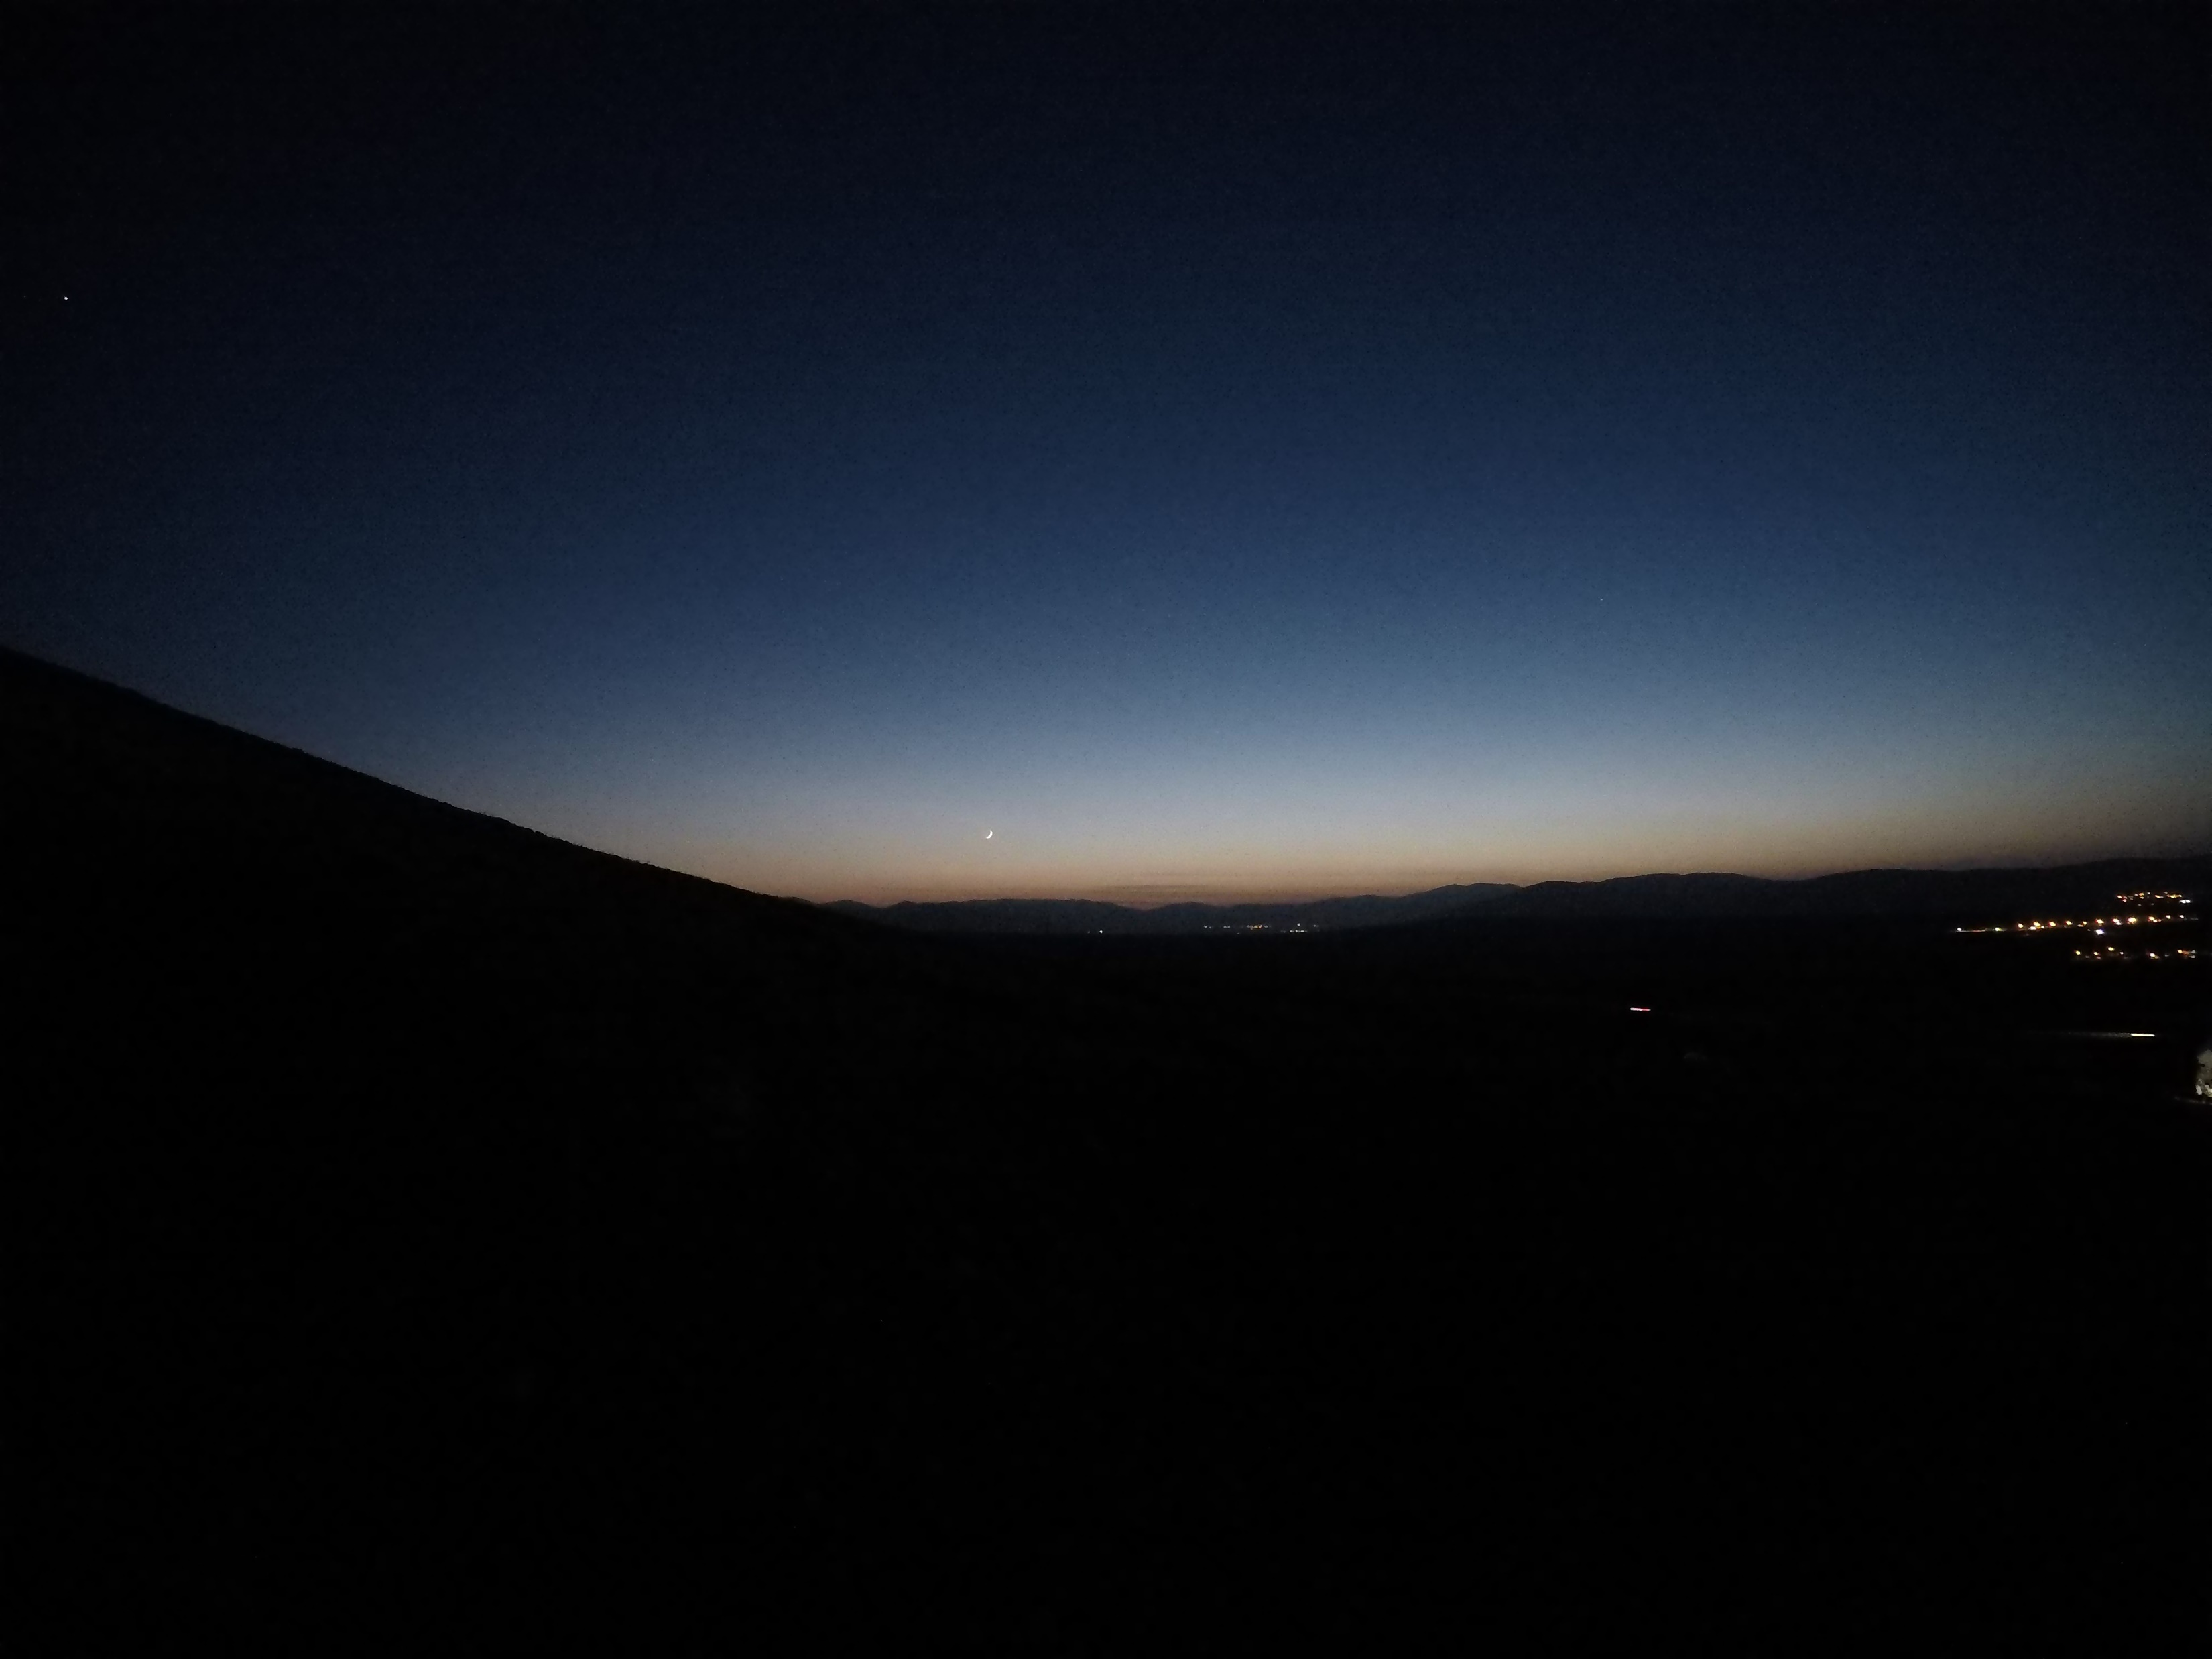
Hour: 18:12 Sun: -8,7°

Slide 22
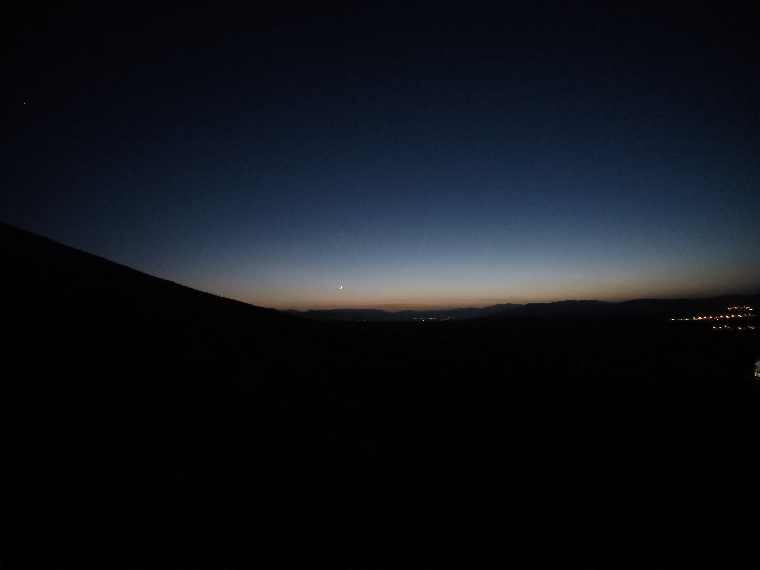
Hour: 18:13 Sun: -8,9°

Slide 23
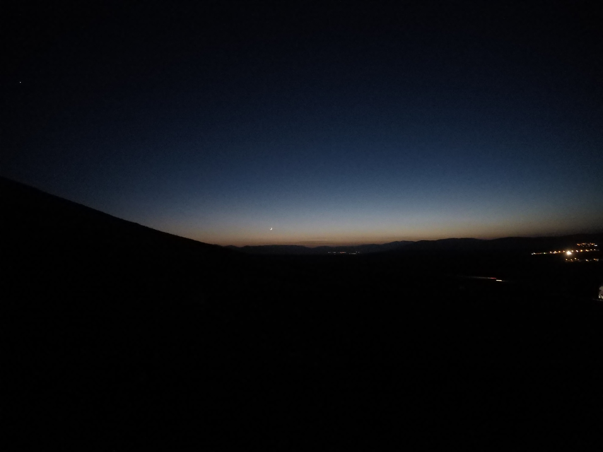
Hour: 18:14 Sun: -9,0°

Slide 24
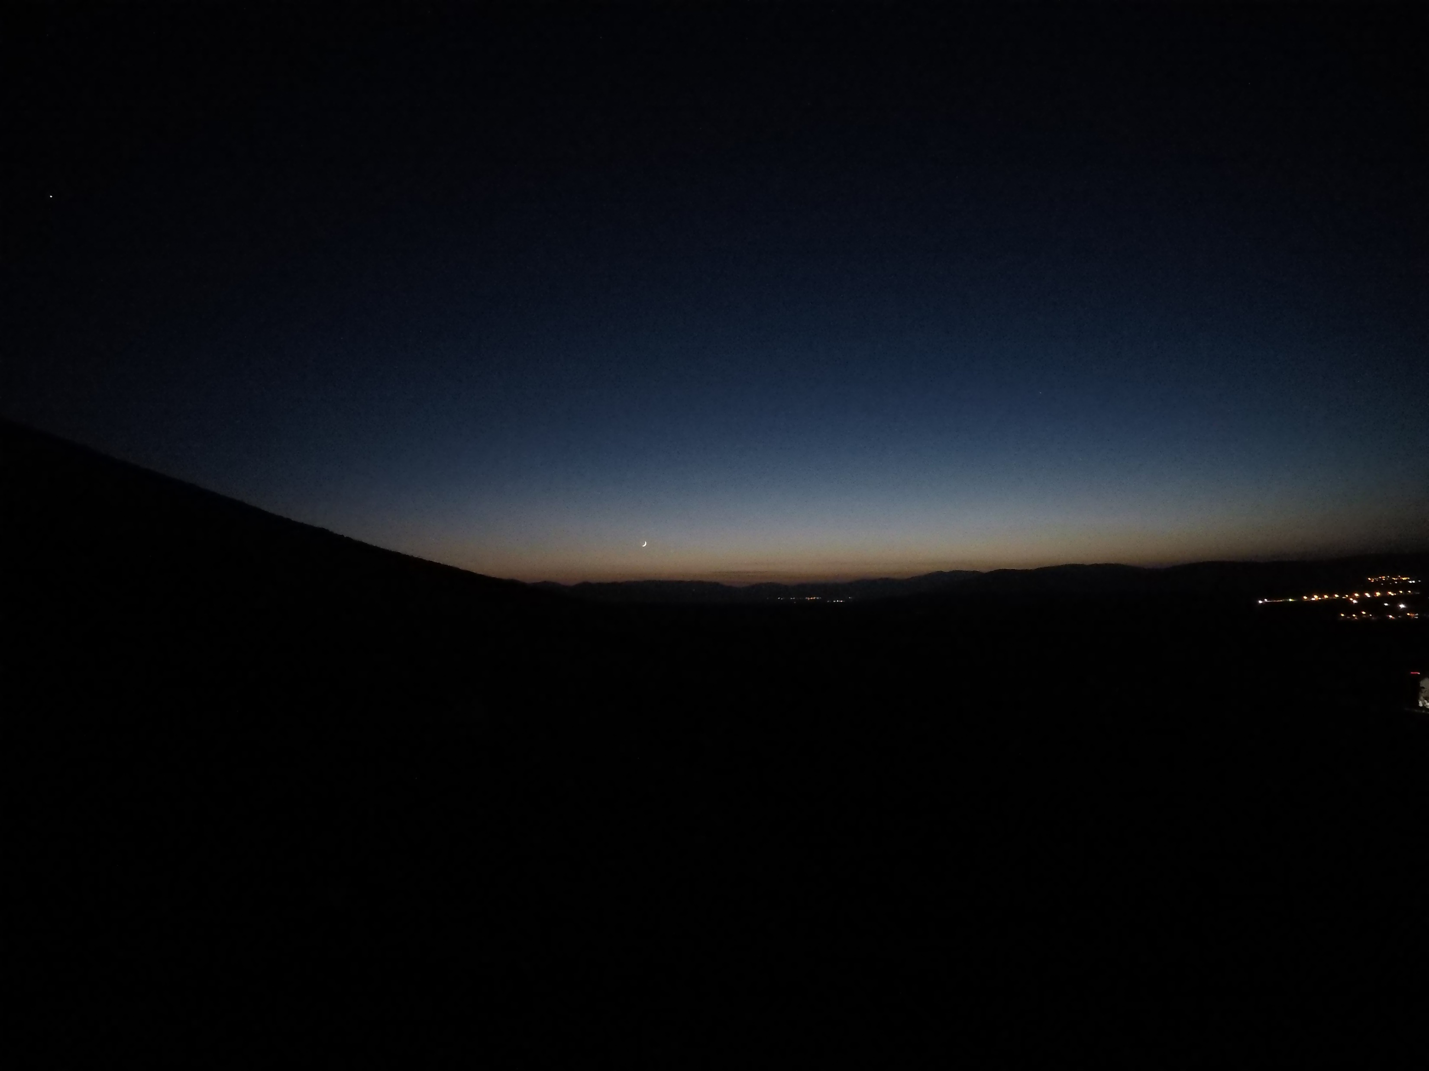
Hour: 18:15 Sun: -9,2°

Slide 25
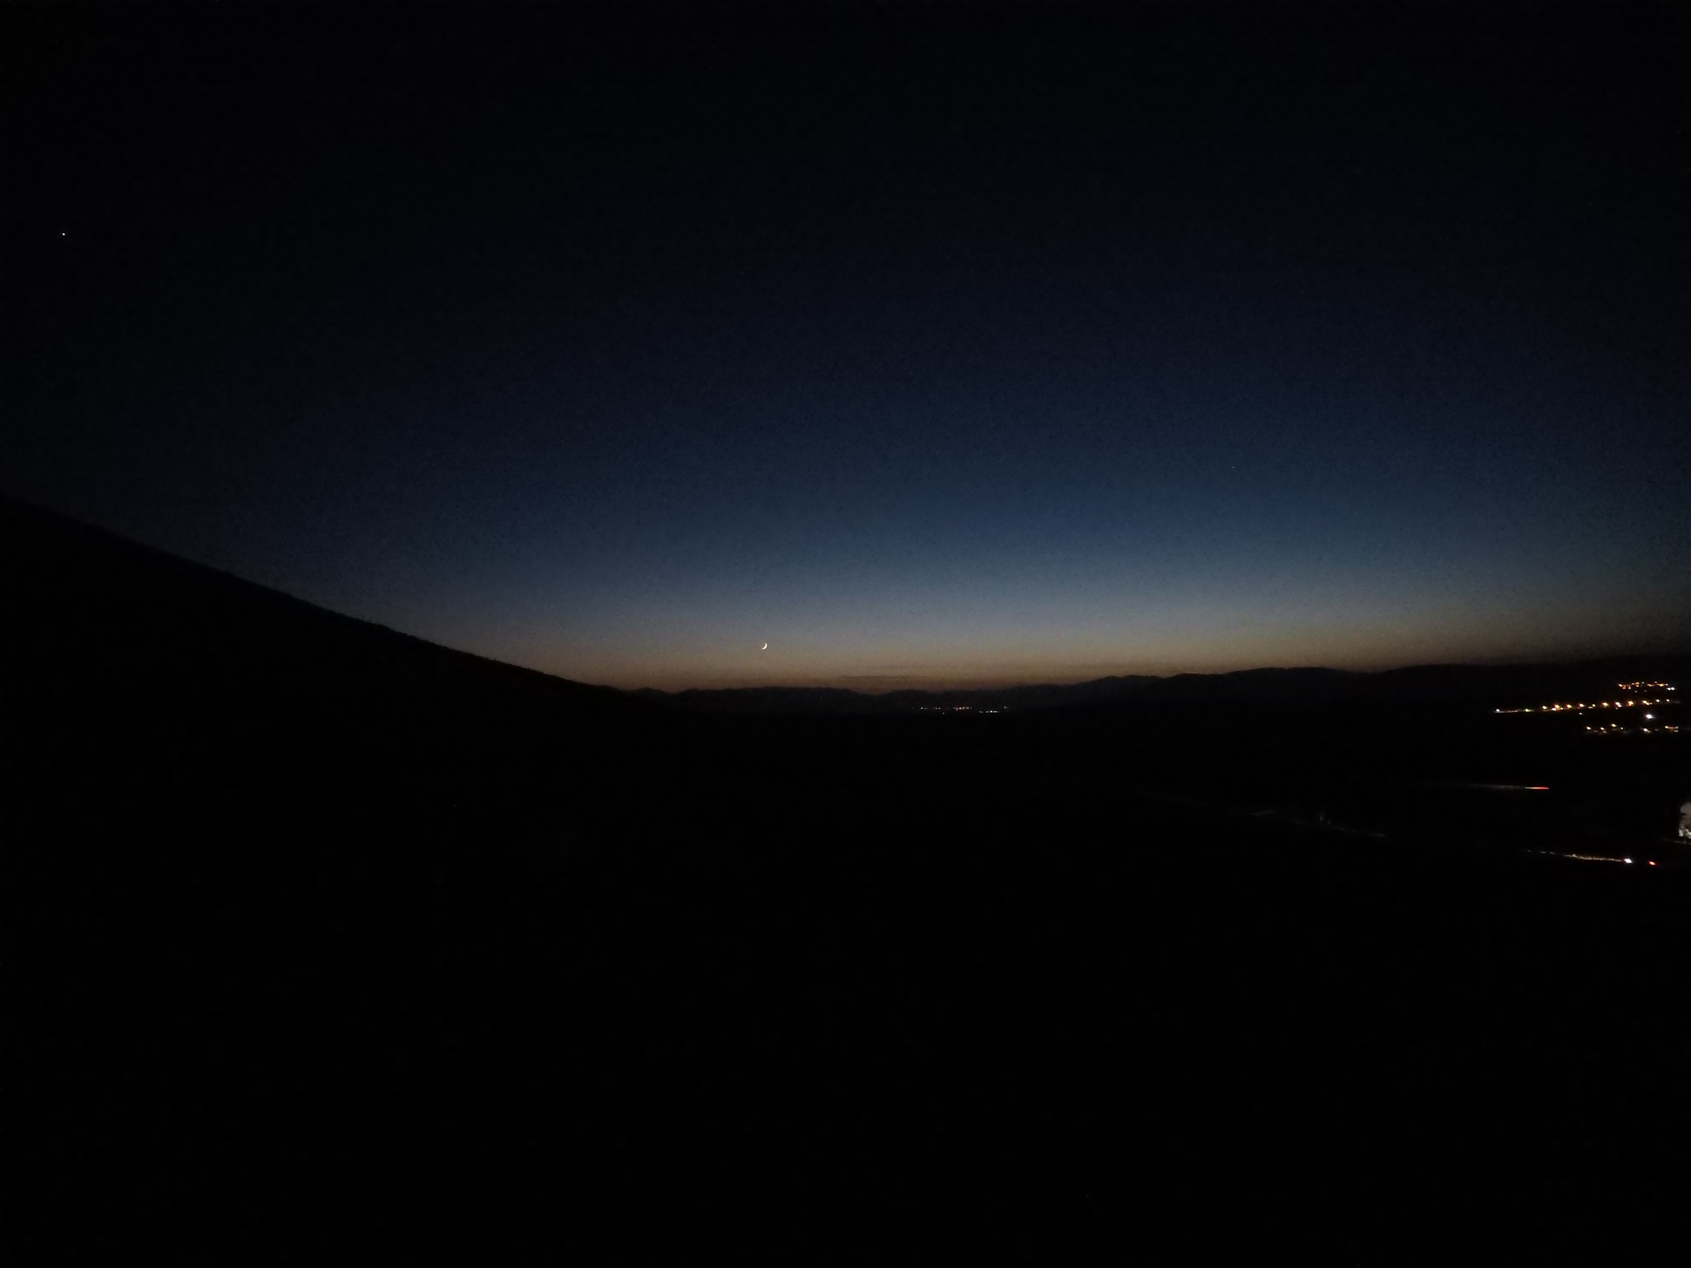
Hour: 18:16 Sun: -9,4°

Slide 26

Hour: 18:17 Sun: -9,6°

Slide 27
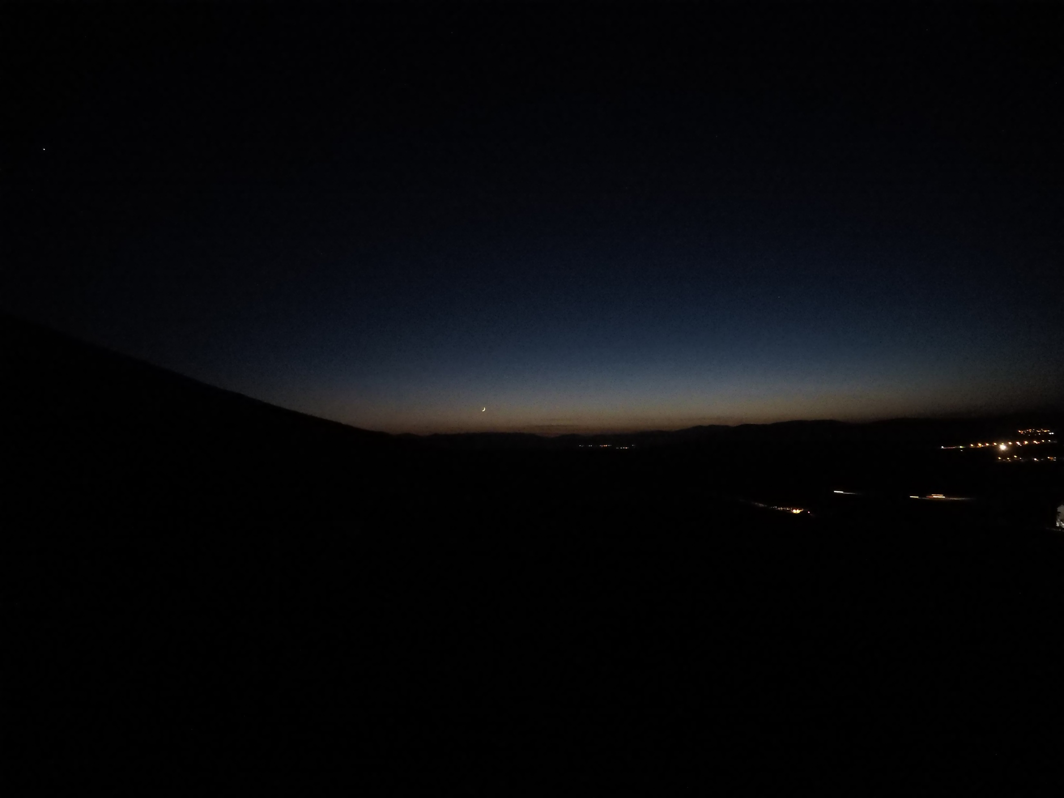
Hour: 18:18 Sun: -9,8°

Slide 28
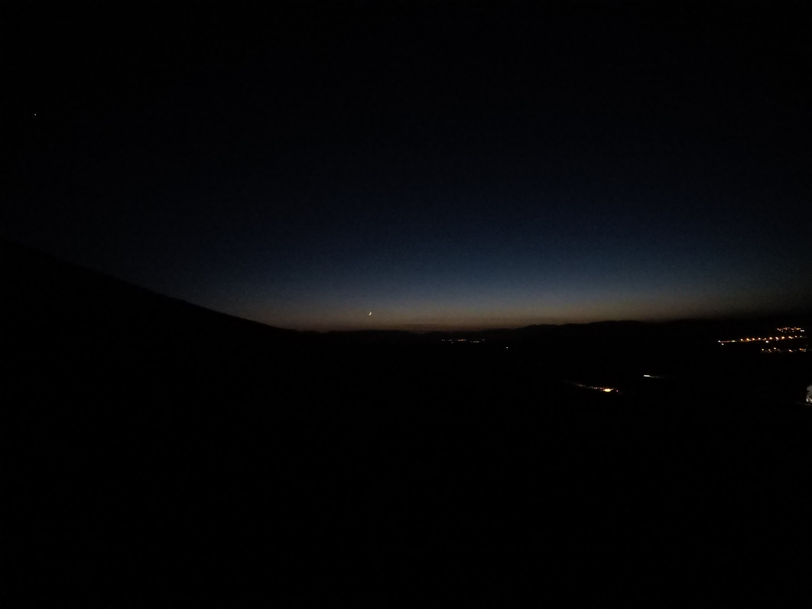
Hour: 18:19 Sun: -10,0°

Slide 29
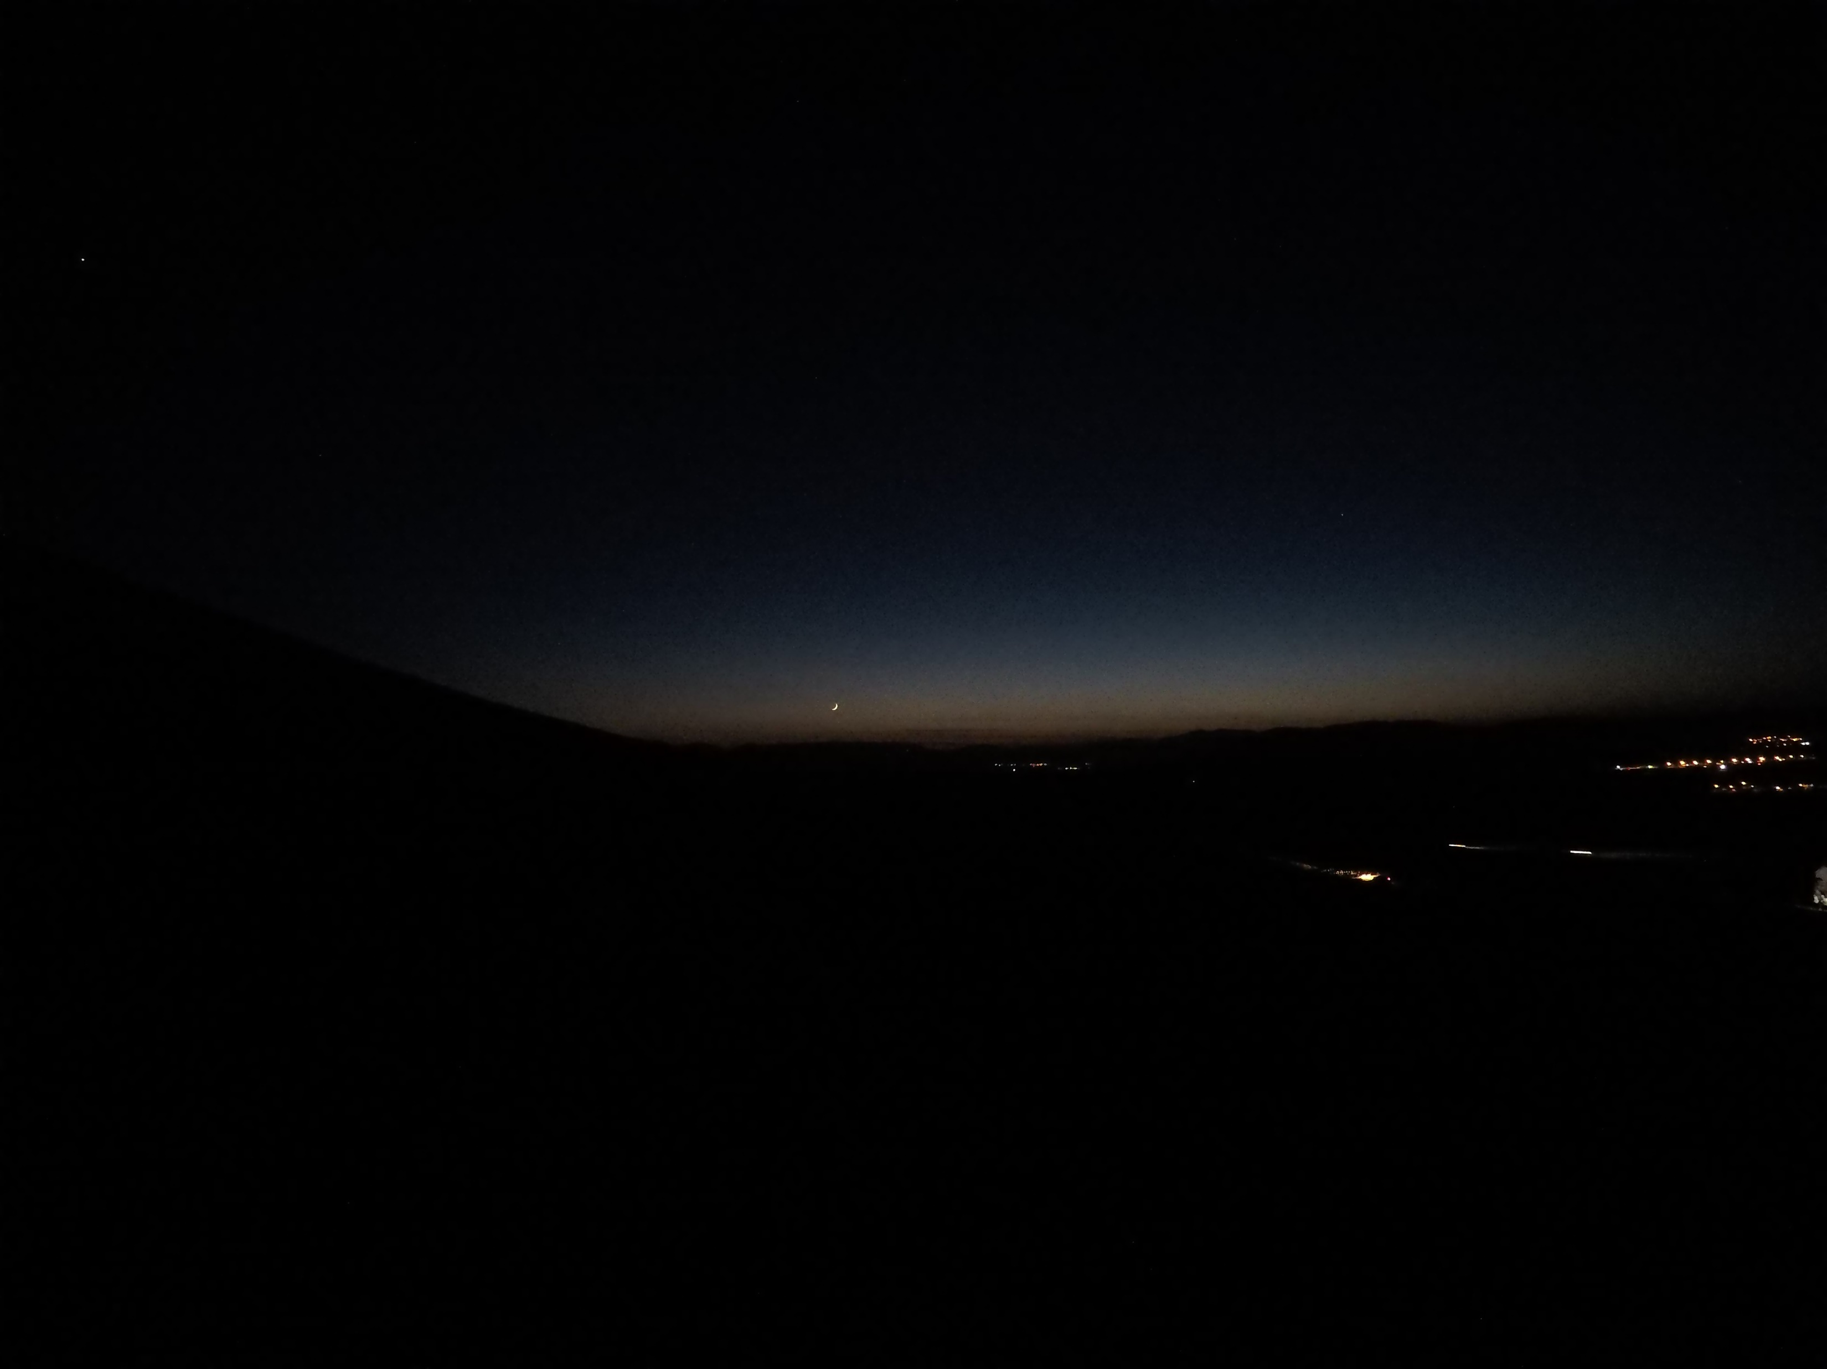
Hour: 18:20 Sun: -10,2°

Slide 30
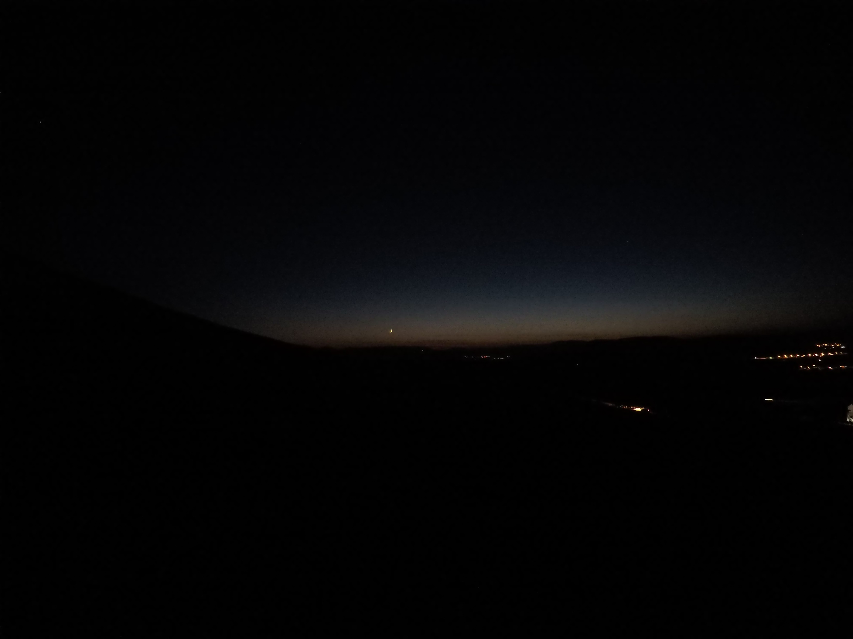
Hour: 18:21 Sun: -10,4°

Slide 31
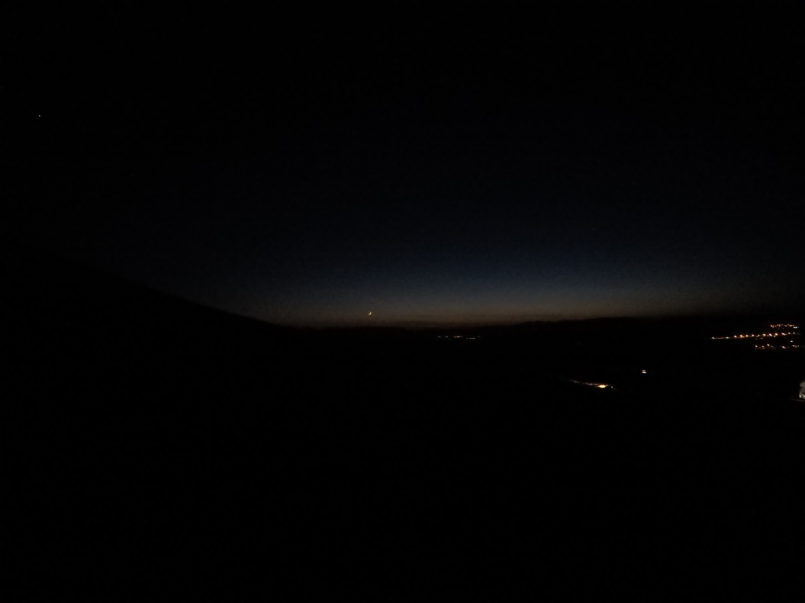
Hour: 18:22 Sun: -10,6°

Slide 32
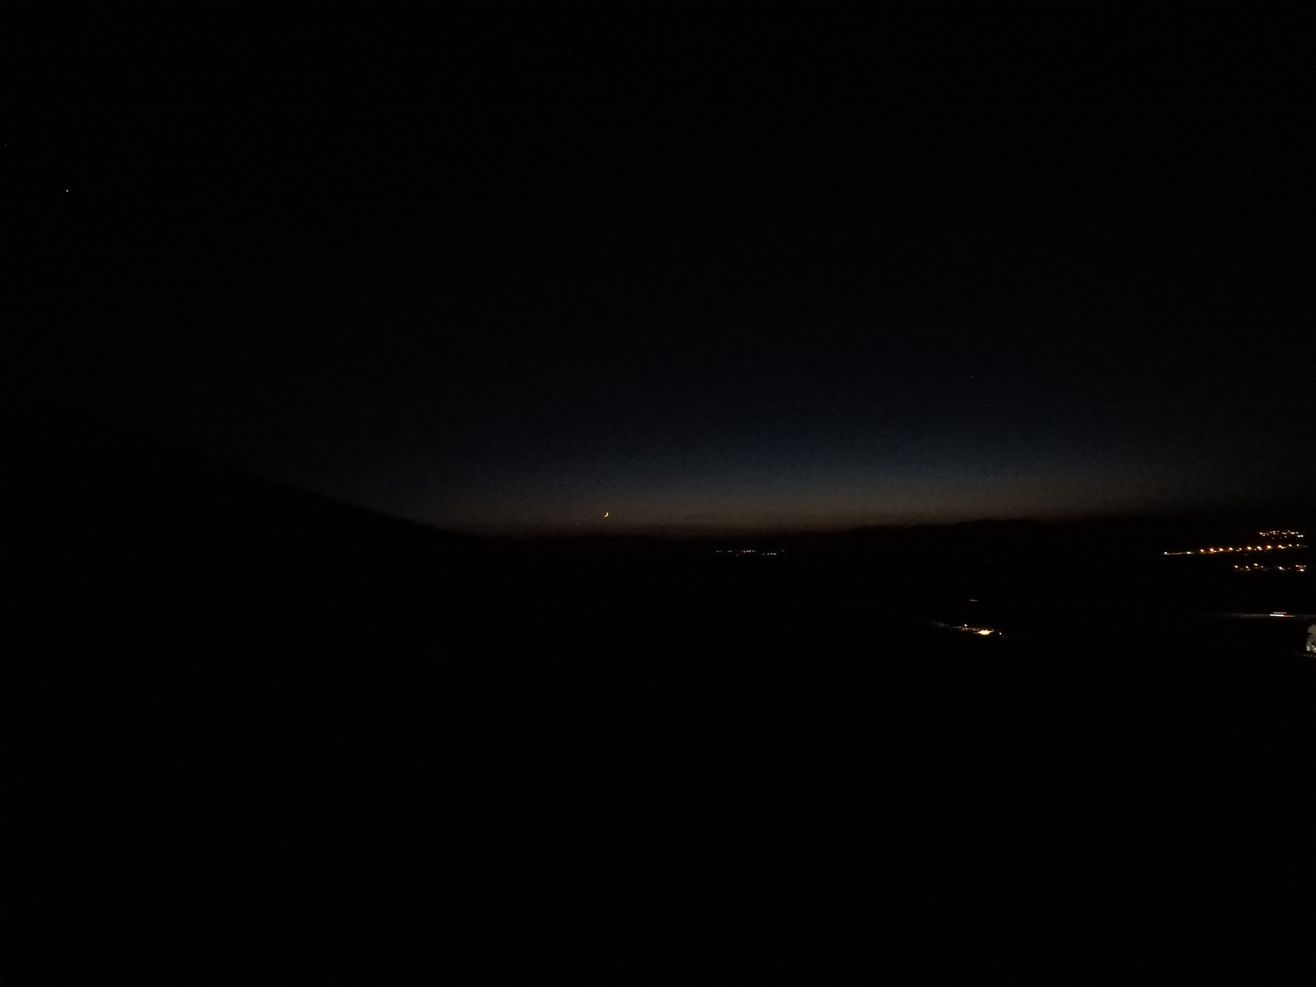
Hour: 18:23 Sun: -10,8°

Slide 33
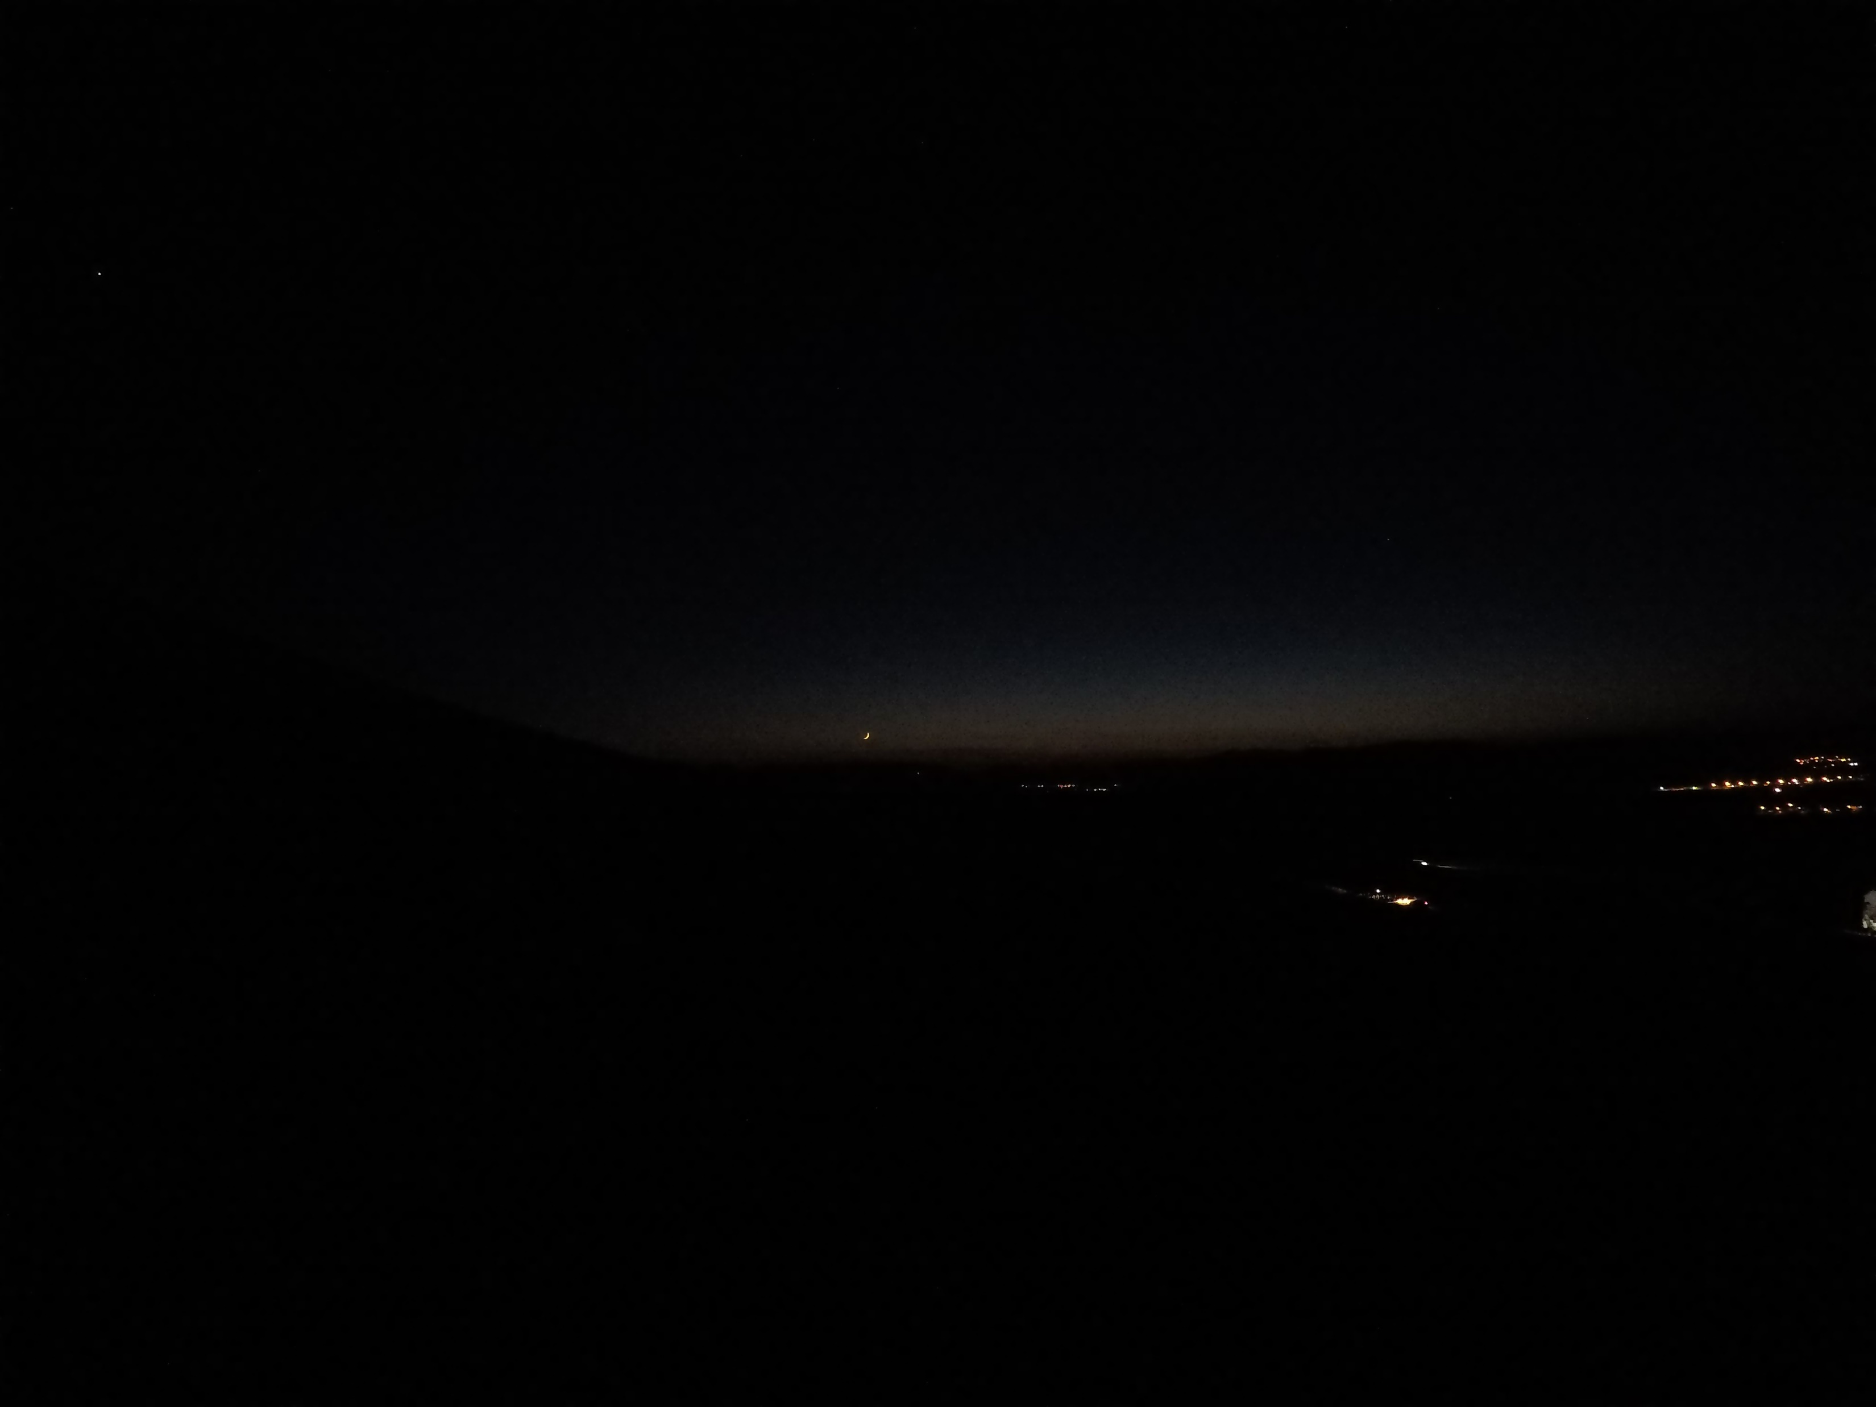
Hour: 18:24 Sun: -11,0°

Slide 34
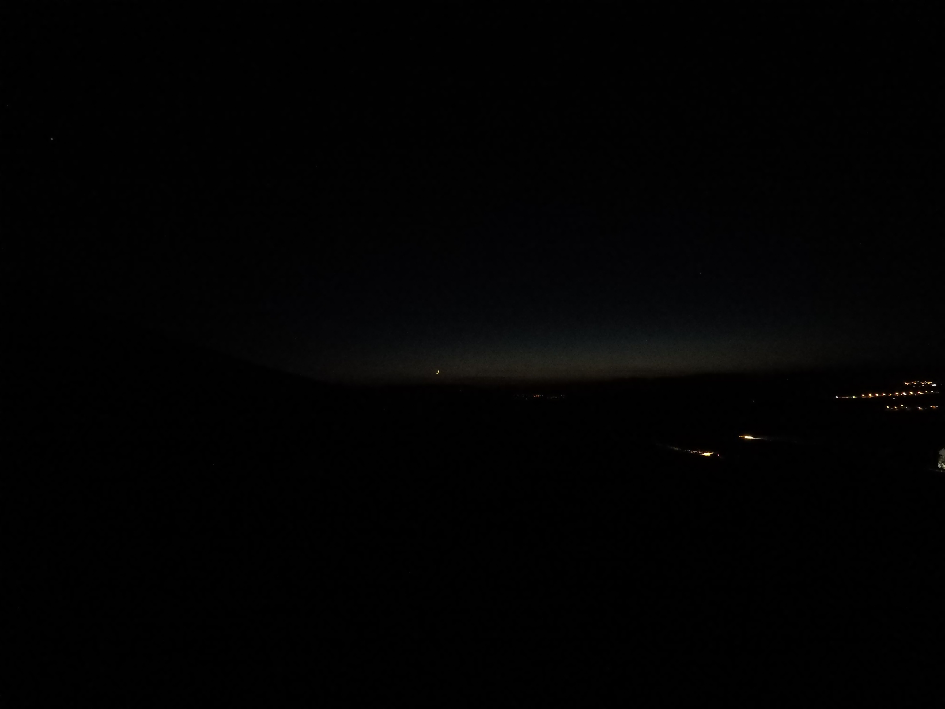
Hour: 18:25 Sun: -11,1°

Slide 35
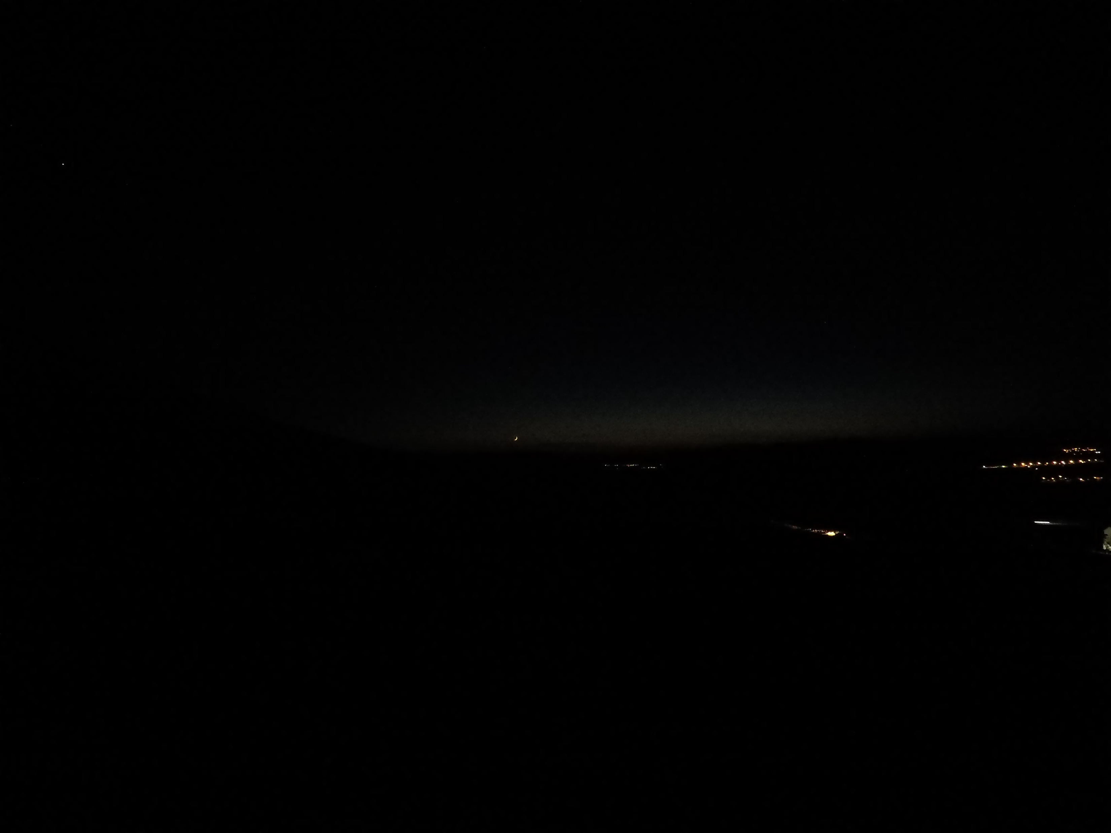
Hour: 18:26 Sun: -11,3°

Slide 36
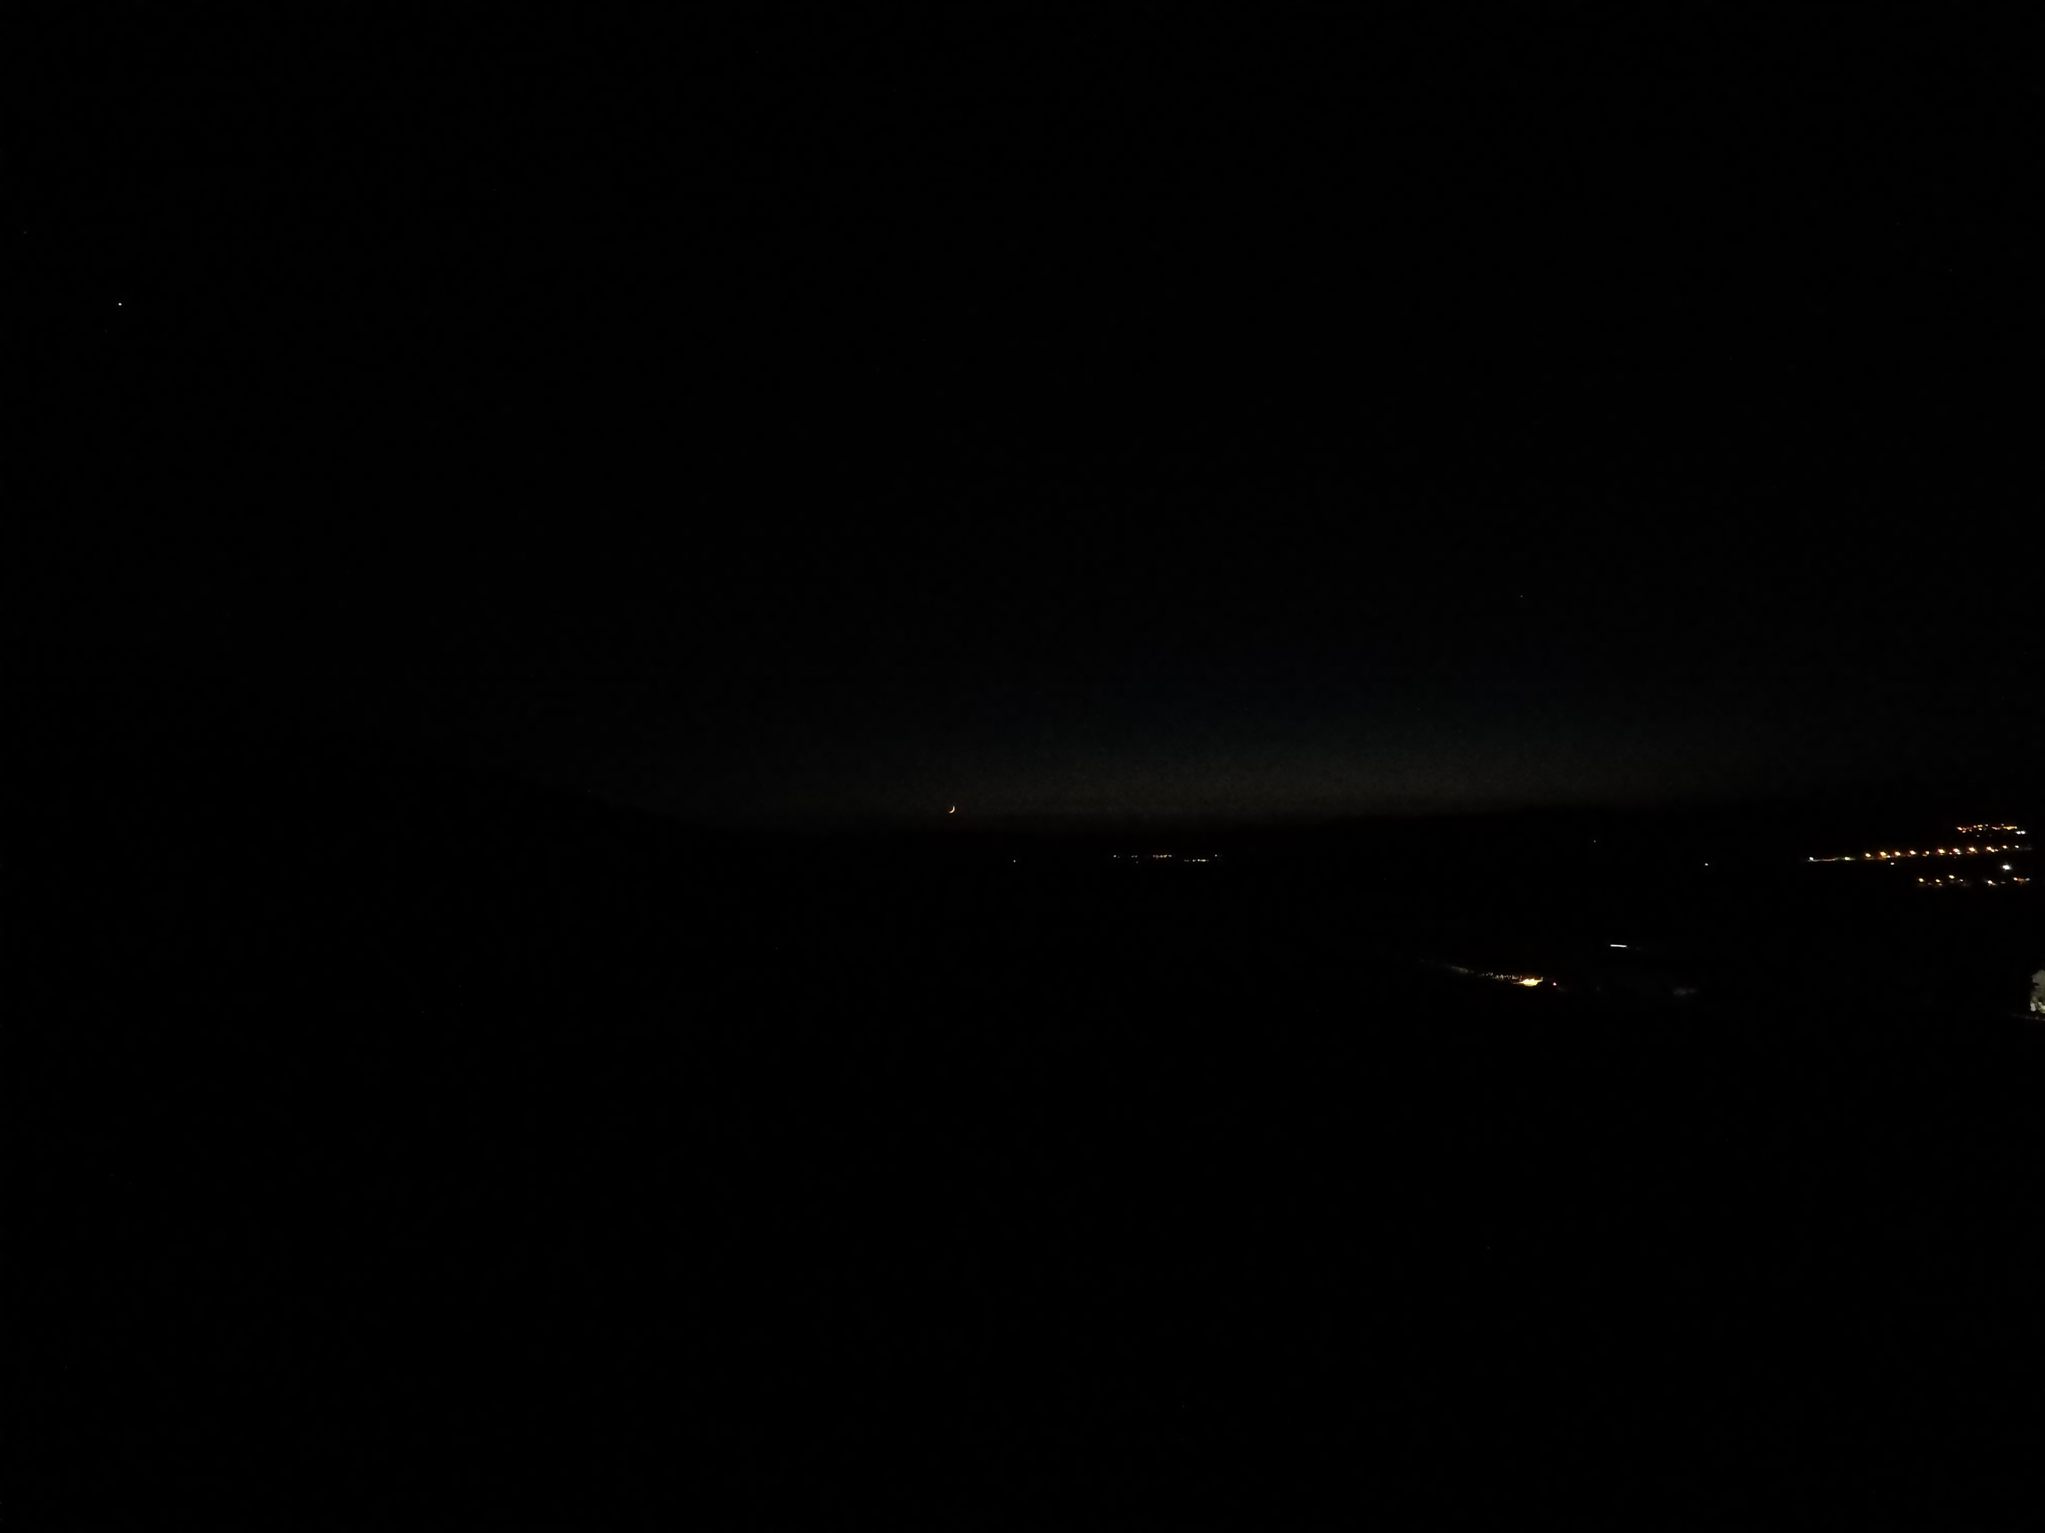
Hour: 18:27 Sun: -11,5°

Slide 37
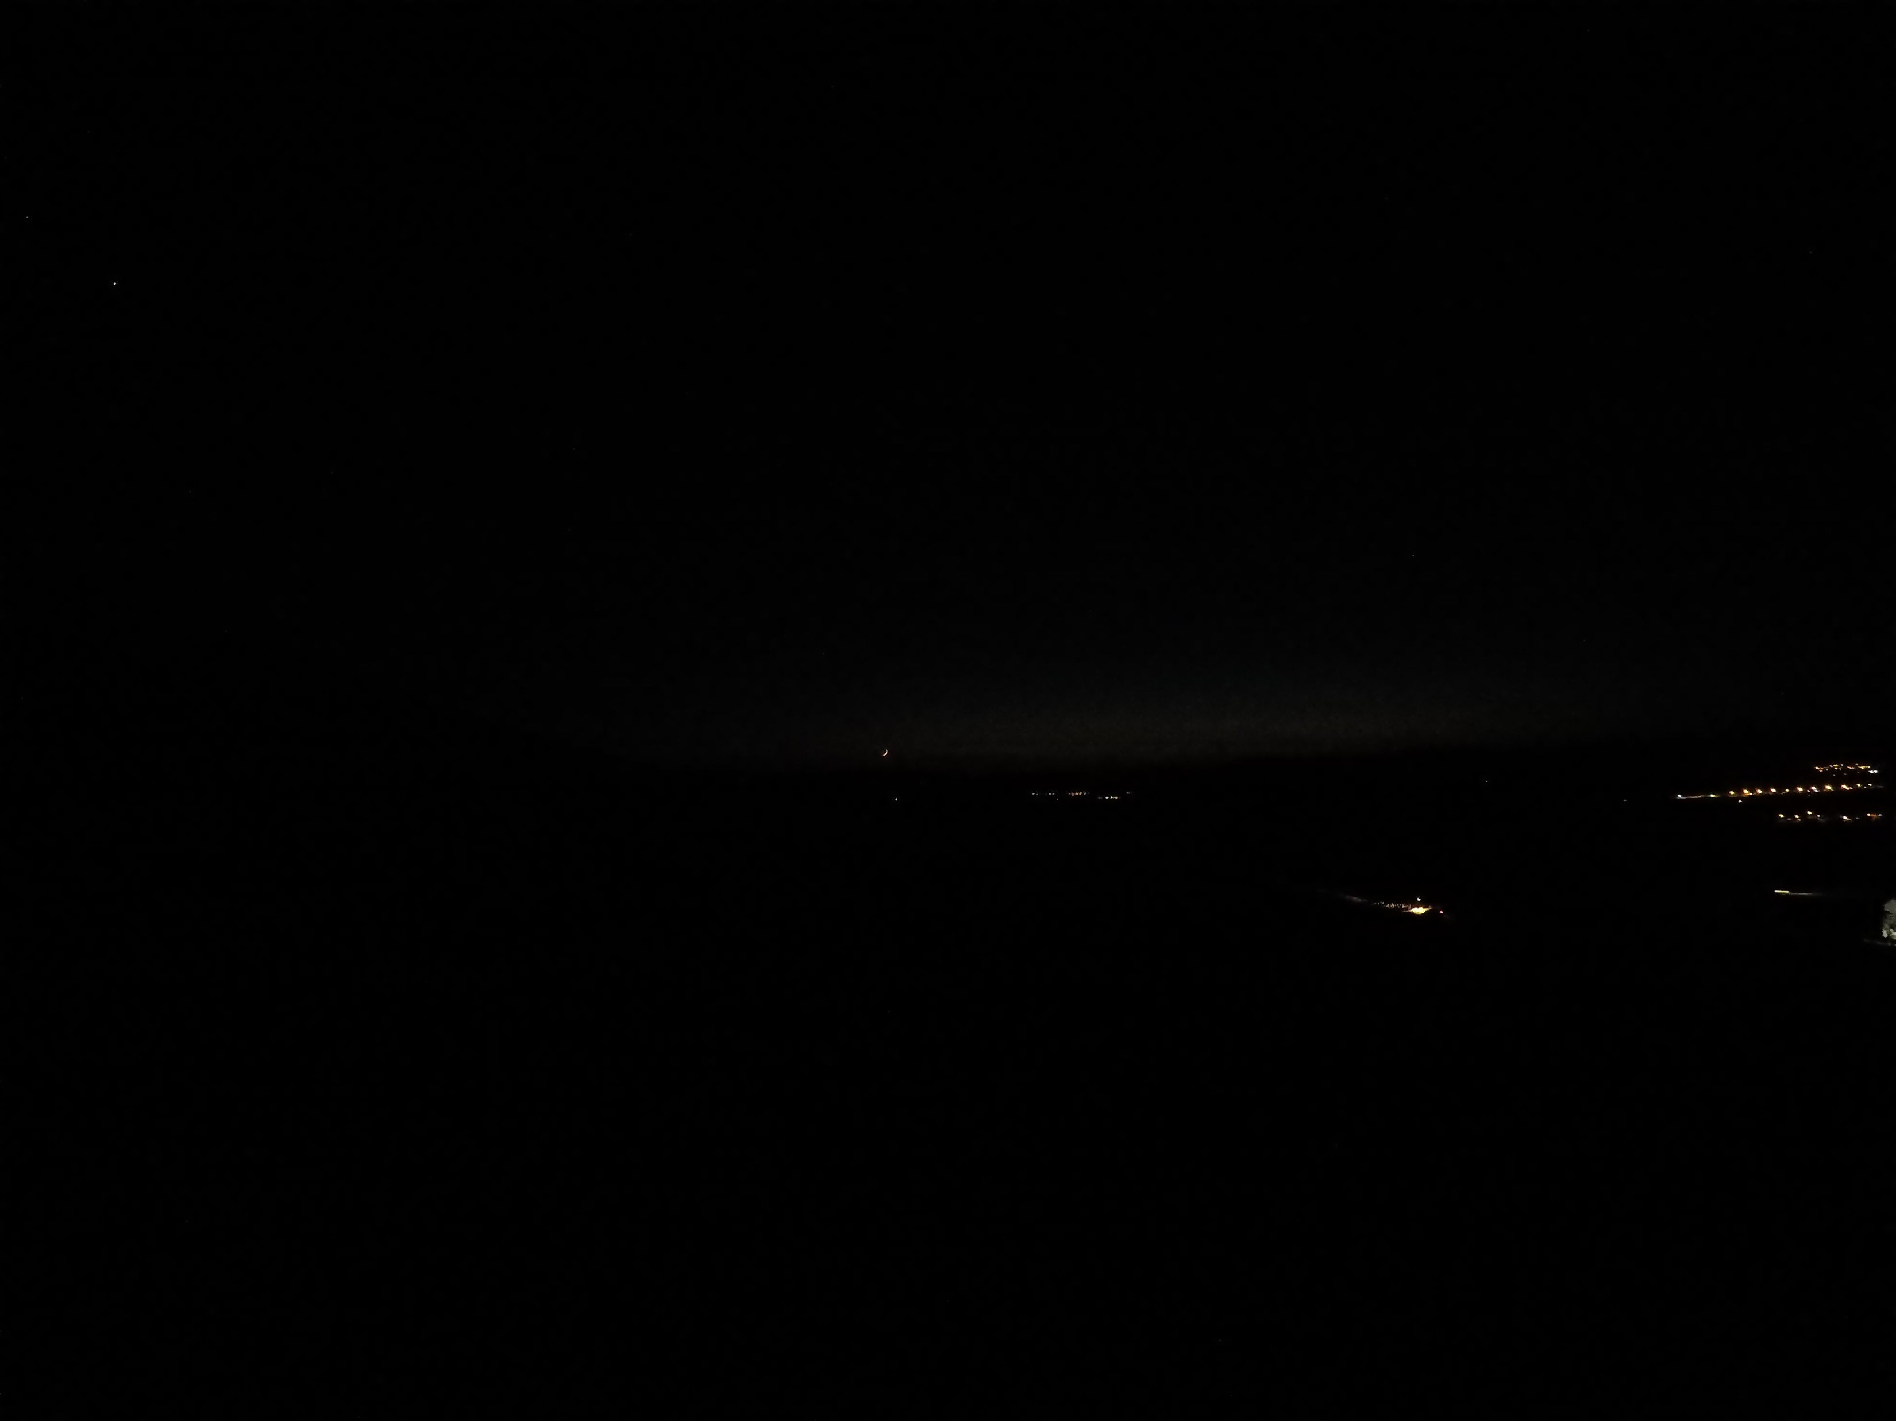
Hour: 18:28 Sun: -11,7°

Slide 38
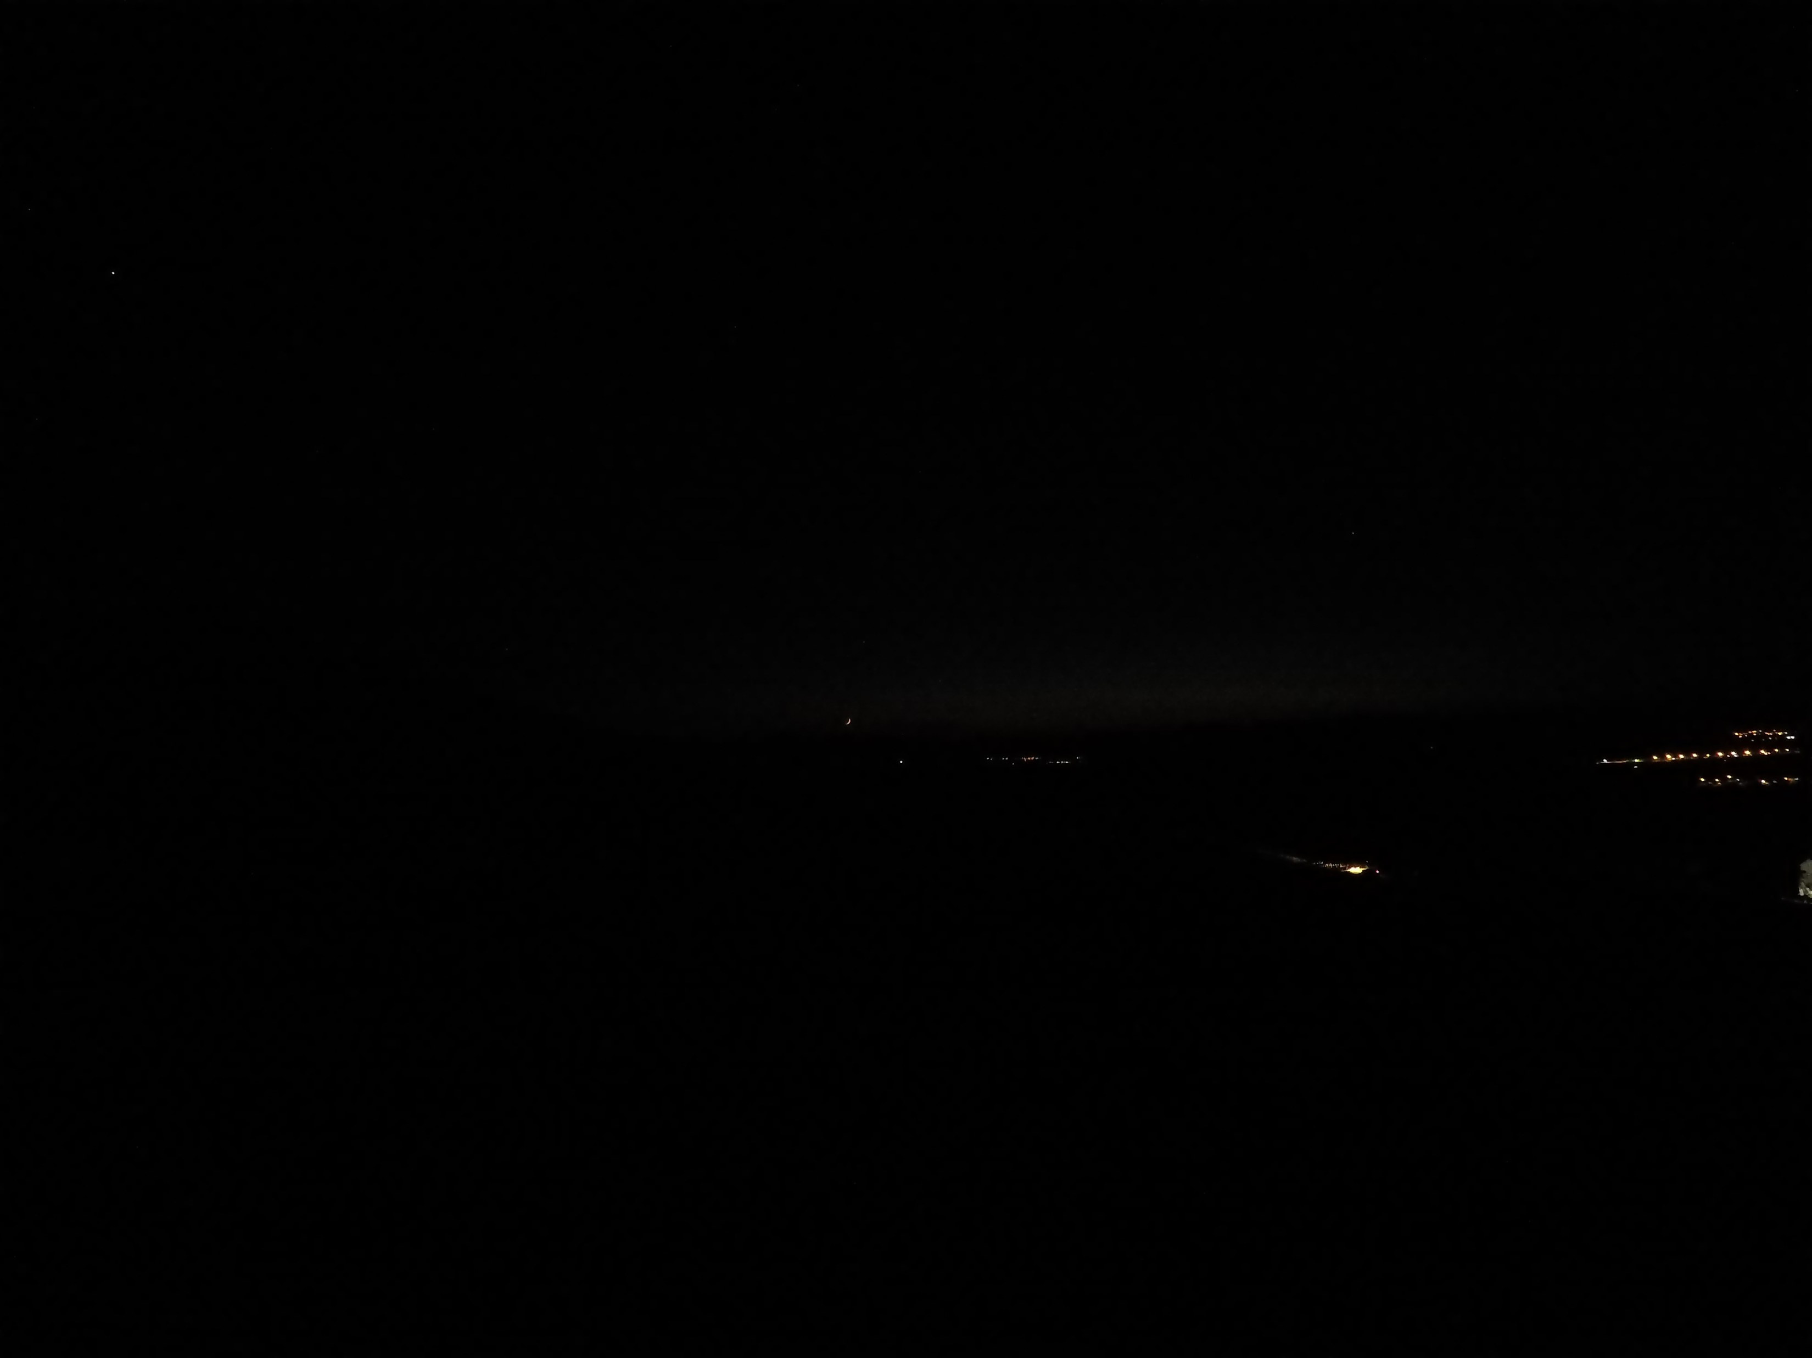
Hour: 18:29 Sun: -11,9°

Slide 39
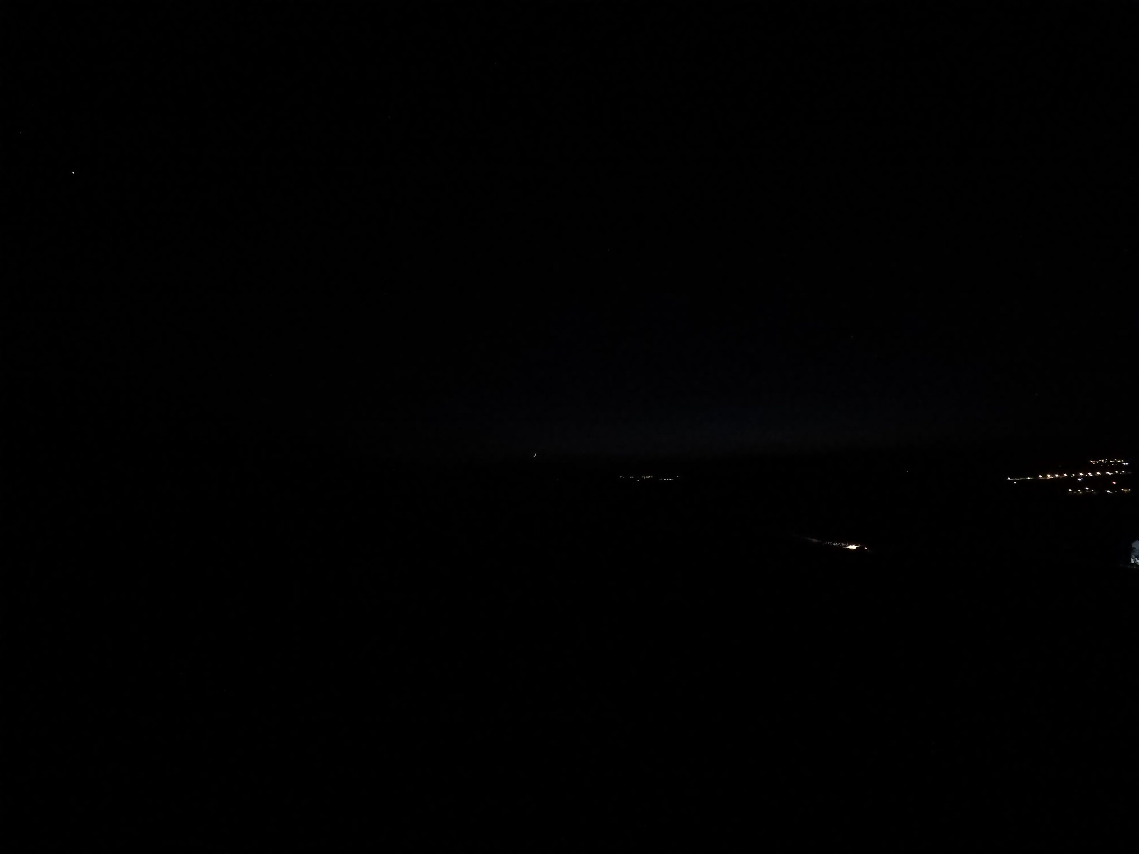
France Maliki Community isha time -12°
Nagutial dawn ending
Hour: 18:30 Sun: -12,1°

Slide 40
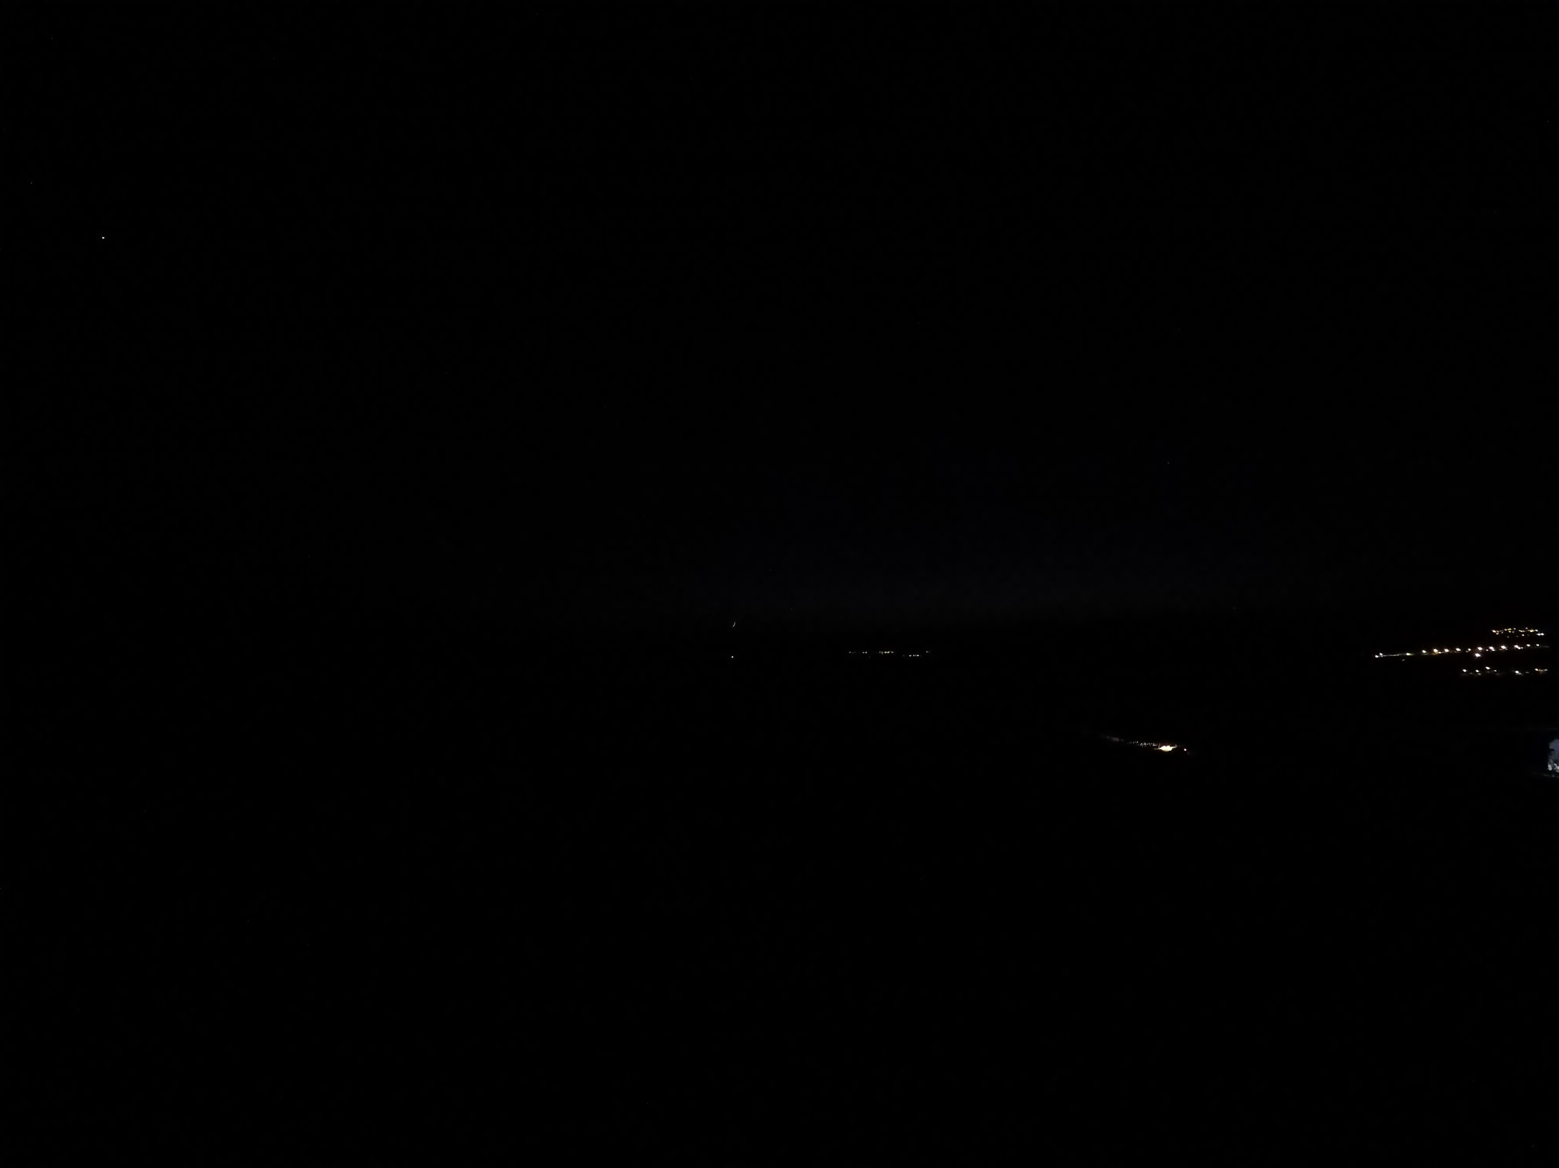
Hour: 18:31 Sun: -12,3°

Slide 41
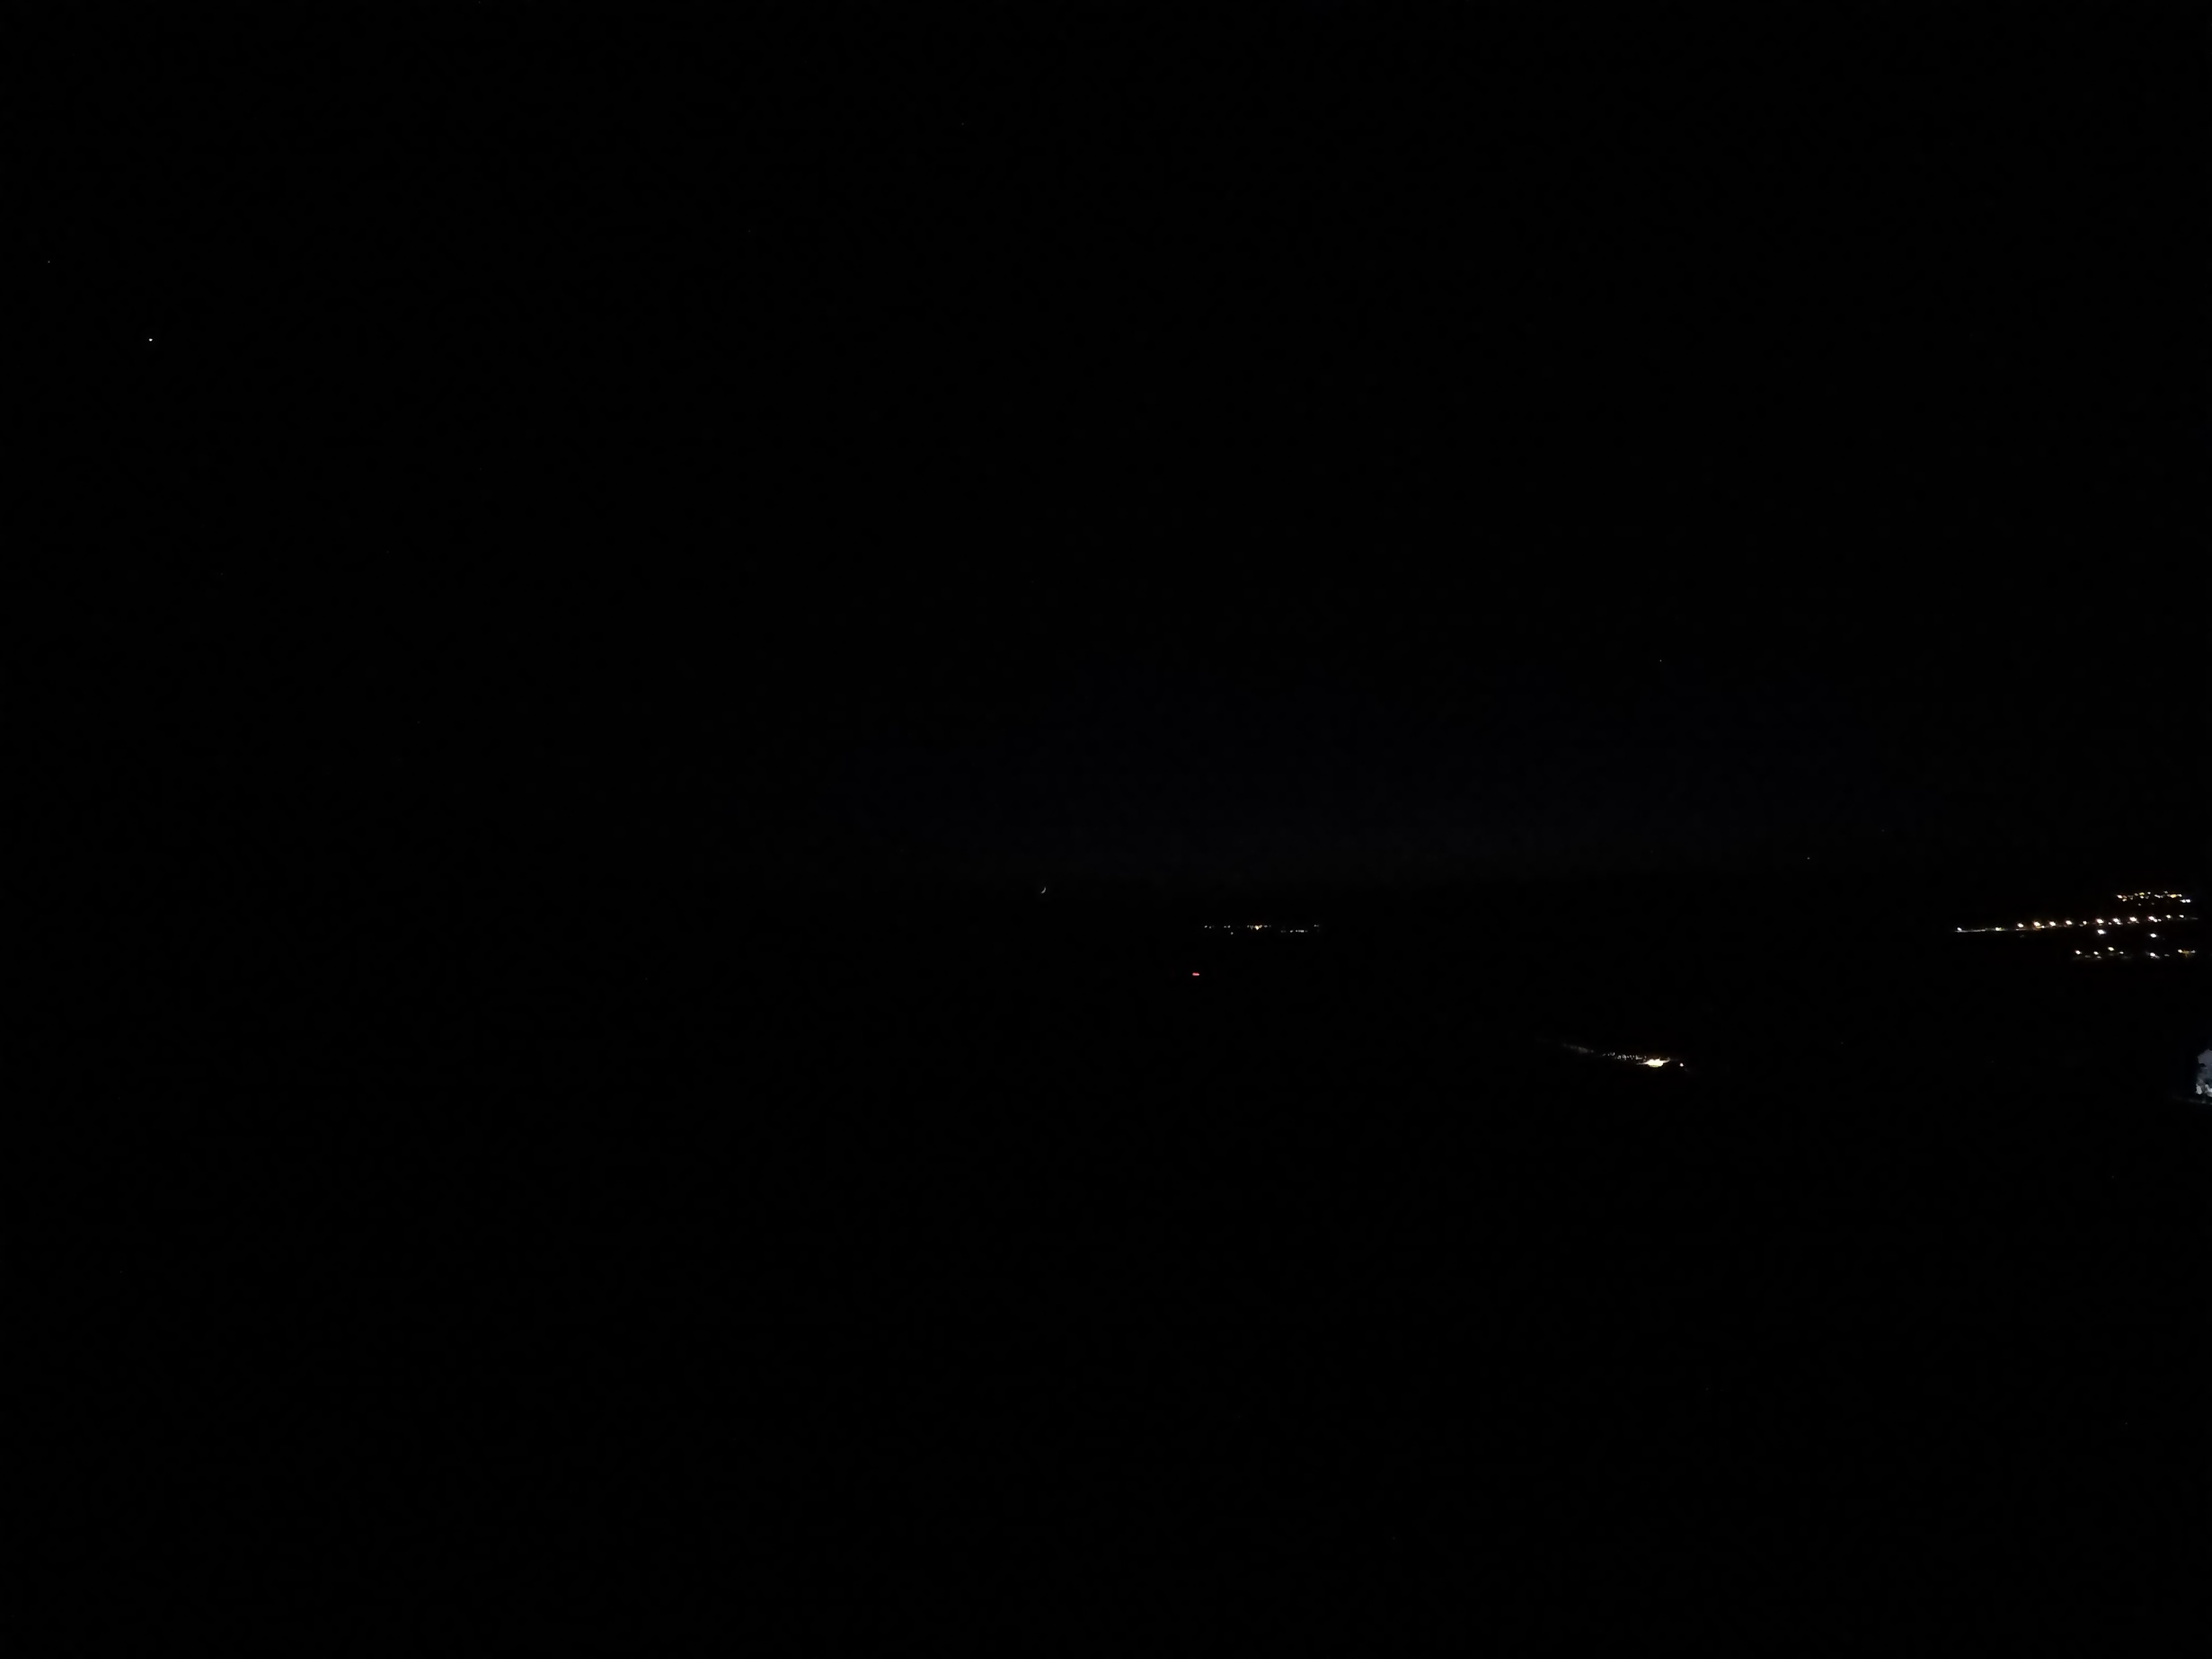
Errufai Isha time -12.5°
1 hour 01 minutes after sunset
Hour: 18:32 Sun: -12,5°

Slide 42
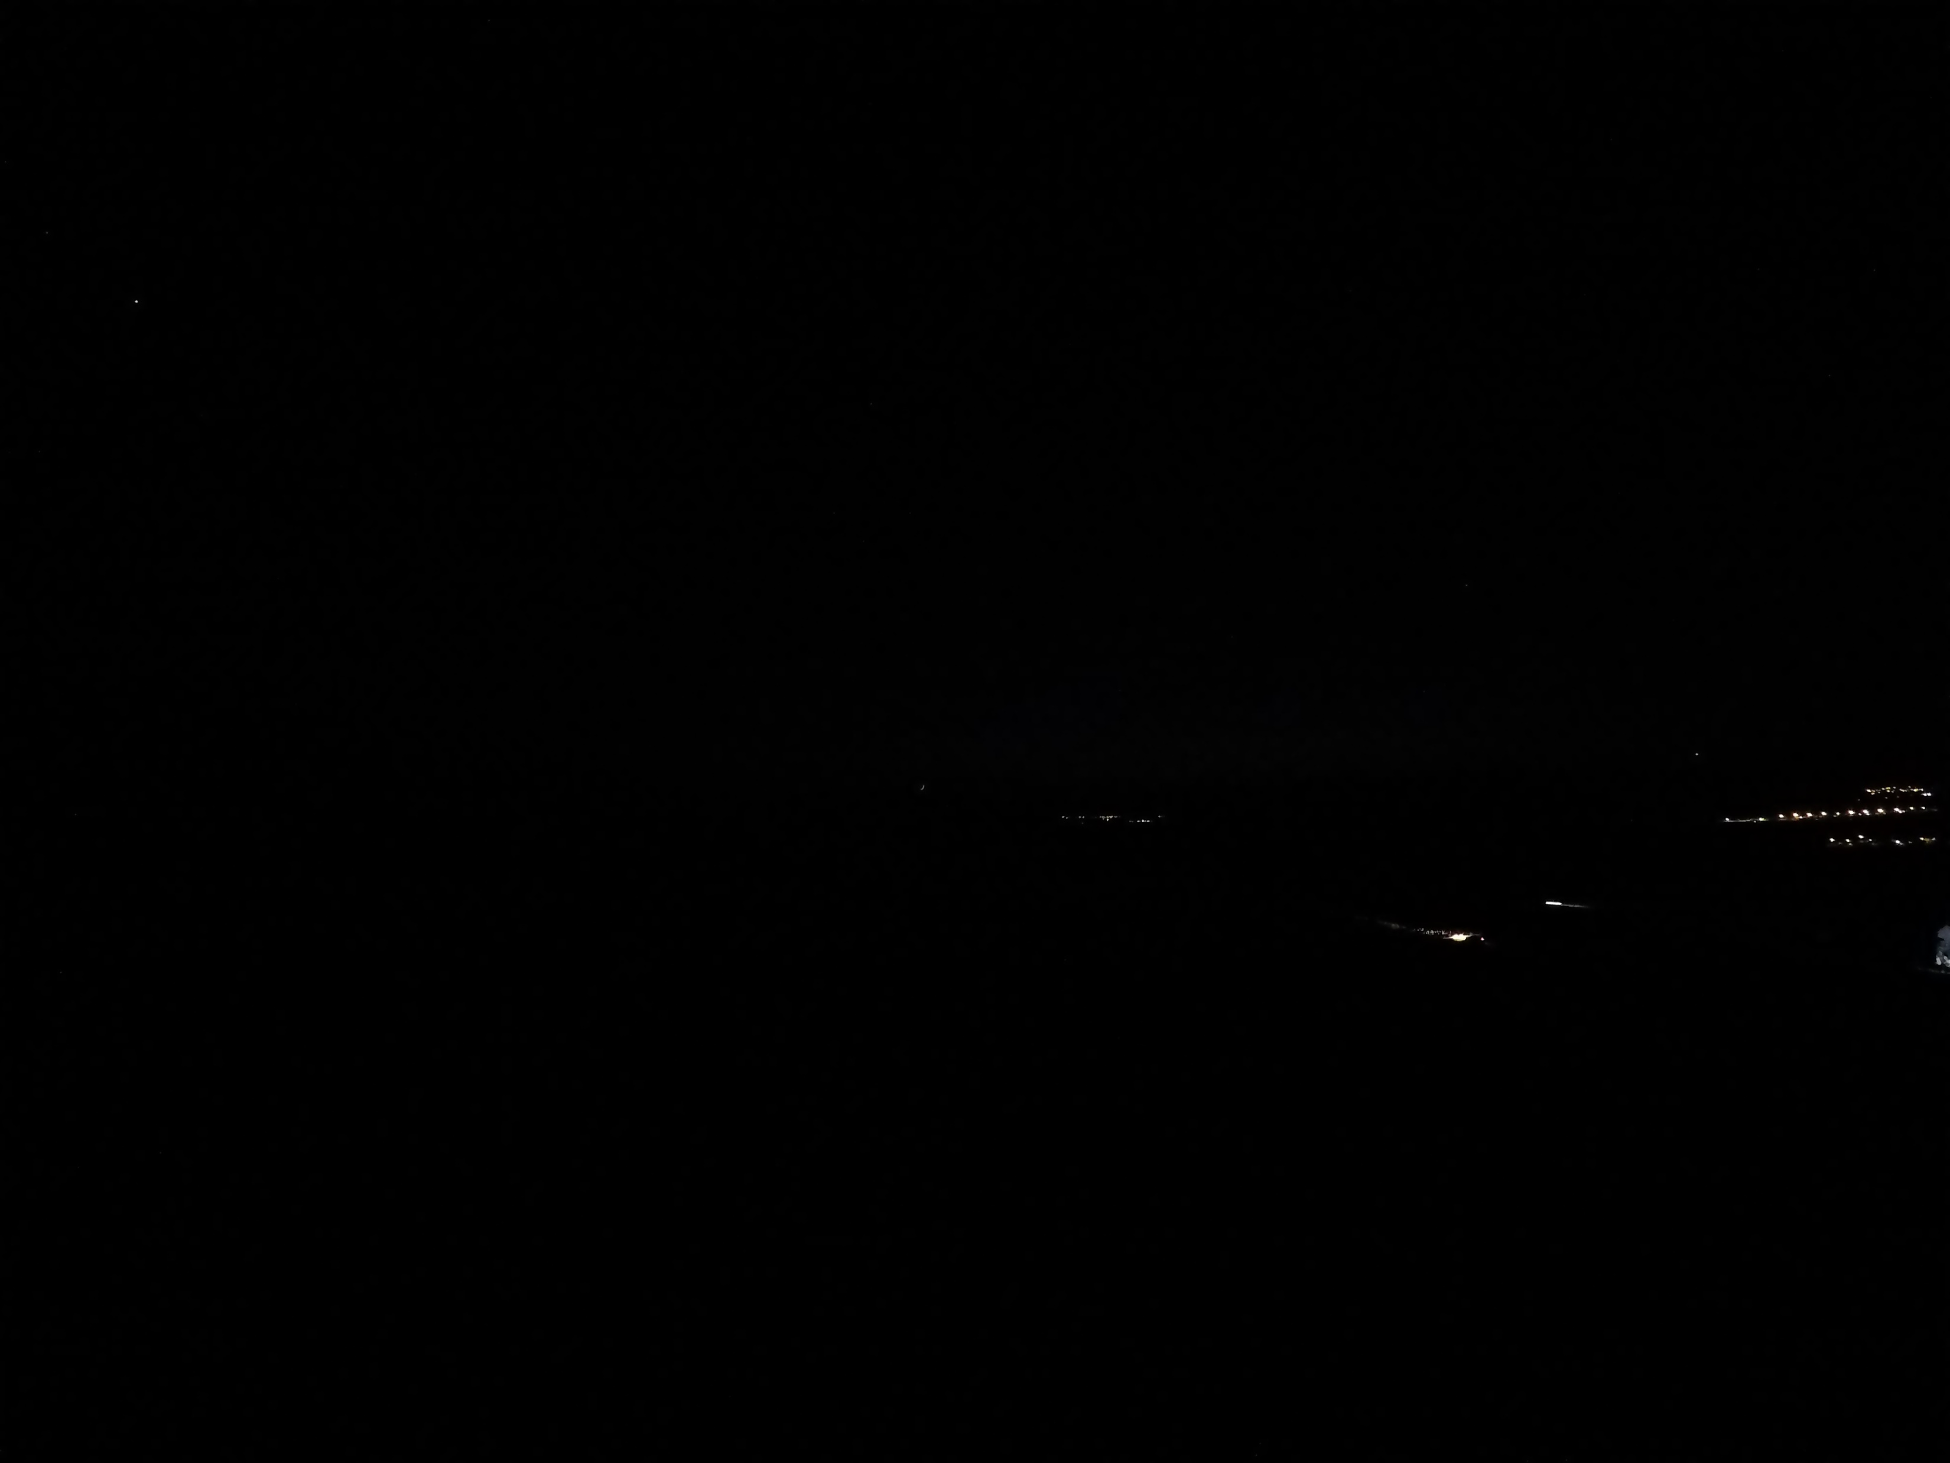
Hour: 18:33 Sun: -12,7°

Slide 43
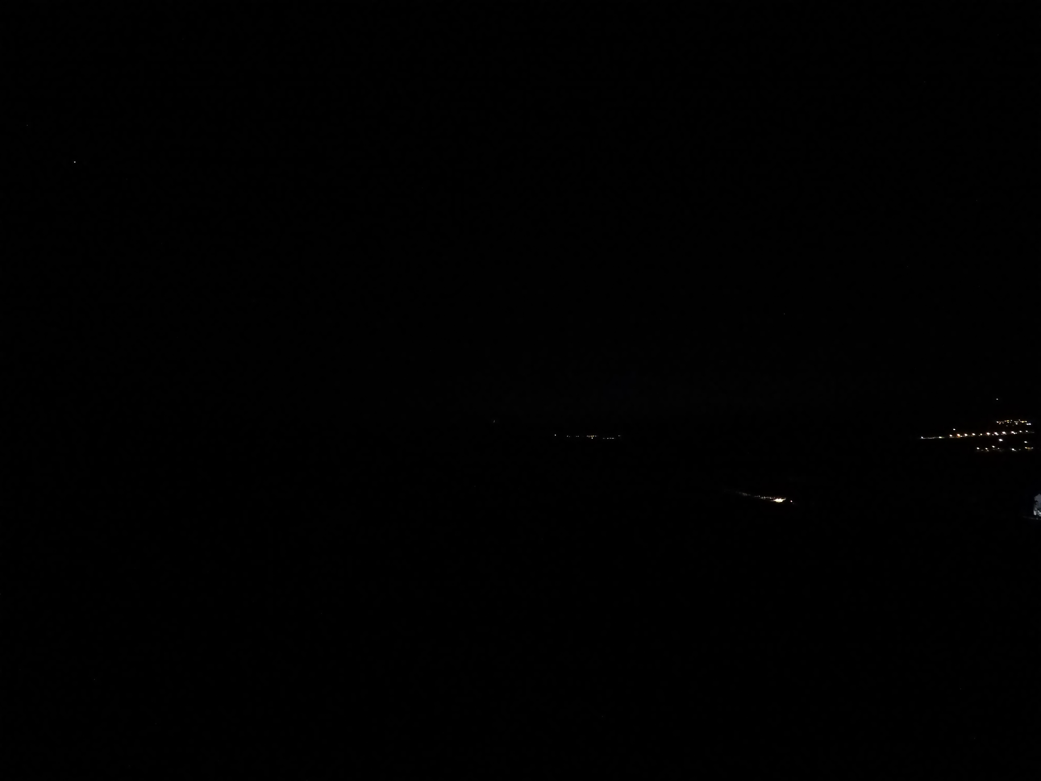
Hour: 18:34 Sun: -12,9°

Slide 44
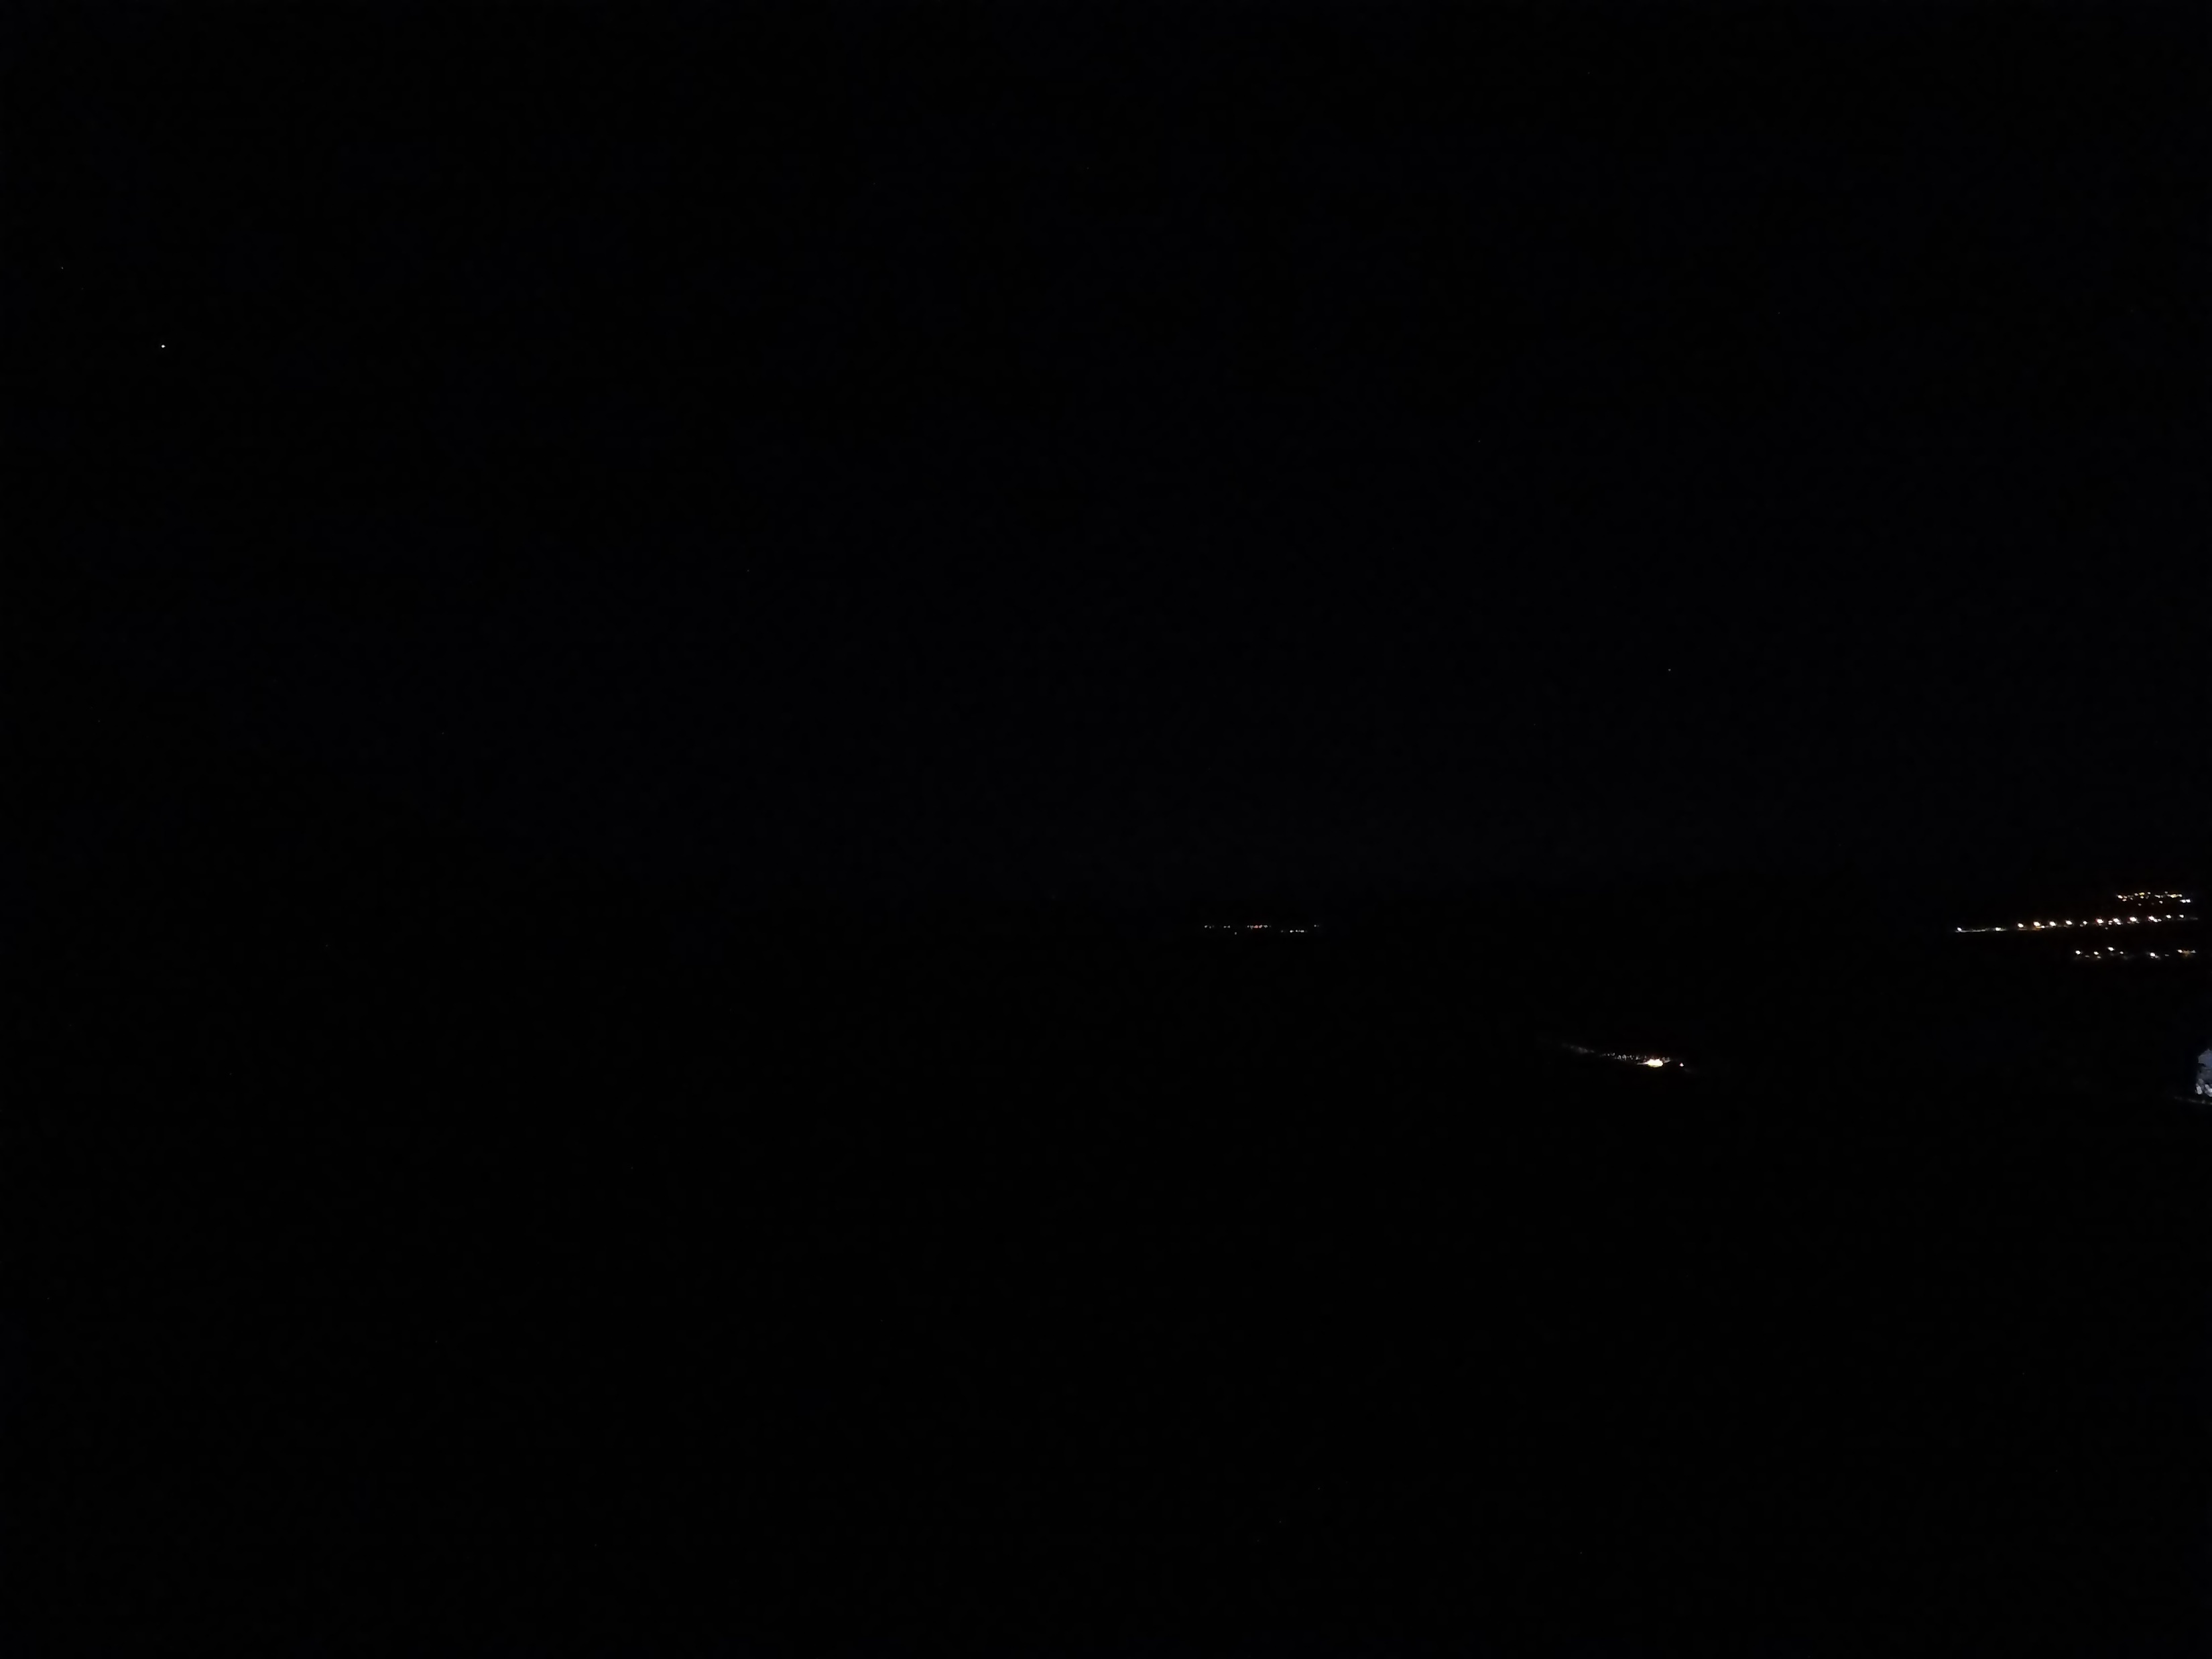
Hour: 18:35 Sun: -13,1°

Slide 45
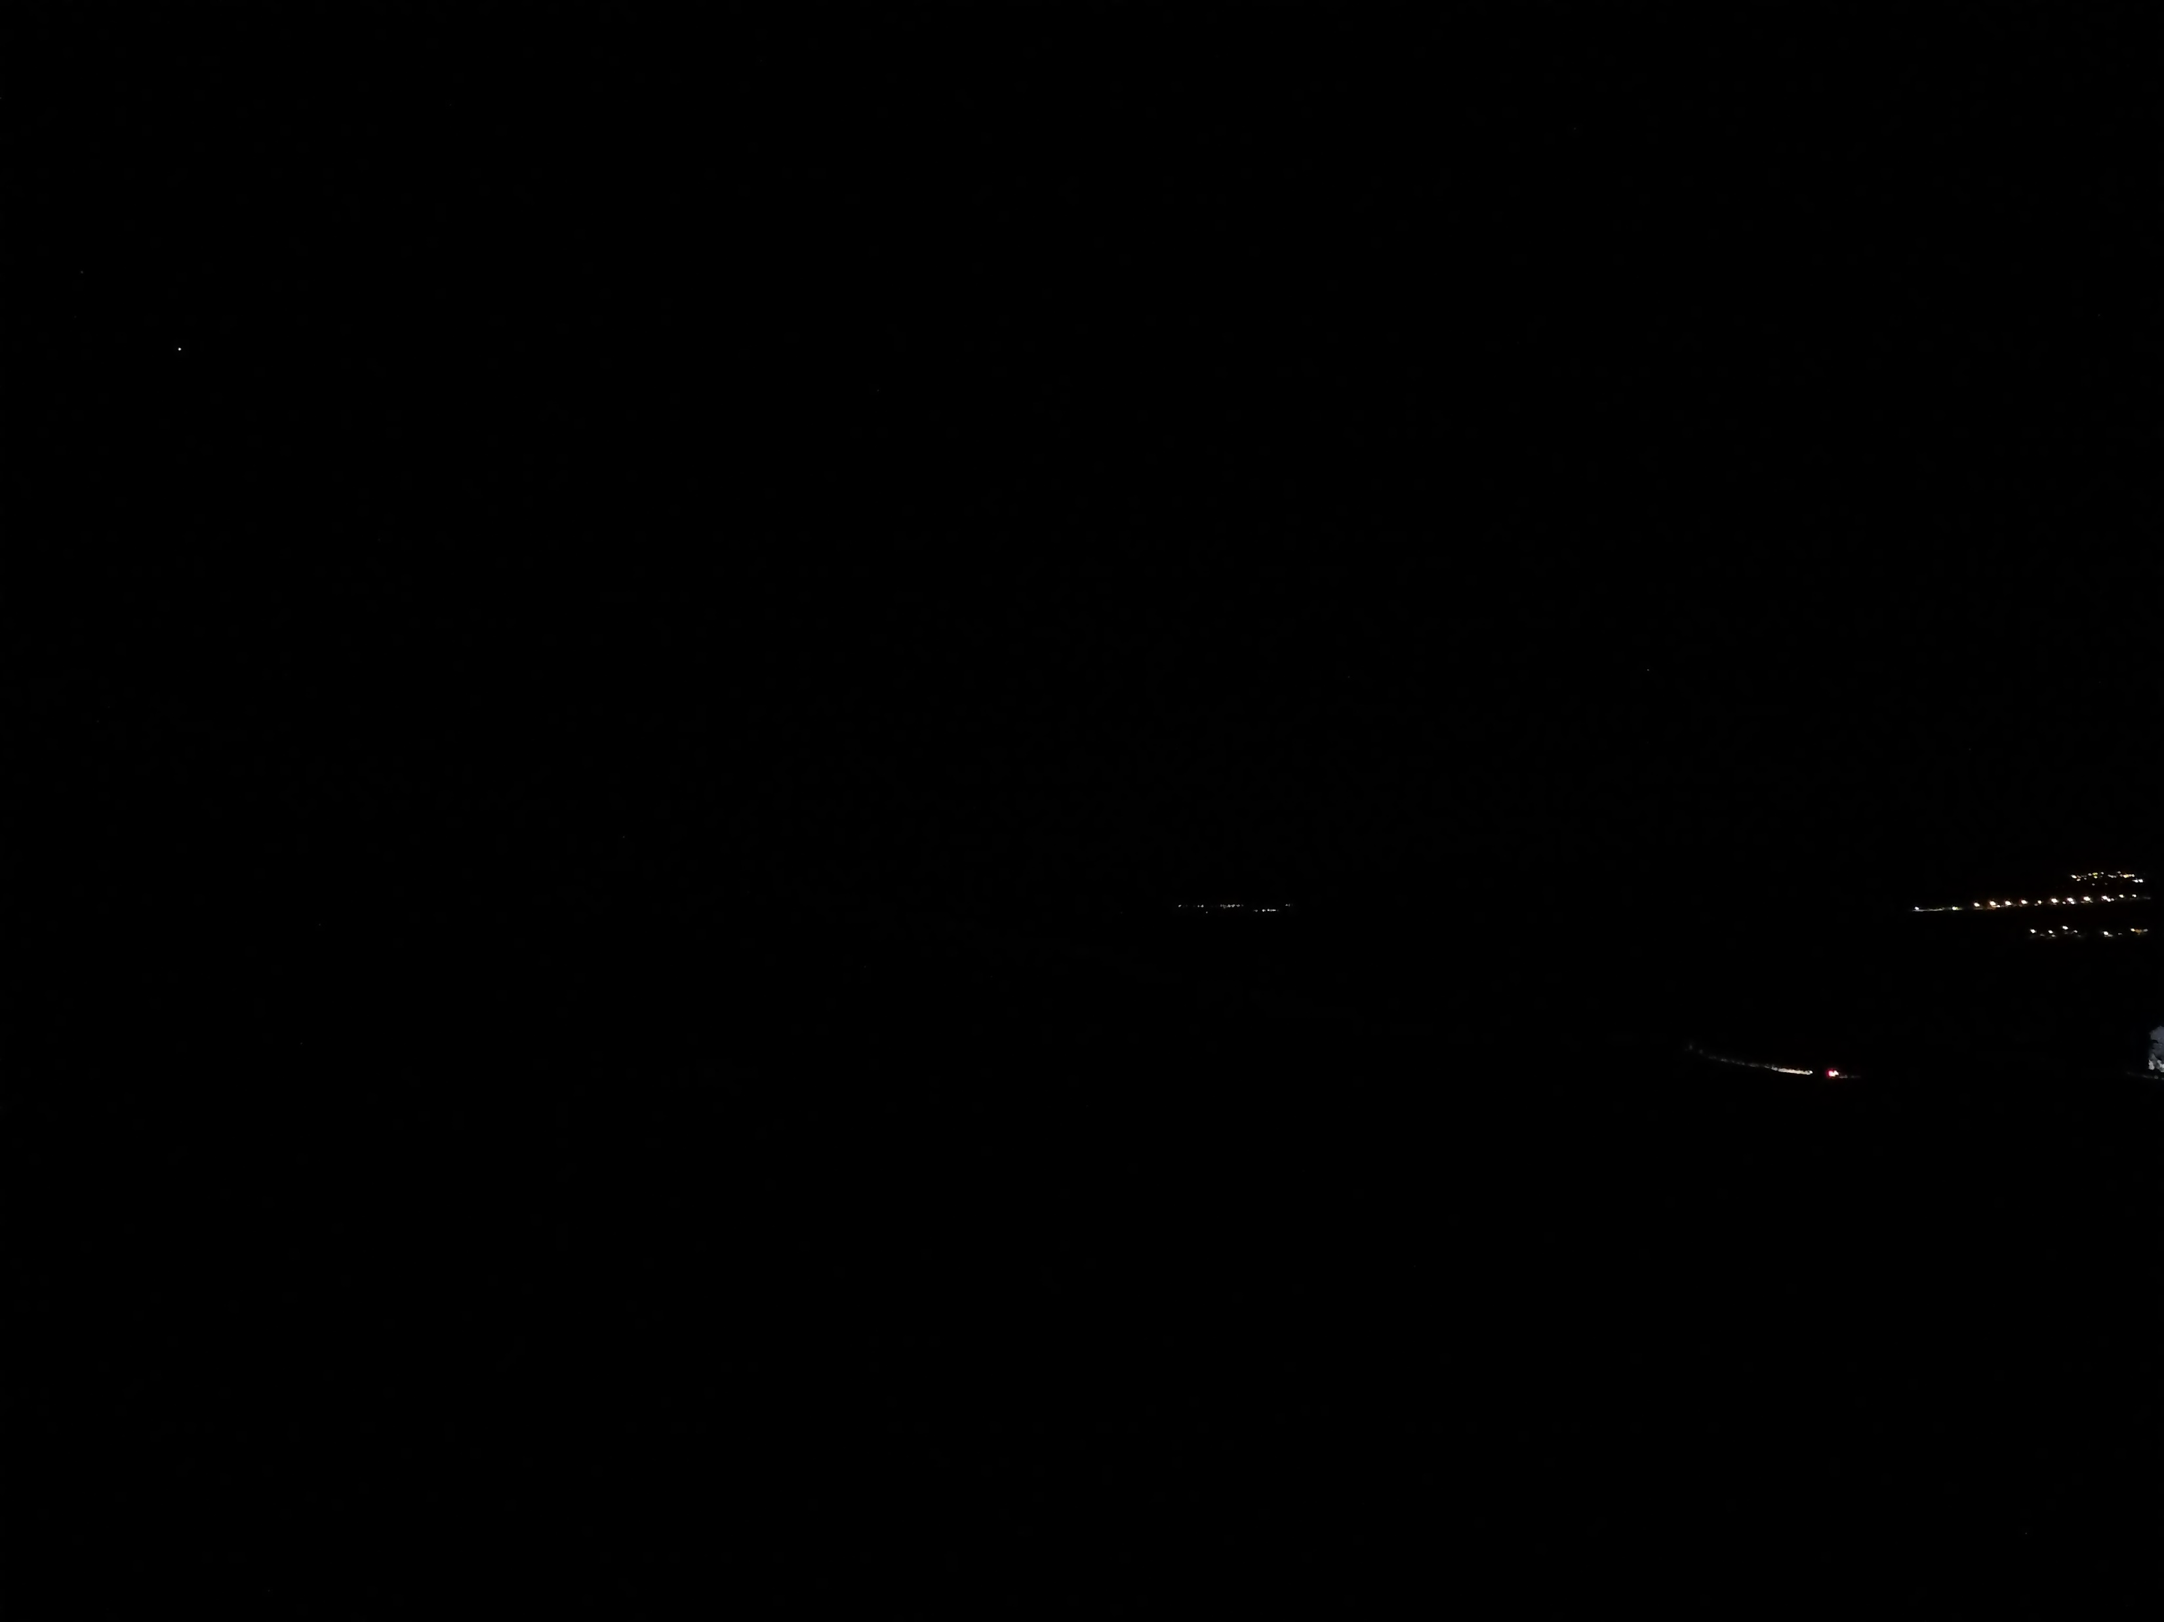
Hour: 18:40 Sun: -14,0°

Slide 46
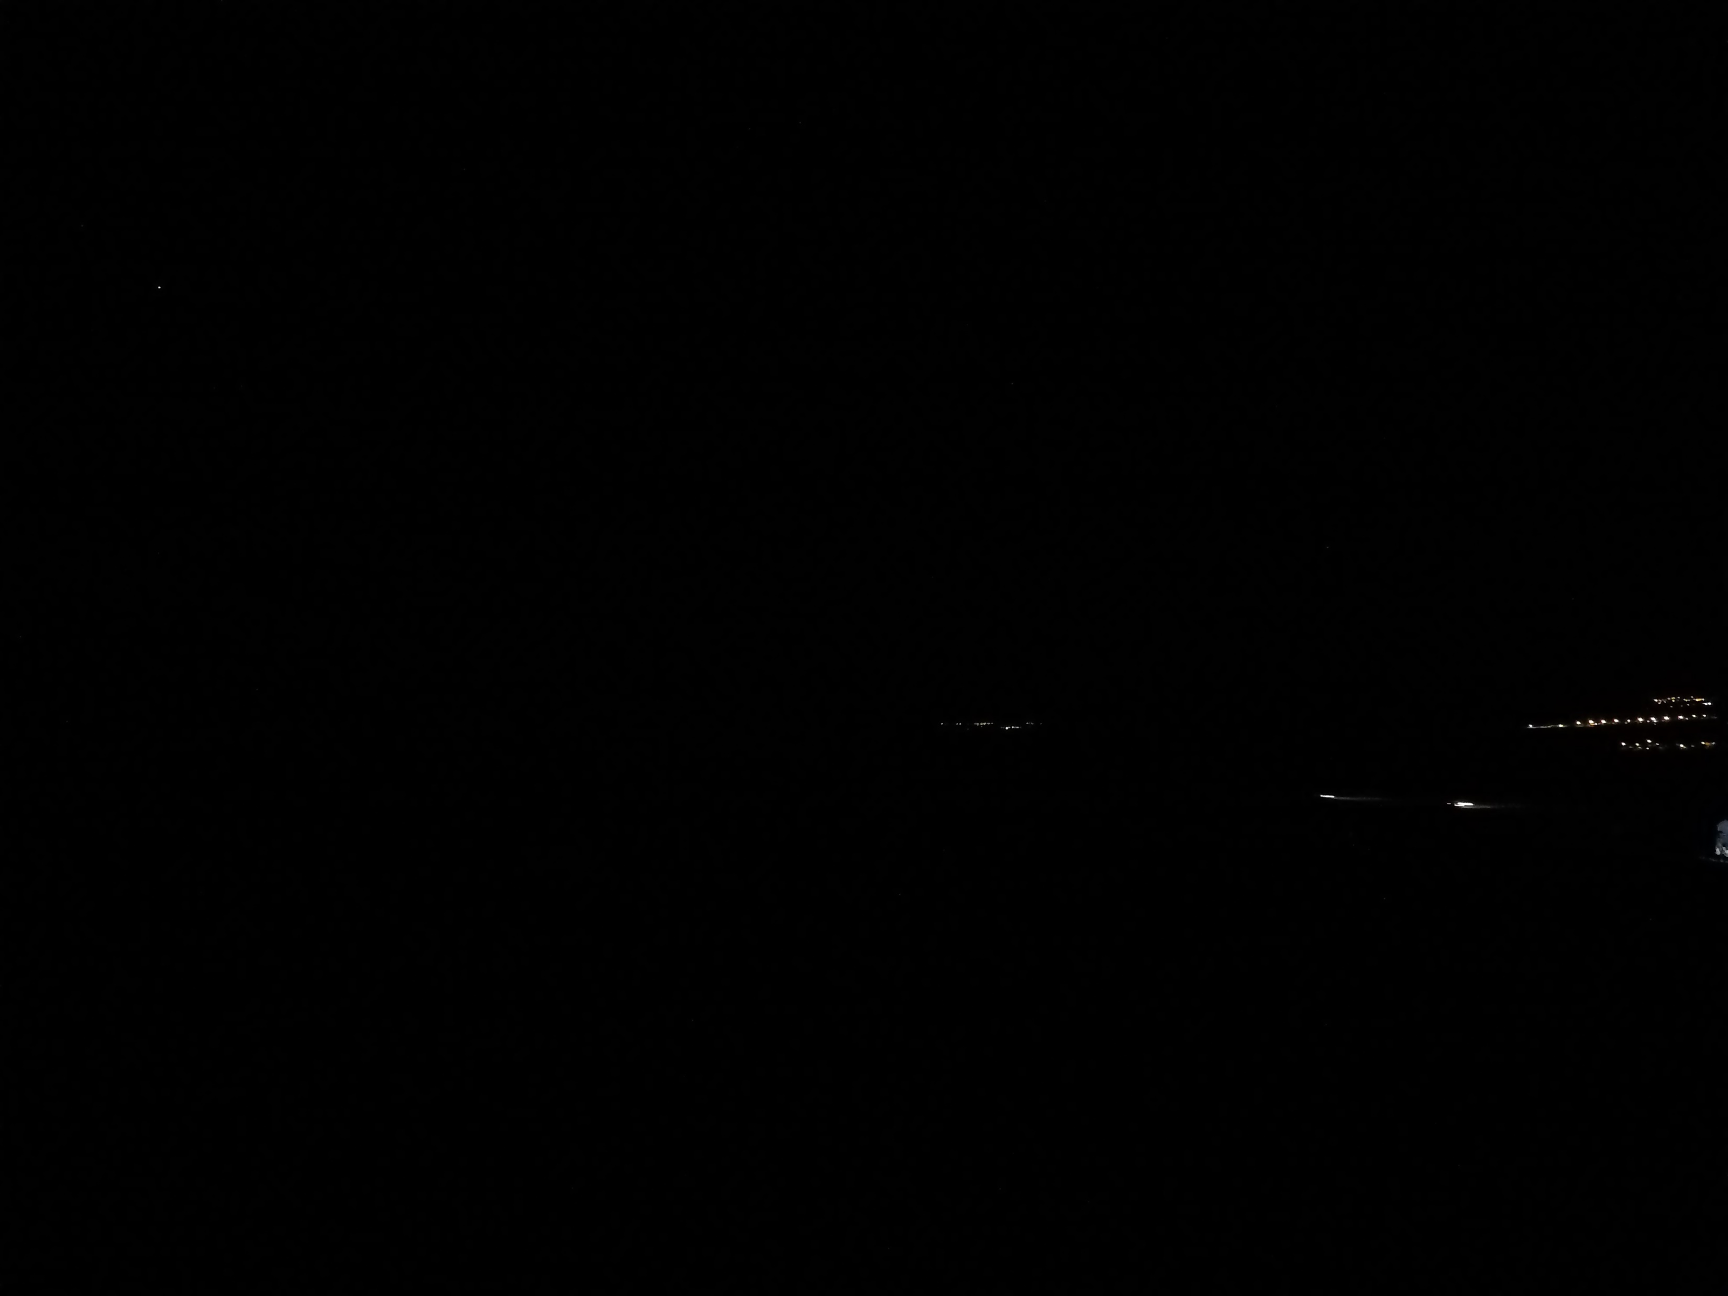
North America Islamic Community Isha ​​time - 15.0°
Hour: 18:45 Sun: -15,0°

Slide 47

Hour: 18:50 Sun: -16,0°

Slide 48

Diyanet yatsı -17.0°
Gün batışından 1 saat 25 sonra
Hour: 18:56 Sun: -17,0°

Slide 49

Pitch Dark Beginning 21:34
1 hour 30 min after sunset
Measurement ended
Hour: 19:01 Sun: -18,0°

Slide 50
As a result, depending on your altitude,
the time for the evening redness to disappear is
Between -12.0°-12.5° below the horizon.
This result shows that the evening prayer, which is performed approximately 30 minutes before the Isha adhan, is performed outside of the time.

